Slide 1
Title : Prediction of the ''play'' attribute in the weather dataset
Group Details :
Aniruddha Hore 1PI13IS019
Giri Gaurav Bhatnagar 1PI13IS039
Kishan Kishore 1PI13IS051
Guide : Dr.Shylaja S S
Prof. And Head
Dept. Of ISE
PESIT

Slide 2
Introduction
This project tries to implement a machine learning program in Java using the Weka library.
Using J48 classifier , we try to predict the label (value) associated with an attribute ('play') of an instance from the given dataset ('weather').

Slide 3
Objective
The weather dataset contains many attributes including 'play' along with other attributes related to weather of a given day.
Our objective is to train a classifier from the 'weather dataset' and apply it to a 'test dataset' and then predict whether the attribute play bears the value 'YES' or 'NO'

Slide 4
Motivation
Machine learning is a vast and a crucial technology that is being used for the better decision making and smart prediction .

Slide 5
Feasibility
Collection and maintenance of a big data set is a little difficult.
Prediction will be more accurate if a large dataset is involved .

Slide 6
Tools/Software/Languages
Java
Weka 3
weatherunderground

Slide 7
SYSTEM DESIGN
unorganised data
Dataset in arff format
(weather.arff)
Learning algorithm
(J48)
Decision model
Weather instance
predicted 'play'
YES
NO
Play Match
Don't play

Slide 8
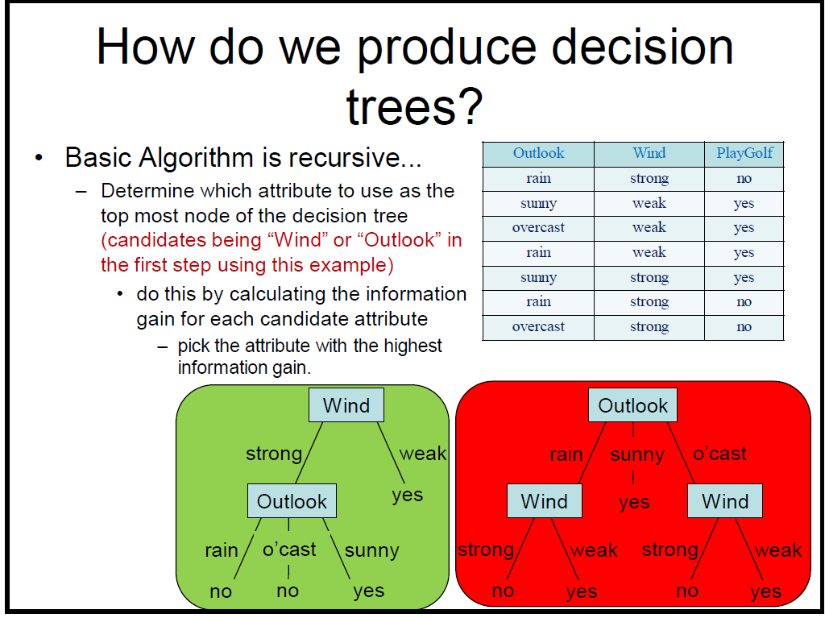

Slide 9
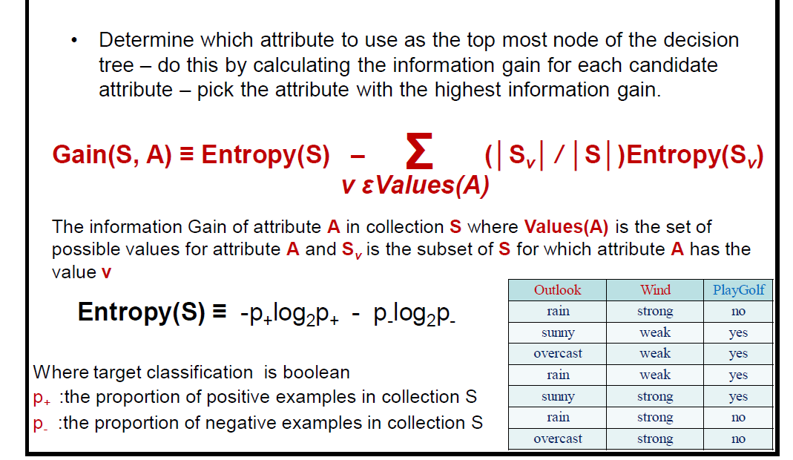
Calculating Information Gain

Slide 10
Modules
prepareDataset
// prepares the arff file from a csv file
evaluate
// evaluates the model , used to calculate acurracy
readfile
// reads a datafile
addInstances
// add your own instances
display
//display the tree
crossValidation
//prepares dataset pairs for crossvalidation

Slide 11
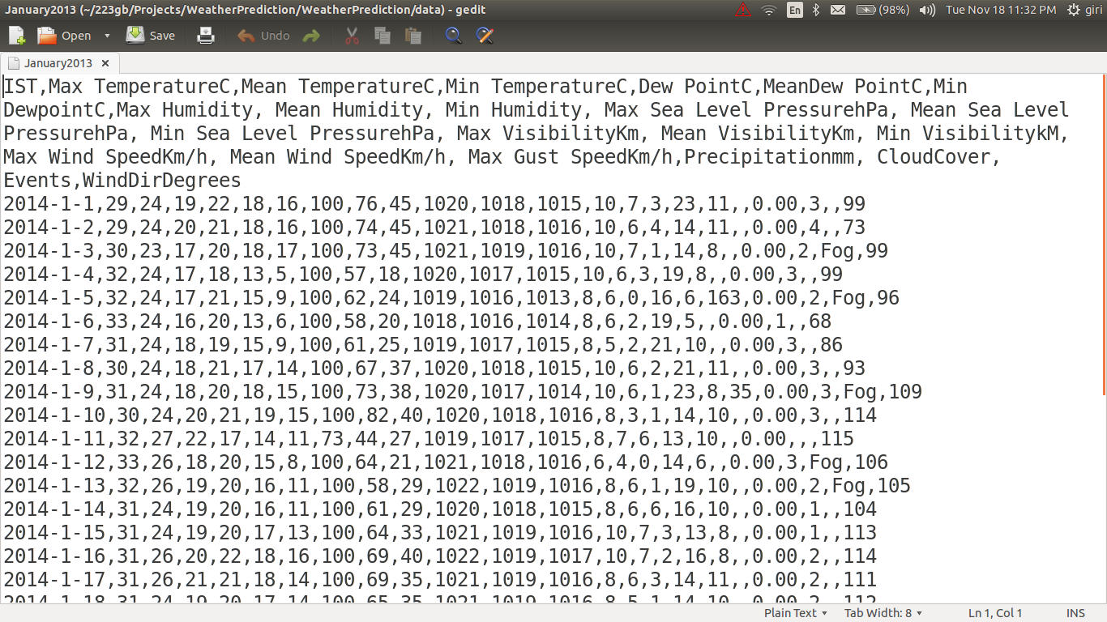
Sample Dataset
[ csv format ]

Slide 12
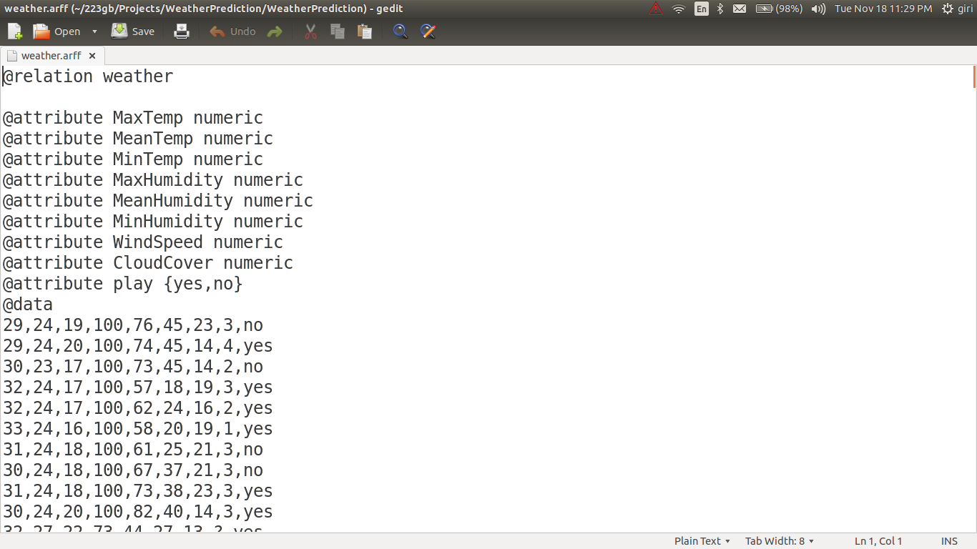
Sample Dataset
[ arff format ]

Slide 13
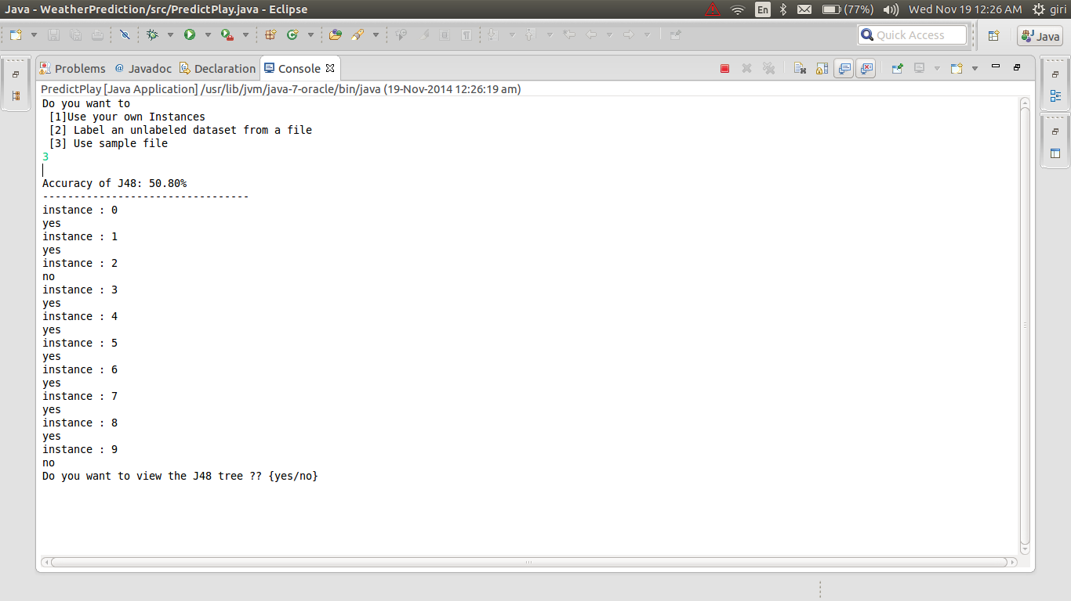
OUTPUT

Slide 14
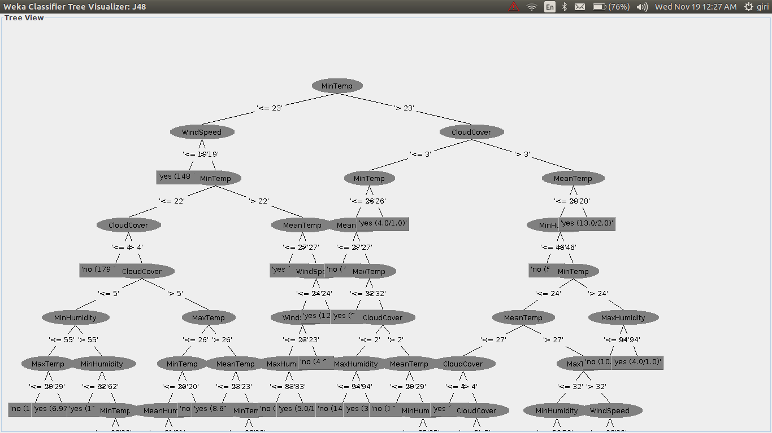
OUTPUT

Slide 15
RESULT
The decision tree was built using the training data set. The values for the 'play' attribute were predicted for each instance in the testing dataset according to the decision tree built.Thereafter, the accuracy of the prediction was calculated.

Slide 16
CONCLUSIONS
We concluded that using the concepts of machine learning one could easily predict values for a given attribute in a dataset if the values for the other attributes are known.
These prediction values could be further used for other purposes for e.g in our case the value of the play attribute could be used to decide whether a cricket match should be held in a particular city on a particular day or not given we have the weather data for that city.

Slide 17
References
[1] “Introduction to WEKA” https://www.cs.auckland.ac.nz/courses/compsci367s1c/tutorials/IntroductionToWeka.pdf
[2] Zdravko Markov,"An Introduction to the WEKA Data Mining System" , http://www.cs.ccsu.edu/~markov/weka-tutorial.pdf
[3]"Hello World program in WEKA " , http://www.programcreek.com/2013/01/a-simple-machine-learning-example-in-java/
[4] "Using WEKA in Java code" , http://weka.wikispaces.com/Use+WEKA+in+your+Java+code
[5] Ian H. Witten and Eibe Frank on "Introduction to Machine Learning", Data Mining :Practical Machine Learning

Slide 18
Thank You

