Slide 1
Design and Optimisation of Photo-Bio Reactors for Green Hydrogen Production from Waste Water
Jawahar Bhawan , Chemical Engineering Problem Statement, Techshila-2024
Aman Behera, Kunwar Abhishank, MD Farhan, Satish Kumar Maurya

Slide 2
Table of Contents
Waste water treatment
Fermentation of refined waste to produce hydrogen
Photolysis of refined waste water to produce hydrogen
Calculation of design parameters for the reactor
Factors affecting efficiency of the process
Investment and Recurring Cost Analysis

Slide 3
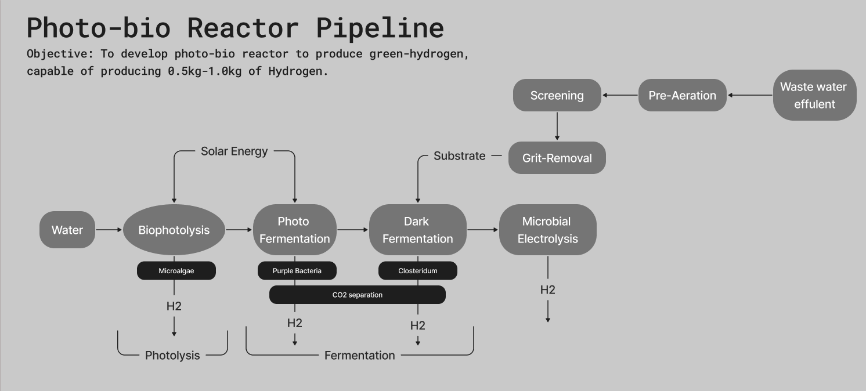
Pipeline of our proposed idea

Slide 4
Waste Water Treatment (Pre-Treatment)
Pre-treatment Steps used in our pipeline to treat the wastewater:
Pre-Aeration:
Purpose: The first step in pre-treatment is pre-aeration, where raw sewage undergoes aeration to keep solid contaminants in suspension. This is achieved using air diffusers.
Aeration helps in the oxidation of organic matter and enhances the removal of volatile compounds, improving the efficiency of subsequent treatment processes.
Screening:
Purpose: Screening is employed to remove solid particles larger than 3 mm from the wastewater.
Screens with appropriate mesh sizes are utilised to capture large debris, such as rags, plastics, and other solids, preventing them from entering the MBR system and causing clogging or damage.
Grit Removal:
Purpose: Grit removal aims to eliminate heavier particles like sand, gravel, and grit, as well as fats and grease.
Various mechanisms, such as settling tanks or grit chambers, are employed to allow these heavier particles to settle out, preventing abrasion and damage to downstream equipment.
Need for Pre-Treatment - Pre-treatment is essential to ensure the effective operation of subsequent treatment processes and the longevity of membrane filtration units. By removing large solids, grit,

Slide 5
—Fermentation of refined waste to produce green-hydrogen—
1. Photofermentation (using Purple Bacteria)
2. Dark Fermentation (using Clostridium)

Slide 6
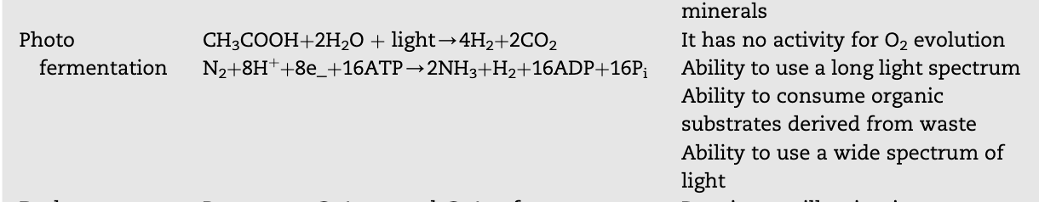
Photofermentation
Photofermentation is the fermentative transformation of organic substrate into hydrogen by Purple Bacteria. Photofermentation is represented as one of the most efficient modes without high risk for BioH2 production. The main process of microbial hydrogen production is defined by the pyruvate anaerobic metabolism and degradation of pyruvate is catalyzed by one of two enzyme systems shown in the equations:

Slide 7
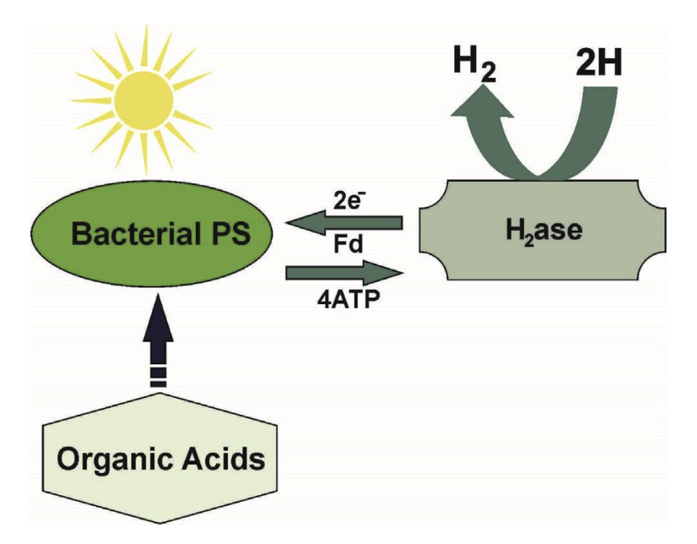
Diagram for photo fermentation

Slide 8
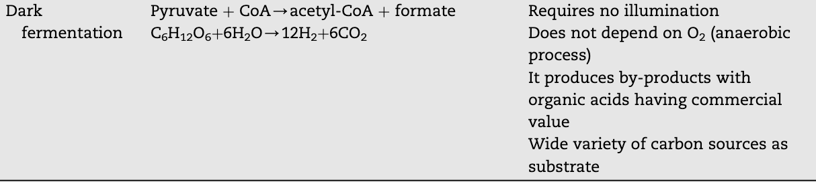
Dark Fermentation
Dark fermentative green-hydrogen production provides a cost-effective and environmentally friendly process. This is an aggregate process revealed by bacterial diverse groups, implying a series of biochemical reactions using several steps similar to anaerobic transition. Dark fermentation is used primarily with anaerobic bacteria, although some algae are also used, on carbohydrate rich substrates grown without the need of light energy

Slide 9
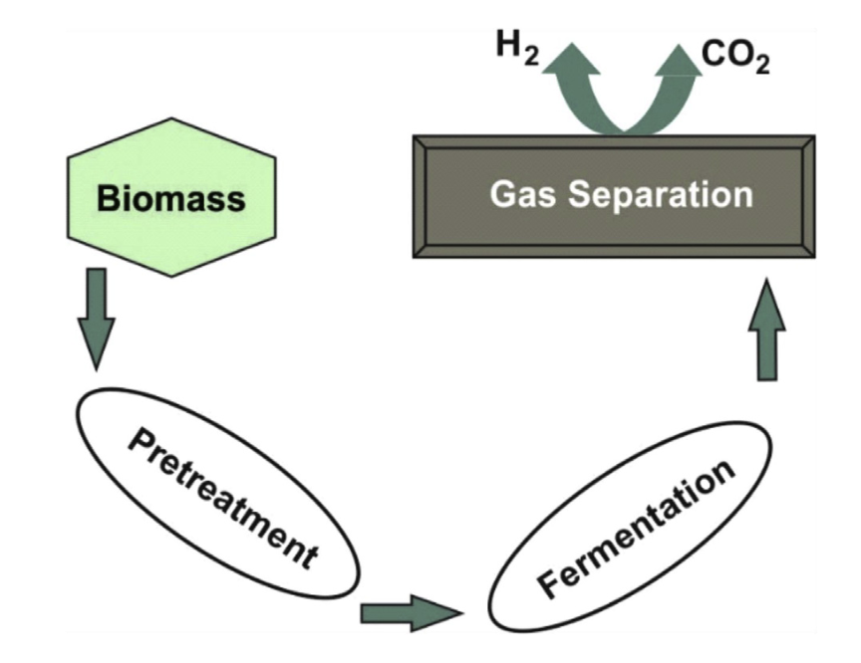
Diagram for Dark Fermentation

Slide 10
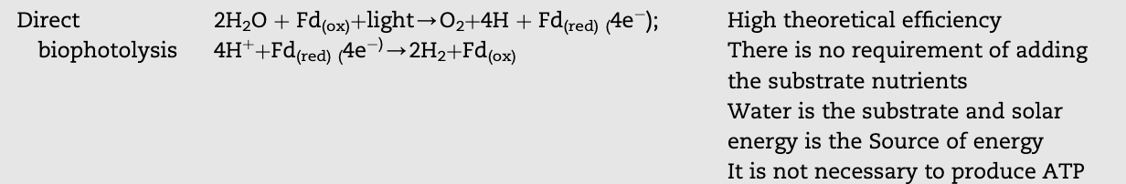
Bio-Photolysis to produce green-hydrogen
Direct biophotolysis is a biological and chemical process resembling photosynthesis, involving microalgae to produce molecular hydrogen directly from water using solar energy.
The reaction is: 2H2O + solar energy → 2H2 + O2
Microalgae such as Microalgae are used ion this process. During this process, photosystem II (PSII) splits water molecules, and the electrons are transferred to ferredoxin (Fd) using solar energy. It's crucial to maintain low oxygen levels to sustain hydrogen production, as hydrogenase enzyme is oxygen-sensitive.

Slide 11
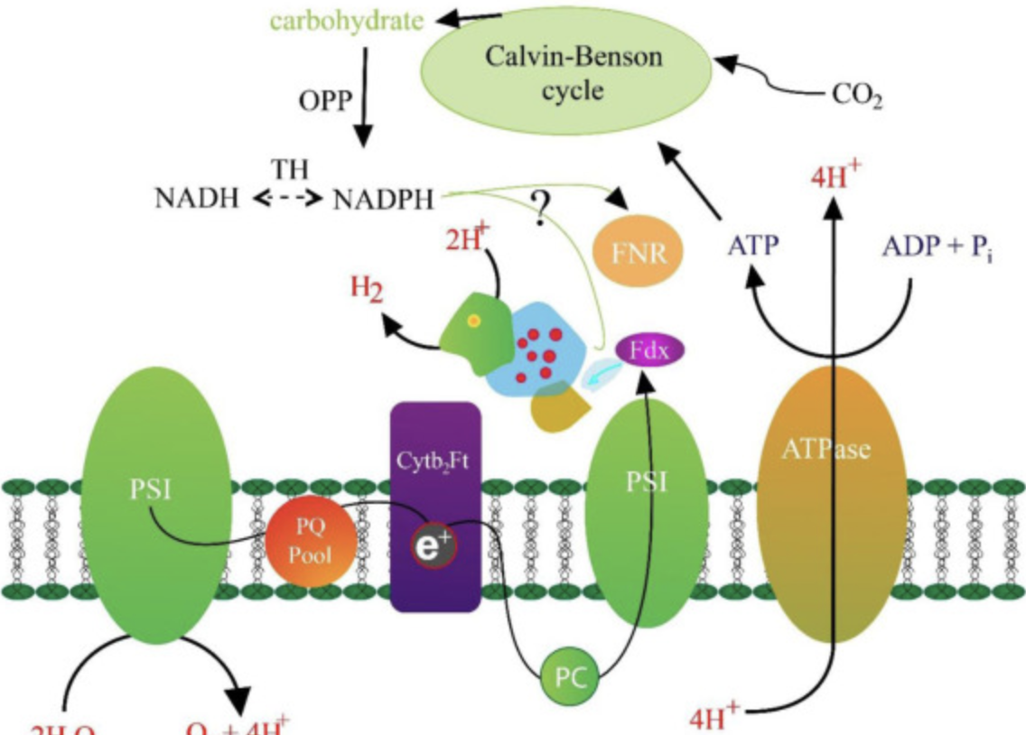
Diagram for Bio-Photolysis

Slide 12
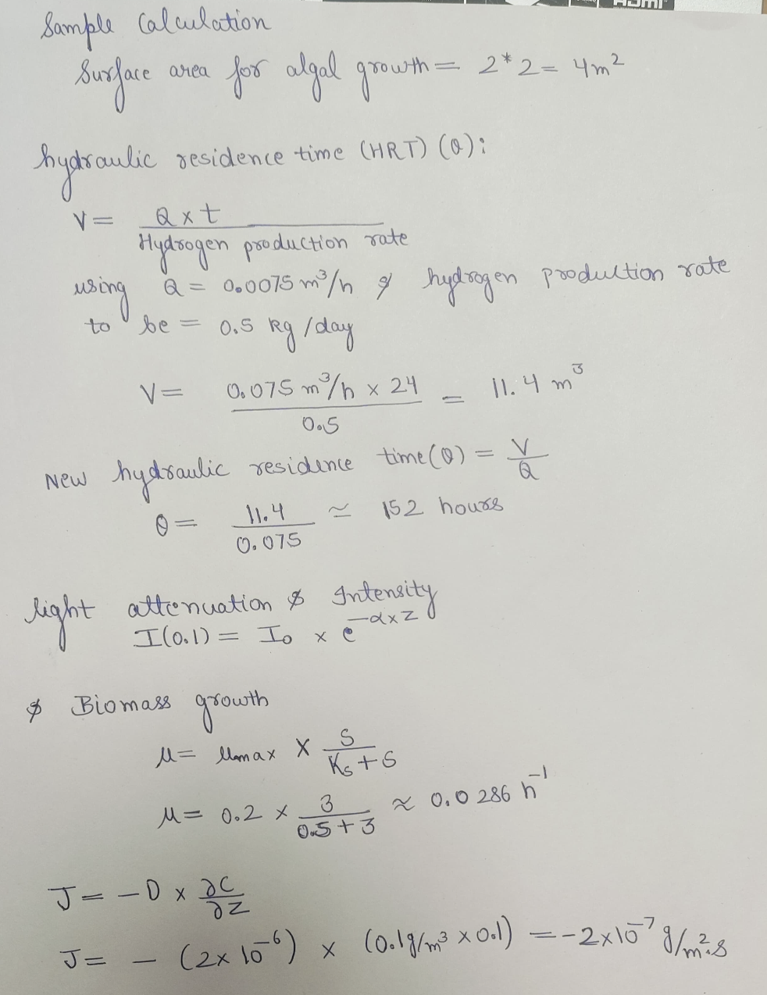
Calculation of design parameters

Slide 13
Factors affecting efficiency (Hyperparameters)
1. Microalgae species - For the microalgae to be able to synthesize hydrogen, it is critical that the required environmental conditions are met so as to induce the specific metabolic pathways in the species. Also, a newly screened biohydrogen production by green microalga, i.e., Chlorella sp. was researched with its new strain showing higher biohydrogen
2. Light intensity: Bio-photolysis, as is, can be considered similar to that of photosynthesis with the presence and amount of light during the hydrogen production process having a major effect
In short, the generation of H2 can be maximized depending on the amount of exposure to light during the anaerobic phase.

Slide 14
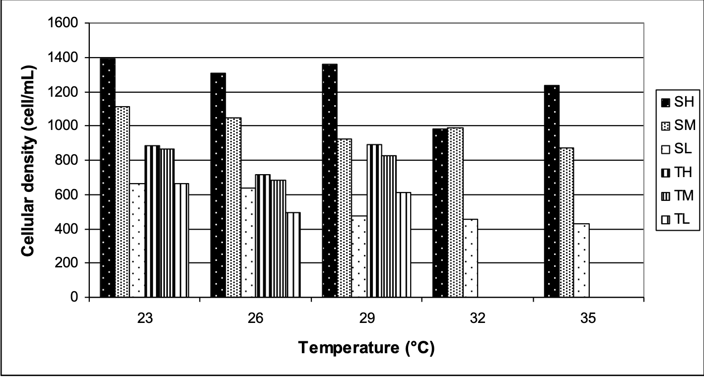
3. Cellular density
Cell density affects the culture of microalgae and its capacity for hydrogen production as it controls the amount of light that passes through the cell
The nature of the cultivation process determines the cell density which in turn affects the H2 productivity of microalgae.
It is extremely important to maintain cell density as the respiration in a culture with low cell concentration would not allow the uptake of the dissolved oxygen into the culture.

Slide 15
4. Subtracts (nutrient intake)
In a culture, additive subtracts such as biotin, cyanocobalamin, and thiamine need to be supplemented to support maximum cell growth and hydrogen production by the microalgae As the culture requires a balance of carbohydrate-based substrate, organic nitrogen and phosphate, which are required for optimal hydrogen production, are vital. Additionally, a carbon source is important for the microalgae to flourish, unless the cultured algae are under photoautotrophic conditions
5. pH
pH is an important physical factor that influences the metabolic pathways and thereby the H2 production by a microalgae
Maximum appropriate pH values depend on the microalgae species in use. however, the functional and appropriate pH level is around 5.2 and 6.0.

Slide 16
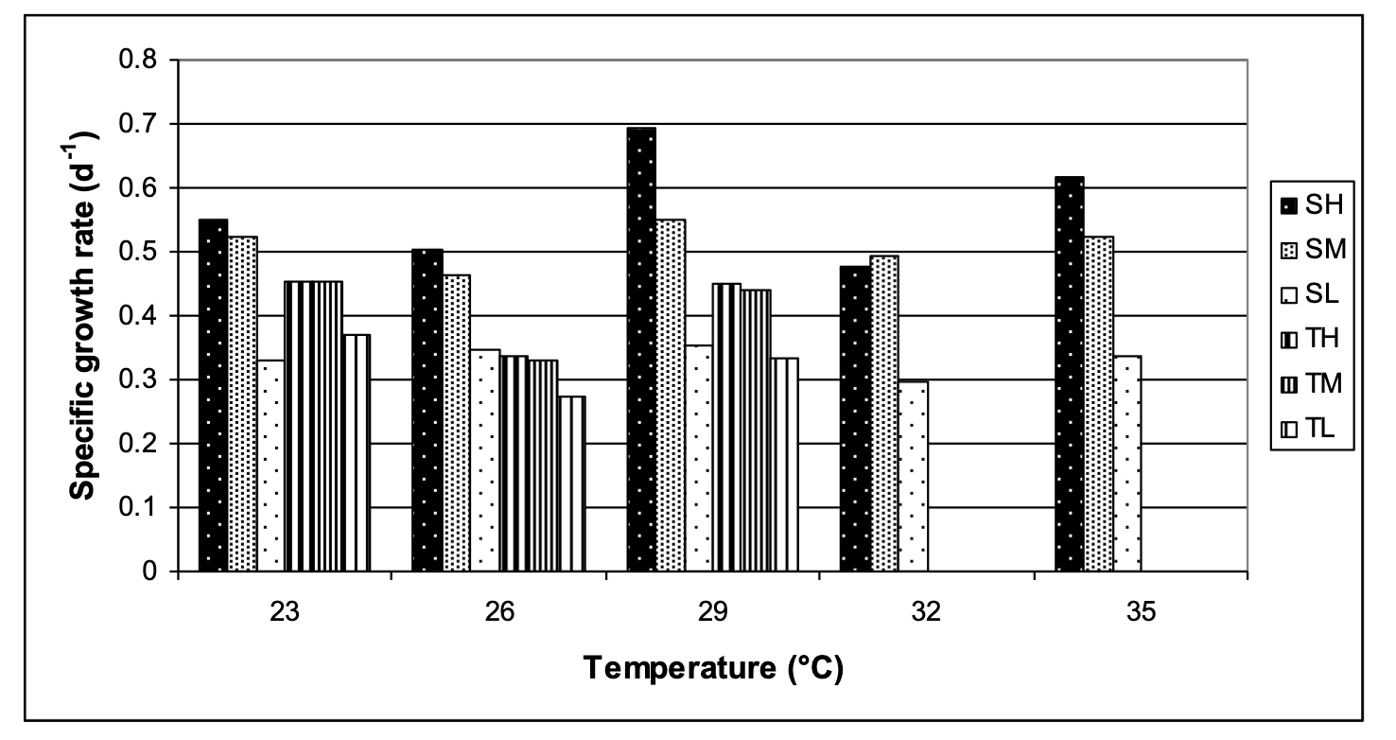
6. Temperature : The optimum temperature at which sustainable growth of the microalgae influencing the optimal hydrogen production is around 15–85 °C in a mixed culture

Slide 17
7. Oxygen sensitivity
Oxygen sensitivity is regarded as the most common and most problematic challenge for many bio-hydrogen production technologies. Oxygen molecules are highly sensitive towards hydrogenase, causing inhibition of the functions of the hydrogenase enzyme.
This occurs due to the oxygen's binding potential to the active site of the hydrogenase. Such bonds are totally irreversible making it even more difficult to extract hydrogen and oxygen molecules from this complex compound
Usually very low levels of hydrogen production are noticed at around 15% atmospheric oxygen level.

Slide 18
Cost Economics behind the plant pipeline setup
Total Initial Investment (Capital Costs):
Sum of all individual capital costs: Reactor vessel, Photobioreactor Panels, Lighting System, Temperature Control Equipment, Infrastructure and Site Preparation, Installation and Commissioning, Pumps, piping, and monitoring equipment, and Fire Pump.
Total Operational Costs per Year:
Electricity: Electricity cost per year = Electricity cost per unit × Total electricity consumption per year Electricity cost per year=Electricity cost per unit × Total electricity consumption per year
Maintenance: Total routine maintenance cost + Total labor costs + Total spare parts and supplies cost
Feedstock: Total cost of wastewater acquisition, pretreatment, transportation, and storage and handling.
Hydrogen Sales Revenue per Year:
Total revenue in 1 year = Selling price of hydrogen per kg * Total production of hydrogen per year.
Return on Investment (ROI):
ROI =( Annual Revenue−Total Annual Operational Cost / Total Capital Cost)×100

Slide 19
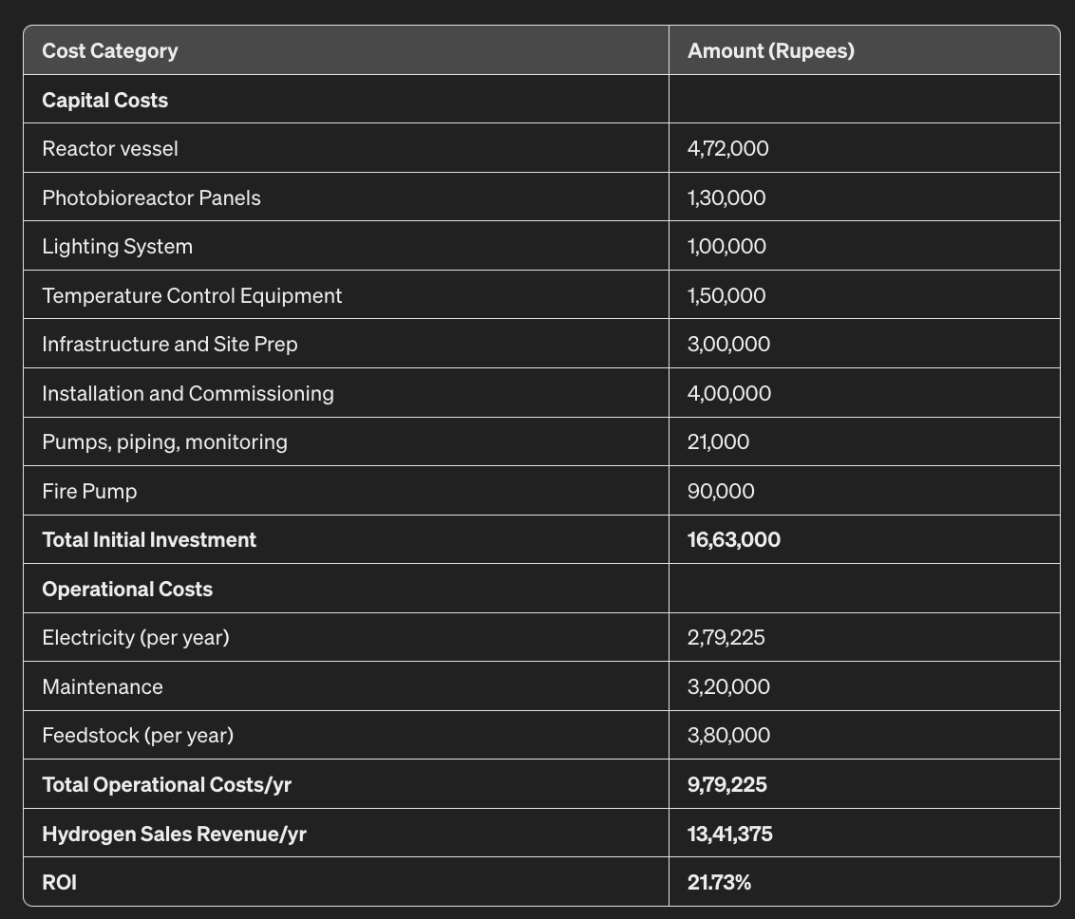
Detailed report of fixed, recurring costs for the pipeline setup of our model

Slide 20
Thank You from one chemical engineer to another chemical engineer

