Slide 1
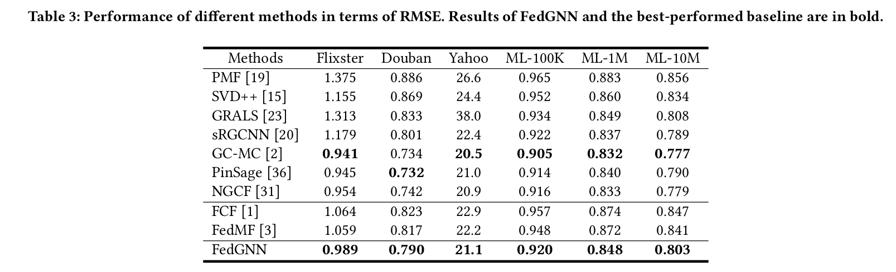

Slide 2
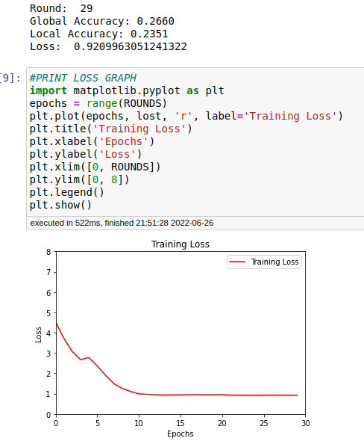
Training Loss
Epochs: 3
Rounds: 30
Optimizer: Adam
Learning Rate: 0.01
Averaging: weighted

Slide 3
Training Loss
Epochs: 3
Rounds: 30
Optimizer: SGD
Learning Rate: 0.01
Averaging: weighted

