Slide 1
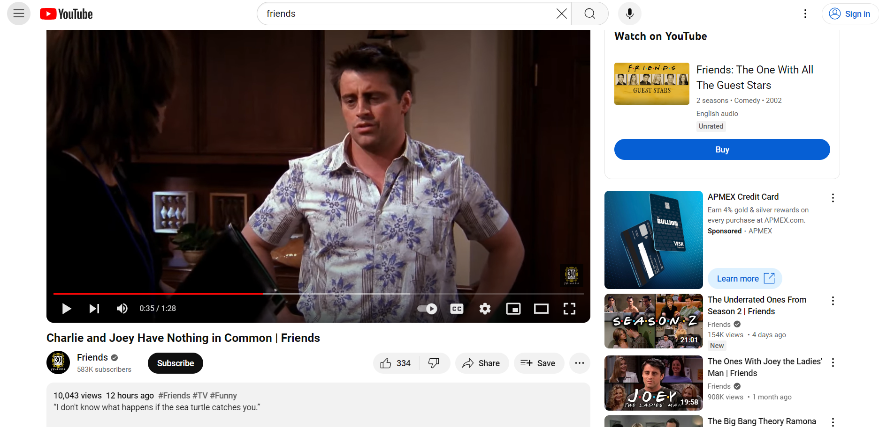
Header bar
Navigator bar
Notes:
what is the layout of the screenshot of web page? e.g. the header, navigation bar, the reference section, main content?
The screenshot shows a web page that appears to be a YouTube video page. Here's a breakdown of the layout elements:
Header: At the top of the page, there's a header with the YouTube logo on the left, a search bar in the middle, and a sign-in button on the right.
Navigation Bar: Below the header, there's a navigation bar with options such as "Home," "Explore," "Inbox," and "Library."
Reference Section: The left side of the page has a sidebar that could be considered a reference section. It appears to contain a list of videos or channels, which could be related to the content of the video being watched or the user's subscriptions.
Main Content: The main content of the page is the video player, which is displaying a scene from the TV show "Friends." The title of the video, "Charlie and Joey Have Nothing in Common | Friends," is displayed above the video player, along with the number of views, the date it was published, and the channel name. There are also various video controls and a progress bar below the video player.
Video Description: Below the video player, there's a description of the video, which is partially visible and seems to provide context or commentary about the scene being shown.
Related Videos: Below the video description, there are several other video thumbnails that are likely related to the content being watched, offering suggestions for further viewing.

