Slide 1
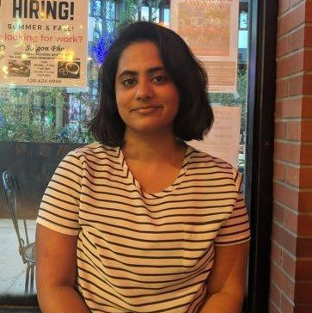
Enfa
George
Major: Computer Science
School: University Of Arizona
Graduation: May 2023
Senior Leader: Len Barlik
Hiring Manager: Taimoor Khawaja
Phone: –
Email: –
LinkedIn: linkedin.com/in/enfageorge

Slide 2
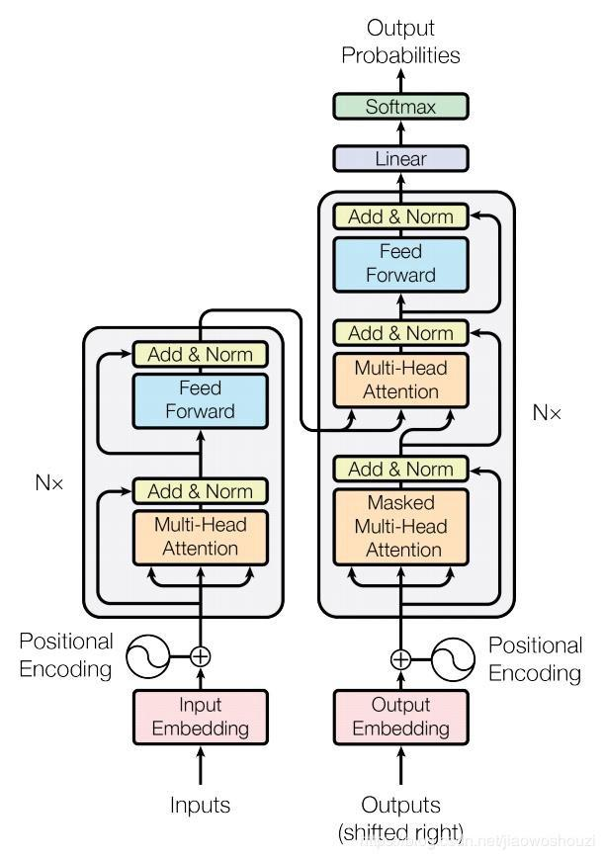

1
Modeling - Intent Classification of Customer Chats
Conducted initial Exploratory Data Analysis on Customer Support chat data to discover patterns, spot anomalies, test hypotheses, and check assumptions with the help of summary statistics and graphical representations.
Constructed a custom set of words, using Tf-IDF and manual process, that, when removed from chat data, reduces noise in input data. This was shown to improve model performance downstream.
Performed careful data class imbalance treatment using hybrid methods to improve the predictive performance of models downstream.
Produced a solid, simple baseline using industry advice and personal experience by creating a model using Tf-Idf and straightforward neural network layers in scikit-learn.
Trained and tested an LSTM model using the Keras framework to compare against the above baseline.
Constructed as a third approach, a combination of pre-trained BERT embeddings from Hugging face and LSTM layers to create a new model later used in deployment in the Tensorflow framework.
Enfa
George
Major: Computer Science
School: University Of Arizona
Graduation: May 2023
Senior Leader: Mark Greatrex
Hiring Manager: Taimoor Khawaja

Slide 3
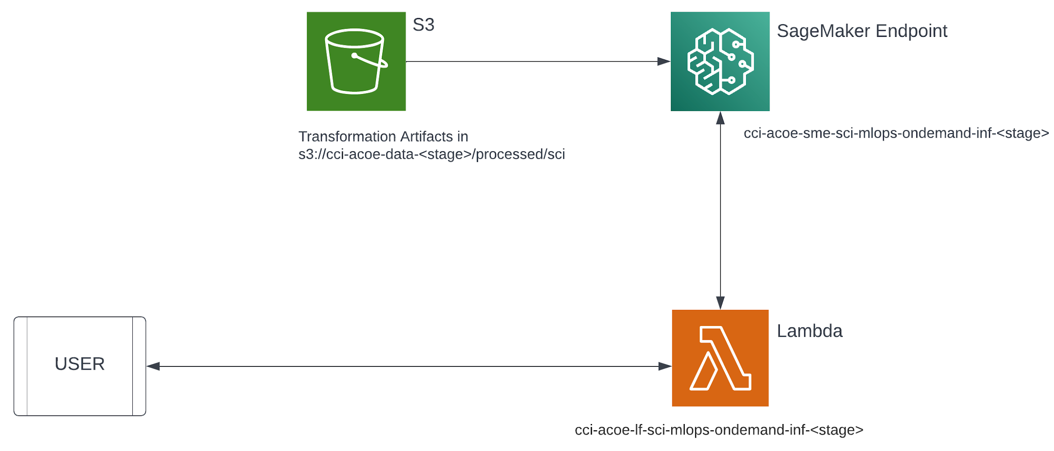
2
Deployment of a Live On Demand Inference Endpoint
Surveyed various training and inference pipeline architectures deployed at large companies using blogs and conference videos.
Presented the info in a summarized and pictorial manner to my manager.
Analyzed inference pipeline deployment patterns supported by AWS and proposed a suitable one for a real-time inference that scales efficiently to large loads.
Trained various simple NLP models in different frameworks (scikit-learn, Pytorch, and Tensorflow) and experimented with creating model and endpoint configurations for the same in AWS.
Enfa
George
Successfully trained a sentiment analysis model using BERT for embedding and Deep Learning.
Deployed it as an on-demand live inference endpoint, triggered through AWS Lambda.
Deployed a Chat Intent Detection Model as Live Inference Endpoint, with preprocessing, and post-processing as a step and using BERT for embedding and DL techniques in a secure data environment in DEV, which will be later used for a cross-team MLOps initiative.
Major: Computer Science
School: University Of Arizona
Graduation: May 2023
Senior Leader: Mark Greatrex
Hiring Manager: Taimoor Khawaja

Slide 4











3
Software/Frameworks I got the Opportunity to Work with
Enfa
George
Major: Computer Science
School: University Of Arizona
Graduation: May 2023
Senior Leader: Mark Greatrex
Hiring Manager: Taimoor Khawaja

