Slide 1


A Project Report On
“Pathology Lab”
Submitted to
DeveVikas Gadekar & Lalit Badgujar
In the partial fulfillment of the degree of
Bachelor of Science (Computer Science)
(2020-2021)
Under the Guidance Of
Prof.Mahajan
Progressive Education Society’s
Department of Computer Science
Modern College of Arts, commerce &science
Pune-411061.

Slide 2
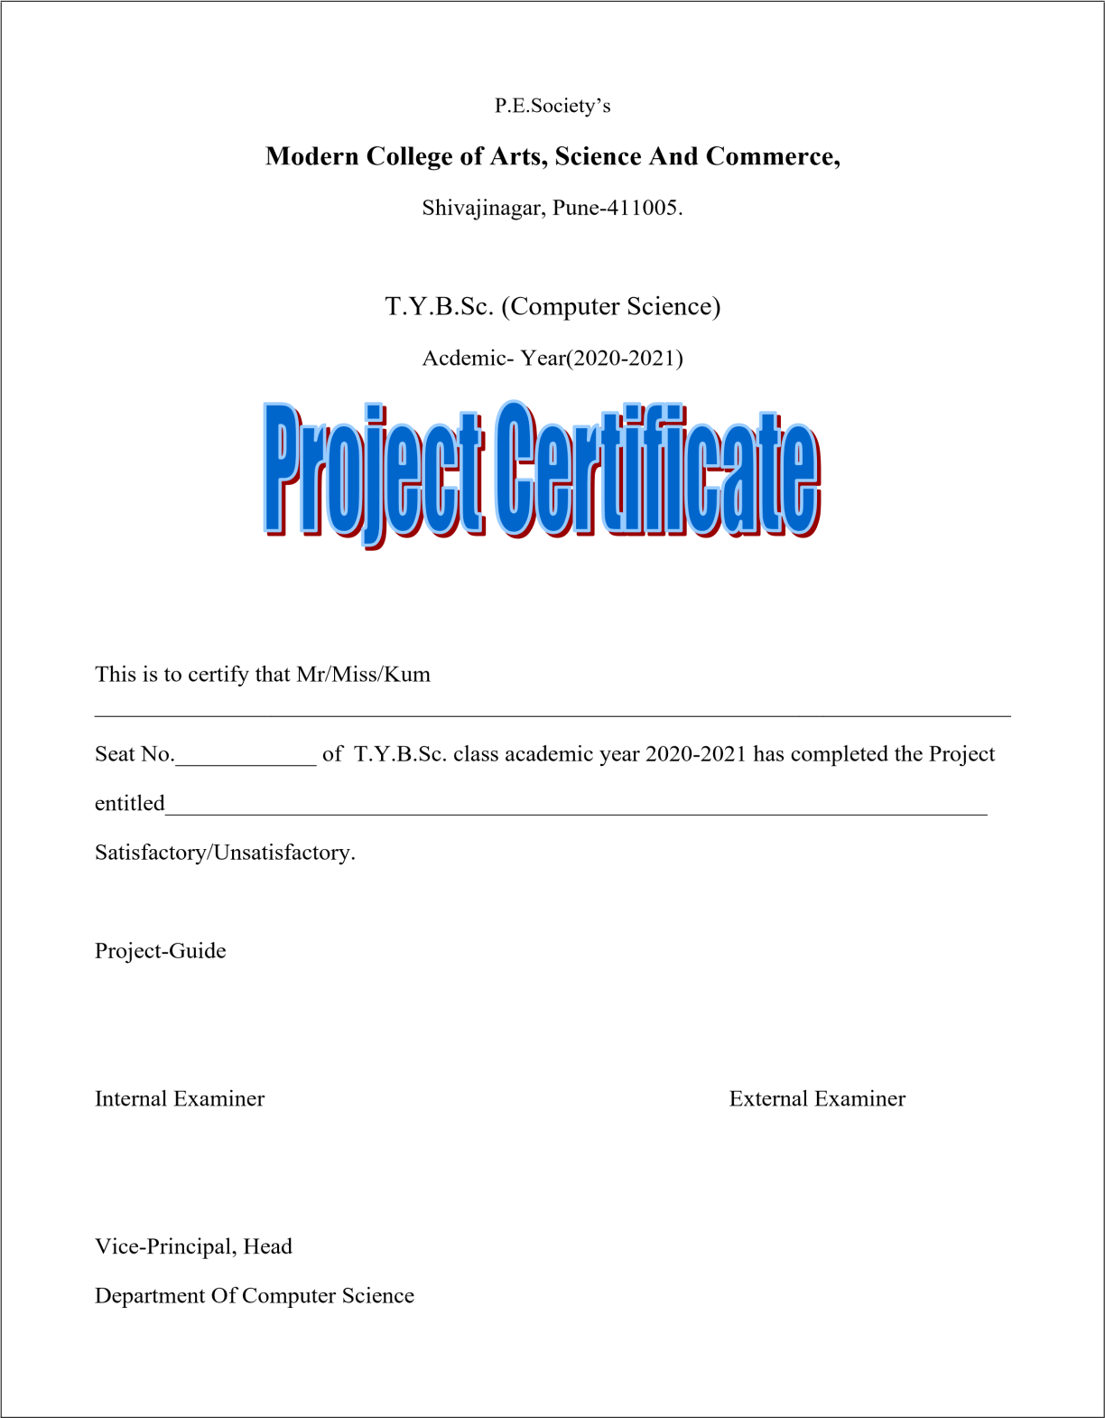

Slide 3
Introduction :
The project, Pathology Lab System is a web-based application that allows the Lab Admin to handle all Pathology activities online.
Interactive GUI and the ability to manage various Services make this system very flexible and convenient.
The Pathology Lab assistant is a very busy person and does not have the time to sit and manage the entire activities manually on paper. This application gives him the power and flexibility to manage the entire system from a single online system.
Pathology Lab project provides service booking, lab assistant management and other necessary Pathology Lab features.
Patient/User can view and book services online. Admin has the power of either approving or disapproving the patient’s booking request. Other Lab services can also be viewed by the Patients’/User and can book them too.
The system is hence useful for both patient and managers to portable manage the Lab activities.

Slide 4
Objectives :
Main objective of this project is to provide solution for lab to manage most there work using computerised process.
This software application will help admin to handle patients information, Service details, payment details, information etc.
Problem Description :
Pathology Lab System is computerised all the daily routine is carried out by computerised and records are maintain in computer.
So record are stored permanentaly. The patient used to make online enquiry on our web for services available and they depending upon the status. He used to make booking on computer we can called all information about patients.
To overcome this difficulties the must be computerized.

Slide 5
Study of Existing System :
Pathology Lab management existing system was manual. All the daily routine is carried out manually and the record are maintained.
In the record books or the register. The patient use to make inquiry for services available and the depending upon the status.
Drawbacks of Existing system :
It is manual system so error is created while register the entry of patient.
Make the mistakes while register the phone number and address.
If patients gives duplicate id there is no way to know the id is fake or not.

Slide 6
Scope of proposed System :
The Lab Management System is a web-based application that allows to lab admin to handle all the activities online .
The ability to manage various services booking and services make system flexible and convenient.
Feasibility Study :
Technical Feasibility :
The technical equipment required for a system development.
For this purpose we required various hardware equipment such as computer intel, pentium, 1.44 MB floppy discs. For taking backup backend tool as php.

Slide 7
Economical Feasibility :
In economical feasibility we carried out the cost benefit analysis of system. Hardware requirement CD ROM drive.
Computer intel 400 MHz Rs 18,000.
A programmer has to assist for a hotel management in his work.
Operational Feasibility :
This web-based system will be helpful in many ways.
The searching time can be reduced.
The date redundancy can be also avoid.
The desperate the developed system, a system analyst will required for Lab Management System.

Slide 8
Advantages :
Time saving
Save excess of paper work
It is easy to use
Date security

Slide 9
ENTITY RELATIONSHIP DIAGRAM

Slide 10
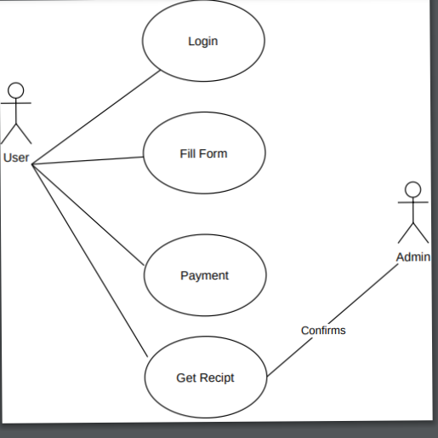
USE CASE DIAGRAM

Slide 11
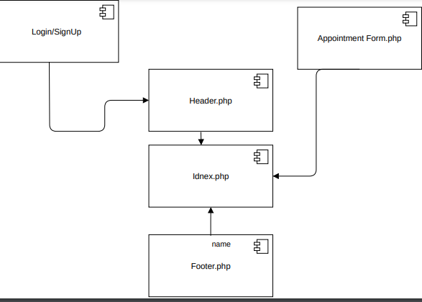
Component diagram

Slide 12
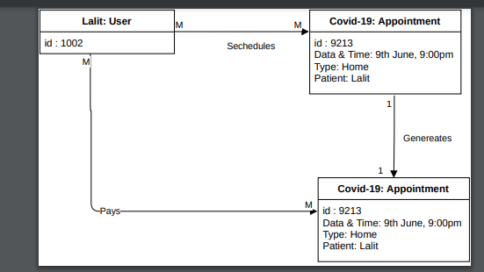
OBJECT DIAGRAM

Slide 13
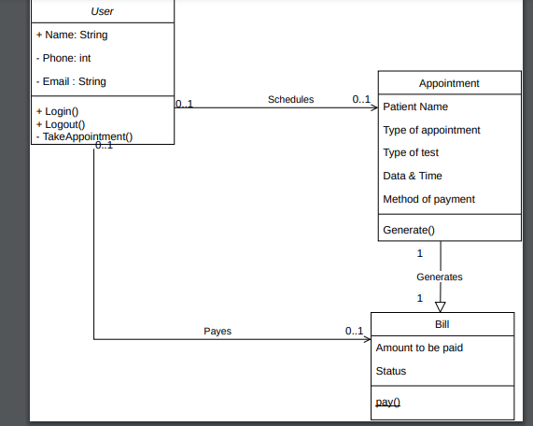
CLASS DIAGRAM

Slide 14
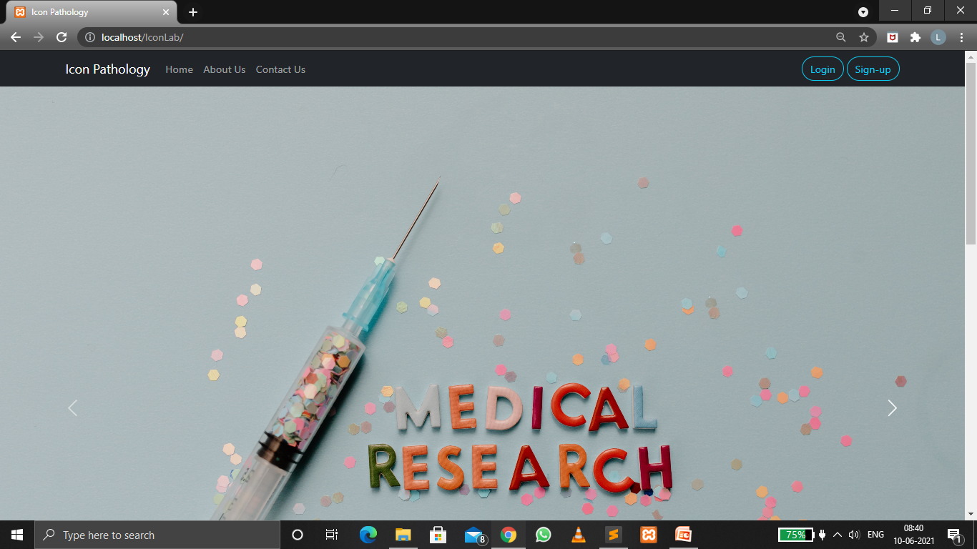
Screenshots :

Slide 15
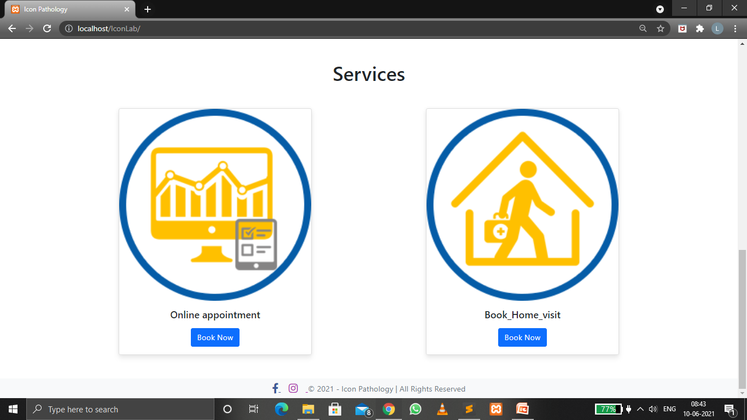

Slide 16
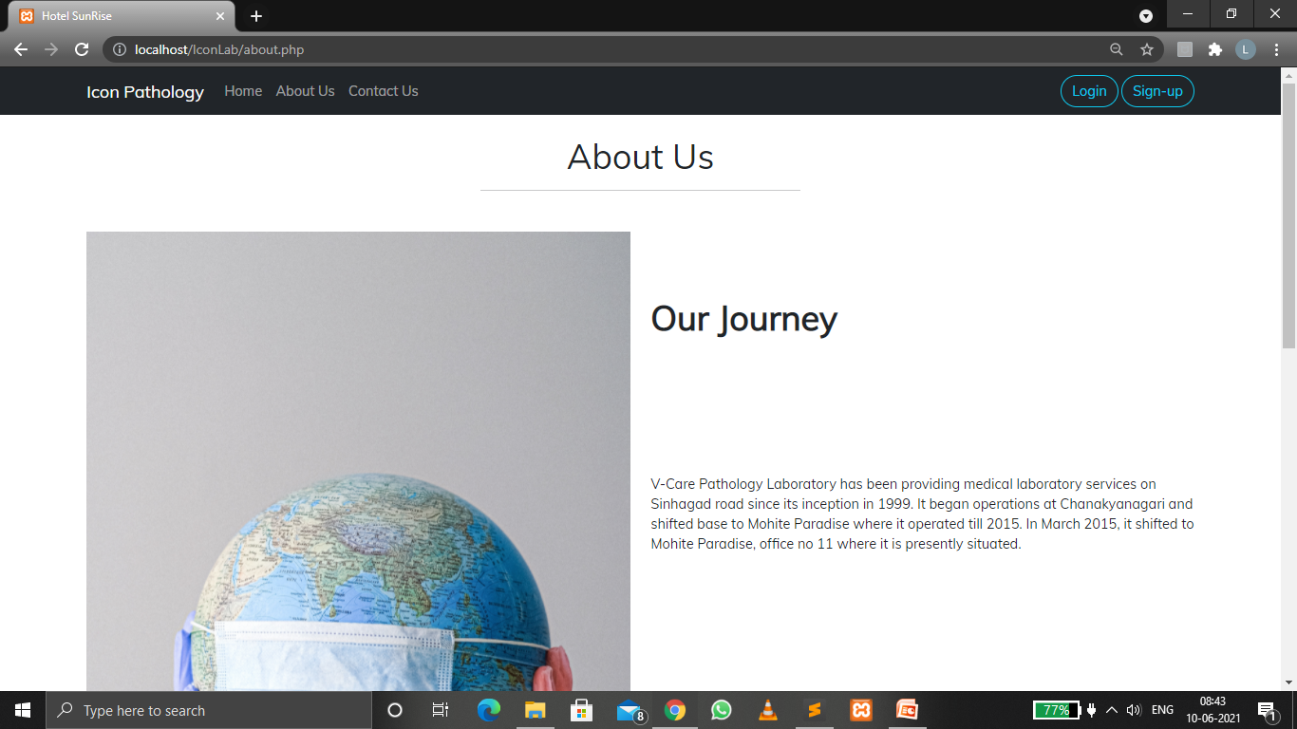

Slide 17
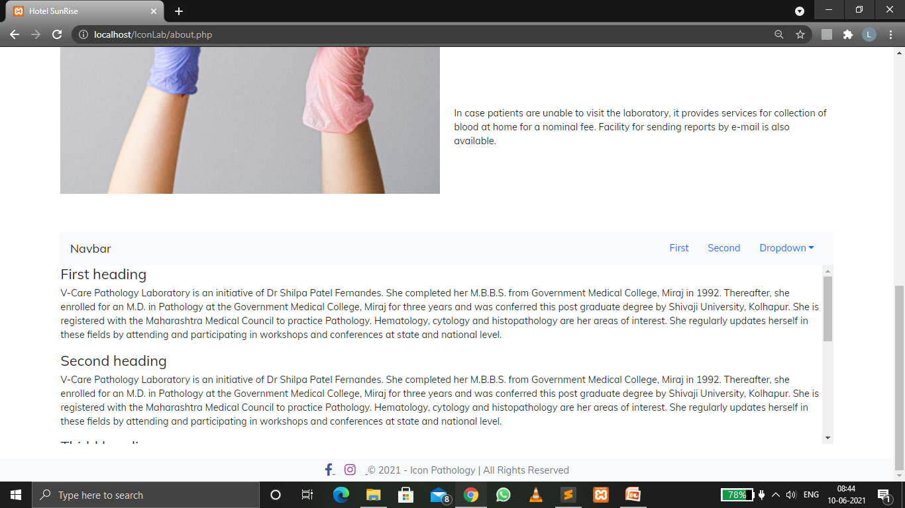

Slide 18
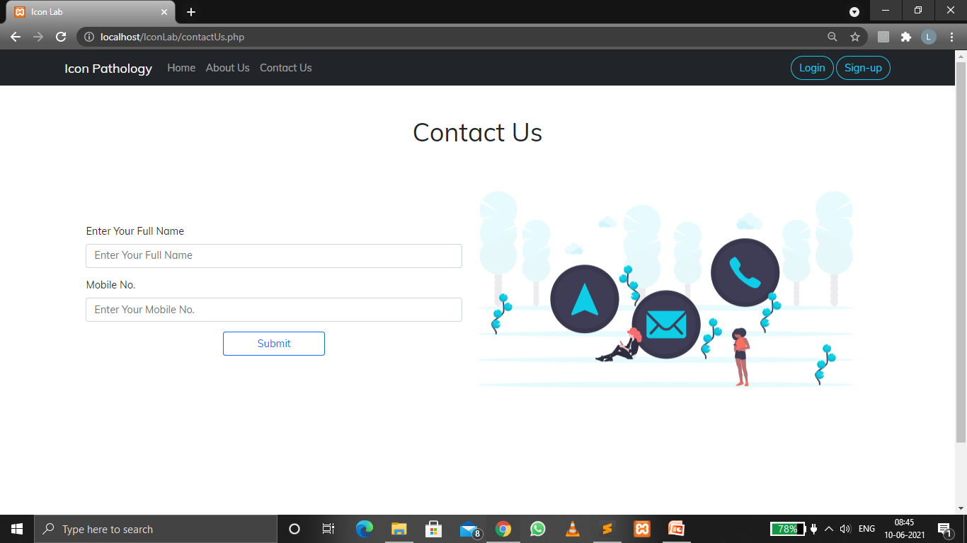

Slide 19
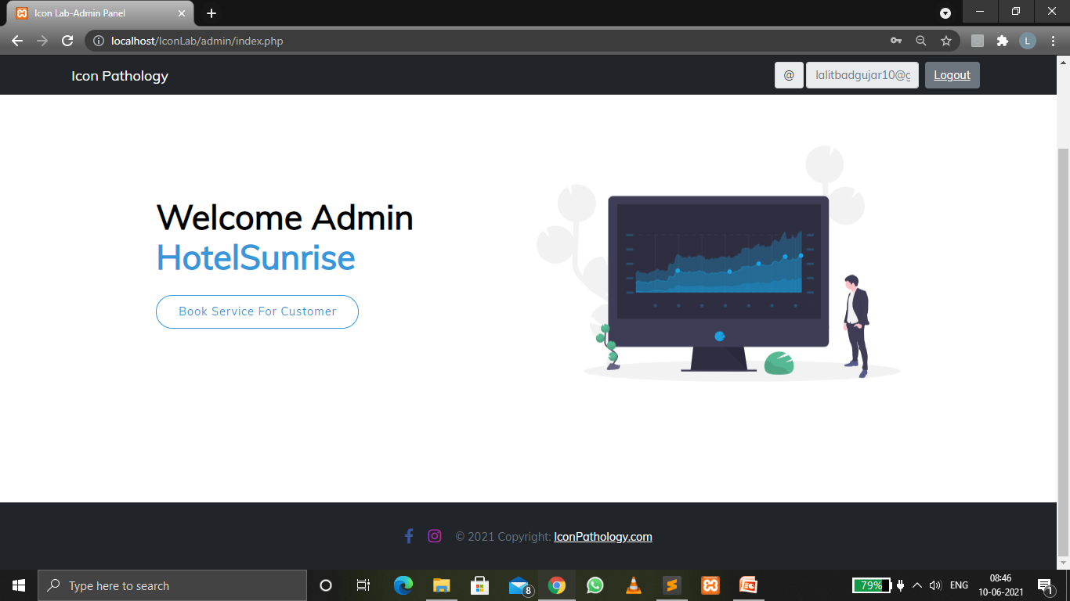

Slide 20
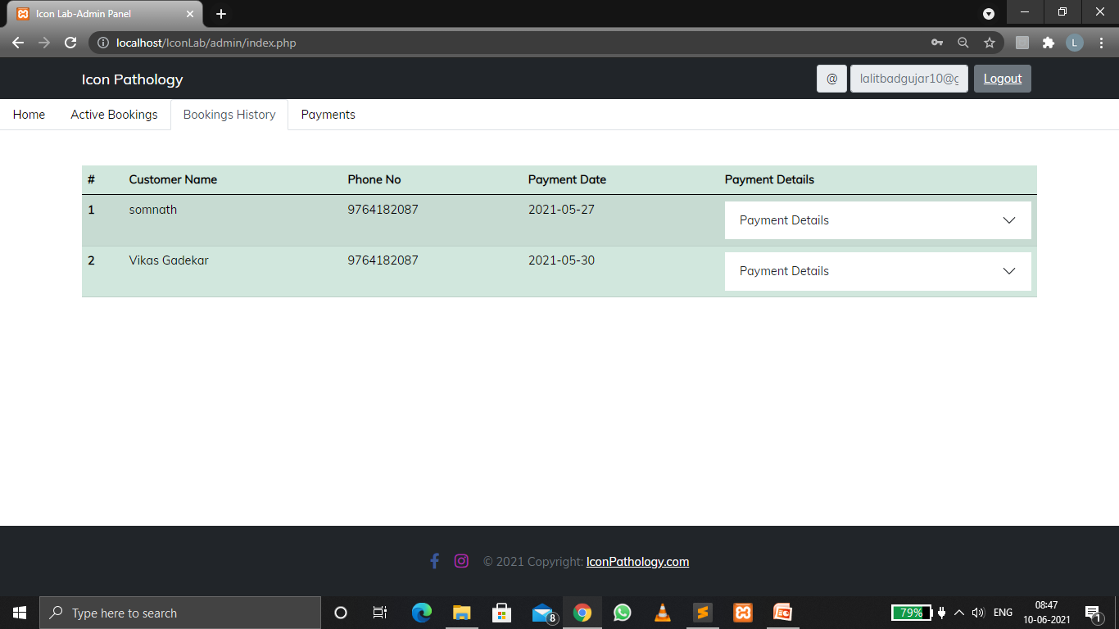

Slide 21
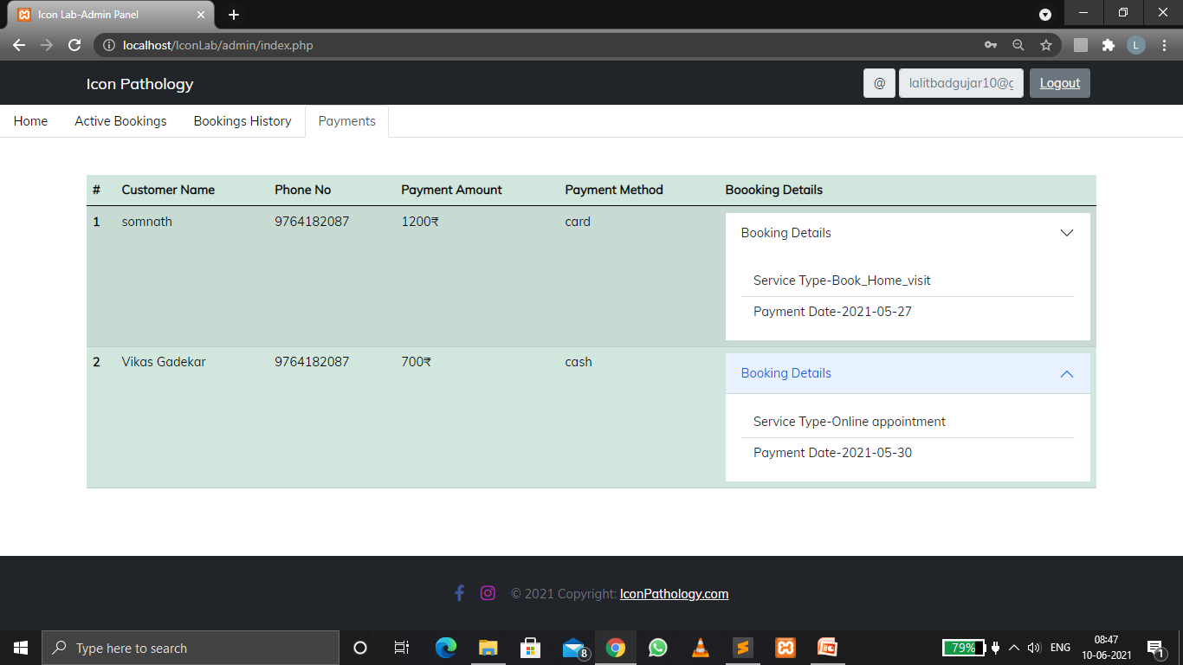

Slide 22
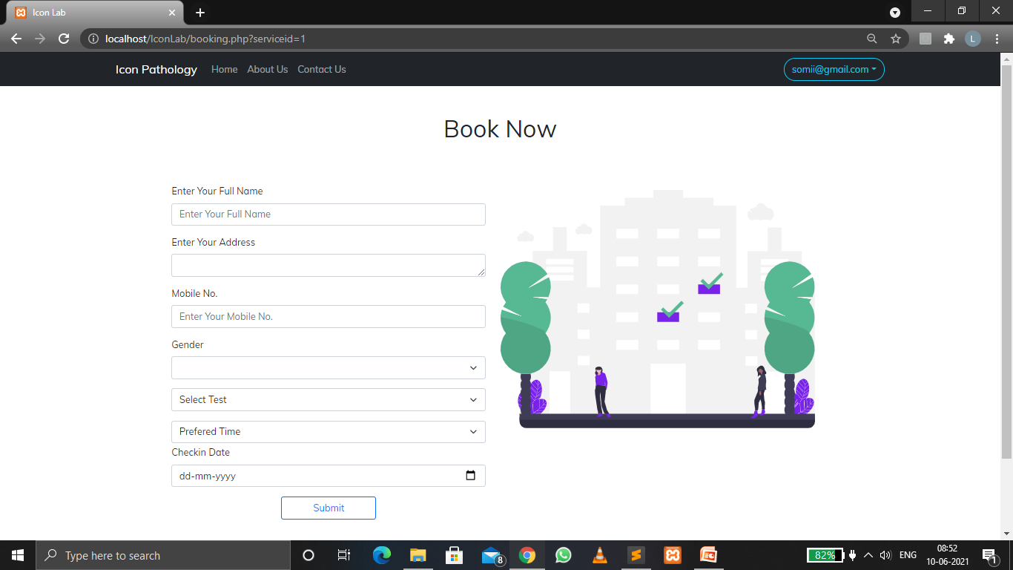

Slide 23
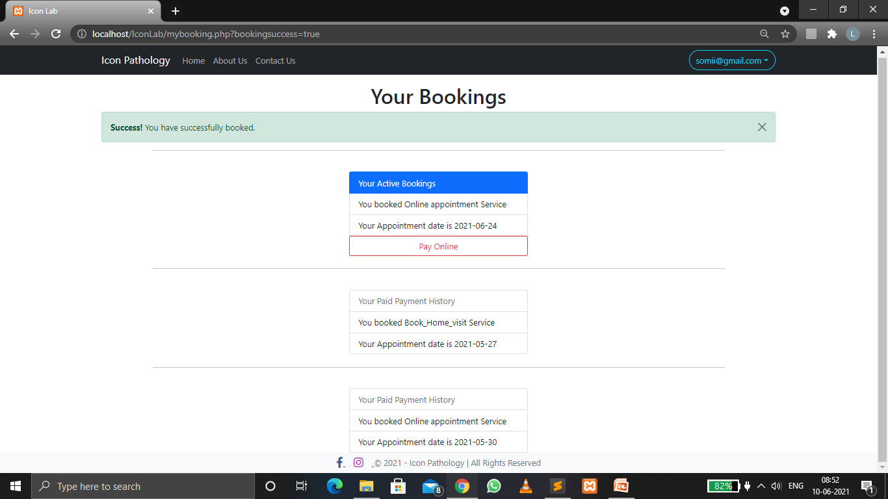

Slide 24
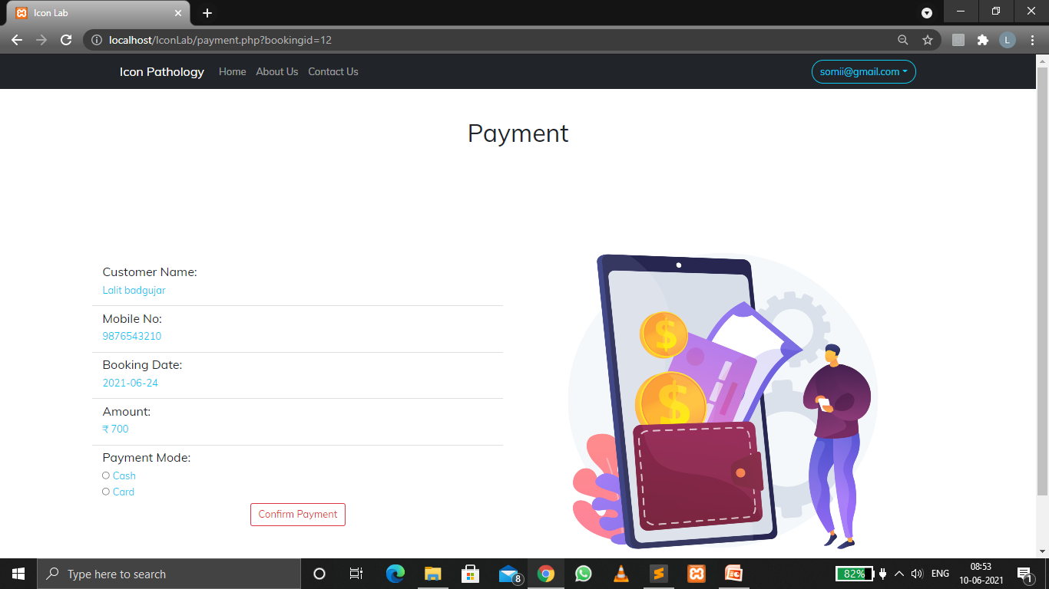

Slide 25
