Slide 1
WhatsApp Chatting App
Guide : PROF. MANISHA S. SURYAVANSHI
Submitted By -
Ishan Sawkar Dorge 2101959
Lalit Ram Badgujar 2102793

Slide 2
INDEX
Introduction
Objective
Scope
Features
Feasibility study
Analysis and Design Diagram
Output Screens
Conclusion
Reference

Slide 3
INTRODUCTION
Social Media app allows individuals to keep in touch with friends and extended family. Some people will use various social media app to network and ﬁnal career opportunities, connect with people across the global with like-minded interests, and share their own thoughts, feelings, and insights online.
In this project we are try to create one basic social media app like whatsapp, messenger etc. App having some basic functionality for example -
1.User can create an account
2.User can chat with other peoples
3.User can update profile photo
4.User can create group chats

Slide 4
“Android” Technology used in this project
What is “Android” ?
Android is a mobile operating system based on a modified version of the Linux Kernel and other open source software, designed primarily for touchscreen mobile devices such as smartphones and tablets. Android is developed by a consortium of developers known as the Open Handsets Alliance and commercially sponsored by Google.

Slide 5
OBJECTIVES
The main objective of the project on social media app. Is to manage the details of User Profile, Chats. It can manages all the information about profile. The purpose of the project is to build an application program to reduce the manual work for managing online interaction.

Slide 6
SCOPE
It may help collecting perfect management in details. In a very short time, the collection will be obvious, simple and sensible. It will help a person to know the management of passed year perfectly. It also help in current all work relative to social media app. It will be also reduced cost of collecting the management and collection procedure will go on smoothly.

Slide 7
FEATURES
User accounts to control the access and maintain security
It contain better storage capacity
Accuracy in work
Access of any information individually
Work becomes very speedy
Easy to update information

Slide 8
FEASIBILITY STUDY
Economic Feasibility -
We are developing a project for practice purpose that will gives us a lots of confidence to build a bigger project in future .Hence the economic feasibility is very good.
Technical Feasibility -
In this aspect of feasibility we consider the technical equipment required for development .
For this we required various things like Good Specified Laptop, Android Studio(Integrated Development Environment (IDE) for Android app development, based on IntelliJ IDEA .)

Slide 9
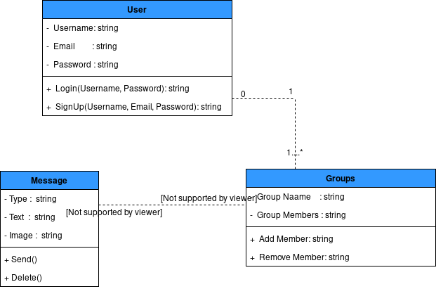
Class Diagram
Class Diagram – class diagram in the Unified Modeling Language (UML) is a type of static structure diagram that describes the structure of a system by showing the system's classes, their attributes, operations (or methods), and the relationships among objects.

Slide 10
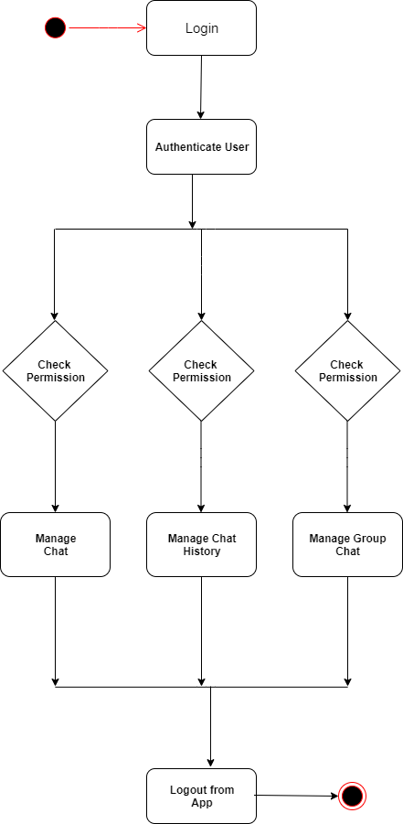
Activity Diagram
Activity diagram is basically a flowchart to represent the flow from one activity to another activity. The activity can be described as an operation of the system

Slide 11
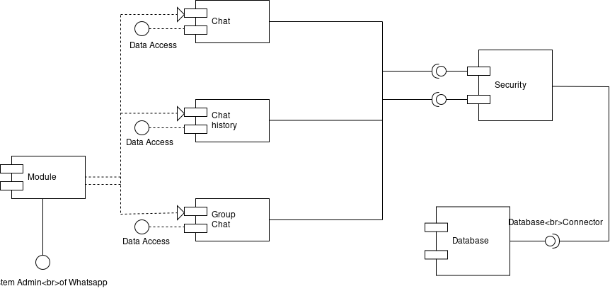
Component Diagram
Component diagrams are used to model the physical aspects of a system.
Component diagrams are used to model the physical aspects of a system.

Slide 12
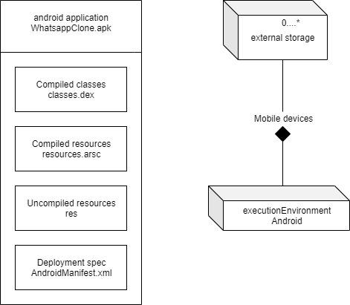
Deployment Diagram
It is a simple UML deployment diagram. It tells about the functioning of the mobile app and the resources that it would need.

Slide 13
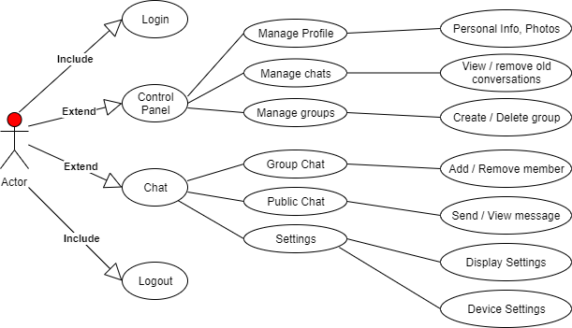
Use Case Diagram
A use case diagram can summarize the details of your system's users (also known as actors) and their interactions with the system.

Slide 14
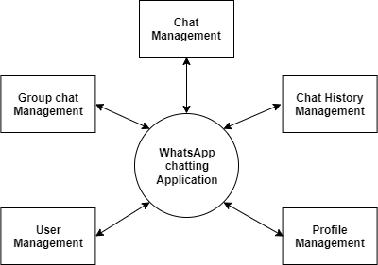
Data Flow Diagram
DFD is the abbreviation for Data Flow Diagram. The flow of data of a system or a process is represented by DFD. It also gives insight into the inputs and outputs of each entity and the process itself.
0-level DFD: It is also known as a context diagram. It’s designed to be an abstraction view, showing the system as a single process with its relationship to external entities. It represents the entire system as a single bubble with input and output data indicated by incoming/outgoing arrows.

Slide 15
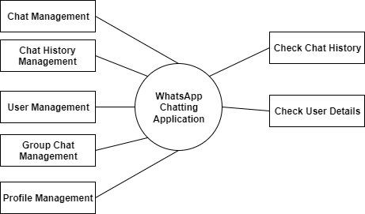
1-level DFD
1-level DFD: In 1-level DFD, the context diagram is decomposed into multiple bubbles/processes. In this level, we highlight the main functions of the system and breakdown the high-level process of 0-level DFD into sub processes. 1-level DFD: In 1-level DFD, the context diagram is decomposed into multiple bubbles/processes. In this level, we highlight the main functions of the system and breakdown the high-level process of 0-level DFD into sub processes.

Slide 16
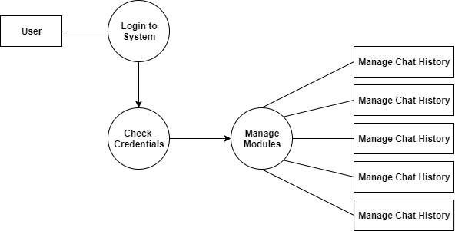
2-level DFD
2-level DFD: 2-level DFD goes one step deeper into parts of 1-level DFD. It can be used to plan or record the specific/necessary detail about the system’s functioning.

Slide 17
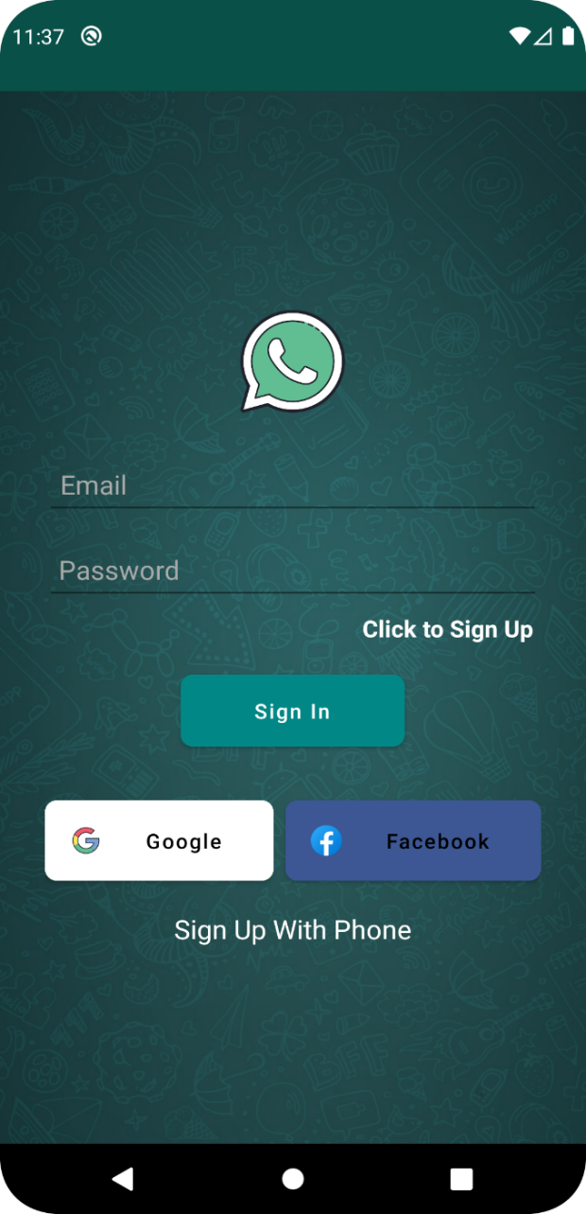
OUTPUT SCREENS
Login/Sign-up Screen

Slide 18
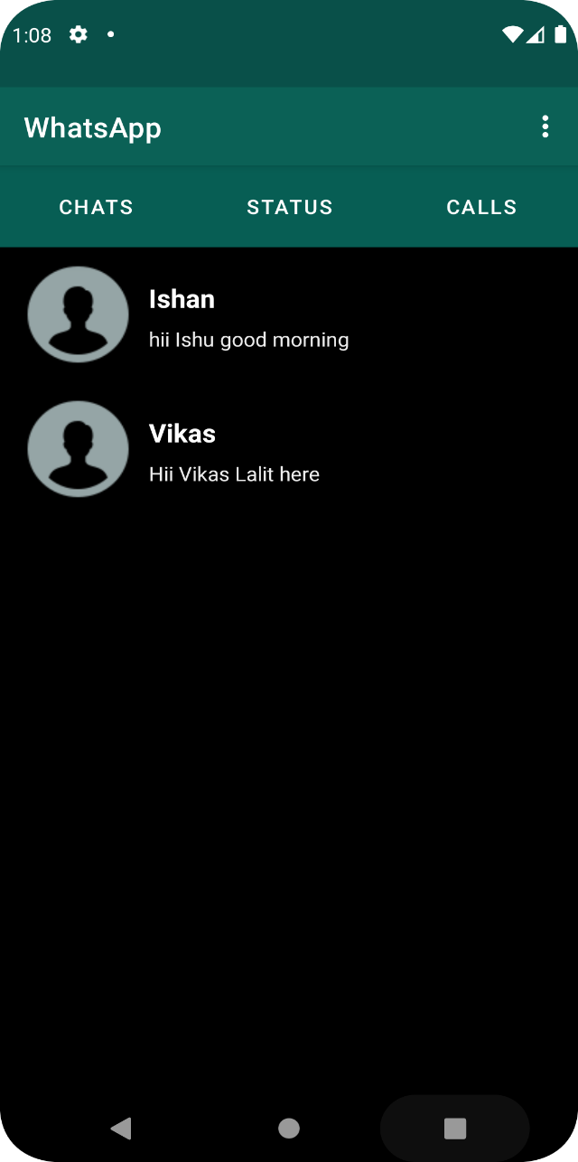
OUTPUT SCREENS
Chatting Screen

Slide 19
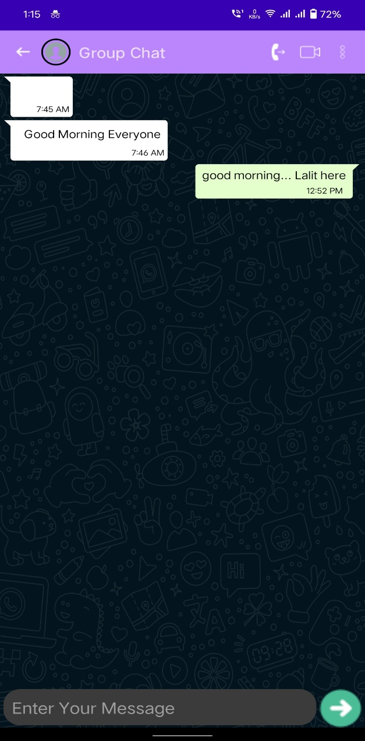
OUTPUT SCREENS
GroupChat Screen

Slide 20
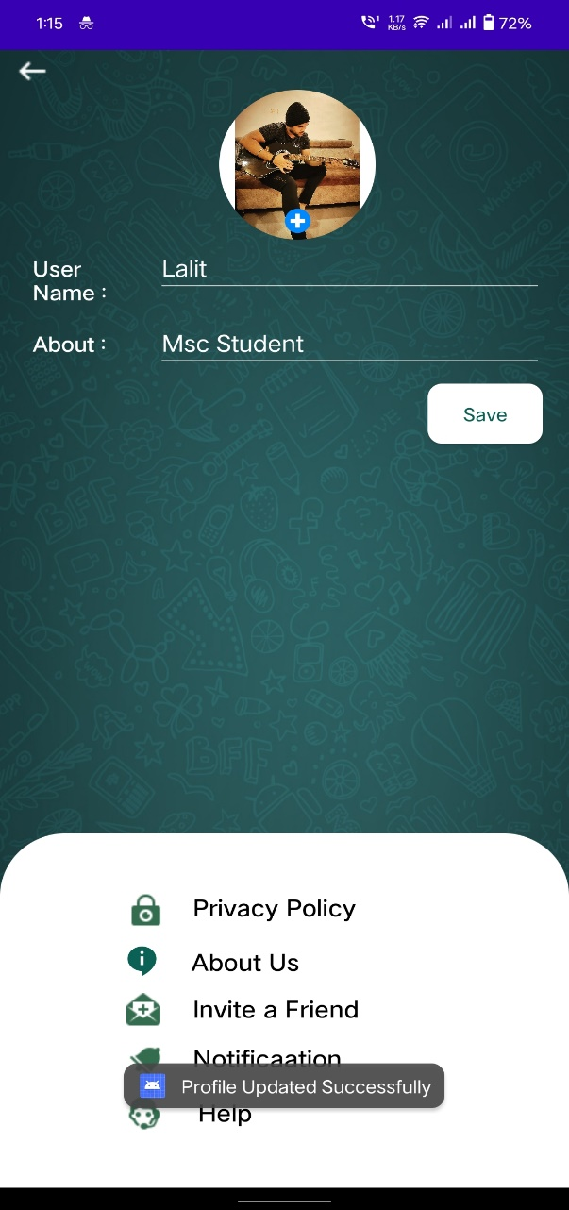
OUTPUT SCREENS
Profile Screen

Slide 21
CONCLUSION
As in face-to-face communication ,disagreements are inevitable in virtual environments when there is a human factor. However, minimisation of the problems is possible by managing the process properly and making out the possible problems. However, Social networks are applications that started to becomes a part of education in the natural flow of daily lives.
As a result of this study, it is determined that the application has a positive impact on success and its use is welcomed substantially.

Slide 22
REFERENCES
https://www.w3school.com
https://www.diagrameditor.com/

