Slide 1


Analyzing Spammers' Social Networks for Fun and Profit
A Case Study of Cyber Criminal Ecosystem on Twitter
Authors:
Chao Yang, Texas A&M University
Robert Harkreader, Texas A&M University
Jialong Zhang, Texas A&M University
WWW-12
Presented By:
Muhammad Saad

Slide 2
Outline
Criminal accounts on Twitter
Cyber criminal ecosystem
Inner social relationship of criminal accounts
Graph density
Reciprocity
Following quality
Criminal leaves and hubs
Criminal following ratio
Shared following ratio
Outer social relationship
Criminal supporters
Mr.SPA algorithm
Social butterflies
Social promoters
Dummies

Slide 3
Outline
Inferring criminal accounts
CIA algorithm
Evaluation and results
Limitations of work
Conclusion and discussion

Slide 4
Criminal Accounts
Behavior
Send spam in tweets
Malicious urls
Phishing
Twitter policy
Blocks spam accounts
If account has few followers and follows many accounts
Problem
Criminal accounts still exist
Evade policies of Twitter
Blend in the normal accounts

Slide 5
Objectives
Understand how criminal accounts survive
Identify their ecosystem
Understand characteristics
Study their distribution
Develop huristic models to spot criminal accounts
Present countermeasures

Slide 6





Cyber Criminal Ecosystem
criminal account
criminal supporter
legitimate account
victim
inner
outer

Slide 7

Inner Social Relationship
G = (V,E)
V: all criminal accounts
E: all follow relationship, directed edge

Slide 8

Inner Social Relationship
Finding 1:
Criminal accounts tend to be socially connected, forming a small-world network.

Slide 9

Inner Social Relationship
Graph Density
 | Account | Follow Relationship | Density
Criminal Space in Sample | 2,060 | 9,868 | 2.33 × 10⁻³
Entire Twitter Space | 41.7 × 10⁶ | 1.47 × 10⁹ | 8.45 × 10⁻⁷

Slide 10
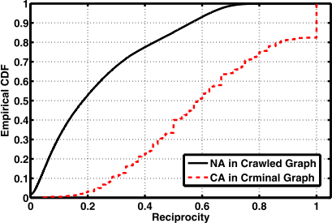
Inner Social Relationship
Reciprocity
Number of Bidirectional Links
Reciprocity of 95% criminal accounts higher than 0.2.
Reciprocity of 55% normal accounts higher than 0.2.
Reciprocity of around 20% criminal accounts are nearly 1.0.

Slide 11
Inner Social Relationship
Average Shortest Path Length
Average number of steps along the shortest paths for all possible pairs of graph nodes.
 | ASPL
Criminal Accounts | 2.60
Legitimate Accounts | 4.12

Slide 12
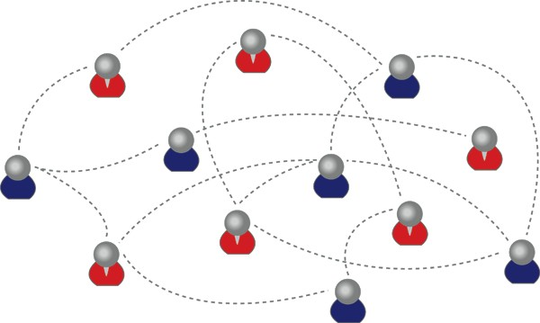
Inner Social Relationship
Criminal accounts have strong social connections with each other. REASON?

Slide 13
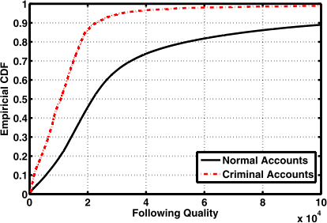
Inner Social Relationship
Tend to follow many accounts without considering those accounts' quality much.
FQ of 85% criminal accounts lower than 20,000.
FQ of 45% normal accounts lower than 20,000.

Slide 14

Inner Social Relationship
Criminal accounts, belonging to the same criminal organizations.

Slide 15
Inner Social Relationship
Criminal accounts, belonging to the same criminal organizations.
Group criminal accounts into different criminal campaigns by malicious URL.
17 campaigns
8,667 edges
87.8 %

Slide 16
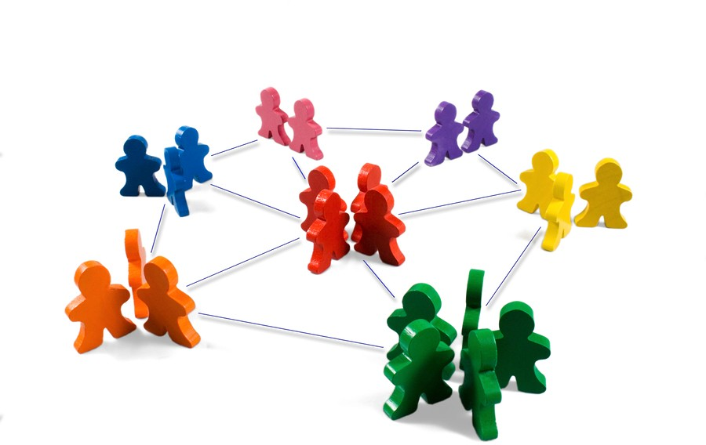
Inner Social Relationship
Provide followers to criminal accounts
Break the Following Limits Policy
Evade spam detection

Slide 17
Inner Social Relationship
criminal hubs
following leaves and acquiring their followers’ information
criminal leaves
randomly following other accounts to expect them to follow back

Slide 18
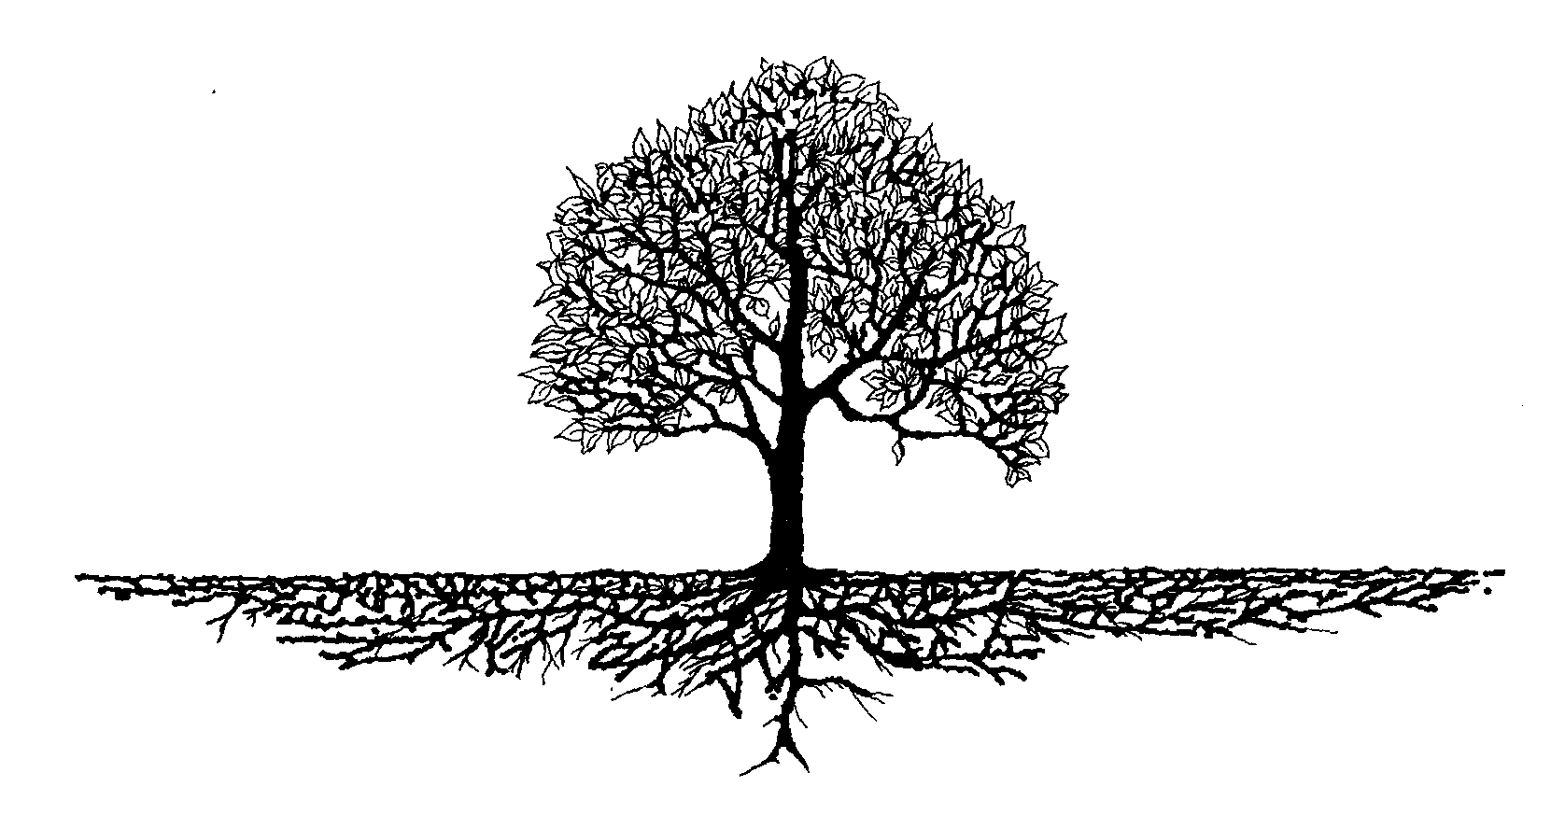
Inner Social Relationship
Finding 2:
Compared with criminal leaves, criminal hubs are more inclined to follow criminal accounts.

Slide 19
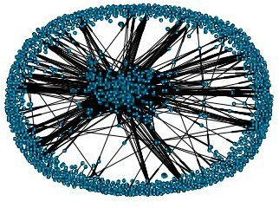
Inner Social Relationship
HITS algorithm to calculate hub score
k-means algorithm to cluster them
Relationship Graph
criminal hubs: 90
criminal leaf: 1,970

Slide 20
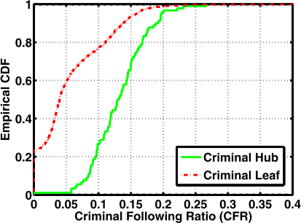
Inner Social Relationship
CFR of 80% criminal hubs higher than 0.1.
CFR of 20% criminal leaves higher than 0.1.
CFR of 60% criminal leaves lower than 0.05.

Slide 21

Outer Social Relationship

Slide 22
Outer Social Relationship
criminal supporters
accounts outside the criminal community, who have close "follow relationships" with criminal accounts

Slide 23


Outer Social Relationship
Malicious Relevance Score Propagation Algorithm (Mr.SPA)
MR score:
measuring how closely this account follows criminal accounts
MR score

Slide 24
Outer Social Relationship
Malicious Relevance Score Propagation Algorithm (Mr.SPA)
the more criminal accounts followed, the higher
score
the further away from a criminal account, the
lower score
the closer the support relationship between a Twitter account and a criminal account, the higher score

Slide 25
Outer Social Relationship
Malicious Relevance Score Propagation Algorithm (Mr.SPA)
Malicious Relevance Graph, G = (V,E,W)
V: all accounts
E: all follow relationship, directed edge W: weight for each edge, closeness of relationship

Slide 26
Outer Social Relationship
After Mr. SPA...
use x-means algorithm to cluster accounts based on their MR scores
5,924 criminal supporters
most accounts have relatively small scores and are grouped into one single cluster
most accounts do not have very close follow relationships with criminal accounts

Slide 27
Outer Social Relationship
Social Butterflies
Those accounts that have extraordinarily large numbers of followers and followings.
use 2,000 following as a threshold
3,818 social butterflies
The reason why social butterflies tend to have close friendships with criminals is mainly because most of them usually follow back the users who follow them without careful examinations.

Slide 28
Outer Social Relationship
Social Promoters
Those accounts that have large following-follower ratios, larger following numbers and relatively high URL ratios.
whose URL ratios are higher than
0.1, and following numbers and following-follower ratios are both at the top 10-percentile
508 social promoters

Slide 29
Outer Social Relationship
Dummies
Those accounts who post few tweets but have many followers.
post fewer than 5 tweets and
whose follower numbers are at the top 10-percentile
81 dummies

Slide 30
Inferring Criminal Accounts
Criminal account Inference Algorithm (CIA)
criminal accounts tend to be socially connected
criminal accounts usually share similar topics, thus having strong semantic coordinations among them

Slide 31
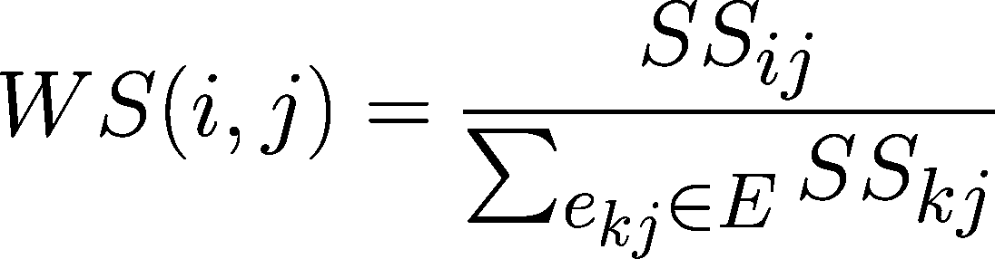
Inferring Criminal Accounts
Criminal account Inference Algorithm (CIA)
Malicious Relevance Graph, G = (V,E,W)
V: all accounts
E: all follow relationship, directed edge W: weight for each edge, WS(i,j)

Slide 32
Inferring Criminal Accounts
Evaluation of CIA
Dataset I: around half million accounts from previous study
Dataset II: another new crawled 30,000 accounts by starting from 10 newly identified criminal accounts and using BFS strategy

Slide 33
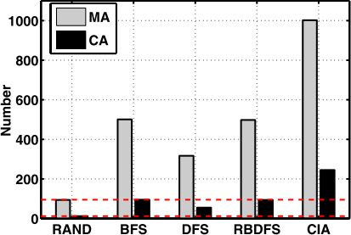
Inferring Criminal Accounts
Evaluation of CIA
Dataset I
CA: Criminal Account
MA: Malicious Affected Account
Selection Strategies
100 seeds, select 4,000 accounts

Slide 34
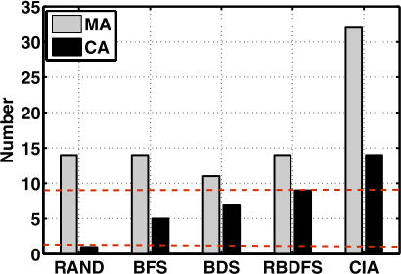
Inferring Criminal Accounts
Evaluation of CIA
Dataset II
CA: Criminal Account
MA: Malicious Affected Account
Seed Type
10 seeds, select 4,000 accounts

Slide 35
Limitations
Data set may have bias
The number of criminal accounts analyzed are a lower bound of the actual criminal accounts
There may be other types of accounts supporting criminal accounts

Slide 36
Conclusion
Emperical study of cyber criminal ecosystem on Twitter
Analysis of inner an outer relationships of criminal accounts
Effective algorithms to catch criminal accounts
The design is composable for accounts generating fake news, fake likes, and forming collusion networks

Slide 37
Thank You

