Slide 1


REVIVE: Rebalancing Off Blockchain Payment Networks
Published in ACM CCS 2017
Authors:
Rami Khalil and Arthur Gervais
ETH Zurich, Switzerland
Presented By:
Muhammad Saad

Slide 2
Outline
Introduction
Payment Channels and Payment Networks
Design and Operations
Existing Payment Channels
Ledger Rebalancing Scheme
System Model
Rebalancing Protocol
Optimality
Atomic Enforceablity
Security Analysis
Threat Model
Guarantees for Honest Parties
Privacy

Slide 3
Outline
Usability
Context
Scaling and Cost
Implementation
Simulation Cases
Model Solution
Conclusion and Discussion

Slide 4
Introduction
Payment Channels
Peer-to-peer off-chain transactions
Two party ledger
Address throughput limitations of major Blockchain applications
Limitations
No refunding on channels after closure
Expensive on-chain transactions
Payment Networks
Group of payment channels
Transactions can be routed through different channels
Constant re-use of channels introduces skewness

Slide 5
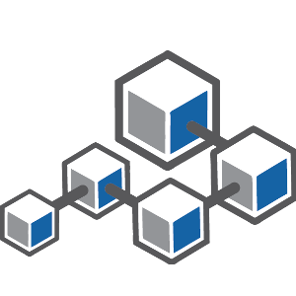




Payment Channels
Blockchain Application
Bob
Coffee Shop

Slide 6
Payment Channels (cont)
Blockchain Application
Bob
Coffee Shop

Slide 7


Payment Channels (cont)
Contract
Payment Channel
Bob
Coffee Shop

Slide 8


Payment Network
Alice
Charlie
Bob
Coffee Shop

Slide 9
Existing Payment Networks
Duplex Micropayment Channel
Time lock functionality of Bitcoin (BIP 68)
Supports routed payments
Lightning
Off-chain Bitcoin payments
Uses punishment to ensure transparency
Raiden
Similar to Lightning
For Ethereum Blockchain
Sprites
Similar to Raiden
Reduces worst-case collateral cost

Slide 10
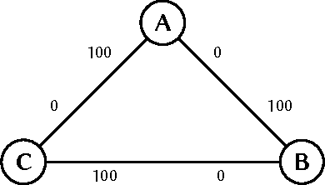
Ledger Rebalancing Scheme (cont)
Skewed Network
Over time, use of payment routes introduces skewness
Limits the capability of bi-directional payments
System Model
Blockchain as root of trust
Smart contracts execution environment
Off-chain payment network pegged to the on-chain smart contract.
Sum of two off-chain balances can not exceed on-chain balance

Slide 11
Ledger Rebalancing Scheme (cont)
Skewed Network
Over time, use of payment routes introduces skewness
Limits the capability of bi-directional payments
System Model
Blockchain as root of trust
Smart contracts execution environment
Off-chain payment network pegged to the on-chain smart contract.
Sum of two off-chain balances can not exceed on-chain balance
50
50
50
50
50
50

Slide 12
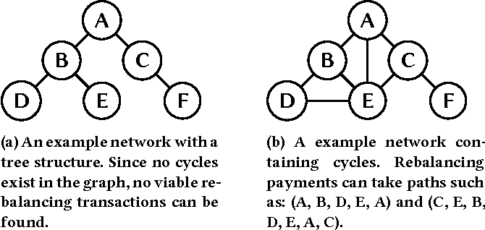
Ledger Rebalancing Scheme (cont)
Payment Network Topology
Each channel owner expected to make outgoing payment
Compensated by incoming payment
Users can be modeled as nodes
Payment channels as edges
No reblancing in a graph with no cycles
Adaptability
Rebalancing algorithm independent from enforcement mechanism
REVIVE is adaptable to any Blockchain application

Slide 13
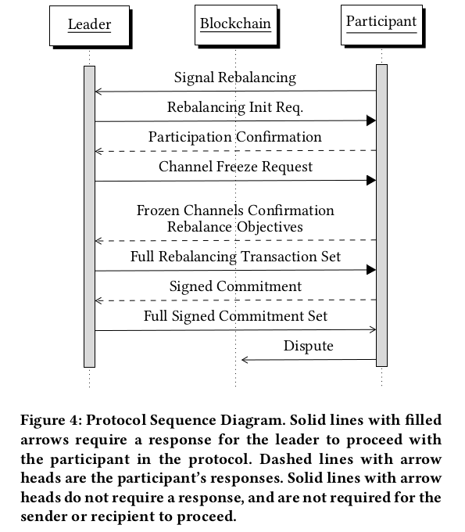
Rebalancing Protocol
Leader Election
Point of synchronization
Calculate rebalancing transactions
Leadership rotation
Protocol Sequence
Triggering
Participation
Transaction set generation
Consensus
Dispute

Slide 14
Rebalancing Objectives
Notations
Maximum balance shift between nodes u and v
Balance that node u will gain from v
Linear Programming Model
Maximize the amount of funds moved between channels
Total balance is conserved at the end
Rebalancing objectives are met
Keep losses negligible
Maintain fairness

Slide 15
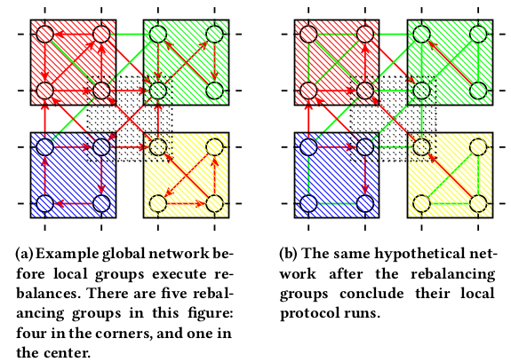
Optimality and Enforceability
Optimality
The objective is to minimize skewness in payment channels
Instead of global rebalancing scheme, run local schemes at sub-networks
More effective until a high degree of global coordination is achieved
In such a case, REVIVE will make a trade-off in optimality
Atomic Enforceability
Before on-chain execution, latest agreed-upon balances of all peers must be broadcast to the network
Once a participant commits for a round, it authorizes enforcement
If outgoing funds are enforceable, incoming funds must follow
On-chain state update is costly. Can be solved with collaborative pre-broadcasting

Slide 16
Security Analysis
Objectives
Honest participants are not cheated
Disputes resolved locally to avoid on-chain cost
Threat Model
Adversary can be leader or participant
Willing to lose some or all his funds
Can abort prematurely

Slide 17
Guarantees for Honest Parties
Balance Conservation
Set of transactions is sent to every participant to commit
Participants can verify conservation of funds
All the transaction amounts related to a channel must sum to zero
Participants can avoid being part of dishonest transactions
Objective Satisfiability
A malicious leader can manipulate balances to cause unfairness
The manipulation might favor some peers
Can be solved by leader committing to randomness seed prior to requesting channel balance information
Participants can use the same seed and solve the linear program to verify objective function

Slide 18
Guarantees for Honest Parties (cont)
Delayed Propagation Immunity
The adversary can withhold fully signed commitment from peers
Denial-of-service attack
Can be solved by issuing on-chain availability challenge
If challenge is not responded within time, rebalancing aborted
Privacy
Leader knows balance of every peer
Public broadcast of state of each channel
REVIVE provides no privacy guarantees
One proposed improvement can be a transaction set that reveals the balance changes rather than total balance

Slide 19
Usability
Context
REVIVE be employed in trust-worthy settings
Despite its guarantees, it is vulnerable to malfunctioning
Scaling
As more users join, more disputes might occur
On-chain dispute resolving costs money
Ethereum has gas limit per block
On Ethereum, REVIVE can be executed with 300 participants
Authors recommend the estimation of on-chain cost of verification before entering a reblanacing scheme
Solution for linear programs take time as complexity increases
REVIVE is optimal for upto 1000 channels

Slide 20
Simulation Cases
Proof of Concept Implementation
Test Blockchain network and some participants
Modified Sprites payment channel
Three participants in simulation
Two test cases
On-Chain Update
REVIVE produced valid rebalancing signed by everyone
No participant signed transactions relevant to their channel
Resorted to on-chain verification
The test case highlighted the need for off-chain collaboration
Availability Challenge
Full signature set is made available to one participant
The other issues on-chain challenge
The test case highlighted that honest parties are incentivized to answer challenge

Slide 21
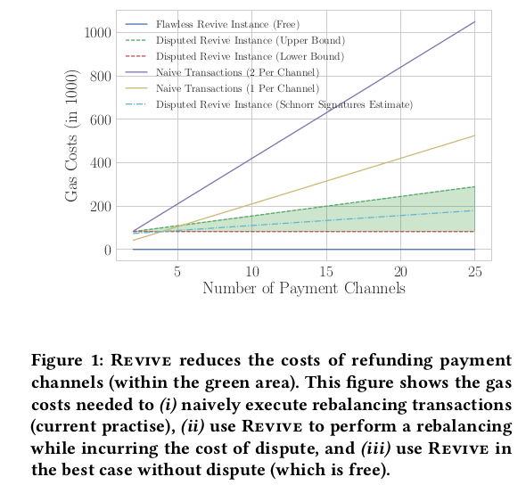
Simulation Cases (cont)

Slide 22
Conclusion and Discussion
Payment networks address scalability challenges of Blockchains
Their major caveat is skewness
REVIVE addresses that by rebalancing payment networks
REVIVE uses linear programming to find optimal solution for rebalancing
Minimizes the on-chain transactions
Best suited for trustworthy systems
Limitations include scalability challenges, privacy leaks, restricted network design, and disputes

Slide 23
Thank You

