Slide 1
Unified Authentication using blockchain based Software Defined Networks
Prabhat Verma 21116071
Dept. of Electronics and Communications Engineering
Supervised by :
Prof. Sandeep Kumar Singh Dept. of Electronics and Communications Engineering
IIT Roorkee
Noble Mittal 21116066
Dept. of Electronics and Communications Engineering

Slide 2
Outline
Motivation
Primitive Architecture
Disadvantages of Primitive Architecture
What do we mean by SDN and blockchain?
Block-SDN Architecture
Workflow
Advantages of Block-SDN architecture
Future Scope of Work
Demonstration
References

Slide 3
Motivation
Every month, there are, on average, 5,200 cyber-attacks on IoT devices.
47% of hacked at-home devices are cameras.
On average, IoT devices can be hacked in just 5 minutes.
Unpatchable vulnerability in Apple chips leaks secret encryption keys
Reference : https://thrivemyway.com/hacking-statistics/

Slide 4
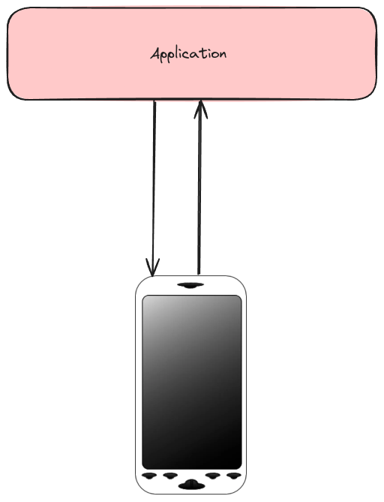
Primitive Architecture
The data packets are being sent from application layer to the authenticating device directly with credentials
The authentication algorithm is directly hardcoded in the device itself with associated hardware

Slide 5
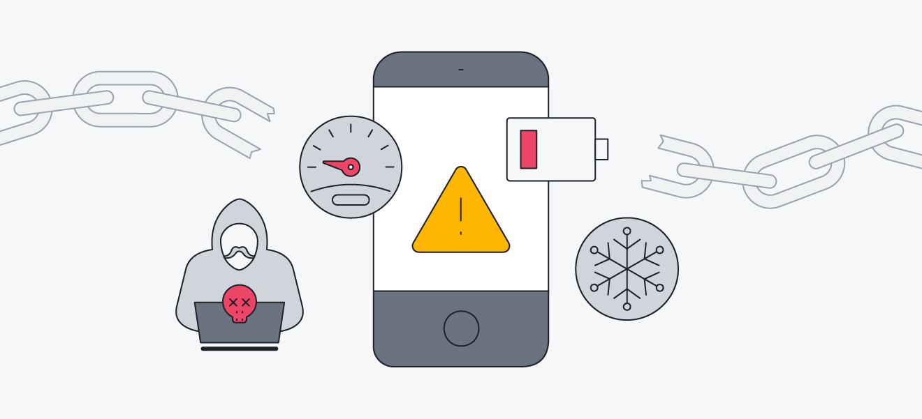
Disadvantages of Primitive Architecture
Authentication is done using inbuilt hardware in device therefore increasing the cost of device.
Its easy to jailbreak the authentication system in the primitive architecture due to potential vulnerabilities in the device.
It’s less scalable due to hardware hardcoding.
Notes:
Authentication is done using inbuilt hardware in device therefore increasing the cost of device.
Its easy to jailbreak the authentication system in the primitive architecture due to potential vulnerabilities in the device
Every device of a particular kind has its own authentication mechanism and this requires a change in Application layer inputs , so we require different Applications for different devices.

Slide 6
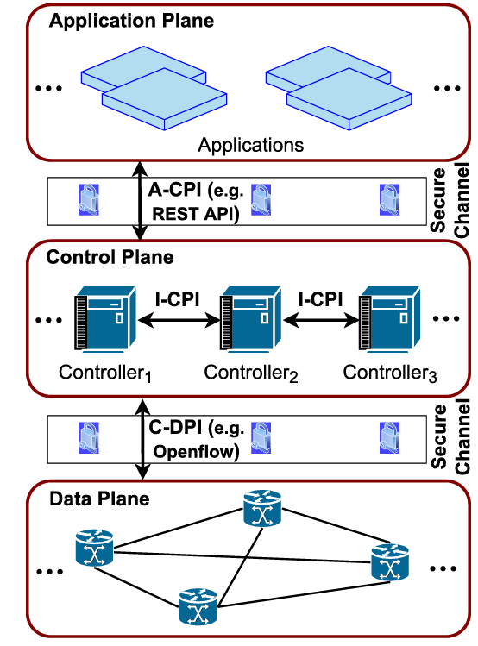
Software Defined Networks
It is an approach to networking that uses software-based controllers or application programming interfaces (APIs) to communicate with underlying hardware infrastructure and direct traffic on a network.
Consists of 3 layers.
Network administrators can dynamically manage traffic flow, optimize resource utilization, and implement policies across the network. So, SDN enhances flexibility.
Notes:
2. Separates the control plane from the data plane in network devices, allowing increased control and programmability.

Slide 7
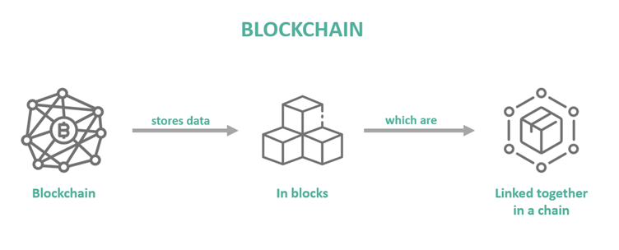
Blockchain
a distributed ledger technology that records transactions across multiple computers in a tamper-resistant and transparent manner.
Each block in the blockchain contains a cryptographic hash of the previous block, creating a chain of blocks that ensures the integrity of the data.
Consensus algorithms like Proof of Work or Proof of Stake are used to validate and add new blocks to the chain, ensuring agreement among network participants
enables decentralized and trustless transactions, eliminating the need for intermediaries and providing immutability, security, and transparency

Slide 8
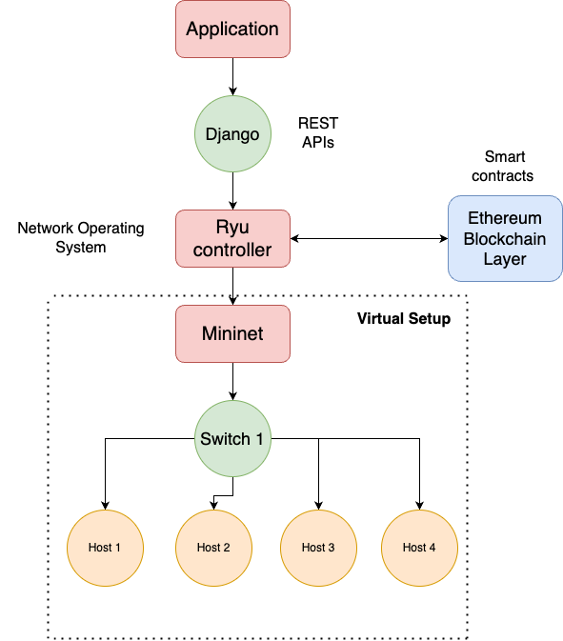
Block-SDN architecture

Slide 9
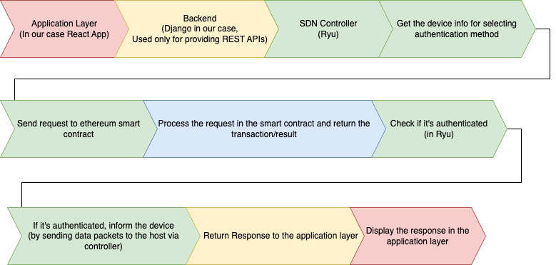
Block-SDN workflow

Slide 10
Advantages of Block-SDN Architecture
Authentication mechanism has been moved to blockchain ledger which provides more security compared to traditional architecture.
This eases the hardware load on the devices since now authentication hardware is not required
Since the NOS handles the different mechanism for different device authentication mechanism , single application is enough to authenticate the devices.

Slide 11
Future Scope of Work
The initial authentication setup process for a new device takes a long time because of the block confirmation and this increases the time in comparison with the traditional architecture
Even after the device has been authenticated , the data packets have to go through NOS which increases the latency of the data transmission in comparison to traditional architecture.

Slide 12
Demonstration
The whole codebase is available at: https://github.com/beingnoble03/block-sdn
It’s demo time!

Slide 13
References
A Promising Integration of SDN and Blockchain for IoT Networks: A Survey
Authentication-Chains: Blockchain-Inspired Lightweight Authentication Protocol for IoT Networks

Slide 14
Thanks
Notes:
– The OpenFlow switch is an OpenFlow-enabled switch. OpenFlow refers to an open communication protocol which allows the control plane to disconnect and interact with the forwarding plane of multiple devices from a central point.

