Slide 1
Unified Authentication using blockchain based Software Defined Networks
Prabhat Verma 21116071 ECE
Noble Mittal 21116066 ECE

Slide 2
Outline
Primitive Architecture
Disadvantages of Primitive Architecture
Block-SDN Architecture
Advantages of Block-SDN architecture
Future Scope of Work
References

Slide 3
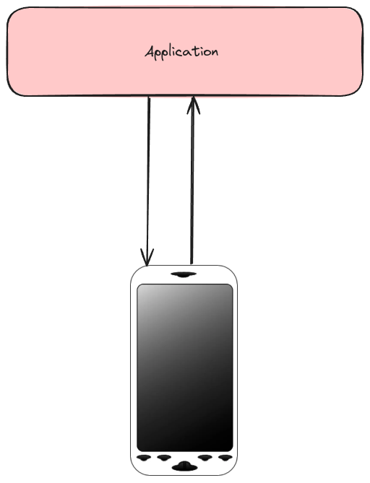
Primitive Architecture

Slide 4
Disadvantages of Primitive Architecture
Authentication is done using inbuilt hardware in device therefore increasing the cost of device .
Its easy to jailbreak the authentication system in the primitive architecture due to potential vulnerabilities in the device
Every device of a particular kind has its own authentication mechanism and this requires a change in Application layer inputs , so we require different Applications for different devices.

Slide 5
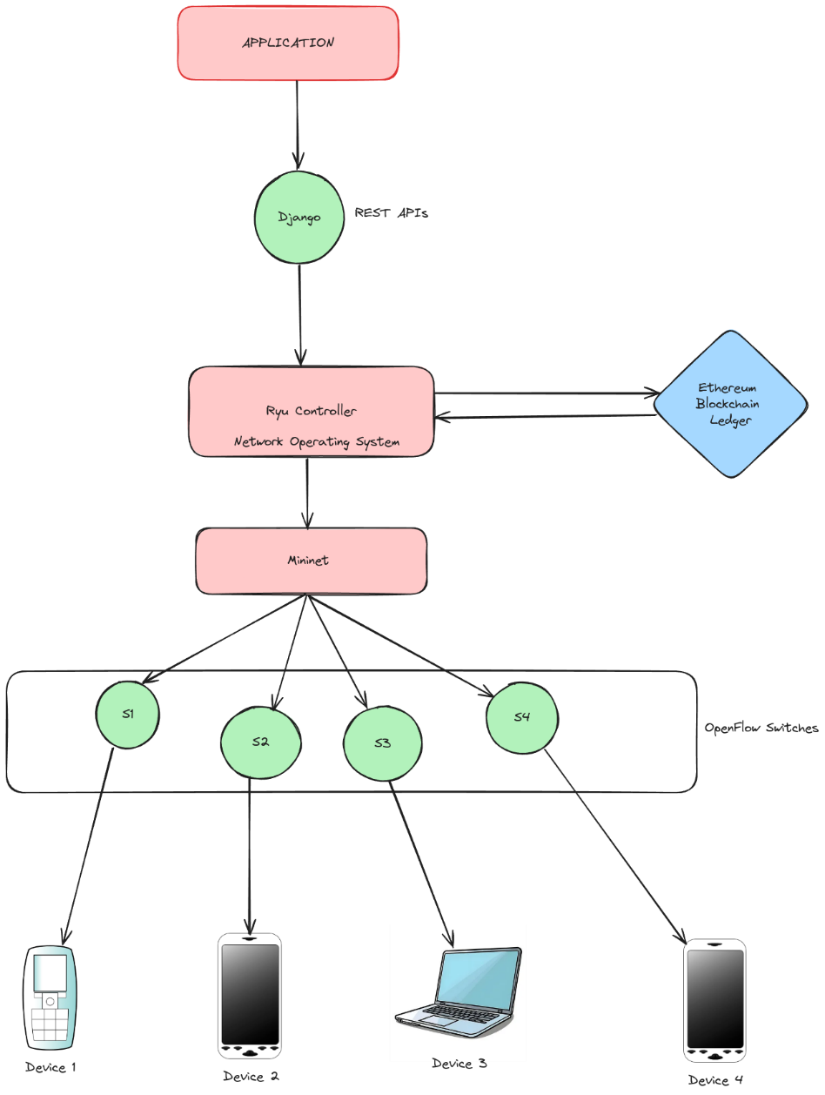
Block-SDN architecture

Slide 6
Advantages of Block-SDN Architecture
Authentication mechanism has been moved to blockchain ledger which provides more security compared to traditional architecture.
This eases the hardware load on the devices since now authentication hardware is not required
Since the NOS handles the different mechanism for different device authentication mechanism , single application is enough to authenticate the devices.

Slide 7
Future Scope of Work
The initial authentication setup process for a new device takes a long time because of the block confirmation and this increases the time in comparison with the traditional architecture
Even after the device has been authenticated , the data packets have to go through NOS which increases the latency of the data transmission in comparison to traditional architecture.

Slide 8
References
A Promising Integration of SDN and Blockchain for IoT Networks: A Survey

