Slide 1
ANALYSIS OF driving factors behind loan default
Pranav Pandey & Rakesh Rangadal

Slide 2
AGENDA
Objective
Background
Key Findings
Techniques Used

Slide 3
Objectives
Able to identify the risky loan applicants, thus helping the institute in cutting down the amount of credit loss.
Finding the driving factors (or driver variables) behind loan default, i.e. the variables which are strong indicators of default. The company can utilize this knowledge for its portfolio and risk assessment.

Slide 4
Key Finds :-
We have found that the loan distribution is mostly concentrated to “dept_Consolidation”. So, diversification is needed to reduce the risk of loan default specific to one category
Applicant who are living on rent or mortgage are more likely to default on loan
Customer who has annual income less equal to 10 lakhs are more likely to default.
Like above conclusion person with more experience are less likely to default as they earn more. This also can indicate the customer who recently have started working are taking loan to full fill their needs without consideration their income.
Mostly of the loans are taken for amount less than 20k to 25k

Slide 5
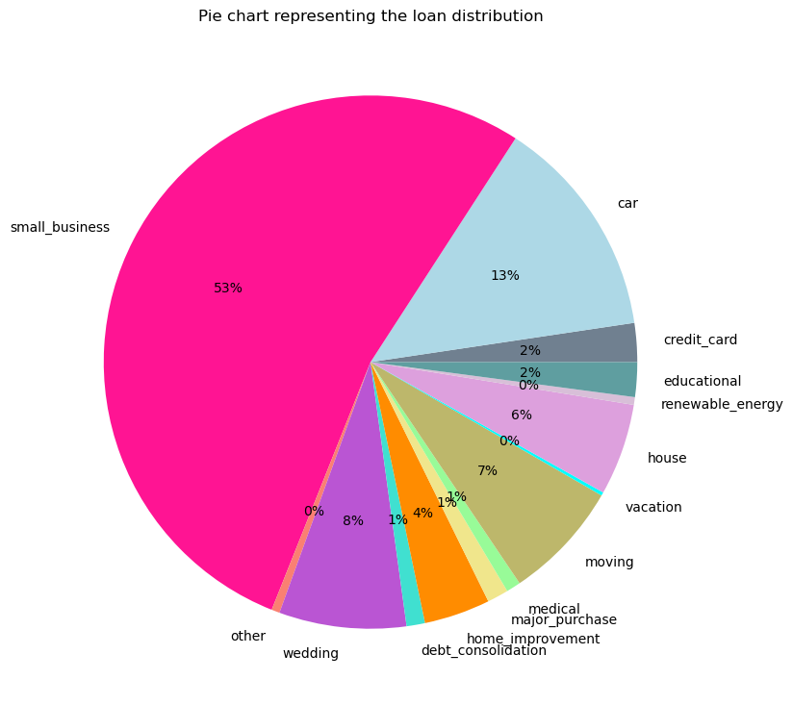
Techniques used
Here we can see that the loan distribution sum amount is mostly concentrated to small business category. Diversification of loan reduces the loan default risk

Slide 6
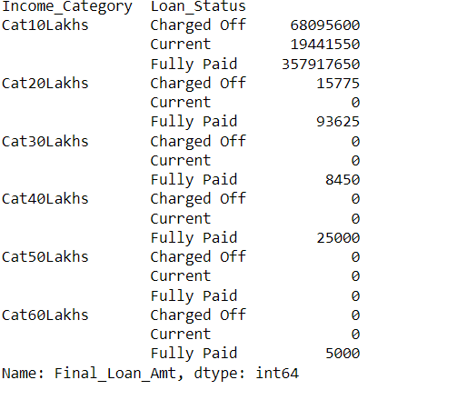
Here you can see that people whose income is near about 10 lakhs are more likely to default

Slide 7
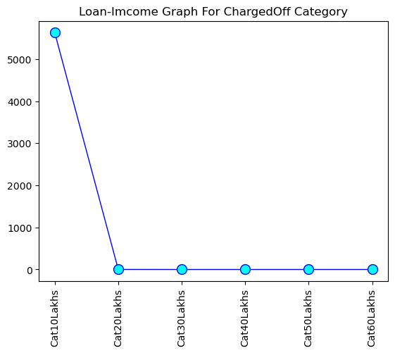
Here you can see that defaulter are mostly people whose income is under or near about 10 lakhs per year

Slide 8
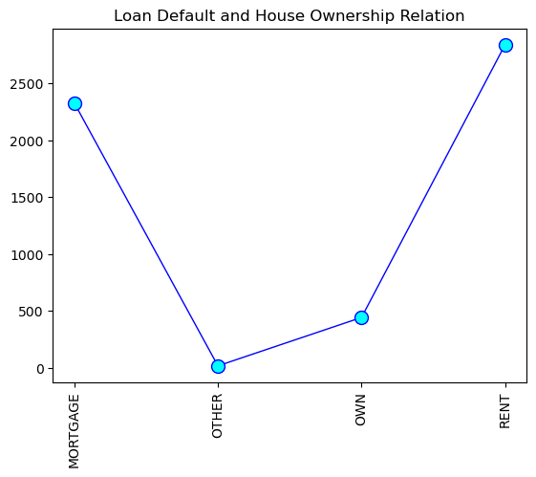
Applicant who lives on rent or has mortgage are more like to default on there loan

Slide 9
THANK YOU

