Slide 1

DATABASE PROJECT REPORT
on
College Management System
By
Abhishek Kumar (23MCA1074)
Prince Kant (23MCA1063)

Slide 2
College Management System
(Desktop Based Application)

Slide 3
Introduction
A college management system is a desktop based application designed to manage various aspects of a college's operations and administrative tasks.
With this system, we can easily add new students and teachers to the database and keep track of their personal information, and academic records. It also provides a feature to update the details of existing students and teachers.
One of the key features of the system is the ability to quickly search and retrieve the details of any student or teacher, using search criteria.
Finally, the system allows us to generate and download PDF reports of various information, such as student and teacher details, fee reports, etc.

Slide 4
How it works
This project aims to provide a centralized and efficient platform for managing various operations in a college.
To access this college management system, users are required to login with their username and password.
Once logged in, users can access the main interface of the application which allows them to manage all college operations

Slide 5
Achievements
Efficient management:
This project provides a user-friendly interface that makes it easy for college staff to manage all college operations in one place, saving time and effort. It can help streamline administrative tasks and increase efficiency in managing college operations.
Data management:
This system helps in the effective management of data. It allows you to store, update, and retrieve data easily and quickly.

Slide 6
Centralized platform:
It provides a centralized platform for managing all college operations such as admissions, student and teacher details, attendance, exam marks, fees, and utility tools like a notepad, calculator, and web browser.
Security:
As the system has a login feature, it ensures the security of data and prevents unauthorized access.

Slide 7
Technologies Used
Language :
Java Core
Swing (Frontend): Swing is a Java-based graphical user interface (GUI) framework and widget toolkit that allows developers to create desktop applications with a graphical user interface. It provides a set of components and classes for building interactive and visually appealing applications.
IDE :
VS Code
CMD
Database :
SQL
PostgreSql (Backend): PostgreSQL is an open-source relational database management system (RDBMS) that provides several key features and benefits for handling the data storage and retrieval needs of your application.
Database Connectivity: JDBC Driver

Slide 8
Team Members
Abhishek Kumar(23MCA1074)
Database Design: He designs the database schema, including tables, relationships, and constraints. He defines how data is stored and organized, considering entities like students, faculty, courses, and so on.
Database Implementation: Write the code to create and manage the database using a database management system like PostgreSQL. This involves writing SQL queries for creating, reading, updating, and deleting data.
Database connectivity : Using JDBC, he connects the application with database
Prince Kant(23MCA1063)
User Interface Design: He is responsible for designing the user interface using Java Swing components. This includes creating the layout of the application, designing the screens, and ensuring a user-friendly and intuitive interface.
GUI Implementation: They write the code to implement the graphical user interface using Swing components. This involves creating windows, buttons, text fields, labels, and other UI elements.

Slide 9
Features of Project
New Information
New Teacher Details
New Student Admission
View Details
Teacher’s Details
Student’s Details
Apply Leave
Student Leave
Teacher Leave
Leave Details
Student’s Leave Details
Teacher’s Leave Details
Exam
Enter Marks
Exam Result
Update Details
Faculty
Student
Fee Details
Fee Structure
Utility
Notepad
Calculator
Web Browser
Exit

Slide 10
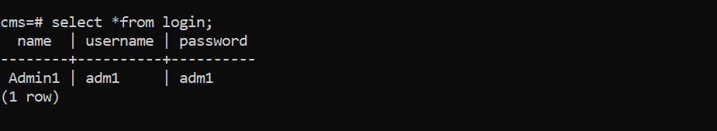
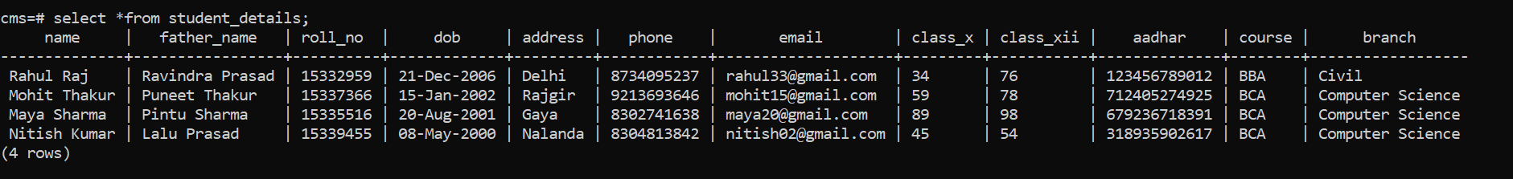
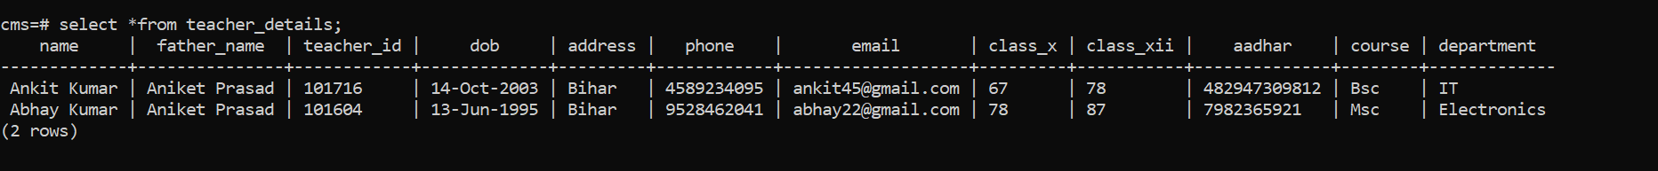
Tables that we have used in this Project
Login table:
Student_details table:
Teacher_details table:

Slide 11
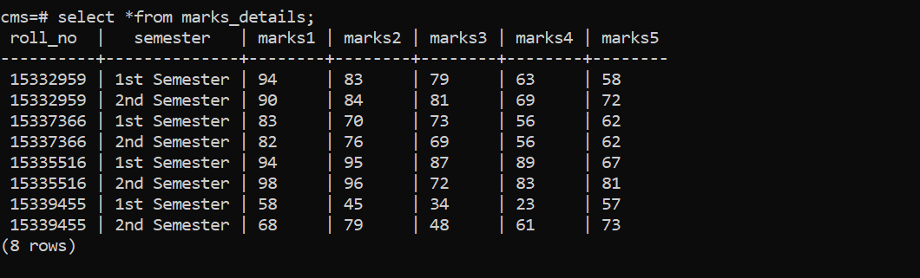
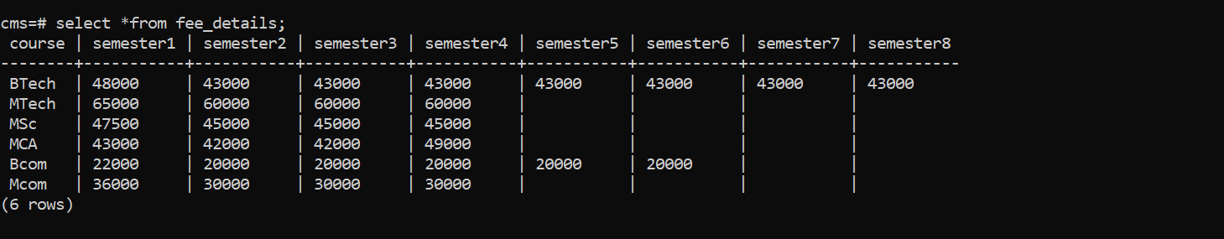
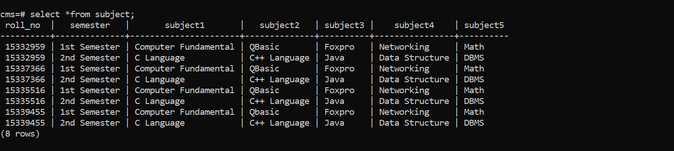
marks table:
Fee_details table:
Subject table:

Slide 12
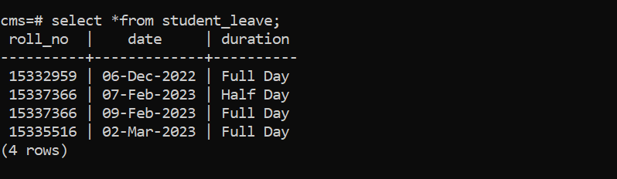
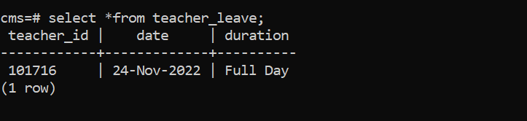
Student_leave table:
teacher_leave table:

Slide 13
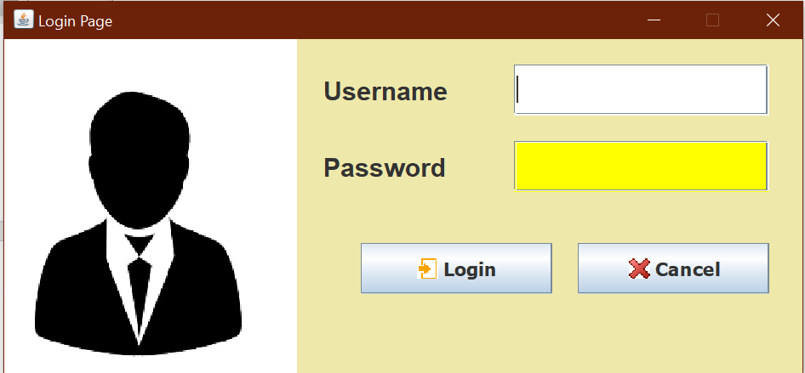

Slide 14
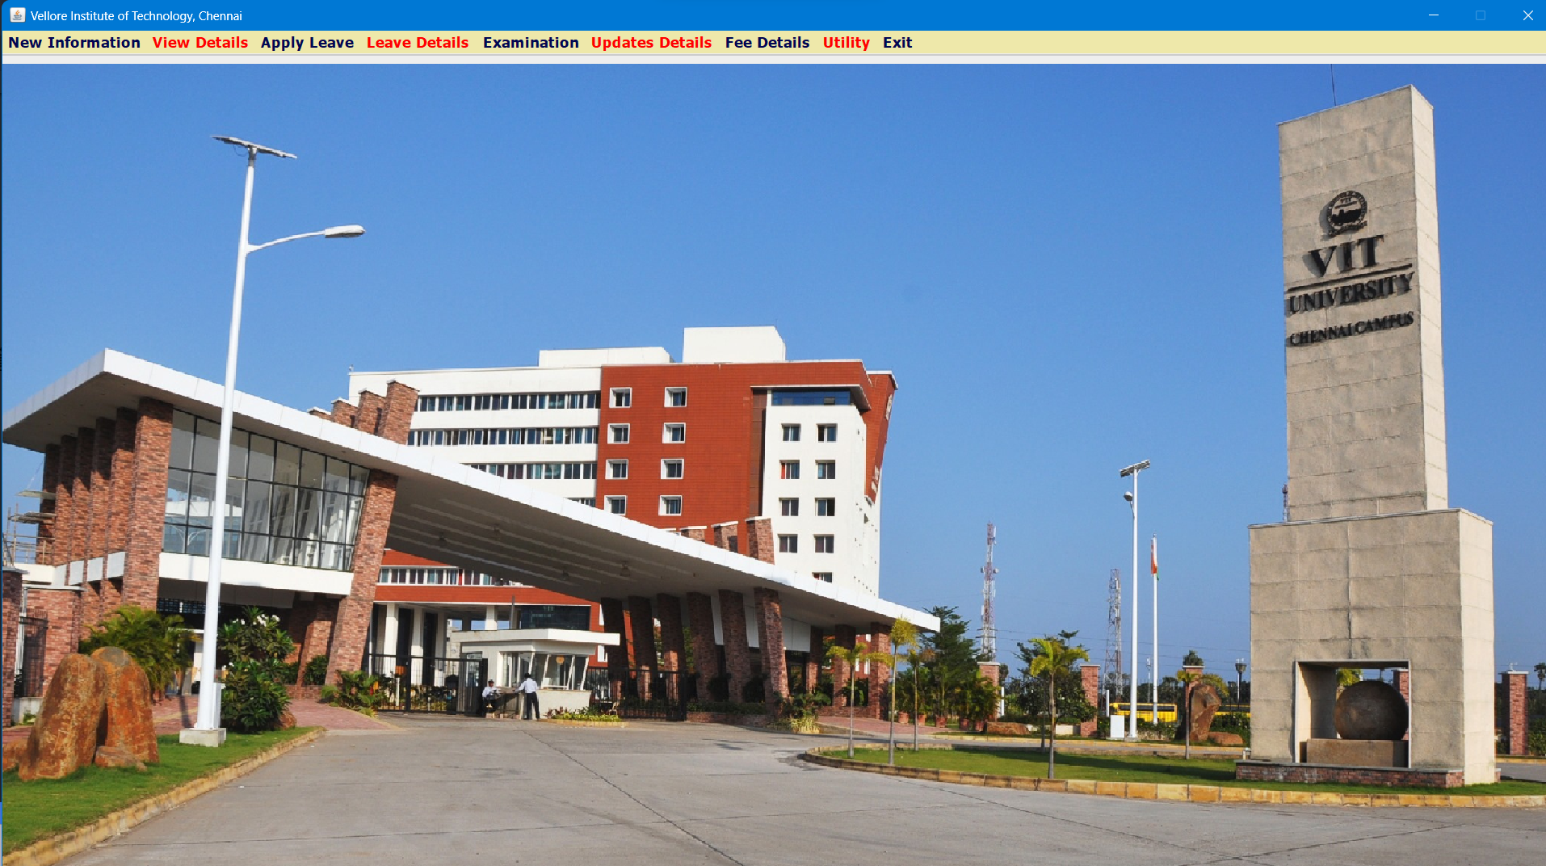

Slide 15
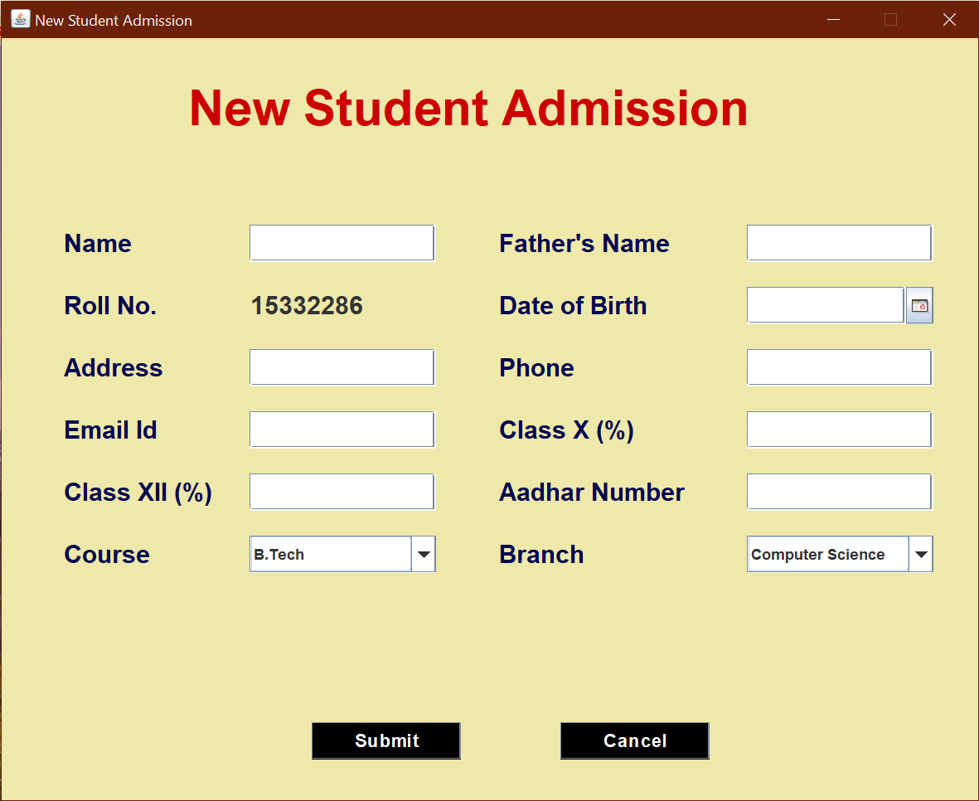

Slide 16
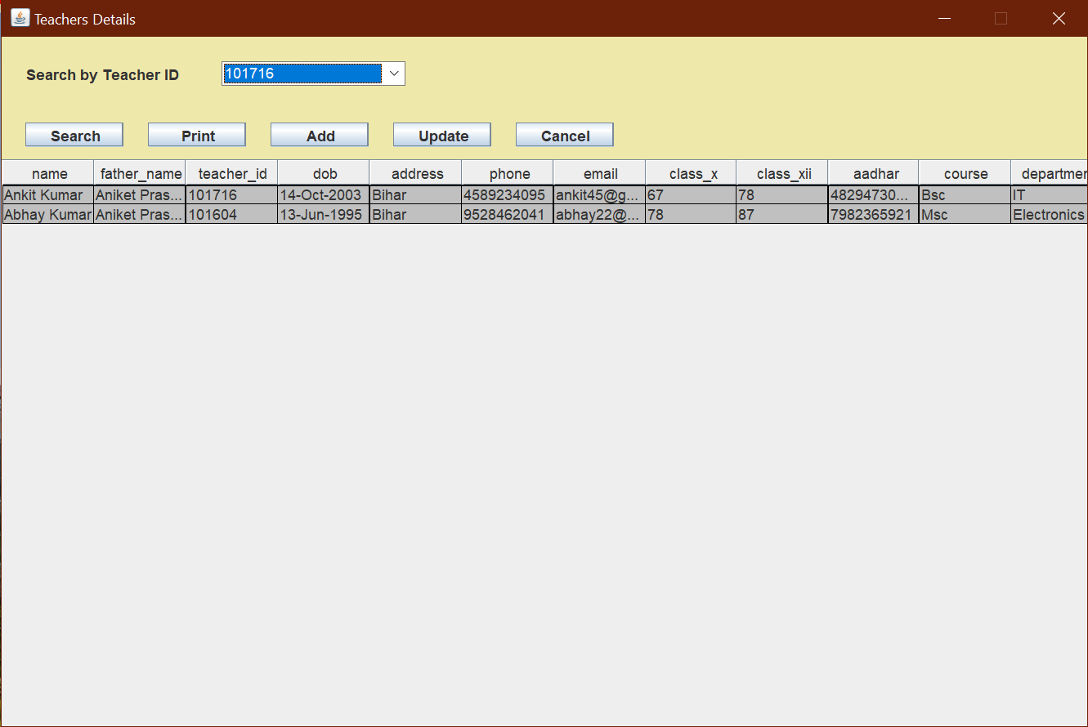

Slide 17
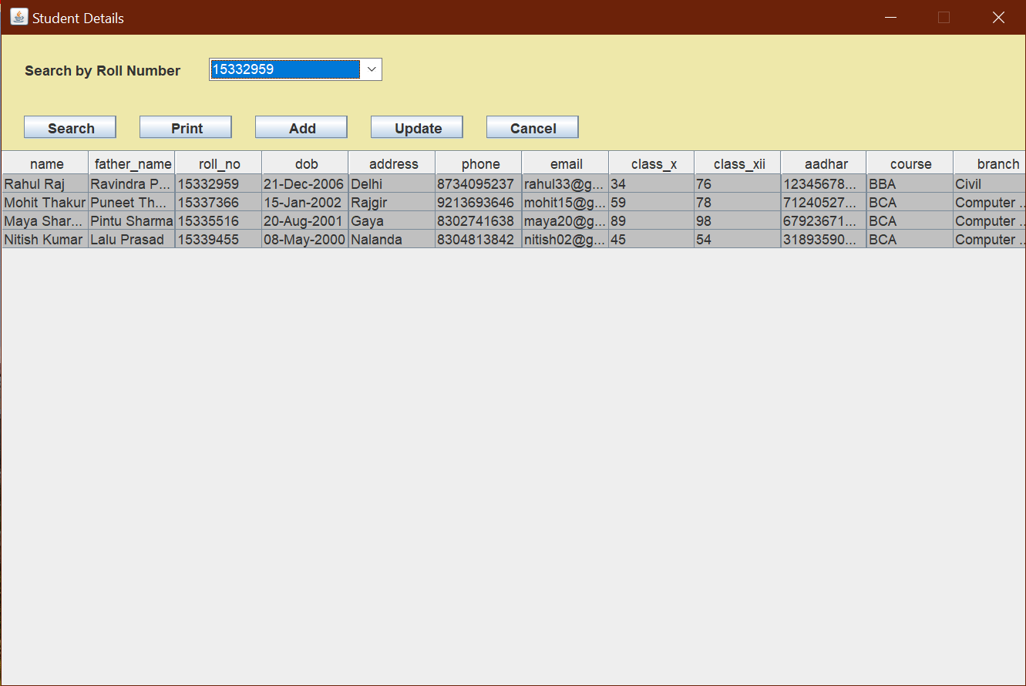

Slide 18
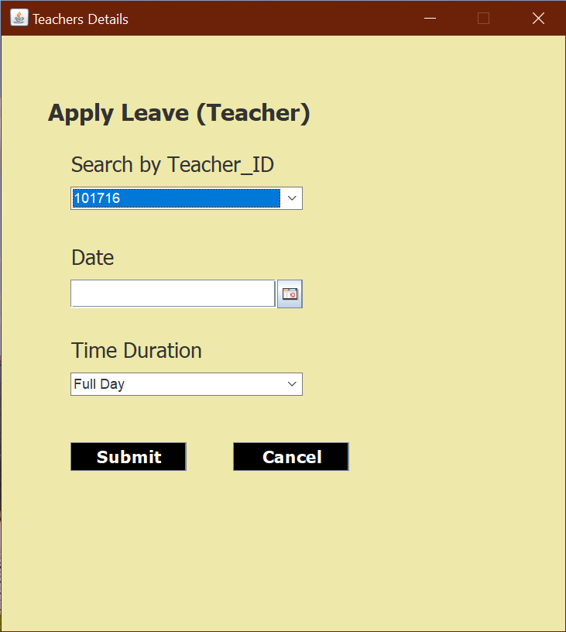
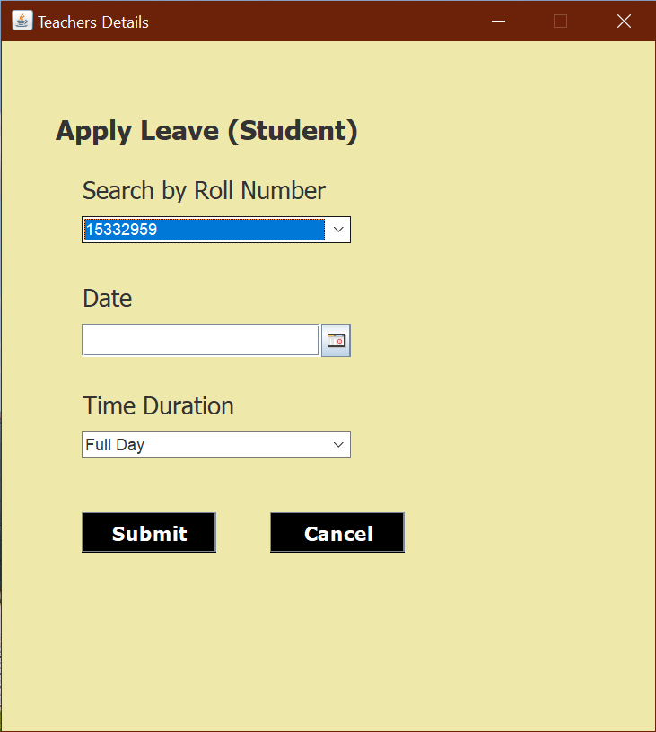

Slide 19
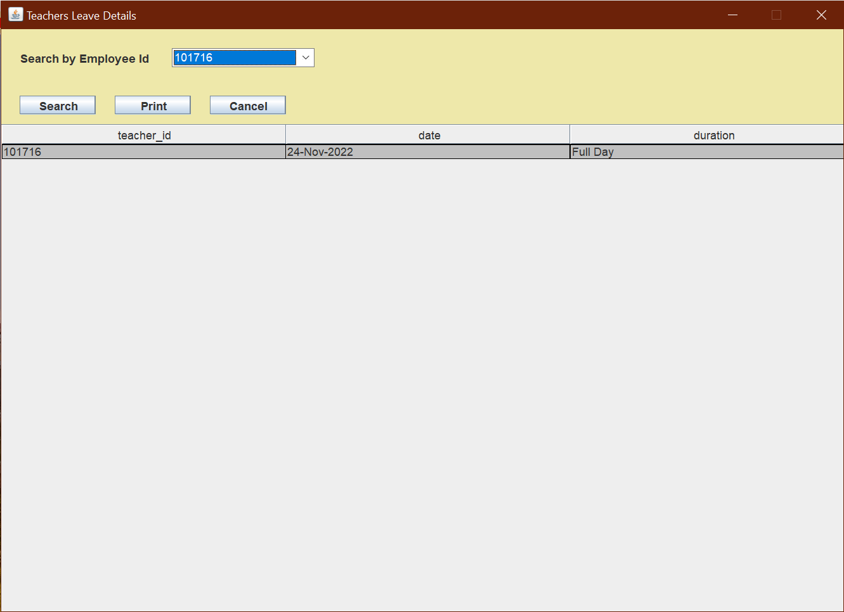

Slide 20
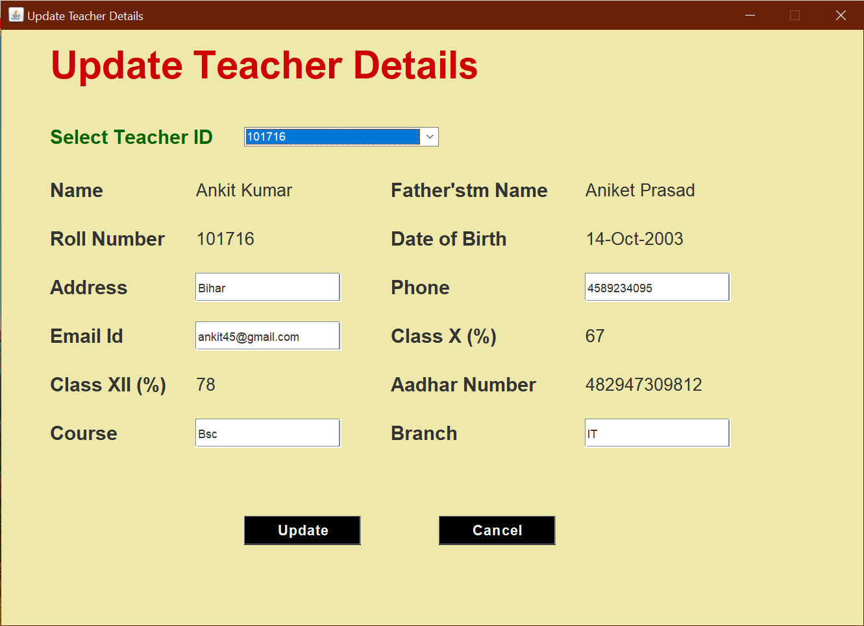

Slide 21
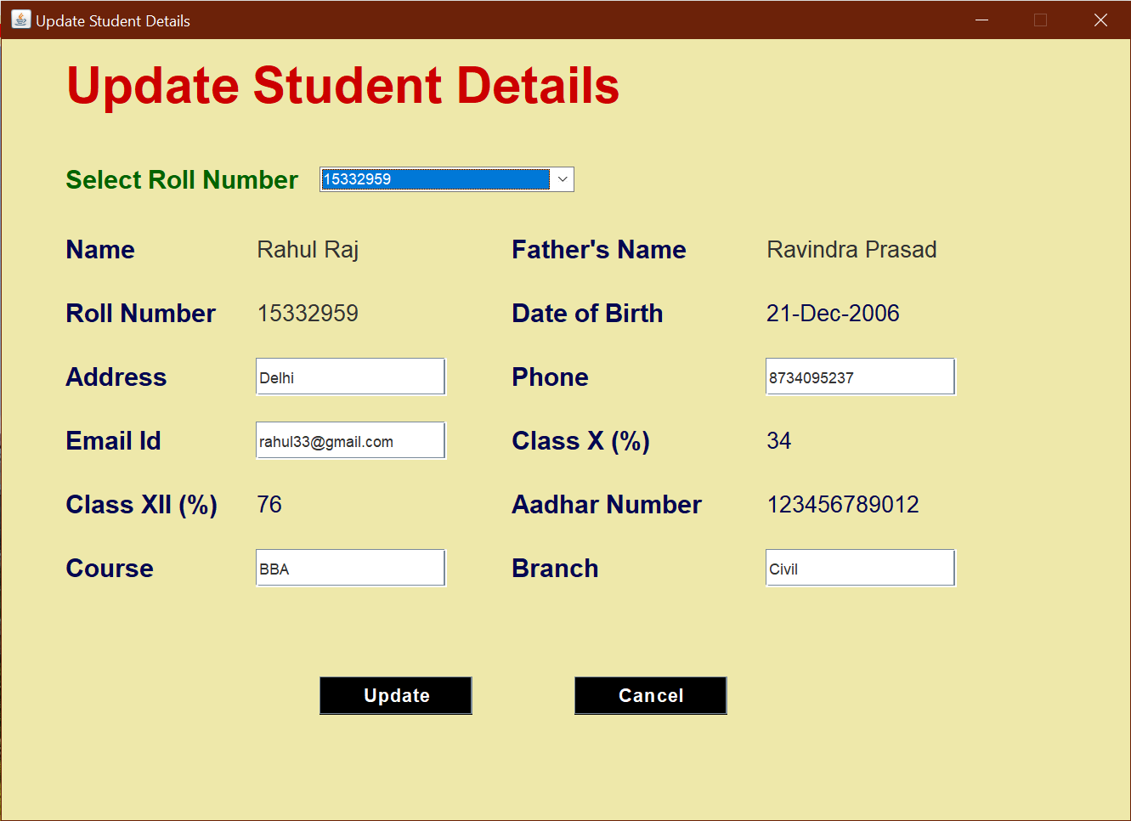

Slide 22
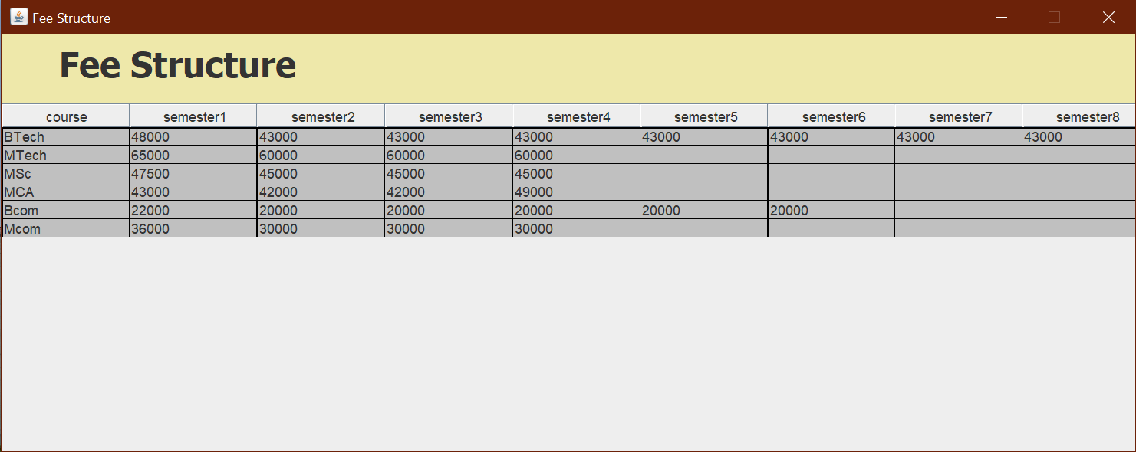

Slide 23
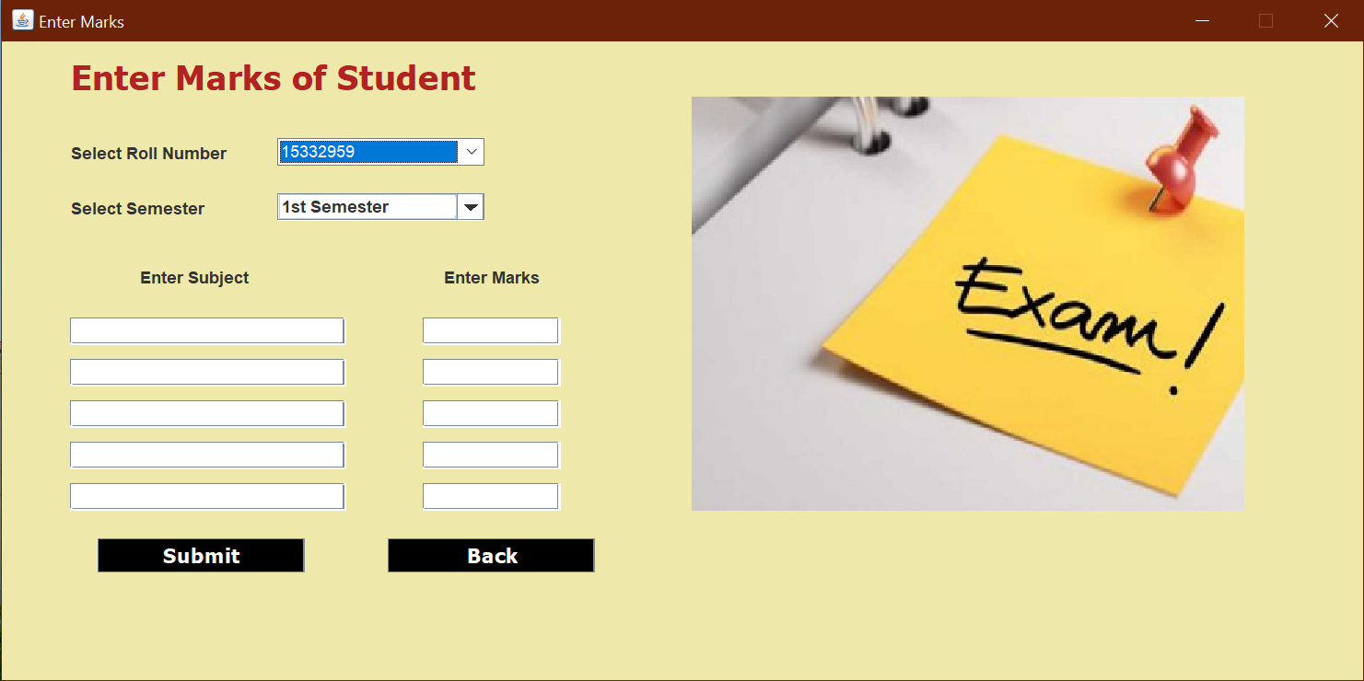

Slide 24
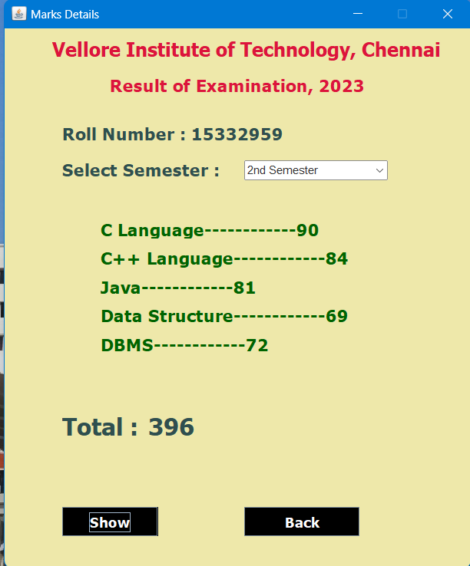

Slide 25
Thank You
Abhishek Kumar (23MCA1074)
Prince Kant (23MCA1063)

