Slide 1
Display Advertisement
KT Session
September 19, 2018

Slide 2
Agenda
Online Advertising Types
KPIs
Online Advertising Value Chain
Ad Serving
Revenue Generation by Ad Networks
Yield Management by Publishers
Rich Media Vendors
Ad Exchanges

Slide 3
Online Advertising Types
Online Advertising
Textual Advertising
Ads displayed in a text format with a link to Customer’s landing page
Content Based Advertising
Ads displayed based on the content displayed on a web page
Search Based Advertising
Ads displayed based upon keywords searched through an online search bar
Multimedia Rich Advertising
Interactive ads
Display Advertising
(Banner/Flash/Games/Pop-Ups)
Can be a double edged sword- Attractive or Distracting

Slide 4
Agenda
Online Advertising Types
KPIs
Online Advertising Value Chain
Ad Serving
Revenue Generation by Ad Networks
Yield Management by Publishers
Rich Media Vendors
Ad Exchanges

Slide 5
Basic Terminologies
Ad Impression: Single viewing of a single as by a single individual Ads/Page * (Page Impression)
Page Impression: Number of times an page is loaded in front of user
Frequency Capping: Techniques used by advertisers to ensure that ads are not seen repeatedly by same user
Volume: Specified areas of the web page which has the opportunity to display an impression of an ad
Unpaid Impressions: Comprises of Make Good Impression or Home Grown Impressions
Sell Through Rate: Paid Impression/Volume
Effective CPM(eCPM): Can be used to determine the average cost advertiser pays for the impression to be displayed on publisher. Allows the advertiser to evaluate which vertical might be outperforming other Can be used by publisher to determine the average revenue it generates for all the impression displayed

Slide 6
Key Performance Index
Cost Per Click (CPC)
Cost to be paid by advertiser whenever the impression is clicked
Revenue/Click
Cost Per Mille (CPM)
Revenue earned by publisher for displaying 1000 impressions
(Revenue/Impression) * 1000
Cost Per Acquisition/Action
Cost to be paid by an advertiser only when desired action is taken by the user
CPM is used for display ads, because the intent of the advertiser is just to spread brand awareness

Slide 7
Agenda
Online Advertising Types
KPIs
Online Advertising Value Chain
Ad Serving
Revenue Generation by Ad Networks
Yield Management by Publishers
Rich Media
Ad Exchanges

Slide 8
Online Advertising Value Chain
PUBLISHER
NETWORK
AGENCY
ADVERTISER
The one with the site or the mobile platform
Interested in maximizing revenues at minimum risks
Large publishers have their sales team who maintain direct relation with advertisers
Small publishers sell their ad inventory through Ad Network
Ad Networks are outsourced sales houses for publisher inventory
Sell inventory that the publisher can’t sell itself
Buy inventory cheaply and sell it on higher price
They create ads and then buy the media to display the ads
Media agency is one that buys media on behalf of its advertiser client
Target of large advertisers will likely be a mix of brand marketing and direct response marketing
Smaller online advertisers are focused on direct-response
Notes:
On the demand side of the value chain, there are advertisers, and their agencies
On the supply side of the value chain, there are publishes, and their networks

Slide 9
Agenda
Online Advertising Types
KPIs
Online Advertising Value Chain
Ad Serving
Revenue Generation by Ad Networks
Yield Management by Publishers
Rich Media Vendors
Ad Exchanges

Slide 10
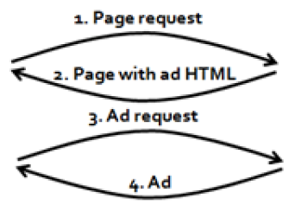


Ad Serving in Old Days
User
Publisher
Web Server
Notes:
Whenever the publisher wanted to change an ad, they had to make a change to their live website, which was time consuming and risky

Slide 11
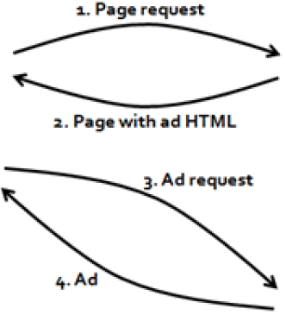
Publishing Ad Server
Publisher Web Server
User
Publisher Ad Server

Slide 12
Publishing Ad Server
Pros
Cons
The publisher ad server act as a repository for the ads
Saves time for loading an advertisement on the page
The publisher manage and predict their ad inventory, handle billing for advertisers, and target ads, ad rotation
Advertiser have to re-send those ads when they changed
Advertiser lacks the ability to track the performance of their ads across multiple publishers
Advertiser is completely dependent on the publisher for data on how many times their ads were served
They have no means of changing the delivery rules for a campaign

Slide 13
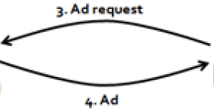
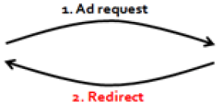
Advertiser Ad Server
Advertiser Ad
Server
Publisher Web Server
User

Slide 14
Advantages of Advertiser Ad Server
Implementation of rules like frequency capping, ad rotation, and targeting
Managing the actual ad creatives (the GIFs of Flash files)
Able to track number of times ads were served, the number of times they were clicked, and the number of conversions generated by those clicks.
They can plan and execute a campaign across multiple publishers easily
Eg: Microsoft/Atlas, Google/DoubleClick
Notes:
Content Delivery Network (CDN) is used by Advertiser Ad Servers which acts as repository for ad content and actually displays the ad

Slide 15
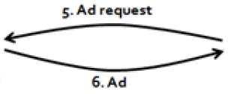
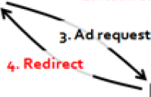
Network Ad Server
Advertiser Ad
Server
Publisher Web Server
User
Network Ad
Server
Notes:
Network Ad Server is used by large publishers used to drop cookie on the user’s machine and hence enable behavioral tracking & targeting

Slide 16
Agenda
Online Advertising Types
KPIs
Online Advertising Value Chain
Ad Serving
Revenue Generation by Ad Networks
Yield Management by Publishers
Rich Media Vendors
Ad Exchanges

Slide 17
Ad networks make money by a number of ways:
Simple arbitrage: The network buys from the publisher at low price and sells the inventory to advertisers at a slightly higher price Eg: Advertising.com, Google Adsense
Vertical aggregation: The network buys lots of small parcels of inventory in specific verticals. The advertiser is able to extend the reach of their campaign in a target audience Eg: Martha’s Circle
Price model arbitrage: The network buys inventory on a CPM (cost-per-thousand impressions) basis, providing the publishers with a nice, reliable revenue stream. But it sells the inventory on a CPC or CPA basis. The network makes money on the difference between the CPM it pays publishers and the eCPM it charges advertisers Eg: DRIVEpm
Platform specialization: Advertising on media platforms Eg: Videoegg
Behavioral targeting: The network buys inventory from publishers, and when the ad call is passed over to the network, it drops a third-party cookie Eg: Tacoda

Slide 18
Agenda
Online Advertising Types
KPIs
Online Advertising Value Chain
Ad Serving
Revenue Generation by Ad Networks
Yield Management by Publishers
Rich Media Vendors
Ad Exchanges

Slide 19
Yield Management: Refers to the practice of maximizing the average price received for inventory through a number of techniques
Packaging & Pricing: Publishers tend to cluster their pages or sites with respect to a particular vertical and try to match the criteria of the advertisers
Price Discrimination, Volume Discounts & Bundling: Depends on certain parameters such as time and volume. Publishers tend to reduce the risk by analyzing the Opportunity Cost
Frequency Capping: Technique used by advertisers to ensure that their ads are not seen over and over and over again by the same people
Guaranteed vs ‘Discretionary’ Inventory: Publishers are called upon to guarantee that advertisers' ads will be shown a certain number of times, to a certain number of users. Discretionary Inventory is often passed off to ad networks and sold on a auction/spot-price basis.
Retargeting: The case where the advertiser brings some of their own data to the table, particularly data to identify users who've had some kind of interaction with the advertiser in the past
Remnant Inventory & Spot Pricing: Passed off to an ad network where it is either sold for a pre-determined 'floor price’ or it is auctioned off in real-time
Notes:
For large advertisers, publishers can charge extra price for their inventory since they are meeting diverse criteria of their clients. Small advertisers although have to settle for the inventory that has not been sold to large advertisers and hence the pricing to these advertisers is also less comparatively
During auction process of Remnant Inventory, publishers look at the quality of ads being displayed and its relationship between publishers and advertisers

Slide 20
Agenda
Online Advertising Types
KPIs
Online Advertising Value Chain
Ad Serving
Revenue Generation by Ad Networks
Yield Management by Publishers
Rich Media Vendors
Ad Exchanges

Slide 21
Rich Media Vendors: to help advertisers & agencies get rich media ads onto publisher sites. Need interface b/w advertiser’s creative agencies and publishers
Functionality of RMVs:
Creating the actual ads themselves, will work with ad agencies to code the ads they need
Trafficking the ads, depends on the kind of the ad is being displayed For Video ads, advertisers should be able to transcode their video into the various required formats For Overlay ads, RMVs need to work with ad agencies and keep their technology requirement updated
Managing and serving the creatives themselves, and measuring delivery and response
RMVs end up acting as a kind of gateway to the publisher, ensuring that some kind of consistency and reliability is maintained

Slide 22
Agenda
Online Advertising Types
KPIs
Online Advertising Value Chain
Ad Serving
Revenue Generation by Ad Networks
Yield Management by Publishers
Rich Media
Ad Exchanges

Slide 23
Shortcomings of an Ad Network
Key challenge of an ad network is to maintain a balance between the supply(inventory bought from publisher) and demand(inventory sold to advertiser)
Each network has to maintain multiple bilateral arrangements with other networks, wasting time and technical resources
The more networks there are in the chain, the longer the ad takes to serve
Each network wants to take a cut of the cost of the inventory generating profit and margin problems for publisher
The publisher has very little or no control over the quality of the ad that ends up being displayed
Trafficking becomes an issue for the publisher as they are not able to record and maintain the tokens of ads being displayed

Slide 24
Ad Exchange: Acts as a central hub through which the networks can trade
Only two networks (plus the exchange) in this transaction
Exchange charges a flat transaction fee (this is essential to maintain the exchange’s impartiality – taking a cut would introduce bias)
Dramatically increases the range of ways in which businesses can participate in this market
Saves time and resources while generating and posting ads

