Slide 1
Coeus
Coeus is an innovative AI platform designed to capture, model, and replicate an individual's tacit knowledge—the intuitive, experience-driven insights that experts accumulate over years but rarely articulate explicitly. By observing real-time behaviors across diverse scenarios, from simple routine tasks to complex problem-solving, the system transforms these unspoken elements into structured, reusable digital assets. This addresses the critical loss of expertise when professionals retire or transition roles, preserving organizational wisdom in a scalable way. Aligned with Order Busters' focus on automating office workflows through AI agents, Coeus extends beyond rule-based RPA by infusing agents with human-like intuition, enabling autonomous handling of nuanced decisions in dynamic environments.

Slide 2

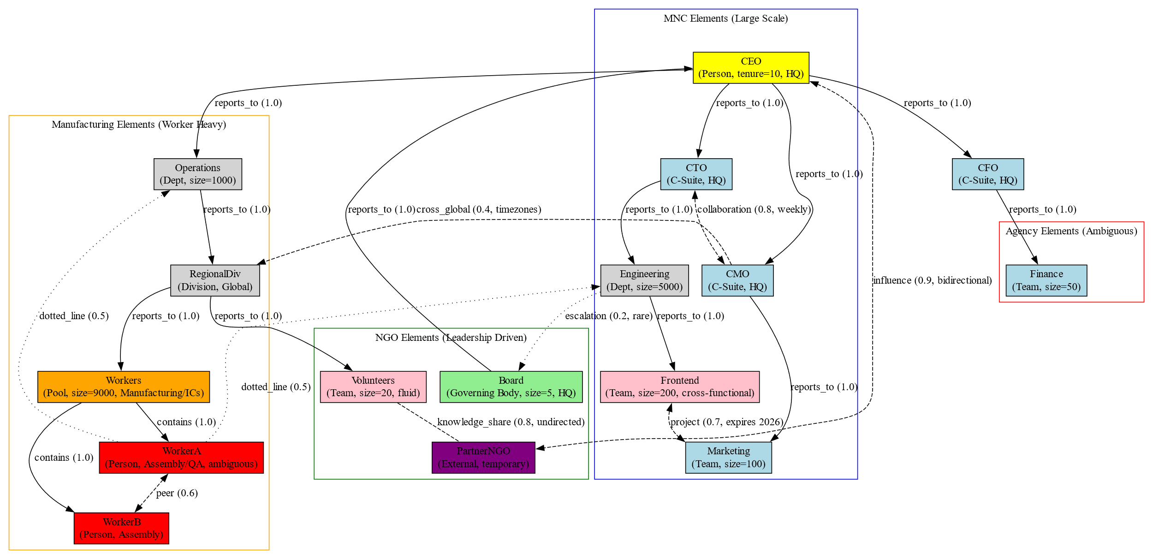

Slide 3
Project will be completed by the end of this oct, for updates see the repo!!
See the live working system archietecture here

