Slide 1

SPOOKYBAY
NAME-TEAM INVINCIBLES
SIDDHARTHA DHAR (RA2011003010081)
TUNMAY SHUKLA (RA2011003010271)
SASWAT SINGH (RA2011003010219)

Slide 2
DESCRIPTION:
Halloween is a holiday celebrated each year on October 31, and Halloween 2023 will occur on Tuesday, October 31. The tradition originated with the ancient Celtic festival of Samhain, when people would light bonfires and wear costumes to ward off ghosts.
The celebration marks the day before the Western Christian feast of All Saints and initiates the season of All hallowtide, which lasts three days and concludes with All Souls' Day.

Slide 3
INTRODUCTION:
SPOOKYBAY
One stop for everything that says HALLOWEEN.
Halloween one of the most anticipated fesival that is particularly famous in the Western countries.
Spookybay is an attempt to create an e-commerce website of all the Halloween themed items to make it a memorable day for all the generations.
Items such as ghost masks,candies,scarecrow and many fascinating things are awaiting for you to explore over here.
We also have in store the top 3 scariest ghost models for you. Stay tuned!

Slide 4
Problem statement:
Decentralised market-The halloween market in India is very decentralized, customers cant find quality with small sellers and the full operations is in the hands of wholesalers and small time businessmen.
Spooky Bay aims towards providing a centralized market place for everything related to Halloween which will help in turning up the profits.
Providing customers with quality - Spooky Bay aims towards providing customers with good quality products for their satisfaction.
One stop for all the Halloween needs - Customers wont have to roam around for buying the products that are required for this megacelebration.
Providing information to sellers - Spooky bay also keeps track of what's selling best and what's already out of fashion.
Our aim with Spooky Bay is to centralise the Halloween market in India which was estamated to be around 200k dollars, which includes Candies, candles , decorations and pumpkins

Slide 5
TECHNOLOGIES USED:
1.HTML,CSS
2.JAVASCRIPT
3.BOOTSTRAP
4. KAGGLE
5. SWIPERJS
6. BACKEND- NODEJS

Slide 6
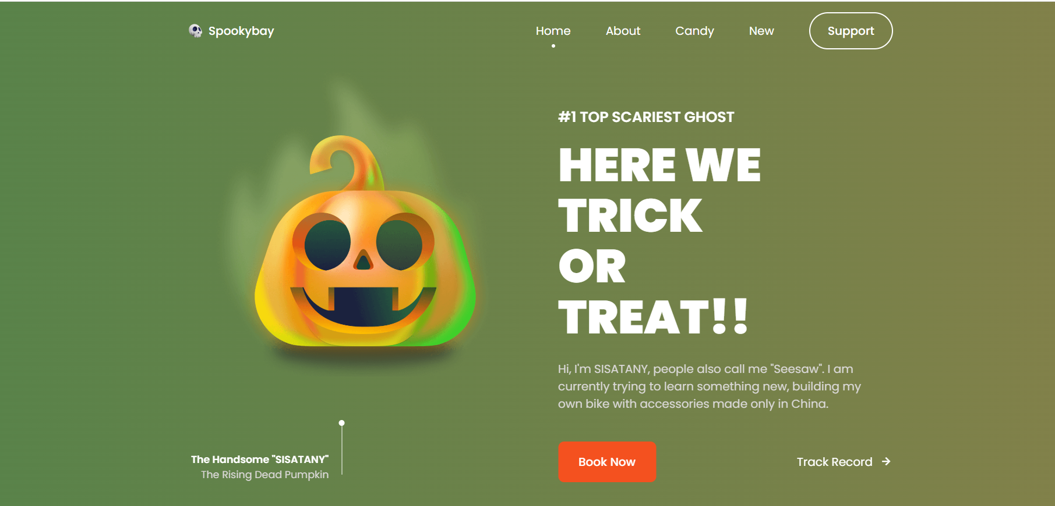

Slide 7
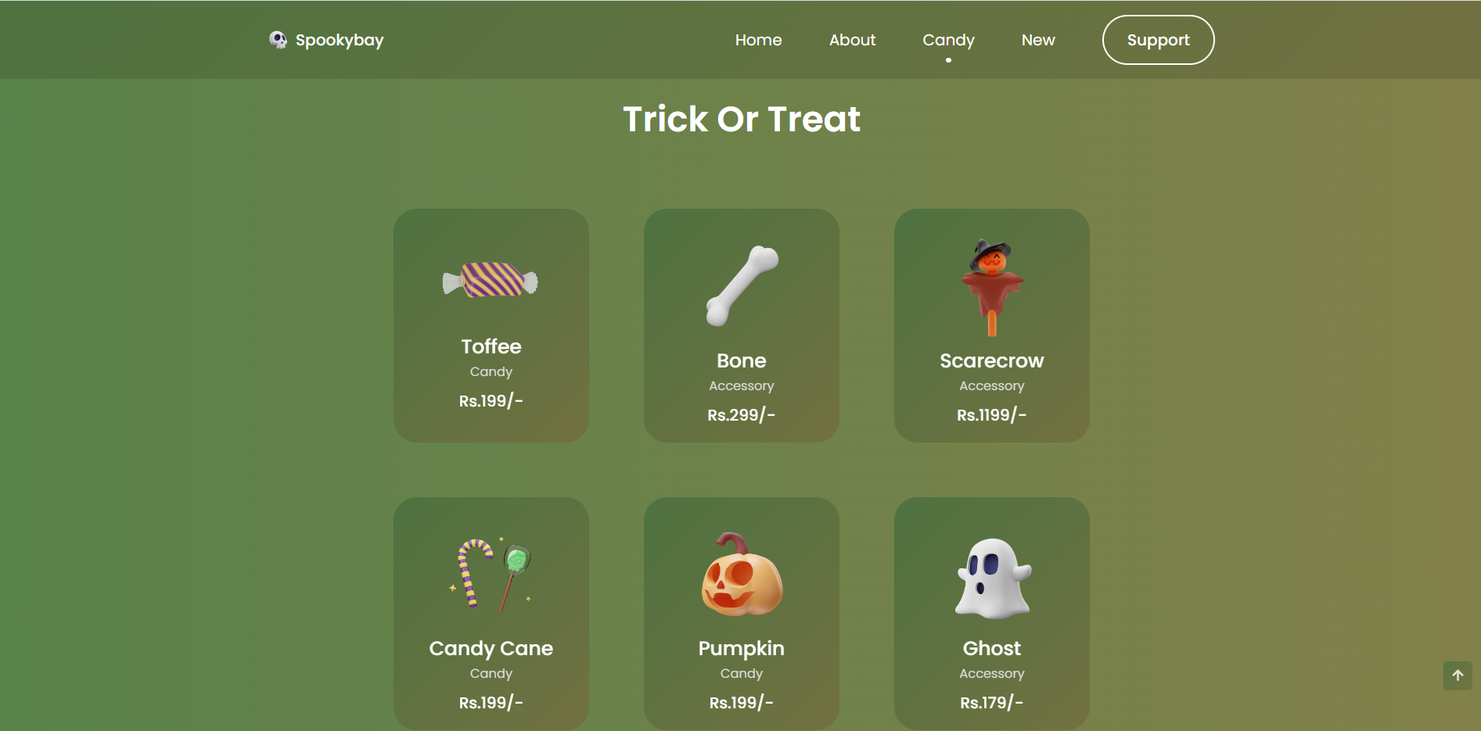

Slide 8
REAL LIFE IMPLEMENTATION:
GO-TO-STORE OF ALL THE HALLOWWEN ITEMS.
WE CAN ALSO RENT OR BOOK SPECIAL HAUNTED THEME ROOMS ONLINE.
SPOOKYBAY-THE FIRST INDIAN HALLOWEEN E-COMMERCE WEBSITE .
ALL THE ITEMS STOCKED FOR THE USERS AND AT YOUR DOORSTEP.
HOME DELIVERY OF ALL THE ITEMS DONE.
BASICALLY, AN AMAZON/MYNTRA OF ALL THE HAUNTED THEMED ITEMS.

Slide 9
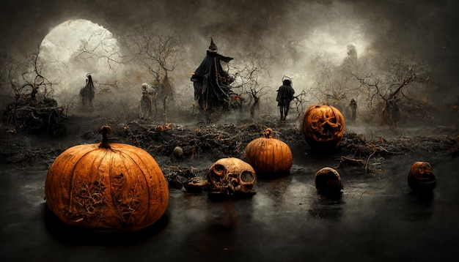
THANK YOU

