Slide 1



PWC
View in Power BI
Last data refresh:
9/21/2023 4:53:00 PM UTC
Downloaded at:
9/21/2023 5:41:51 PM UTC

Slide 2
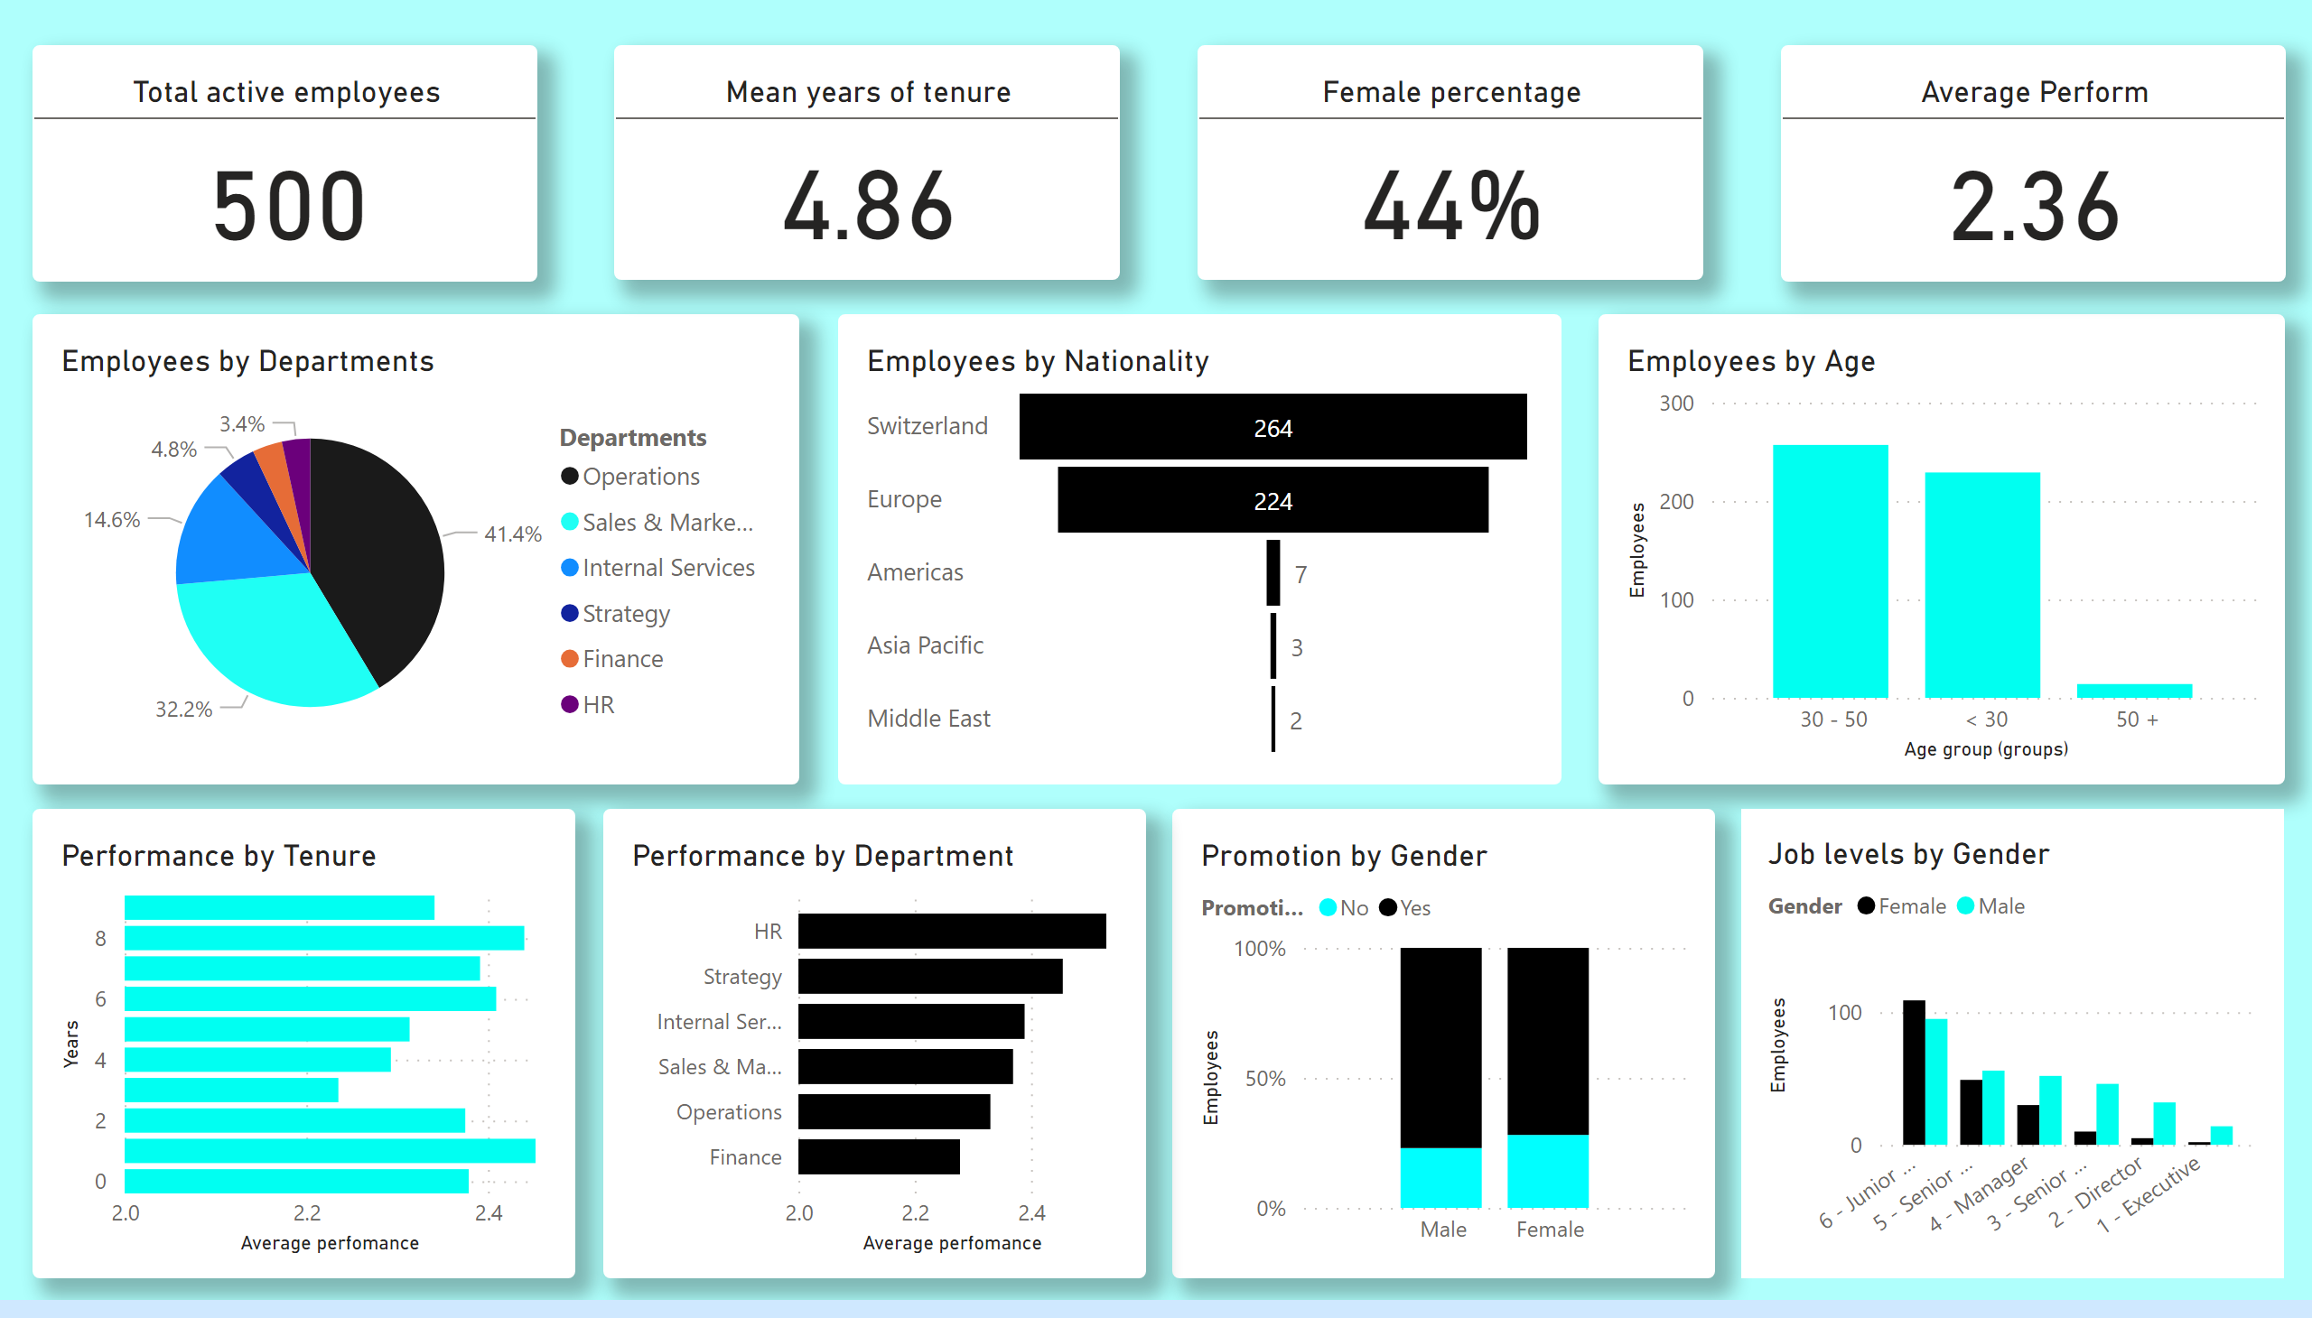
HR
Notes:
Total active employees
No alt text provided
Female percentage
No alt text provided
Employees by Departments
No alt text provided
Employees by Age
No alt text provided
Performance by Tenure
No alt text provided
Employees by Nationality
No alt text provided
Promotion by Gender
No alt text provided
Performance by Department
No alt text provided
Average Perform
No alt text provided
Mean years of tenure
No alt text provided
Job levels by Gender
No alt text provided

Slide 3
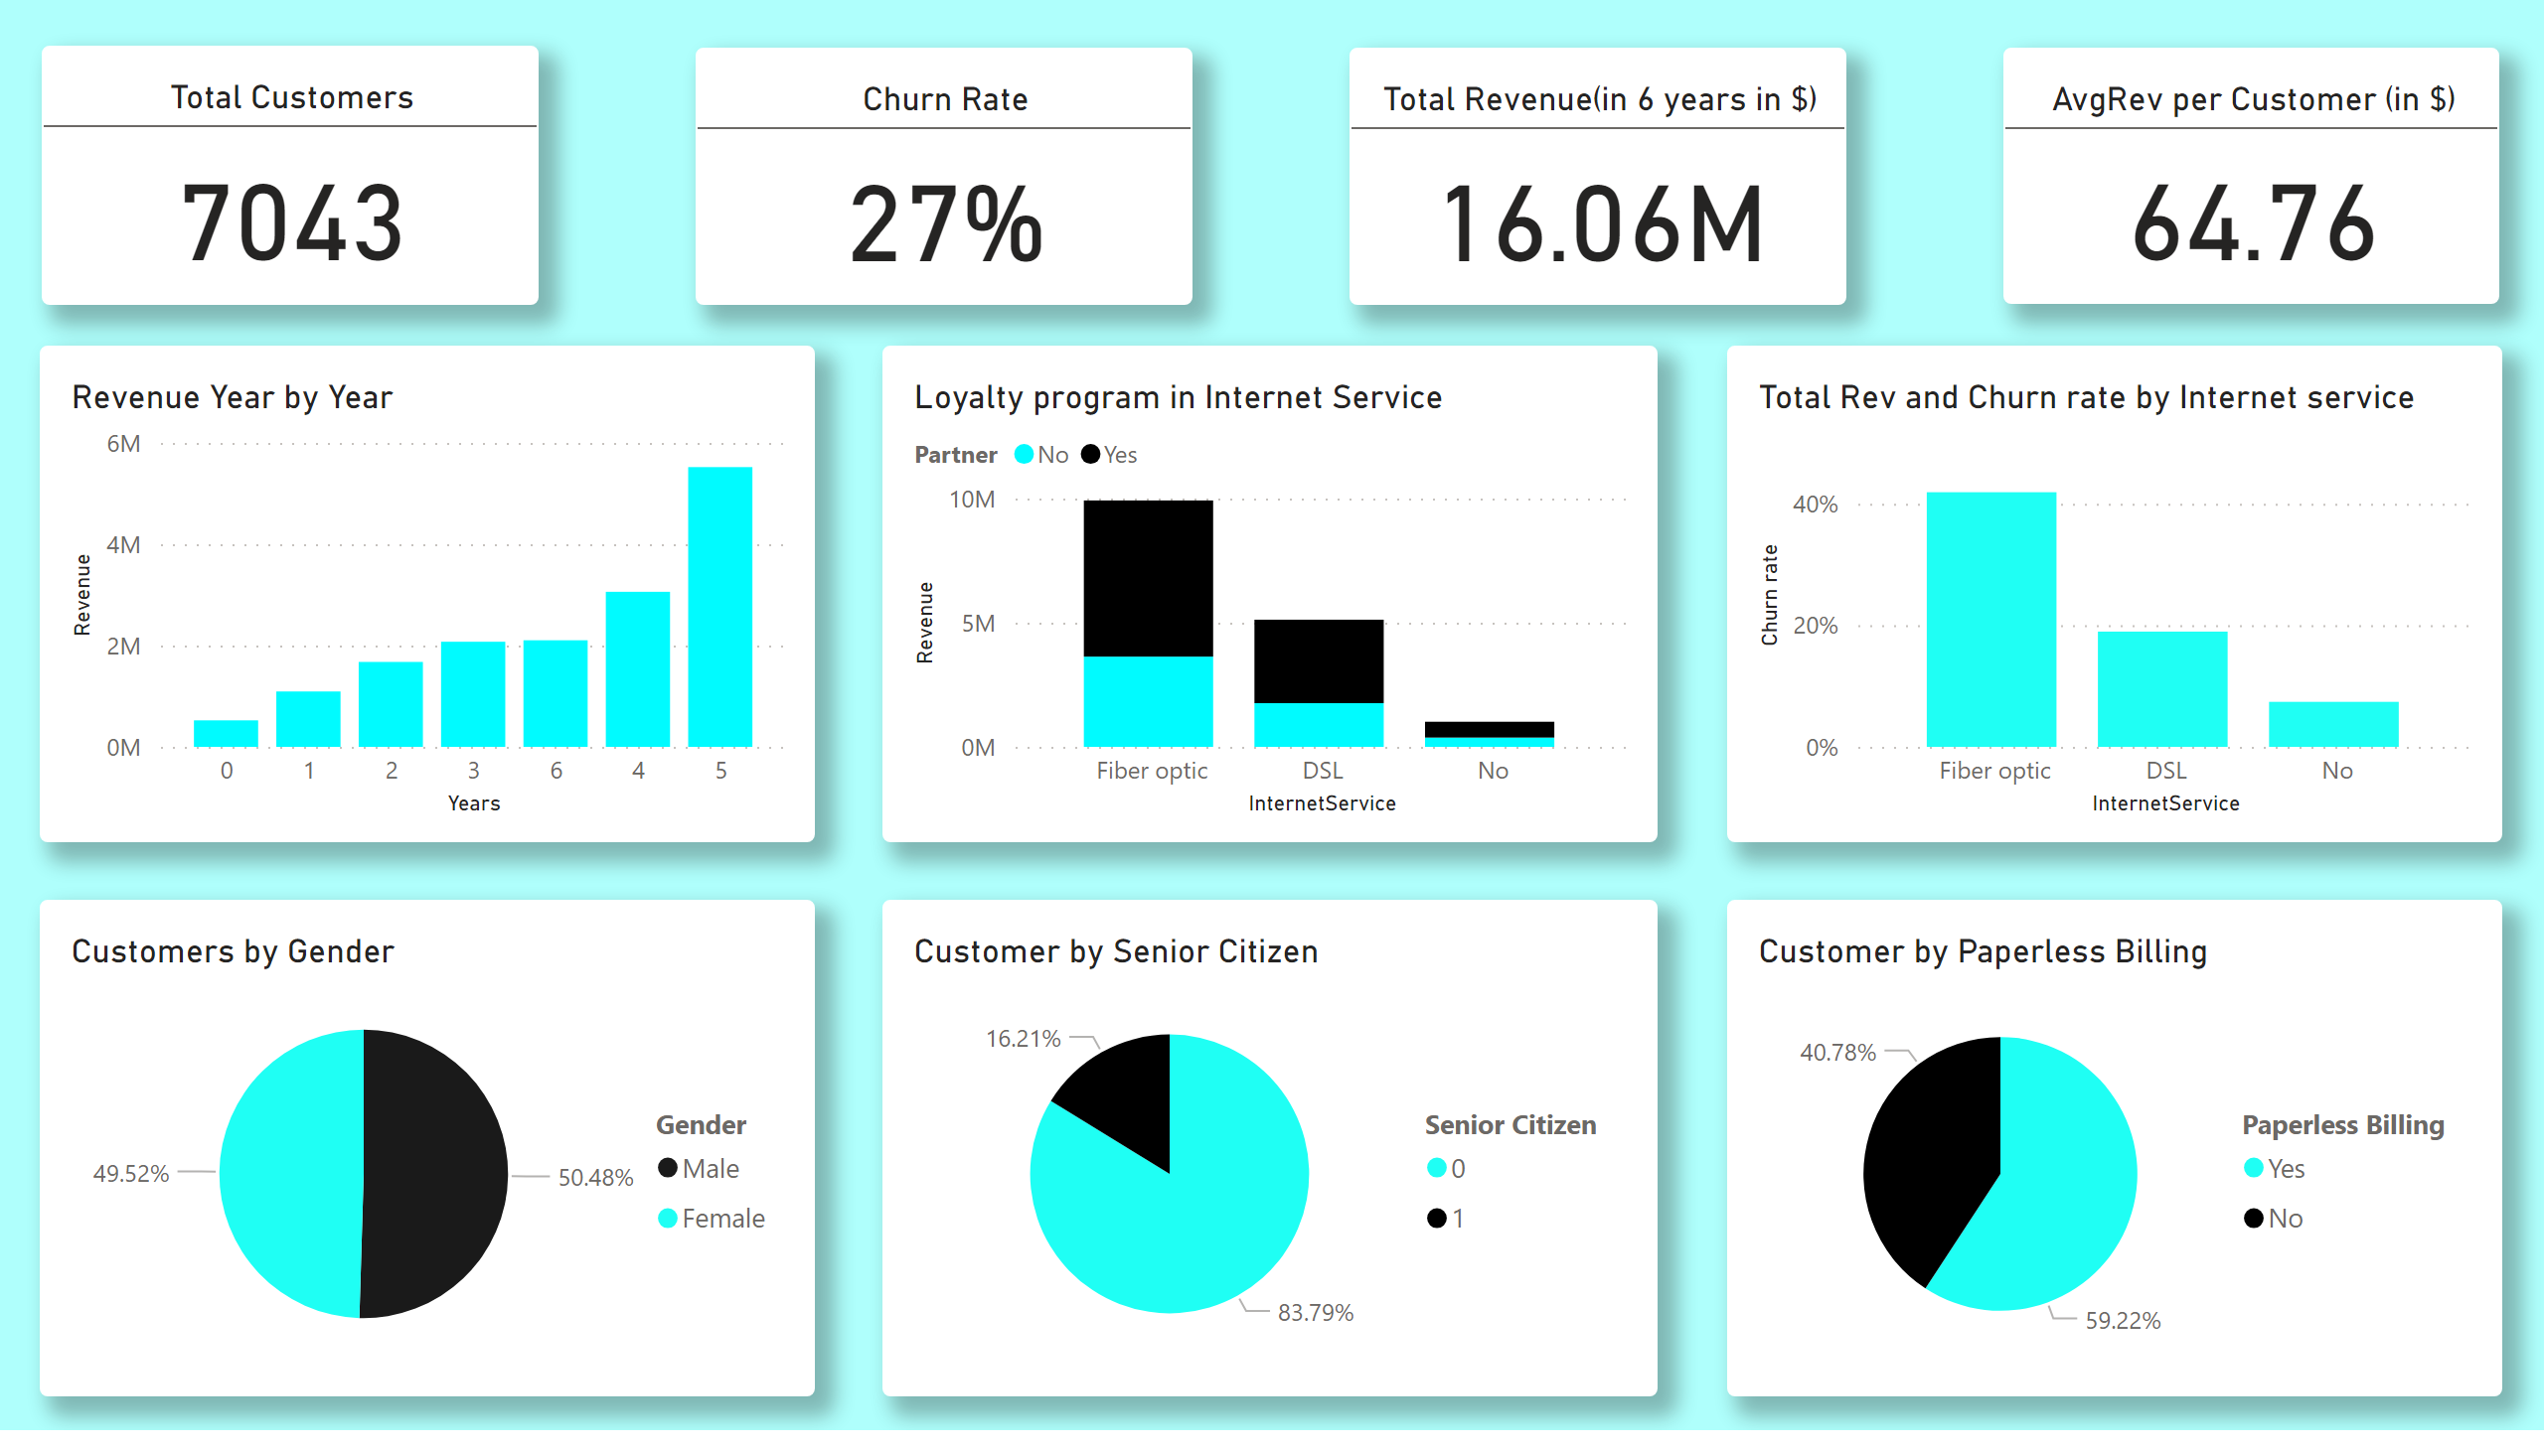
Revenue and Customers
Notes:
Total Customers
No alt text provided
Churn Rate
No alt text provided
Total Revenue(in 6 years in $)
No alt text provided
AvgRev per Customer (in $)
No alt text provided
Revenue Year by Year
No alt text provided
Loyalty program in Internet Service
No alt text provided
Total Rev and Churn rate by Internet service
No alt text provided
Customers by Gender
No alt text provided
Customer by Senior Citizen
No alt text provided
Customer by Paperless Billing
No alt text provided

Slide 4
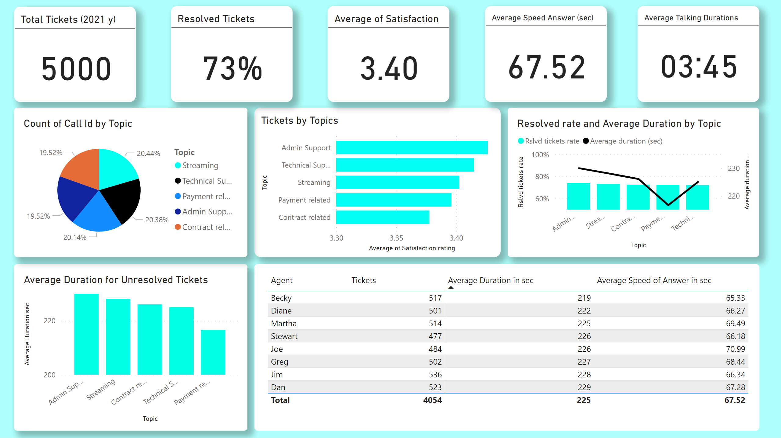
Call Centre operations
Notes:
Tickets by Topics
No alt text provided
Total Tickets (2021 y)
No alt text provided
Resolved Tickets
No alt text provided
Average of Satisfaction
No alt text provided
Average Speed Answer (sec)
No alt text provided
Resolved rate and Average Duration by Topic
No alt text provided
Average Duration for Unresolved Tickets
No alt text provided
tableEx
No alt text provided
textbox
No alt text provided
Average Talking Durations
No alt text provided
pieChart
No alt text provided

