Slide 1
Predicting Particulate Matter of 2.5 Microns or Less in Diameter (PM 2.5)
Bei Wang
MACS 33002 Winter 2022 Project 2

Slide 2
Task
Importance: use available PM2.5 data to help predict PM2.5 in areas with limited to no monitoring
Goal: regression task predicting outdoor PM.2.5 (ug/m^3) using the Beijing Multi-site air quality data. The original dataset has 420768 hourly observations over 5 years (2013-17) across 12 air-quality monitoring sites in Beijing, China.
Target: PM2.5 (ug/m^3)
17 features in the original data → 39 features
Data exploration
Data preprocessing
Model selection and evaluation
Result summary & interpretation
Notes:
PM2.5 is a widespread and inhalable air pollutant that has serious health effects. Data on PM2.5 concentration is important as they advice robust policies for substantial decreases in PM2.5.
The problem: monitoring in developed countries vs. undeveloped countries
Drop useless features
Drop feature to increase generalizability
Feature representation

Slide 3
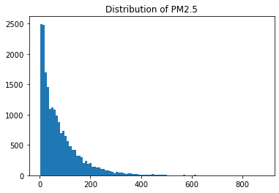
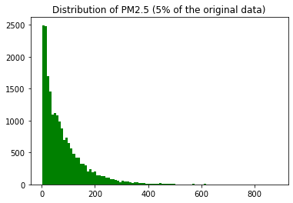
Data
Data size (420,768 x 18)
Distributions of target
Shrink data (20601 x 18)
A random 5% sample
17 features (predictors)
2 categorical features: wind direction, station
16 numeric features: year, # of observation, year, month, day, hour, so2, no2, co, o3, temperature, pressure, dew point temperature, rain, wind speed.
Notes:
Shrink data )
Given the large sample size of the data and my computer power, I was not able to perform many model training techniques. For instance, I performed GridSearchCV and RandomSearchCV with 3-folds cross-validation and a few combinations of parameters; I was not able to run it within a reasonable time.
So, I decide to add this step in data preprocessing to randomly select a subset of the full dataset, although this might not be the best solution in practice.
Similar distribution in

Slide 4
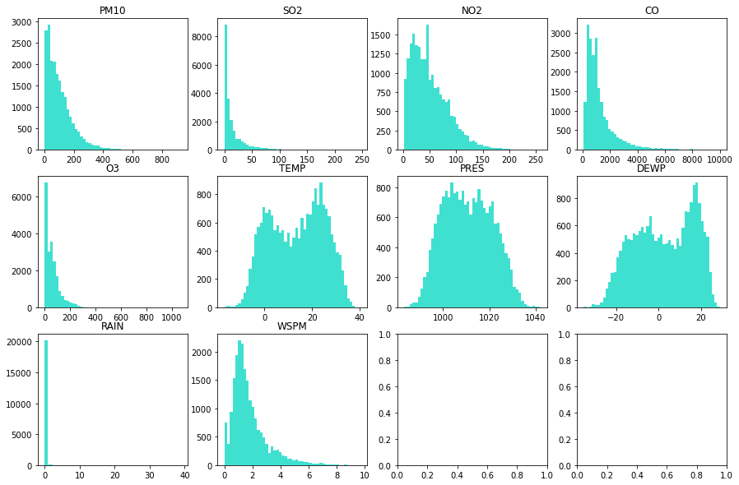
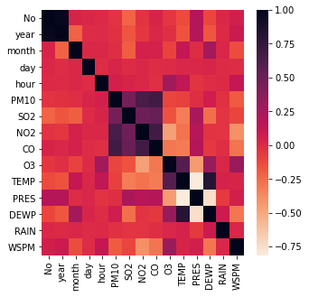
Data Preprocessing (done on original data)
Missing value and imputation
Drop missing in target (8739)
Numeric: Impute with means or medians
Categorical: impute with most freq (#1)
Correlation matrix
TEMP, PRES, and DEWP are highly correlated (r>0.75); only keep PRES
Drop unhelpful features (generalizability)
‘No’, ‘station’
Notes:
Mean: symmetrical distributions; median: skewed distribution.
I impute TEMP and PRES with means and use medians for the other features.

Slide 5
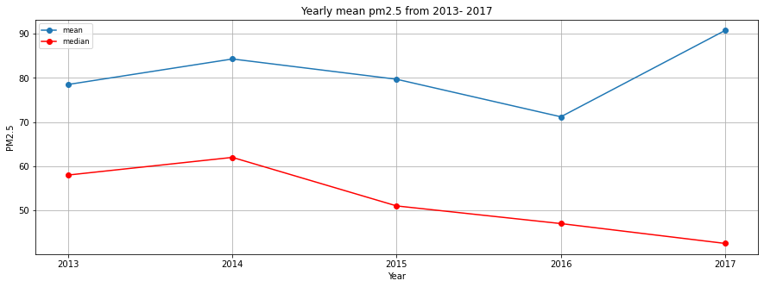
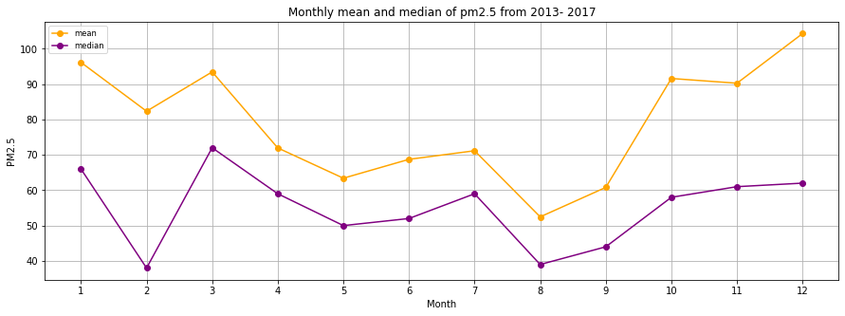
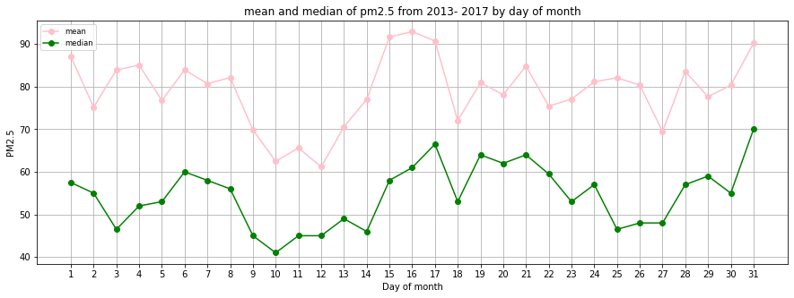
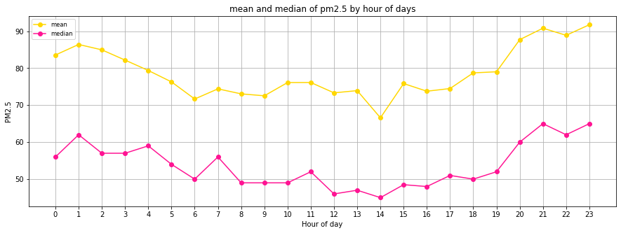
Data Preprocessing (done on original data)
year
Feature representation (informed by visuals)
Month, day, hour: lack of linearity → meaningful categories (seasons, morning, evening, etc.)
Year: generalizability issue → numeric feature
One-hot coding
Month, day, hour categories + wind direction
Standardization
Numeric features (not needed for tree-based methods)
70% train + 30% test
Final: 20601 x 36
month
day
hour
Notes:
These univariate relationship between time and PM2.5 have important implications for me in terms of how to include these features in my analysis.
Month, day, hour: The lack of linearity of these features and PM2.5 suggests that it is better to one-hot code them instead of treat them as a numeric value. But one-hot coding all these time features would lead to a large number of features that are not that informative for interpretation and not useful for making prediction. So, I will convert these features into categoris such as winter, spring, summer, winter, morning, evening, etc (see more in 2.6 feature representation).
Year: Given that the median of PM2.5 decrease over the year somewhat linearily and it is more useful to include year as a numeric feature for interpretation and prediction purposes. For example, it makes sense to look at year and say one year increase in time in the future would lead to certain change in PM2.5. This would not be true if treating year as some binary features (e.g., 2017 vs. not 2017).

Slide 6
Model: general steps
Candidate models
simple linear regression model, Lasso regression, support vector regression, decision tree regression, and random forest regression
In the 70% training set:
Hyper-parameter tuning: GridSearchCV
3- to 5-folds cross-validation and select the best model based on the Mean Absolute Error (MAE) closest to 0
In the 30% test set:
Test the best model’s performance
R^2, MAE, residual plot

Slide 7
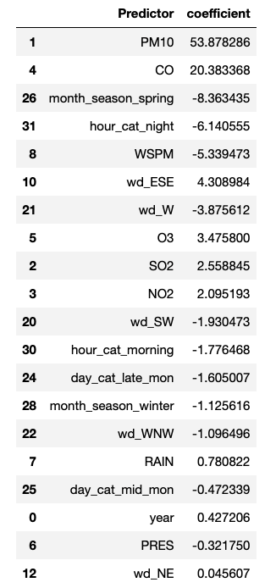
Model: linear regression models
Baseline model: simple linear regression
R^2: 0.79
MAE: 25.29
# of predictors: 32
Regression with regularization (Lasso)
GridSearchCV: cv=5
Alpha: 0.01, 0.1, 1
Performance:
R^2: 0.84
MAE: 20.66
# of predictors: 20
Notes:
Lasso: reduce some large weight feature to 0 to reduce # of features

Slide 8
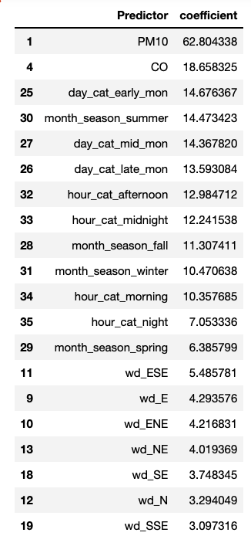
Model: support vector regression
3. Support vector regression
GridSearchCV: cv=5
C: 0.01, 1, 10
Performance:
R^2: 0.83
MAE: 20.18
# of predictors: 32
Notes:
The results look worse compared to Lasso. Although they have similar R^2 and MAE, the Lasso was able to reduce the number of features significantly, whereas svm did not.

Slide 9
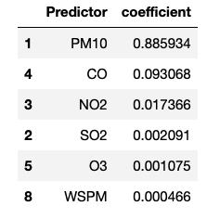
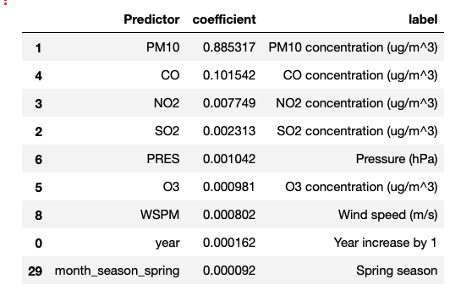
Model: tree-based models
Decision tree regression
GridSearchCV: cv=3
Criterion: ‘absolute_error’
Max_dept: 3, 4, 5
Performance:
R^2: 0.83
MAE: 19.44
# of predictors: 6
Random forest regression
GridSearchCV: cv=3
Criterion: ‘absolute_error’
Max_dept: 3, 4, 5
Performance:
R^2: 0.85
MAE: 18.57
# of predictors: 9
Notes:
I would like to keep the tree simpler by limiting the "max_depth" in my grid search to 3-5. If I increase this number range, the R^2 would likely to go up, sacrificing the simplicity of my model. However, even with a maximum depth of the tree being 5, the model performance is slightly better judging by MAE compared to SVM, Lasso regression, and simple linear regression. More importantly, the model built by decision tree regression results in a model with only 7 predictive features for PM2.5. This is a greater reduction of features compared to Lasso. So far, the decision tree regressor seems to produce the best model.

Slide 10
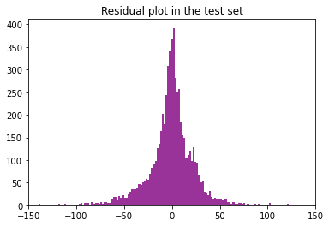
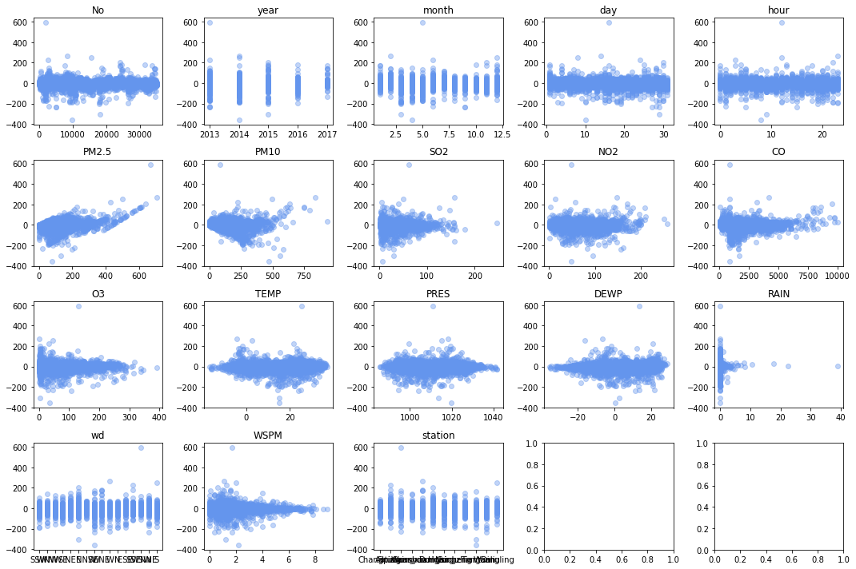
Summary and interpretation
 | R^2 | MAE | # of predictors
Linear regression | 0.79 | 25.29 | 32
Lasso | 0.84 | 20.66 | 20
Support vector regression | 0.83 | 20.18 | 36
Decision tree regression | 0.83 | 19.44 | 5
Random forest regression | 0.85 | 18.57 | 9
Notes:
Residual plot by features: helpful to see where model makes wrong predictions using the test set.
Good: random, homoscedasticity along y=0.
Pm2.5
Rain

