Slide 1
Java Heap Analysis

Slide 2
Agenda
Java Heap 101
Garbage Collection – generation concurrent
Heap Analysis
Q/A

Slide 3
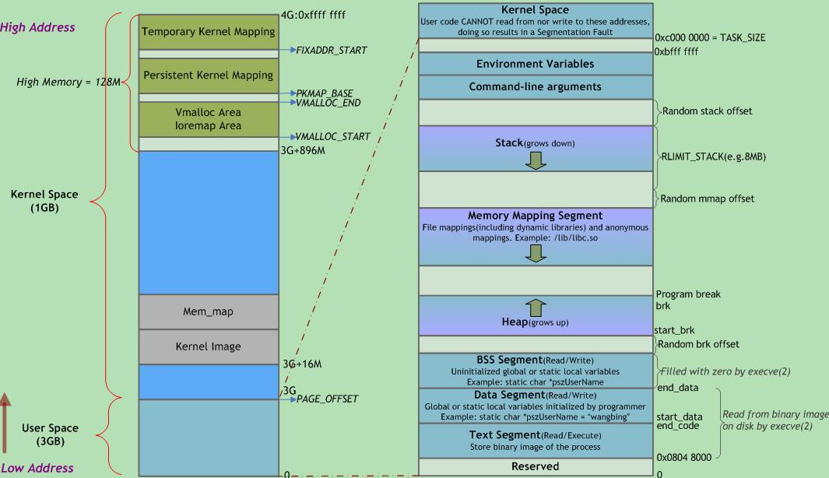
Java Heap 101
GC Domain
JavaHeap
Stack

Slide 4
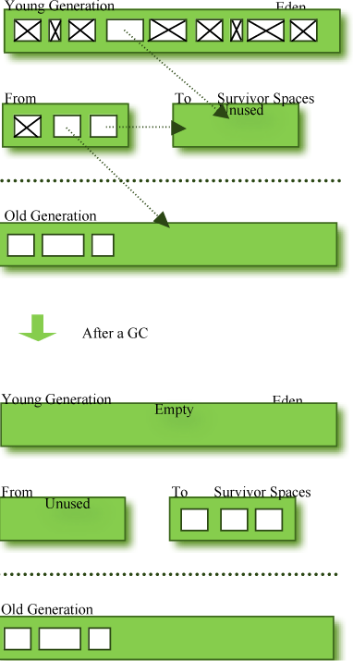
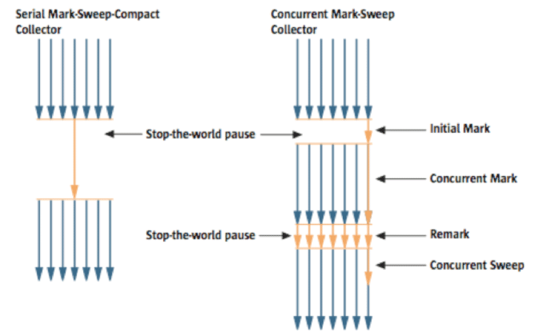
GC - generation concurrent
Old Generation GC – Full GC
Impact – Stop the world
ScavengerGC

Slide 5
Heap Analysis – Garbage analysis
Enable verbose GC log
Use GA tool
https://www.ibm.com/developerworks/community/groups/service/html/communityview?communityUuid=22d56091-3a7b-4497-b36e-634b51838e11

Slide 6
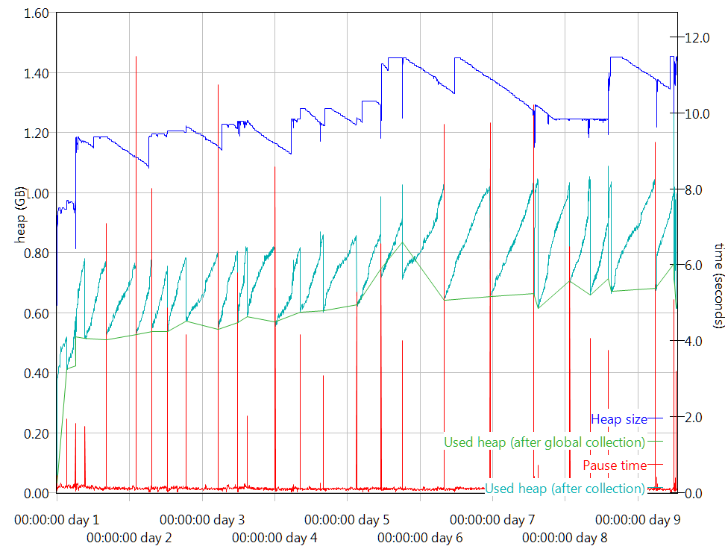
GA - Sample

Slide 7
HA Tool
Trigger heap dump
http://www.ibm.com/support/knowledgecenter/SSYKE2_6.0.0/com.ibm.java.doc.diagnostics.60/diag/tools/heapdump_enable.html
Use HA Tool
https://www.ibm.com/developerworks/community/groups/service/html/communityview?communityUuid=4544bafe-c7a2-455f-9d43-eb866ea60091

Slide 8
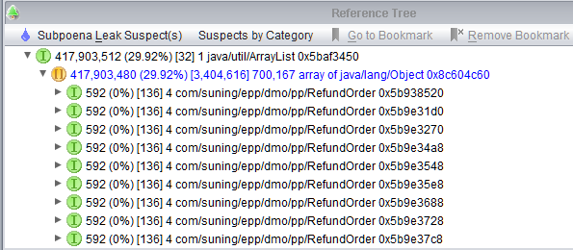
HA Tool - Sample
Leak Suspect – Identify big drop to spot issues quickly
Total Size (Total %) [Qty of Children] Size of Self Class Address

Slide 9
Q/A

