Slide 1
Java Virtual Machine Analysis
- WCS Threading PD with Java Core Dump

Slide 2
Agenda
JVM Threading Internals
Java Core Dump 101
JCA analysis samples
Q/A

Slide 3
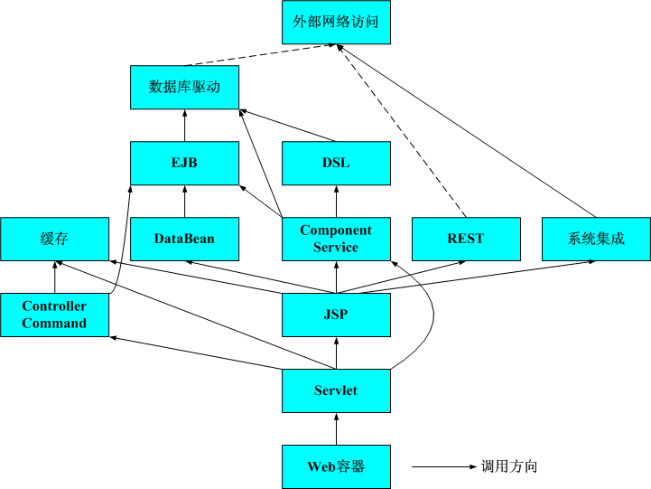
JVM Threading Internals

Slide 4
Java Core Dump 101
Java Virtual Machine standard – a snapshot-like text dump
Contents
TITLE
GPINFO
ENVINFO
MEMINFO
LOCKS
THREADS
CLASSES

Slide 5
Title
1TICHARSET UTF-8
1TISIGINFO Dump Event "user" (00004000) received
1TIDATETIME Date: 2016/08/09 at 22:45:05
1TIFILENAME Javacore filename: /opt/WebSphere/Liberty/usr/servers/default/javacore.20160809.224505.6.0001.txt
1TIREQFLAGS Request Flags: 0x81 (exclusive+preempt)

Slide 6
Environment
1CIJAVAVERSION JRE 1.7.0 Linux amd64-64 build (pxa6470sr9fp40-20160422_01(SR9 FP40) )
1CIVMVERSION VM build R26_Java726_SR9_20160406_0949_B298397
1CIJITVERSION tr.r11_20160328_1141921CIGCVERSION GC - R26_Java726_SR9_20160406_0949_B298397_CMPRSS1CIJITMODES JIT enabled, AOT enabled, FSD disabled, HCR enabled1CIRUNNINGAS Running as a standalone JVM1CIPROCESSID Process ID: 6 (0x6)
1CICMDLINE /opt/WebSphere/Liberty/java/java_1.7_64/jre/bin/java –java …

Slide 7
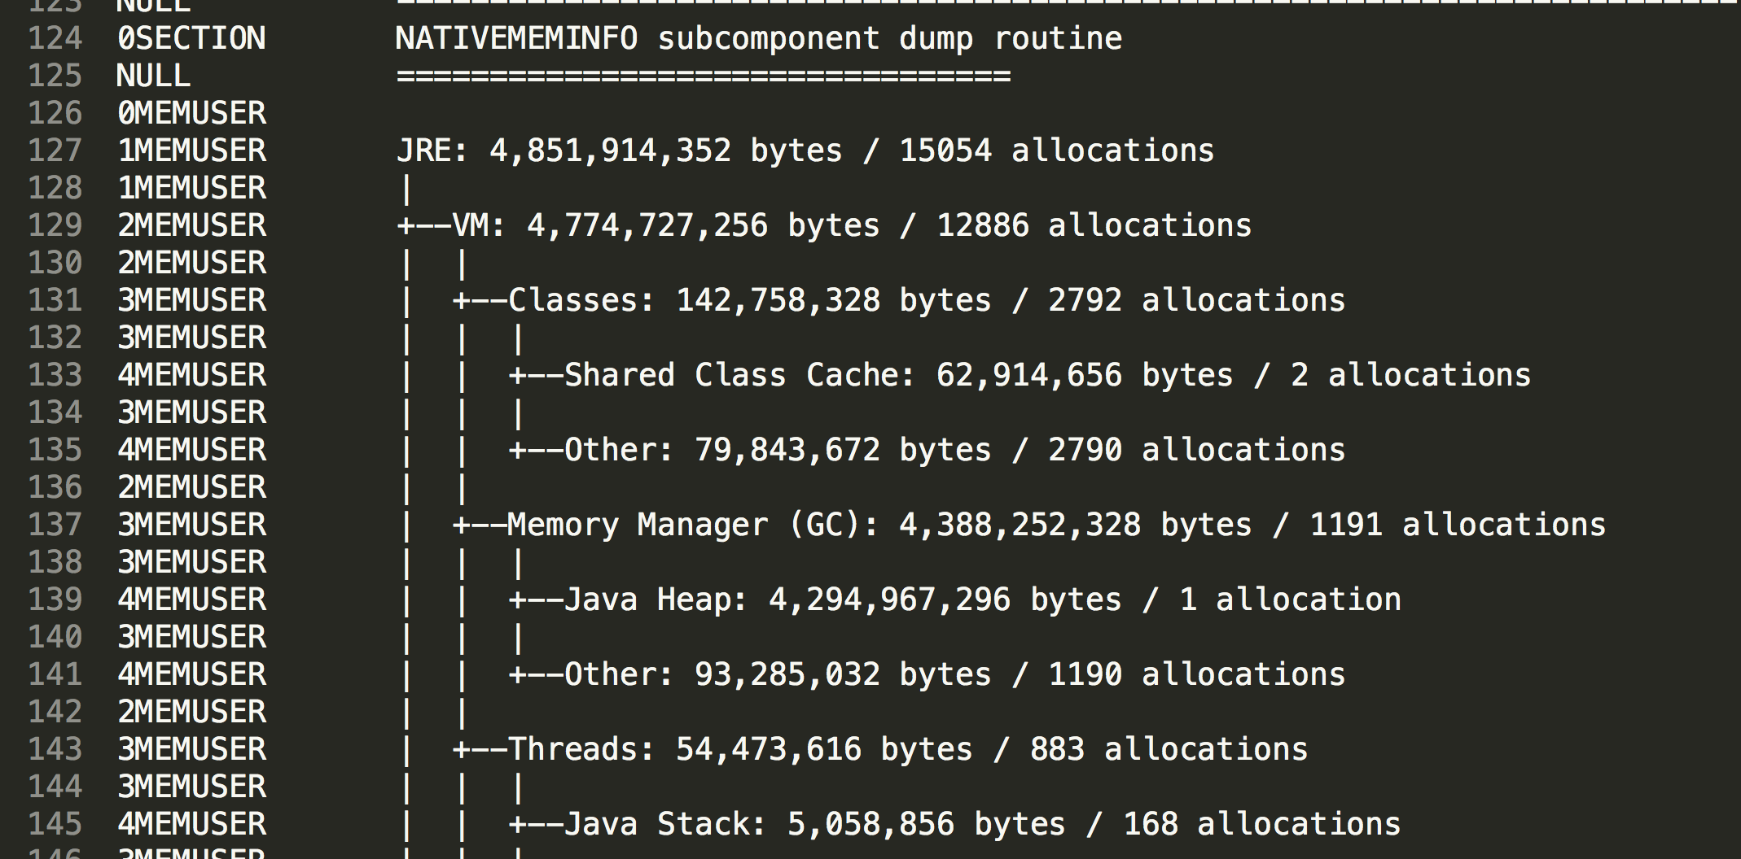
Memory

Slide 8
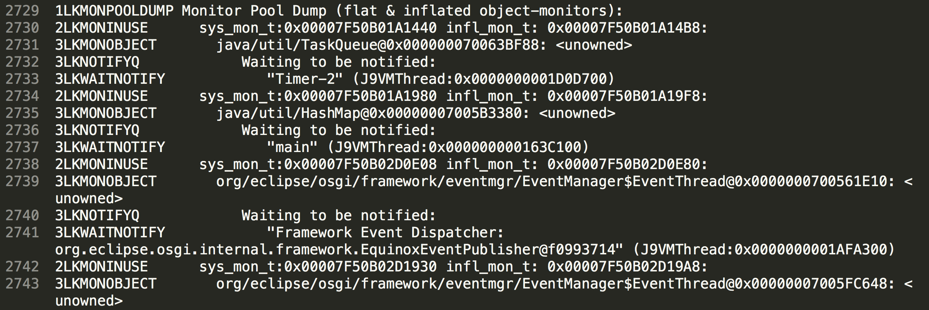
Lock

Slide 9
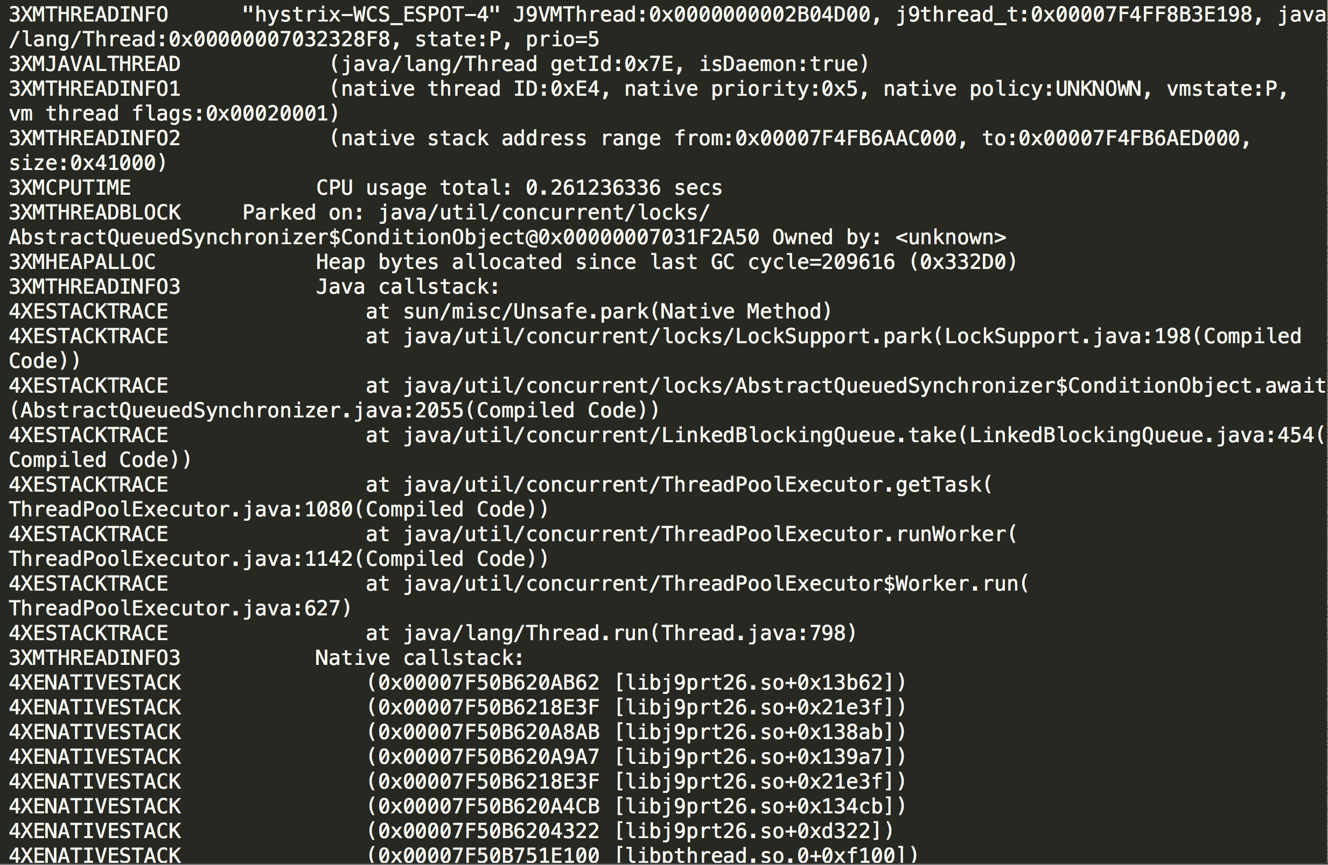
Thread

Slide 10
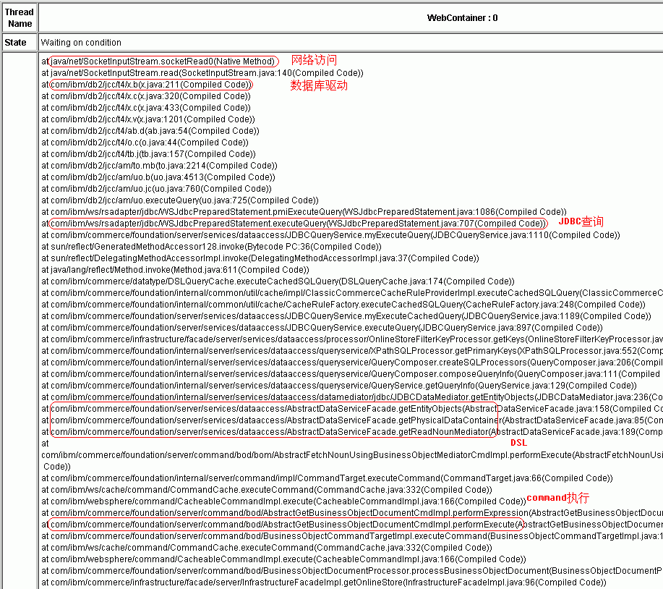
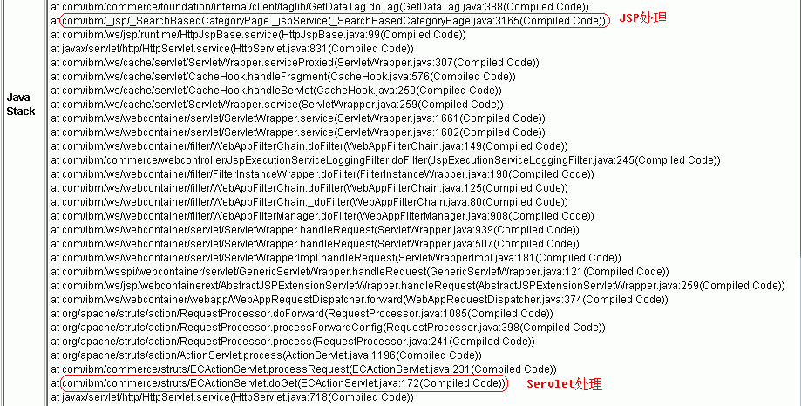
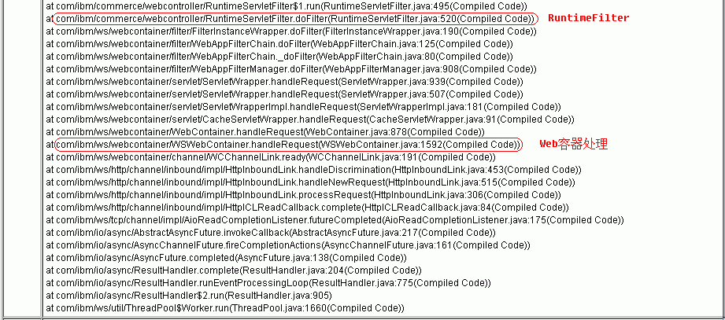
Call Stack

Slide 11
Thread Status
Deadlock
Runnable
Wait on condition
Suspend
Wait
Park
Blocked

Slide 12
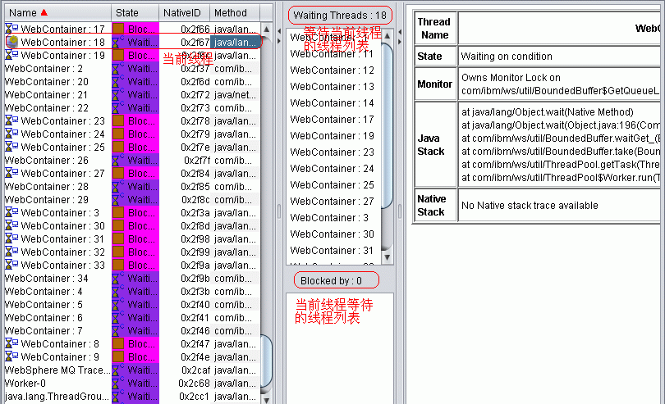
Block Sample

Slide 13
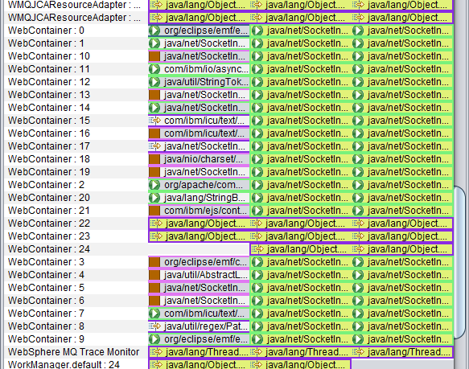
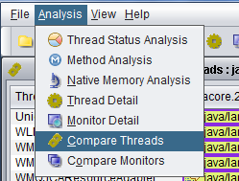
JCA Tool – compare thread

Slide 14
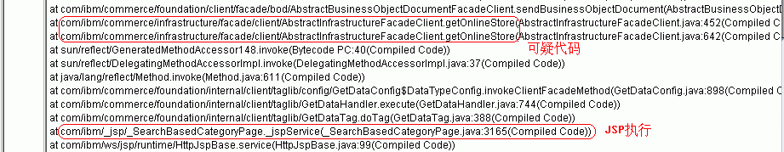
JCA Tool – Rough profiling

Slide 15
Resource
JCA Tool download
https://www.ibm.com/developerworks/community/groups/service/html/communityview?communityUuid=2245aa39-fa5c-4475-b891-14c205f7333c
Trigger java dump
http://www.ibm.com/support/knowledgecenter/SSYKE2_6.0.0/com.ibm.java.doc.diagnostics.60/diag/tools/javadump_trigger.html

Slide 16
Q/A

