Slide 1

Recommend a Similar Neighborhood
From Paris to London

Slide 2
Background
Pierre lives in Paris 75015 ever since he was born
He needs to rent a place in London
He likes the neighborhood in Paris
Find him a similar neighborhood in London

Slide 3

Data Acquisition/Cleaning
Paris data
https://datanova.legroupe.laposte.fr/explore/dataset/laposte_hexasmal/information/?disjunctive.code_commune_insee&disjunctive.nom_de_la_commune&disjunctive.code_postal&disjunctive.ligne_5
London Data
https://en.wikipedia.org/wiki/List_of_London_boroughs
Neighborhood stores data
Use Foursquare API
39193 rows
Useless columns
Cleaned data and grouped neighborhood with different features

Slide 4

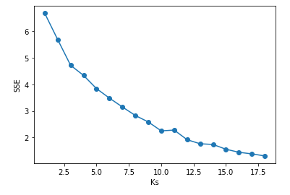
Model – unsupervised training, use KMEANS
First to define a K number. Turning point is 10.

Slide 5
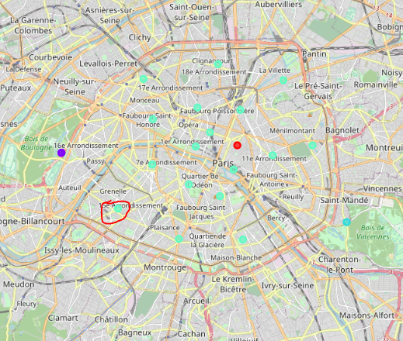
Build the model with K=10. Map the cluster result on Map. The red circle is where Pierre lives.

Slide 6
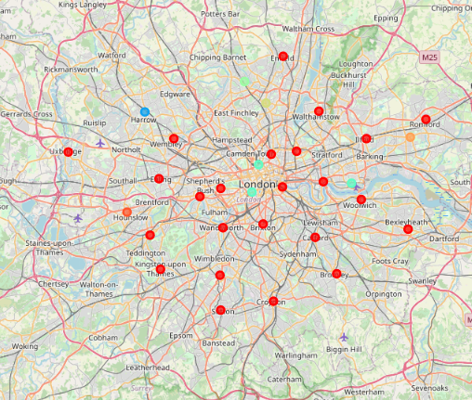
Map London use the same cluster result. The light blue is the similar neighborhood.

Slide 7
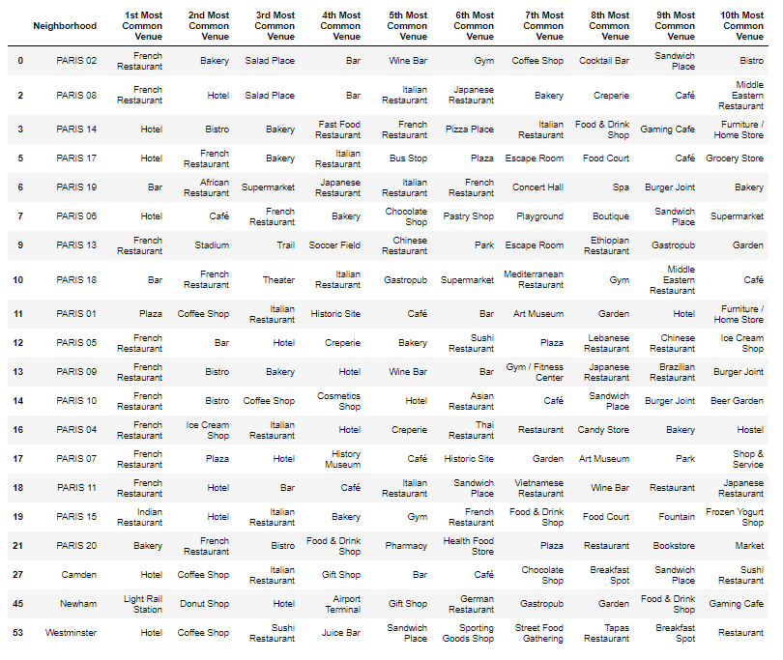
Pierre can choose Camden/Newham/Westminster

