Slide 1

Design of a Synchronising Device
For Parallel Generators
Author: Bogdan Bejan
MSc Electrical and Electronic Engineering
Supervisor: Zahra Sangelaji

Slide 2
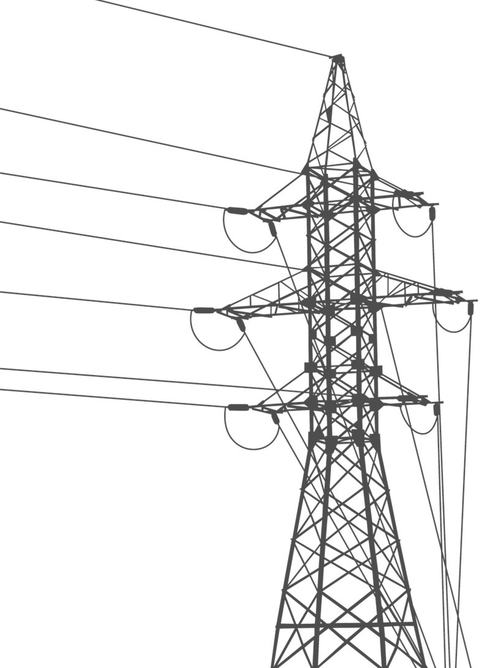
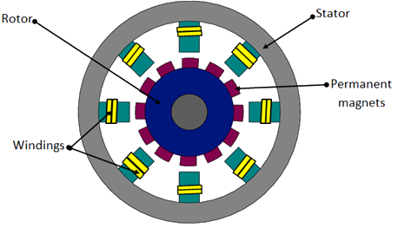
Permanent Magnet Synchronous Generator
(PMSG)
POWER ELECTRONICS
Notes:
The Generator is considered to be a PMSG. Construction. Advantage: energy density.
Second generator (CLICK)= the grid (BECAUSE – constant v, f source).
To connect PMSG – GRID, power electronics are normally used to adjust the PMSG’s parameters to the ones of the grid.

Slide 3
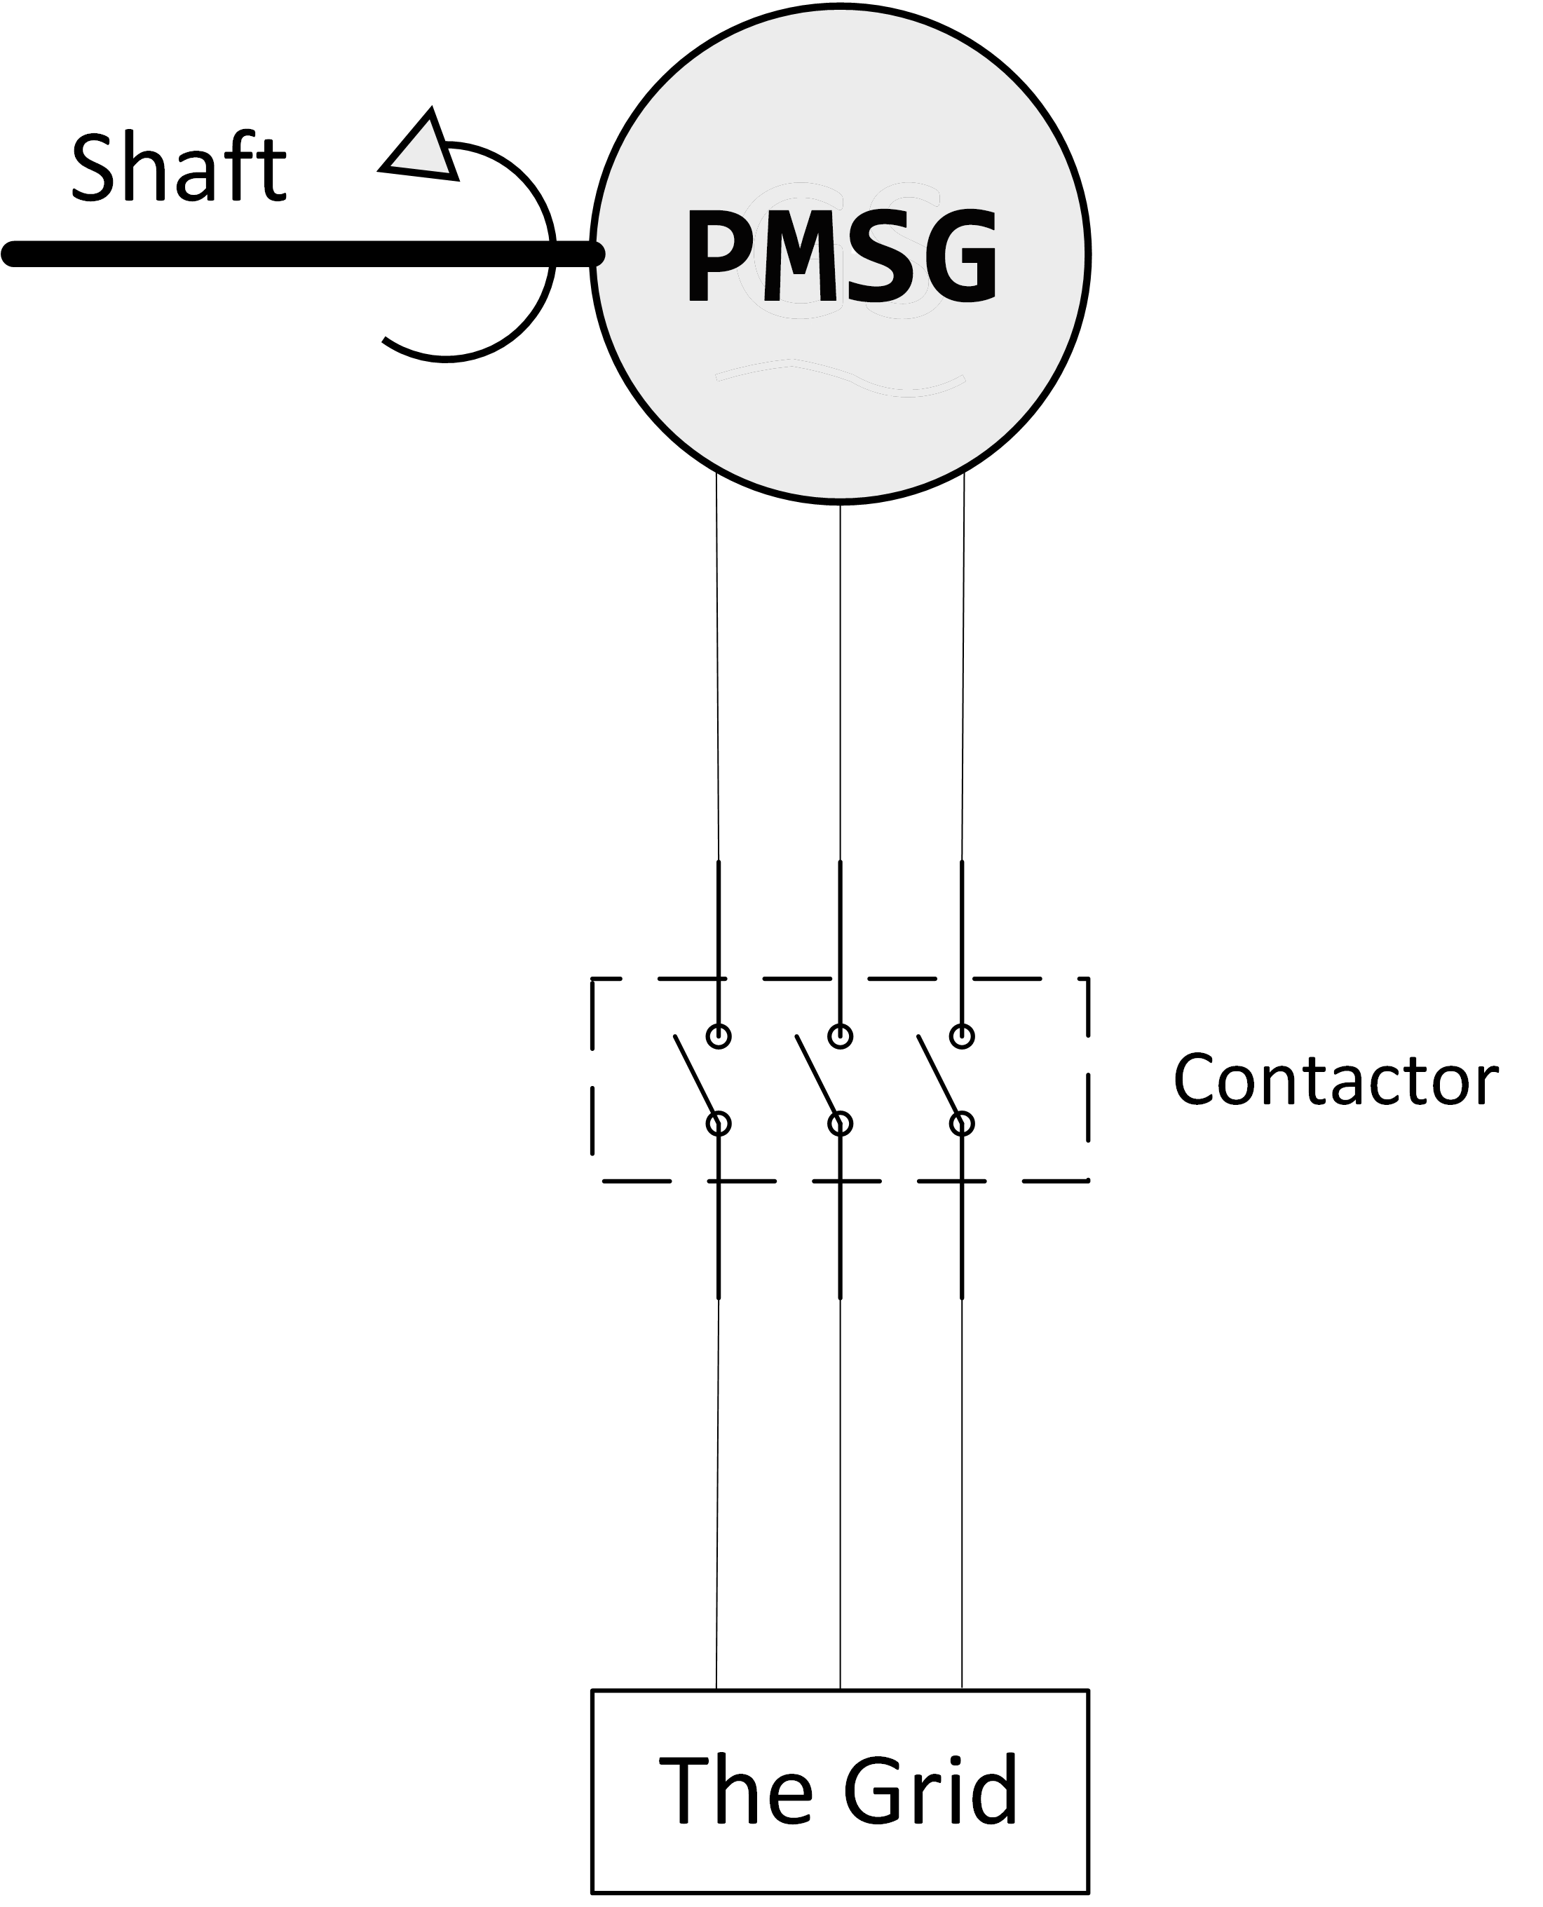
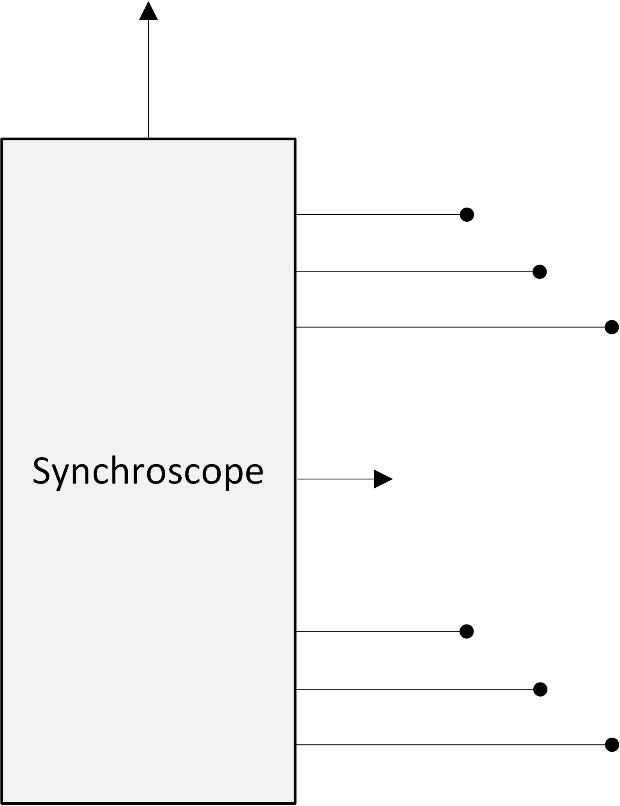
Project Overview
Direct connection
Content:
Connect a PMSG directly to the grid
The constraints
How this is achieved
The synchronisation device called Synchroscope
Notes:
Different idea of connecting a PMSG to the grid.
Constraints associated.
The solution to the constraints
And the device that will synchronise the generator called Synchroscope.
Now, Project About excluding the Power Electronics
In addition, a control and command block is needed (CLICK). Purpose – check parameters – make connection. The system brain.

Slide 4
Aims, Objectives and Deliverables
Aim
Successful direct connection to the grid
Objective
Design Synchroscope device
Deliverable
System simulation using Matlab
Notes:
seamless connection.
Objective , device , automatically synch.
Achieved = deliverables - simulation, script.

Slide 5
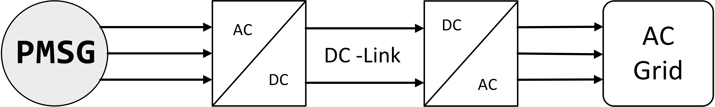
Permanent Magnet Synchronous Generators
Traditional Grid Connection
Losses
Complexity
Cost
Notes:
PMSG TRADITIONAL CONNECTION, DISADVATAGES.
PMSG is connected in such a way due to v/f proportions. It is suitable for wind turbine because of the different speeds the wind is having.
Downsides: Losses, Complexity, Cost

Slide 6
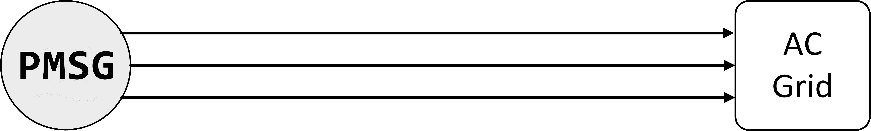
Permanent Magnet Synchronous Generators
Proposed Solution
DIRECT CONNECTION
Constant shaft speed
Specially magnetised magnets
Notes:
To counteract the disadvantages – direct connection proposed.
2 Conditions (CLICK): 1. constant speed at shaft 2. specially magnetised magnets
Next Why is important.

Slide 7
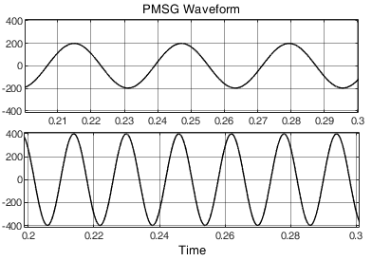
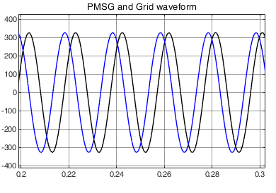
Specially magnetised magnets
Why?
Least complex
Simple to implement
Notes:
How?!....
Why have I choose this approach? -> simple (the least complex, possible with today’s technology).
However, downsides: demagnetisation.

Slide 8
Synchroscope connections
2/3 grid’s phases
2/3 PMSG’s phases
Synchroscope
Mechanical power provider equipment
Notes:
Mechanical power provider EG: steam turbine

Slide 9
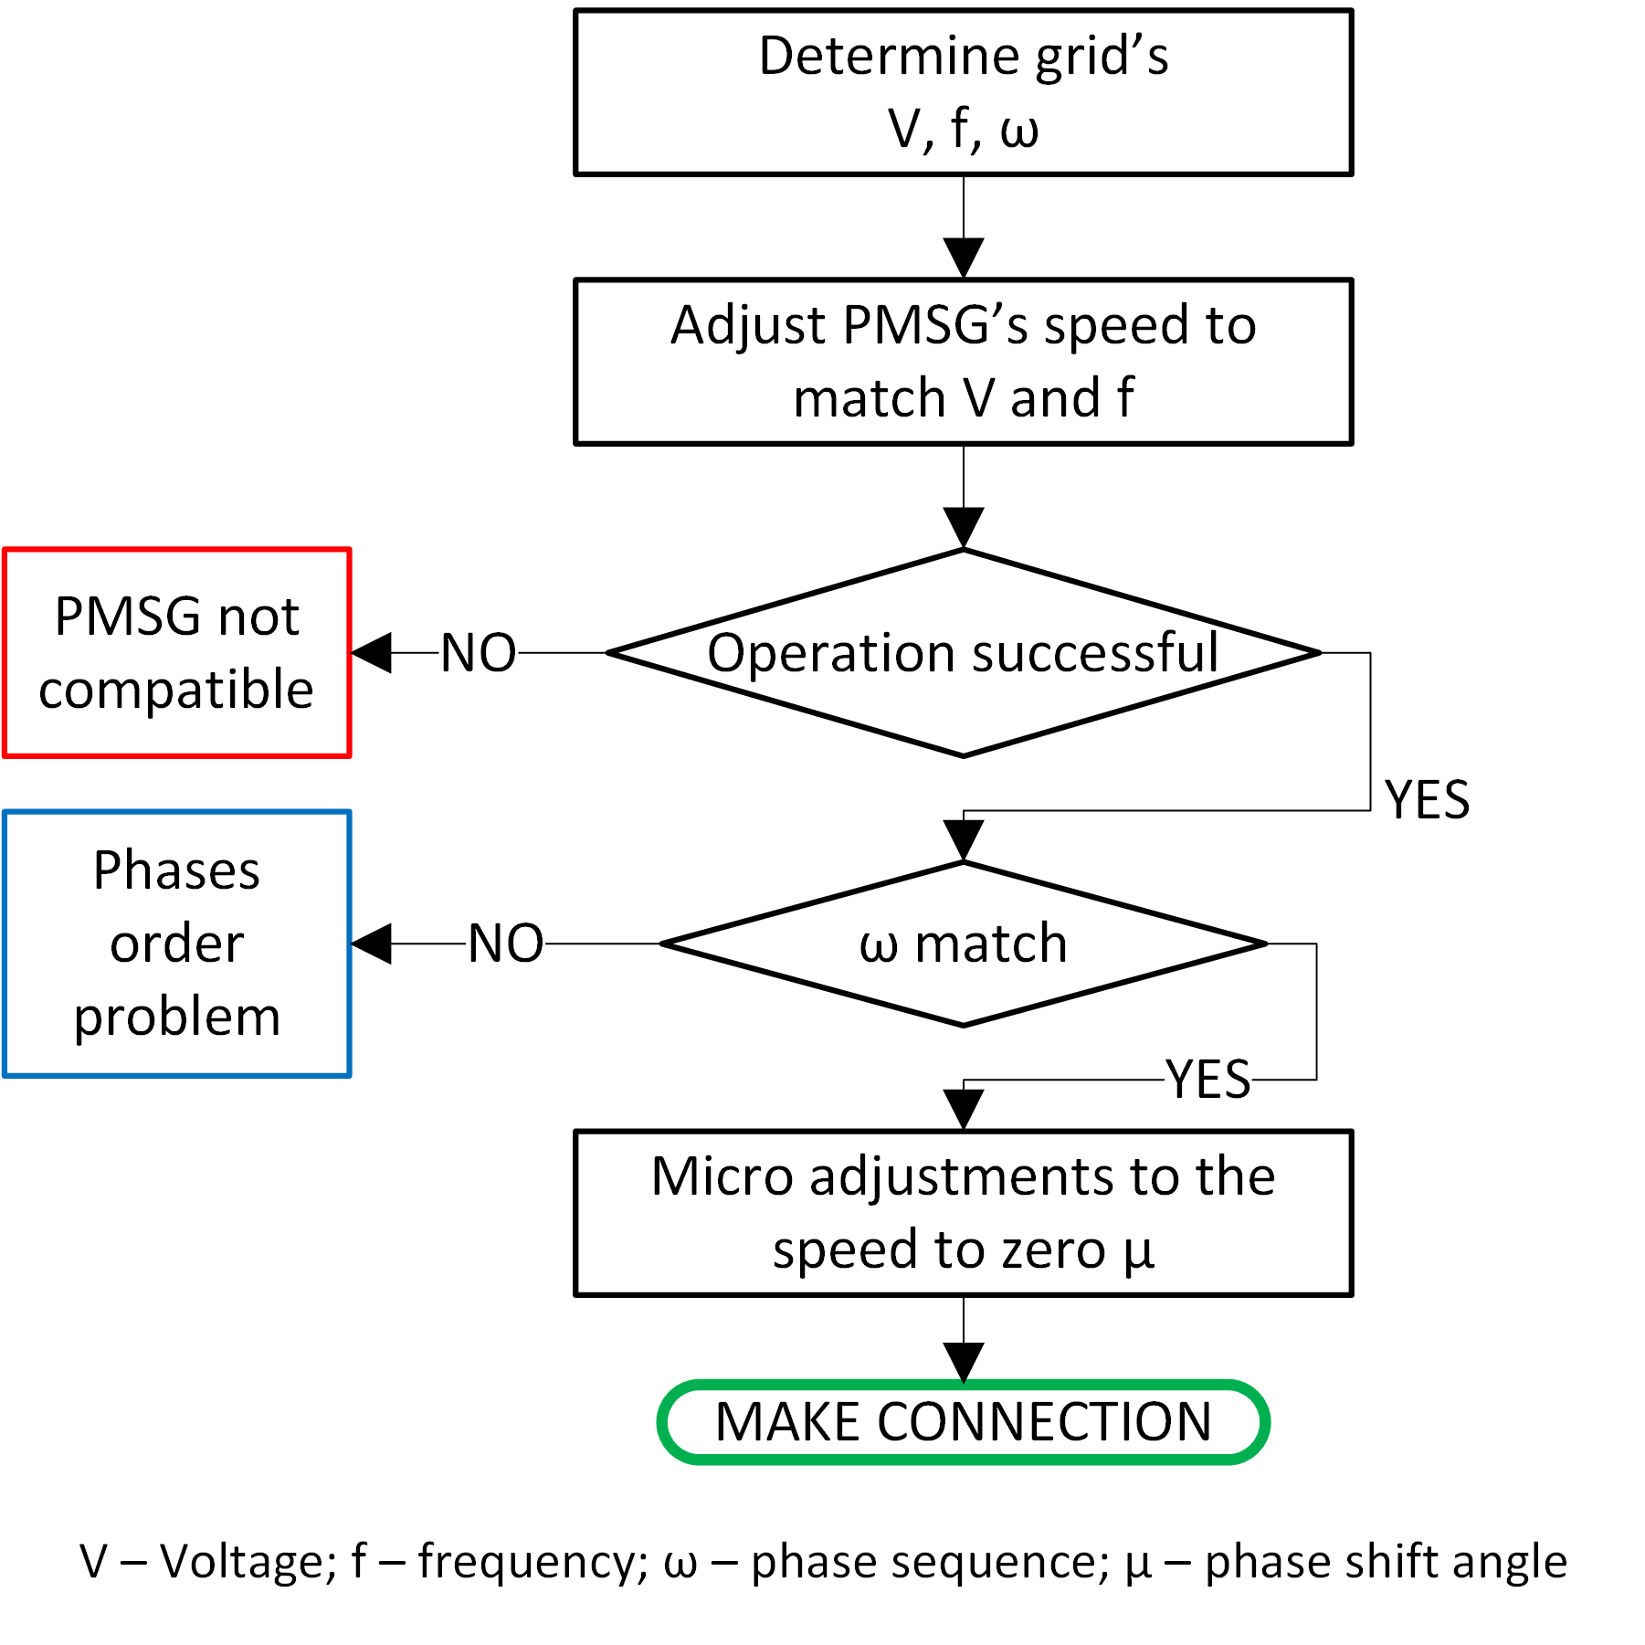
Synchroscope logic
Notes:
NEXT: Results.

Slide 10
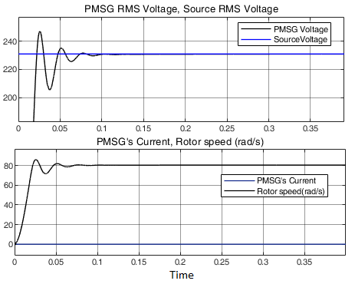
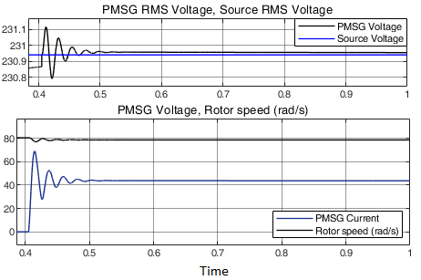
Successful connection !
Notes:
PMSG voltage VS Grid Voltage. Synchroscope adjusts the voltage to match the Grid.
PMSG rotor speed
When the synchroscope decides to make the connection, oscillations – amount and amplitude

Slide 11

Conclusion
Grid direct connection
Synchronisation device
Simulation
Notes:
The project has meet the aim, the objective and deliverable. With the help of the Synchroscope, the PMSG has successfully connect to the grid. However, due to the complexity of the idea, many other aspects need to be investigated.
Personal achievement:
Because of the difficulty in finding other researches about grid-direct connection of a PMSG, I realised that we should never stop looking at the world with different eyes. That's what research is about.

Slide 12
This presentation …
Different way to connect a PMSG to the grid.
Conditions for PMSG to directly connect to the grid.
Solution towards a successful connection.
The Synchroscope.
Notes:
This presentation has shown a different way to connect a PMSG to the grid without the need of converters.
This is possible with the right generator specifications and constant speed at the shaft.
You have also seen one of the solutions of this task and it involves the use of a synchronisation device.
The Synchroscope is also explained and described as being the part of the system who deals with the synchronisation it self. Is the device that does calculations and takes actions towards a successful connection.

Slide 13
Thank you!
Questions?
Author: Bogdan Bejan
MSc Electrical and Electronic Engineering
Supervisor: Zahra Sangelaji

