Slide 1
UseRelationShip
UseRelationShip

Slide 2
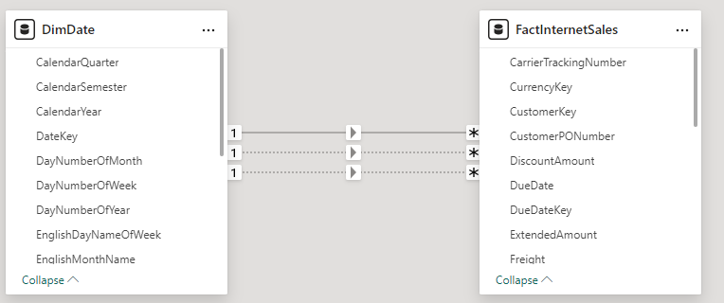
UseRelationShip
Note: This demo uses the AdventureWorks2016 database and more precisely the DimDate table , and FactInternetSales
Note that there are at least two relationships that are inactive between DimDate on the one hand and FactInternetSales on the other hand based on the DateKey key
UseRelationShip function is used to use a relationship between two tables even though it is not fully active.

Slide 3
UseRelationShip
Start by creating a measure that returns the sum of sales for the first half of the year at the FactInternetSales table
Sales First Quarter = CALCULATE(SUMX(FactInternetSales,FactInternetSales[OrderQuantity]*FactInternetSales[UnitPrice]),FILTER(DimDate, DimDate[CalendarQuarter]=1))
Use the UserelationShip function to force the calculation to go through DueDateKey instead of DateKey by creating the relationship between DimDate on one hand and FactInternetSales on the other hand
Sales First Quarter (Due Date) = CALCULATE(SUMX(FactInternetSales,FactInternetSales[OrderQuantity]*FactInternetSales[UnitPrice]),USERELATIONSHIP(DimDate[DateKey],FactInternetSales[DueDateKey]),FILTER(DimDate, DimDate[CalendarQuarter]=1))

Slide 4

UseRelationShip
Repeat the previous step replacing DueDateKey with ShipDateKey which also represents an inactive relationship
Sales First Quarter (Ship Date) = CALCULATE(SUMX(FactInternetSales,FactInternetSales[OrderQuantity]*FactInternetSales[UnitPrice]),USERELATIONSHIP(DimDate[DateKey],FactInternetSales[ShipDateKey]),FILTER(DimDate, DimDate[CalendarQuarter]=1))
Put the three measurements next to each other and try to compare them.

Slide 5
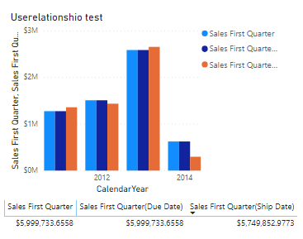
UseRelationShip
Try to represent the measures by a Stacked Columns visualization repartitioned on the basis of years at the x-axis level

Slide 6
Thank you
Thank you

