Slide 1
UseRelationShip
UseRelationShip

Slide 2
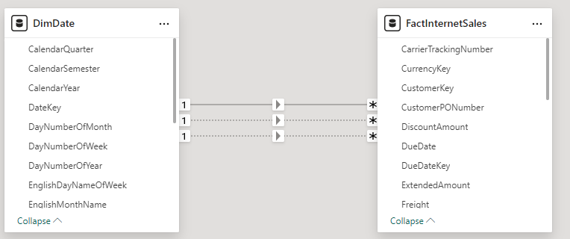
UseRelationShip
Note: This demo uses the AdventureWorks2016 database , specifically the DimDate and FactInternetSales tables .
Note that there are at least two inactive relationships between DimDate on the one hand and FactInternetSales on the other, based on the DateKey key .
The function UseRelationShip East used to exploit a relationship between two tables,
even if She is not fully active .

Slide 3
UseRelationShip
Start by creating a measure that returns the sum of sales for the first half of the year in the FactInternetSales table .
Sales First Quarter = CALCULATE ( SUMX ( FactInternetSales , FactInternetSales [ OrderQuantity ] * FactInternetSales [ UnitPrice ] ), FILTER ( DimDate , DimDate [ CalendarQuarter ] = 1 ))
Use the function USERELATIONSHIP to force the calculation to go through DueDateKey instead
from DateKey in creating the relationship between DimDate on the one hand and FactInternetSales on the other hand.
Sales First Quarter (Due Date) = CALCULATE ( SUMX ( FactInternetSales,FactInternetSales [ OrderQuantity ]* FactInternetSales [ UnitPrice ]), USERELATIONSHIP ( DimDate [ DateKey ], FactInternetSales [ DueDateKey ]) , FILTER ( DimDate , DimDate [ CalendarQuarter ] = 1 ))

Slide 4

UseRelationShip
Repeat the previous step, replacing DueDateKey with ShipDateKey , which also represents an inactive relationship.
Sales First Quarter (Ship Date) = CALCULATE ( SUMX ( FactInternetSales,FactInternetSales [ OrderQuantity ]* FactInternetSales [ UnitPrice ]), USERELATIONSHIP ( DimDate [ DateKey ], FactInternetSales [ ShipDateKey ]) , FILTER ( DimDate , DimDate [ CalendarQuarter ]= 1 ))
Place the three measurements side by side and try to compare them.

Slide 5
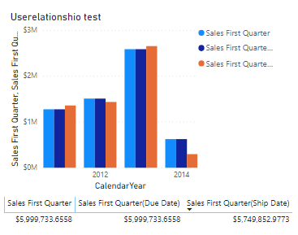
UseRelationShip
Try to represent the measurements by a column visualization​ stacked distributed in function
years on the x - axis .

Slide 6
Thank you
Thank you

