Slide 1
IFFERROR
IFFERROR

Slide 2
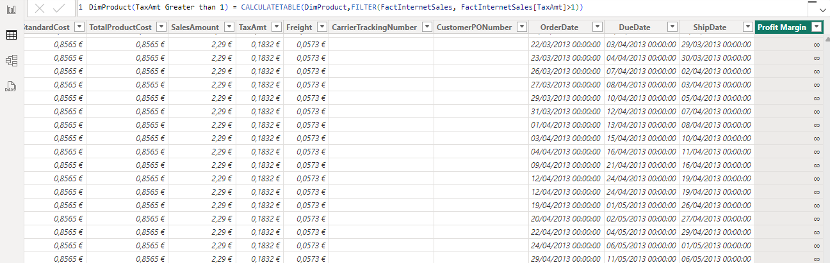
IFFERROR
Note: This demo uses the FactInternetSales table from the Adventureworks2016 database .
Start by creating a calculated column that calculates the profit margin.
Profit Margin =
( FactInternetSales [ UnitPrice ] - FactInternetSales [ ProductStandardCost ] )
/ FactInternetSales [ ProductStandardCost ]
Note that among the values mentioned there are infinity symbols.
Profit Margin =
( FactInternetSales [ UnitPrice ] INT ( FactInternetSales [ ProductStandardCost ] ))
/ INT ( FactInternetSales [ ProductStandardCost ] )
Note that among the values mentioned there are infinity symbols.

Slide 3
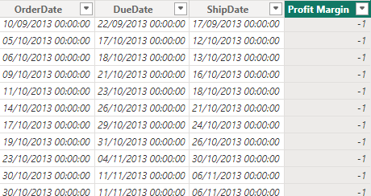
IFFERROR
Try putting the whole expression into an IFERROR function , indicating that the value represented when divided by 0 is -1.
Profit Margin = IFERROR (
( FactInternetSales [ UnitPrice ] - INT ( FactInternetSales [ ProductStandardCost ]))
/ INT ( FactInternetSales [ ProductStandardCost ]), -1 )
Notice that the infinity value is replaced by -1.

Slide 4
THANKS
THANKS

