Slide 1
IFFERROR
IFFERROR

Slide 2
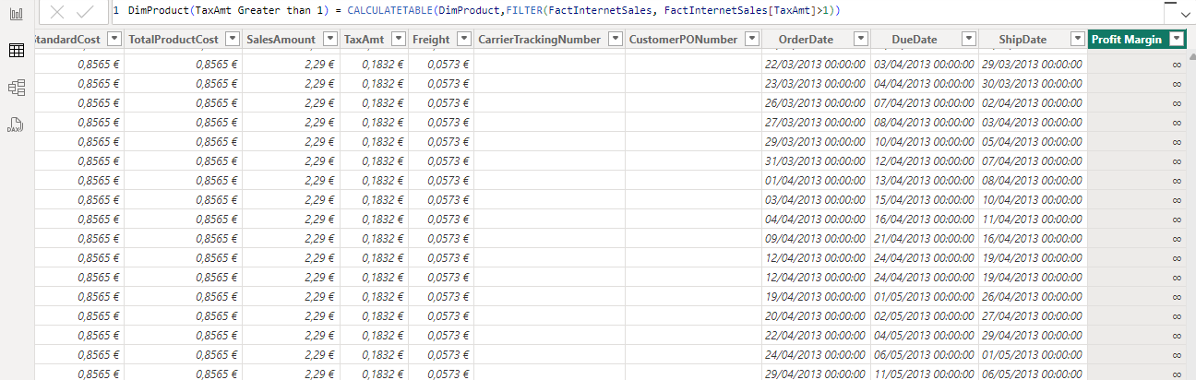
IFFERROR
Note: This demo uses the FactInternetSales table from the Adventureworks2016 database
Start by creating a calculated column that calculates profit margin
Profit Margin =
(FactInternetSales[UnitPrice] - FactInternetSales[ProductStandardCost])
/FactInternetSales[ProductStandardCost]
Trying to cause a divide by zero operation by rounding the standard cost of the product
Profit Margin =
(FactInternetSales[UnitPrice] INT(FactInternetSales[ProductStandardCost]))
/INT(FactInternetSales[ProductStandardCost])
Note that among the values mentioned there are infinity symbols

Slide 3
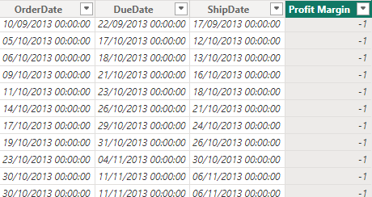
IFFERROR
Try putting the whole expression into an IFERROR function , indicating that the value represented when divided by 0 is -1
Profit Margin = IFERROR(
(FactInternetSales[UnitPrice] - INT(FactInternetSales[ProductStandardCost]))
/INT(FactInternetSales[ProductStandardCost]), -1)
Notice that the infinity value is replaced by -1

Slide 4
Thank you
Thank you

