Slide 1
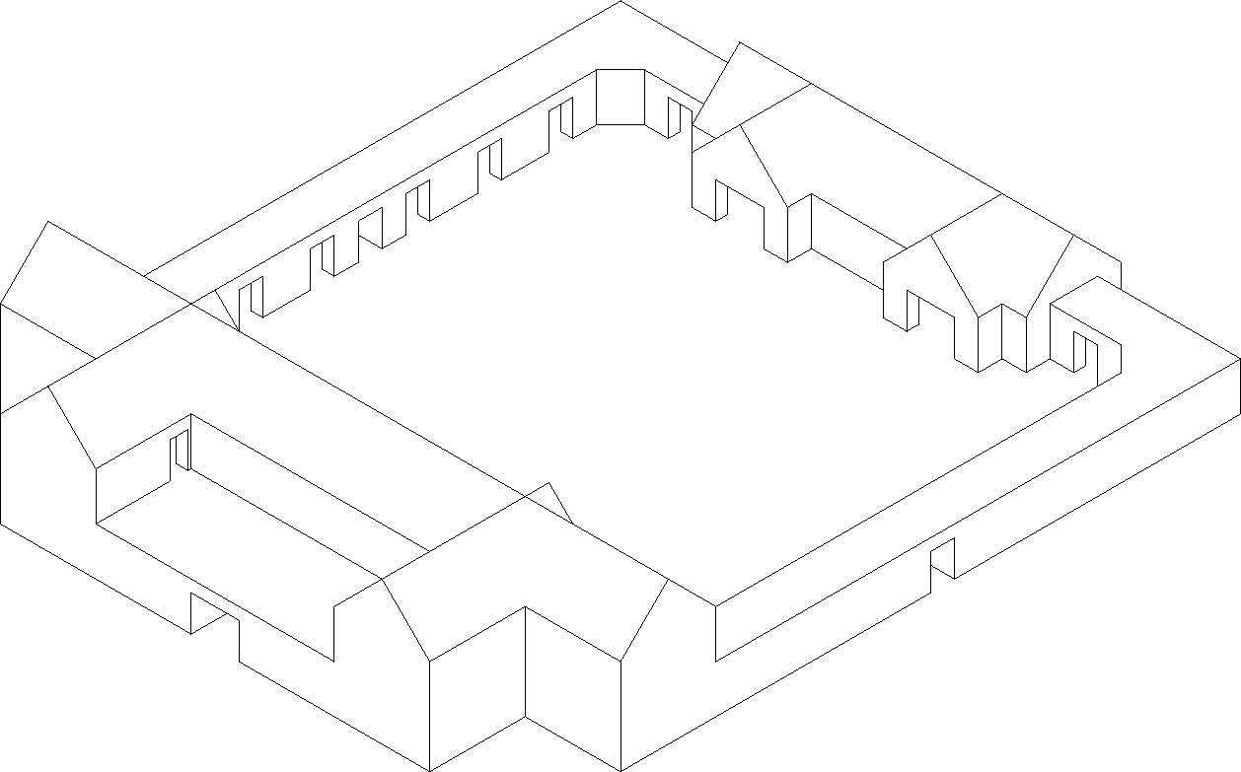
Elevations
Front
Side
Rear

Slide 2
B1
Cellar
Chapel

Slide 3
1F
Library
Tavern
Tele-
portation
Circle
Reception
Kitchen
Caravansary
Bath House

Slide 4
2F
Balcony
Open Space
BR
BR
BR
BR
BR
BR
BR
BR

Slide 5
Roof

