Slide 1
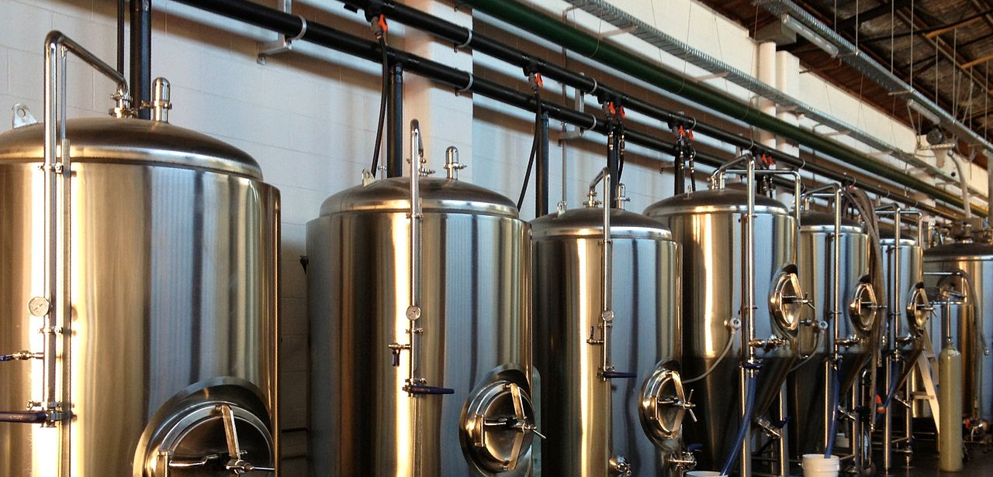

Brewpedia
This Photo by Unknown Author is licensed under CC BY-SA
Ashish Desai
Bejirose K. Stanly
Poonam Kushwaha
Renee Gillmore

Slide 2
Source List
Ashish
https://googles.p.rapidapi.com/breweries
https://api.openbrewerydb.org/breweries
https://www.kaggle.com/
Bejirose
https://maps.googleapis.com/maps/api/geocode/json
https://maps.googleapis.com/maps/api/place/nearbysearch/json
https://sandbox-api.brewerydb.com/v2/breweries
Poonam
https://maps.googleapis.com/maps/api/place/textsearch/json
Renee
https://www.wine-searcher.com/contact-general?action_F=contactUsViaForm&contact_return_F=/api&subject_F=Trade%20Enquiry%2DAPI%20FREE%20TRIAL

Slide 3
Source Limitations
Unable to get API Key (TripAdvisor API)
Limited API request calls (Beermapping API)
Limited dataset(Google API)
Limited data for data analysis (Kaggle.com)

Slide 4
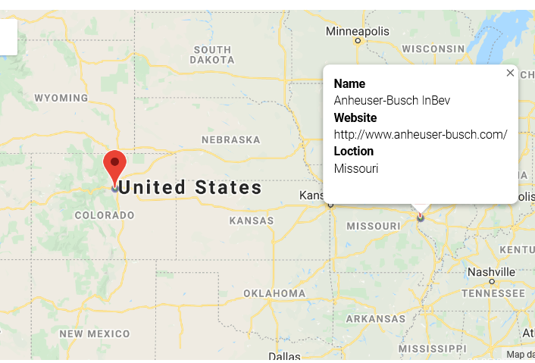
Random US Brewery List
Queried breweryDB API
Cleaned data with no Latitude and Longitude
Marked using latitude and longitude
Heatmap on rating
Pinned on Brewery Name and Website

Slide 5
Add text

