Slide 1

Brewpedia
Ashish Desai
Bejirose Satnley
Renee Gillmore
Poonam Kuswaha

Slide 2
Find list of api’s
https://www.brewerydb.com/developers
https://www.openbrewerydb.org/documentation/01-listbreweries
https://rapidapi.com/blog/best-beer-wine-alcohol-api/
https://www.programmableweb.com/category/Beer/apis?category=20058
https://www.programmableweb.com/api/
https://www.globalwinescore.com/account/api/#

Slide 3
Source of list
Poonam : https://maps.googleapis.com/maps/api/place/textsearch/json
Place API : https://maps.googleapis.com/maps/api/place/textsearch/json
Params { “Brewery in Arizona, AZ“ , “restaurant,bar”}
CSV File: breweries.csv file
Search for state = “Arizona”

Slide 4
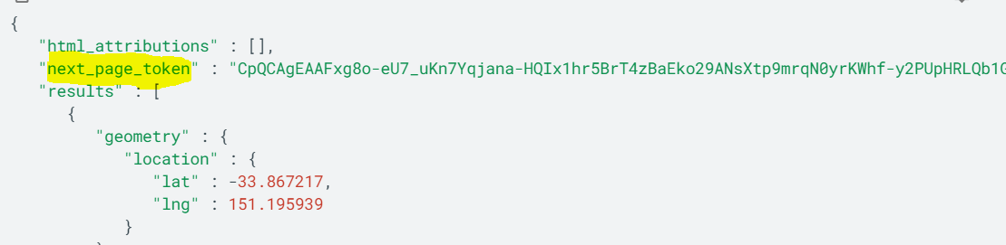
Data source Limitation
Google API’s : Limited dataset (20 record).
By default, each Nearby Search or Text Search returns up to 20 establishment results per query; however, each search can return as many as 60 results, split across three pages. If your search will return more than 20, then the search response will include an additional value — next_page_token. Pass the value of the next_page_token to the pagetoken parameter of a new search to see the next set of results.

Slide 5
Data cleansing
Issue faced
Missing address
Missing city
Removing NaN (NULL)

Slide 6
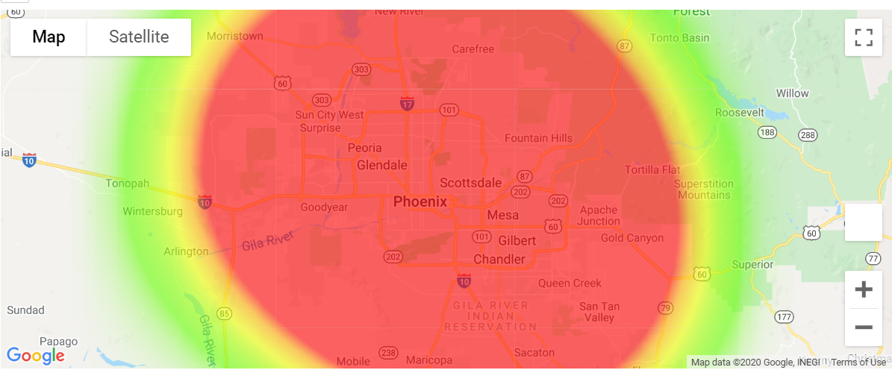
Jupyter GMAP heat layer

Slide 7
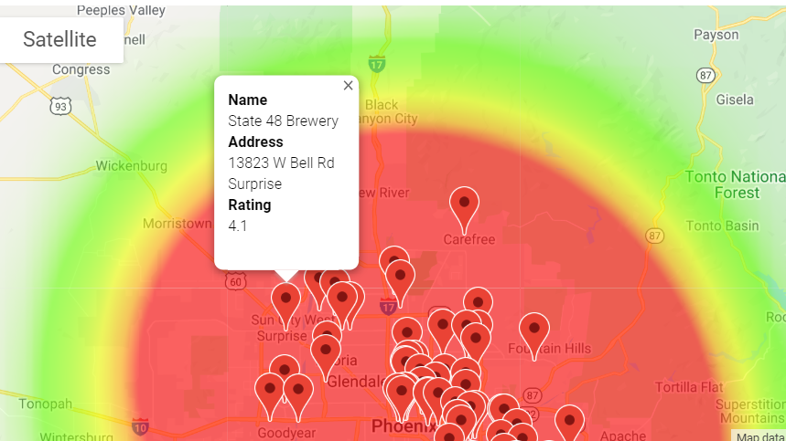
Jupyter GMAP marker with name,address & Rating

Slide 8
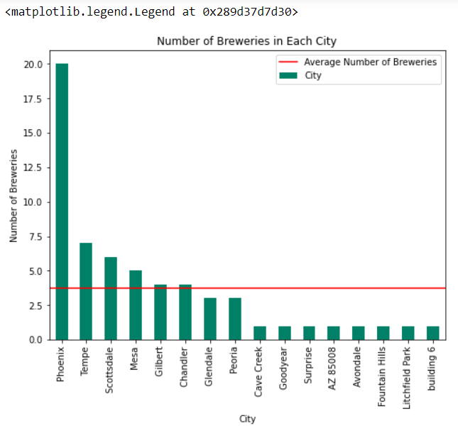
Jupyter matplotlib

Slide 9
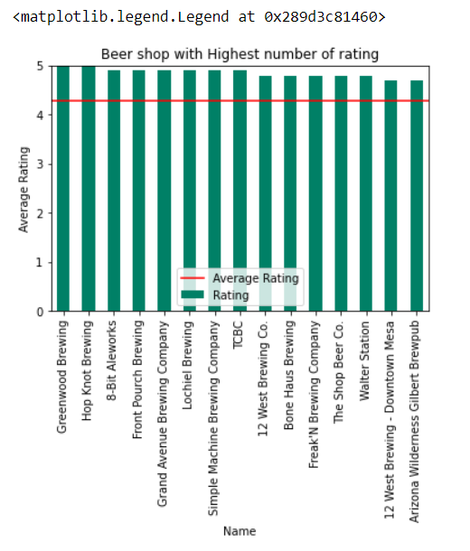
Jupyter matplotlib based on average rating.

