Slide 1
Interactive digital portfolio
PROJECT
Presented By:
1. Bejjanki Sharvani-Malla Reddy Engineering college for women -CSE

Slide 2
OUTLINE
Problem Statement
System Development Approach
Algorithm & Deployment
Result
Conclusion
References

Slide 3
Problem Statement
Traditional resumes and CVs have a static format
They have a limited ability to showcase skills, experience, and personality.
A responsive webpage with interactive visuals, project showcases, and real-time updates provides a dynamic way to present work and achievements.
It makes it easier for potential employers or clients to get a comprehensive understanding of a person's capabilities.
Such a webpage is a more effective way to showcase skills and experience compared to traditional resumes and CVs.

Slide 4
System Approach
Frontend Technologies:
HTML5 – Structure of the webpage
CSS3 – Styling and responsive layouts
JavaScript – Dynamic interactivity (cart, filtering, total calculation)
Design Approach:
Clean and user-friendly interface
Mobile-responsive design
Modular separation of HTML, CSS, and JS files

Slide 5
Algorithm & Deployment
Portfolio Creation
Define project categories and details (image, description, skills used)
Frontend Design Layout using HTML and CSS (grid & cards)
Interactive Features
Dynamic project showcases with modal views for details
Filtering projects by category or skill
Real-time updates for project showcases
Design Approach
Clean and minimalistic design
Mobile-responsive layout for optimal viewing on various devices
Testing
Test for mobile responsiveness and cross-browser compatibility
Ensure all interactive features work as expected
Deployment
Host using GitHub Pages or Netlify for free and easy access
Ensure cross-browser compatibility and smooth performance
Here's the matter for a responsive portfolio in the specified format:- *Portfolio Creation* - Define project categories and details (image, description, skills used) - Frontend Design Layout using HTML and CSS (grid & cards)- *Interactive Features* - Dynamic project showcases with modal views for details - Filtering projects by category or skill - Real-time updates for project showcases- *Design Approach* - Clean and minimalistic design - Mobile-responsive layout for optimal viewing on various devices- *Deployment* - Host using GitHub Pages or Netlify for free and easy access - Ensure cross-browser compatibility and smooth performance- *Testing* - Test for mobile responsiveness and cross-browser compatibility - Ensure all interactive features work as expected

Slide 6
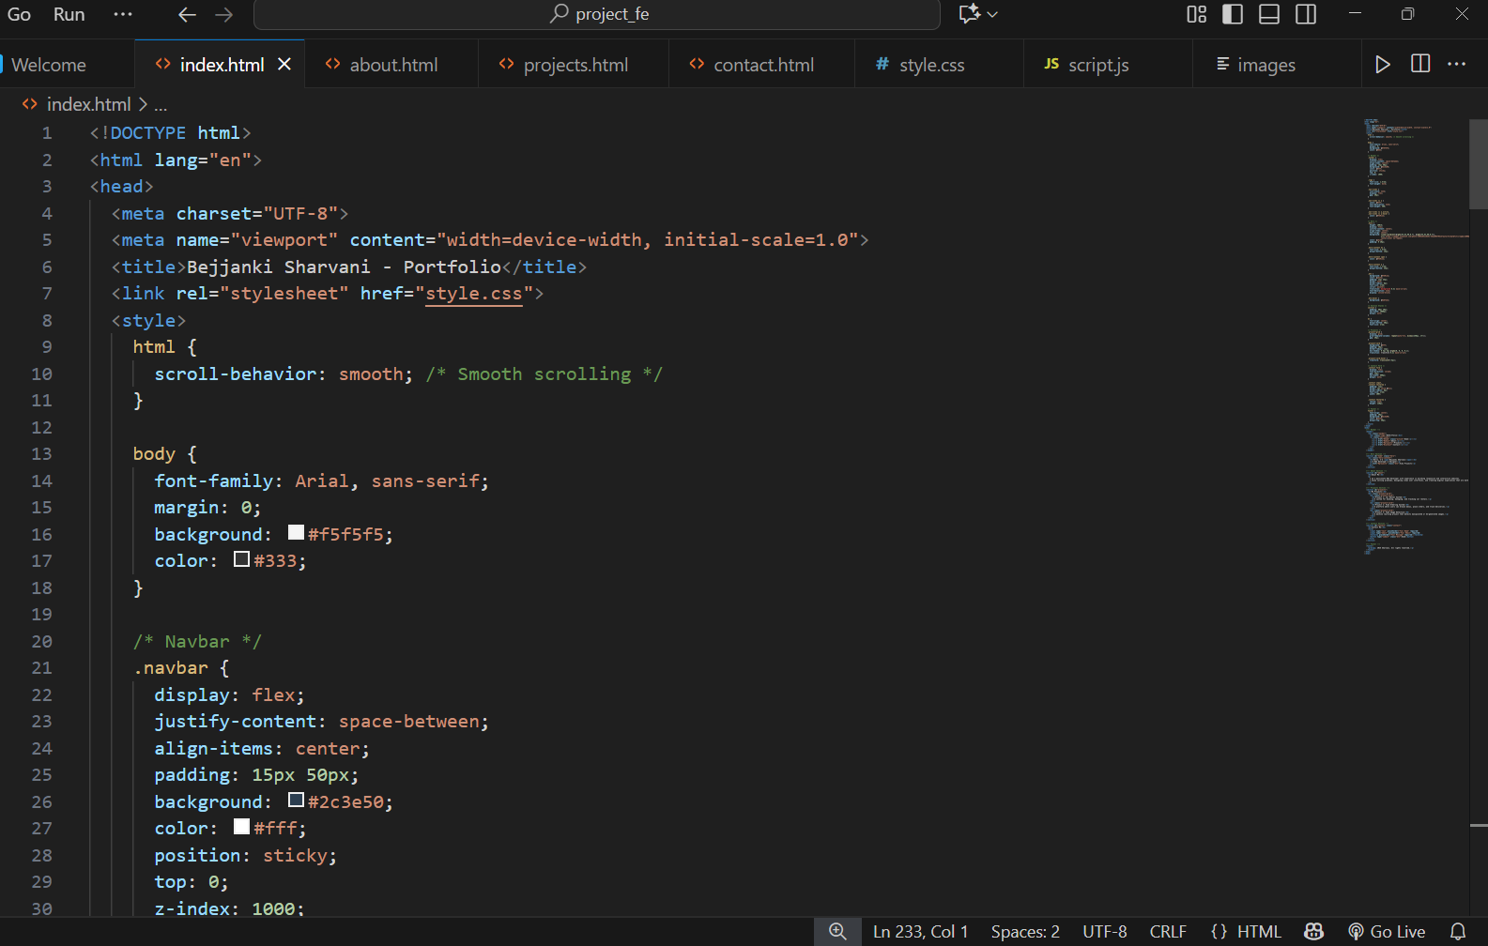
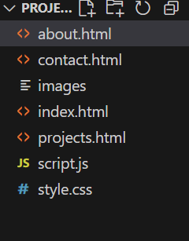
Result
Project structure
Index.html

Slide 7
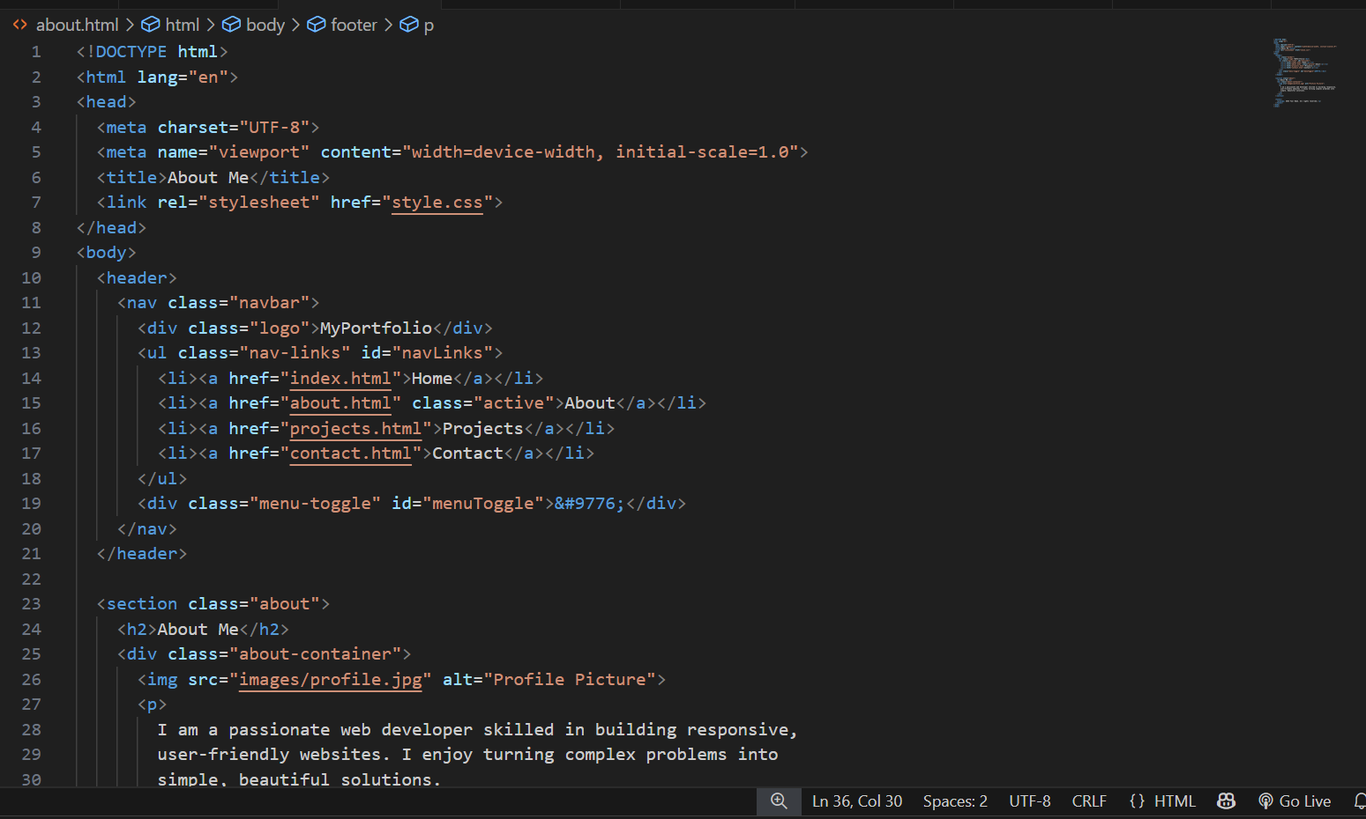
About.html

Slide 8
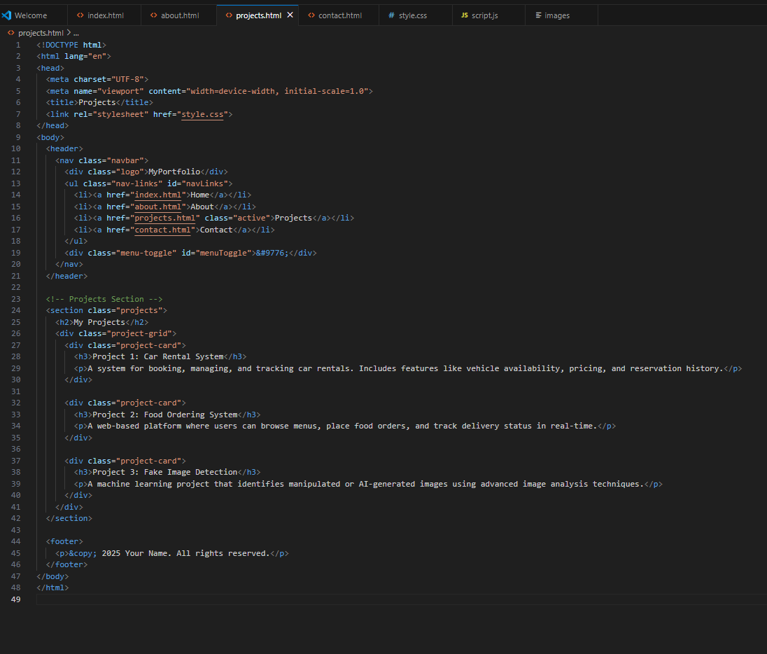
Project.html

Slide 9
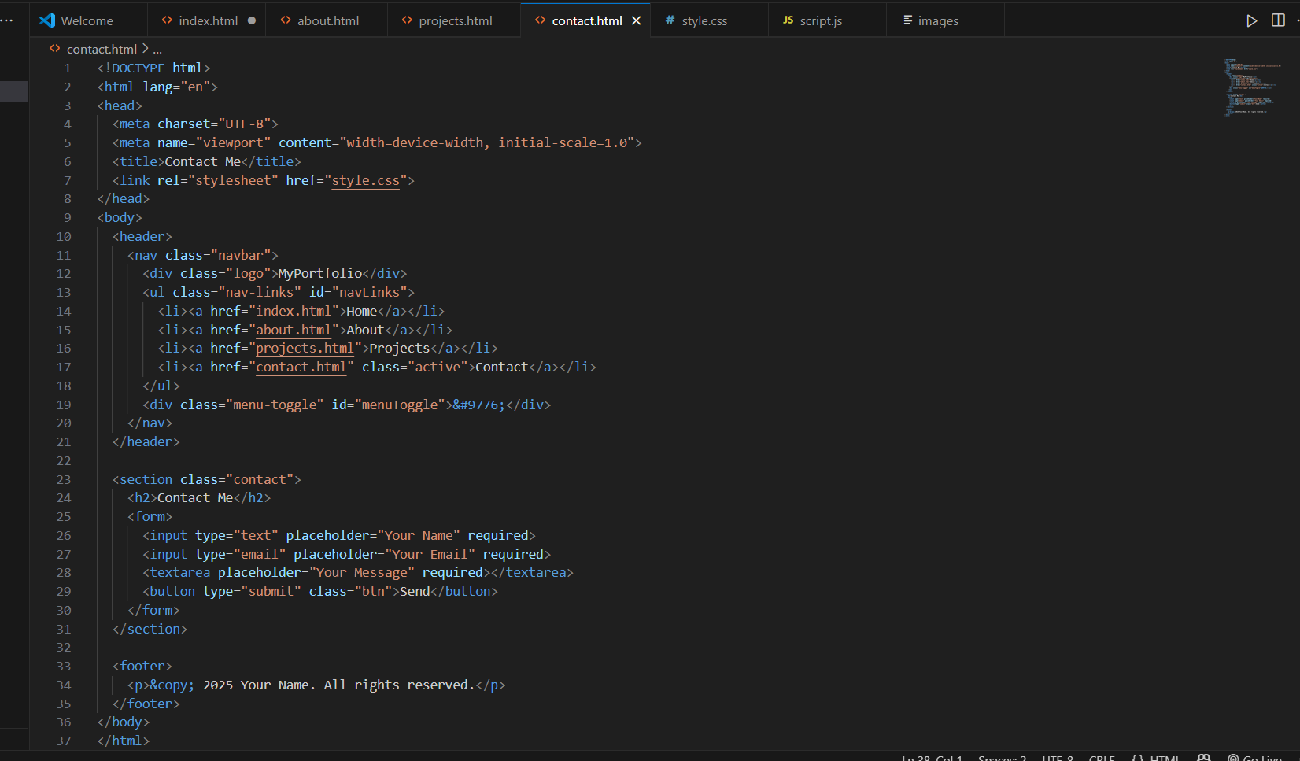
Contact.html

Slide 10
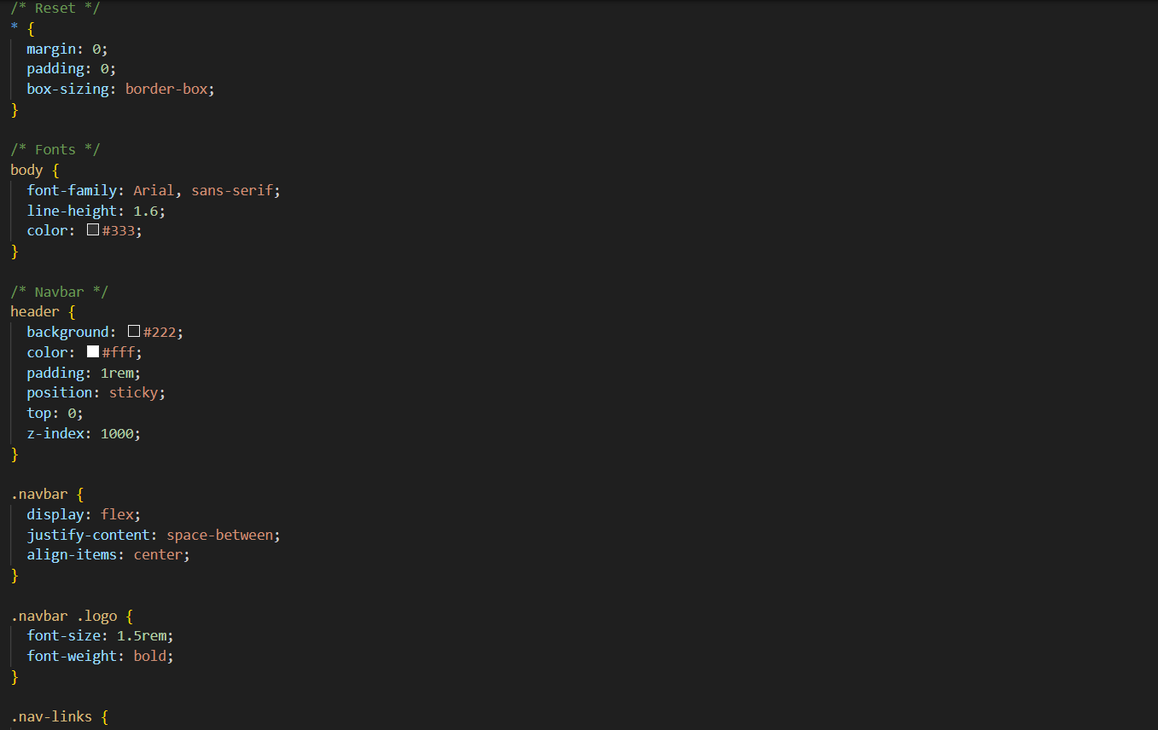
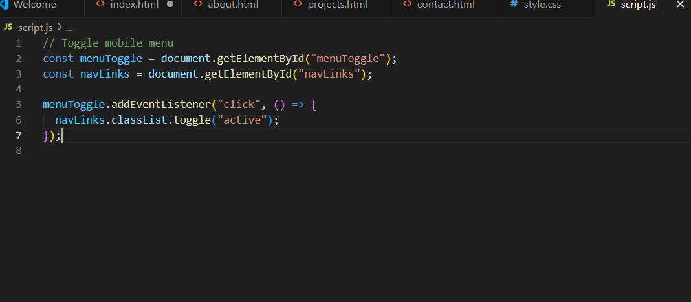
Style.css
Scrip.jss

Slide 11
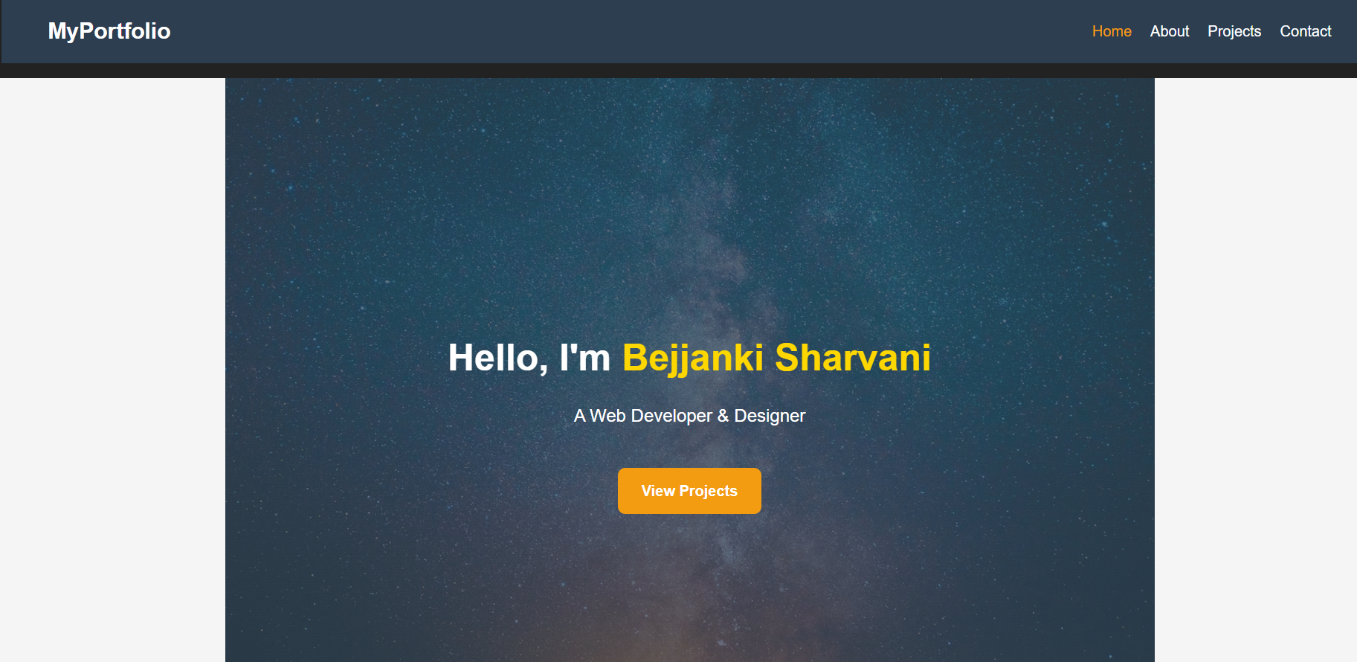
Web pages

Slide 12
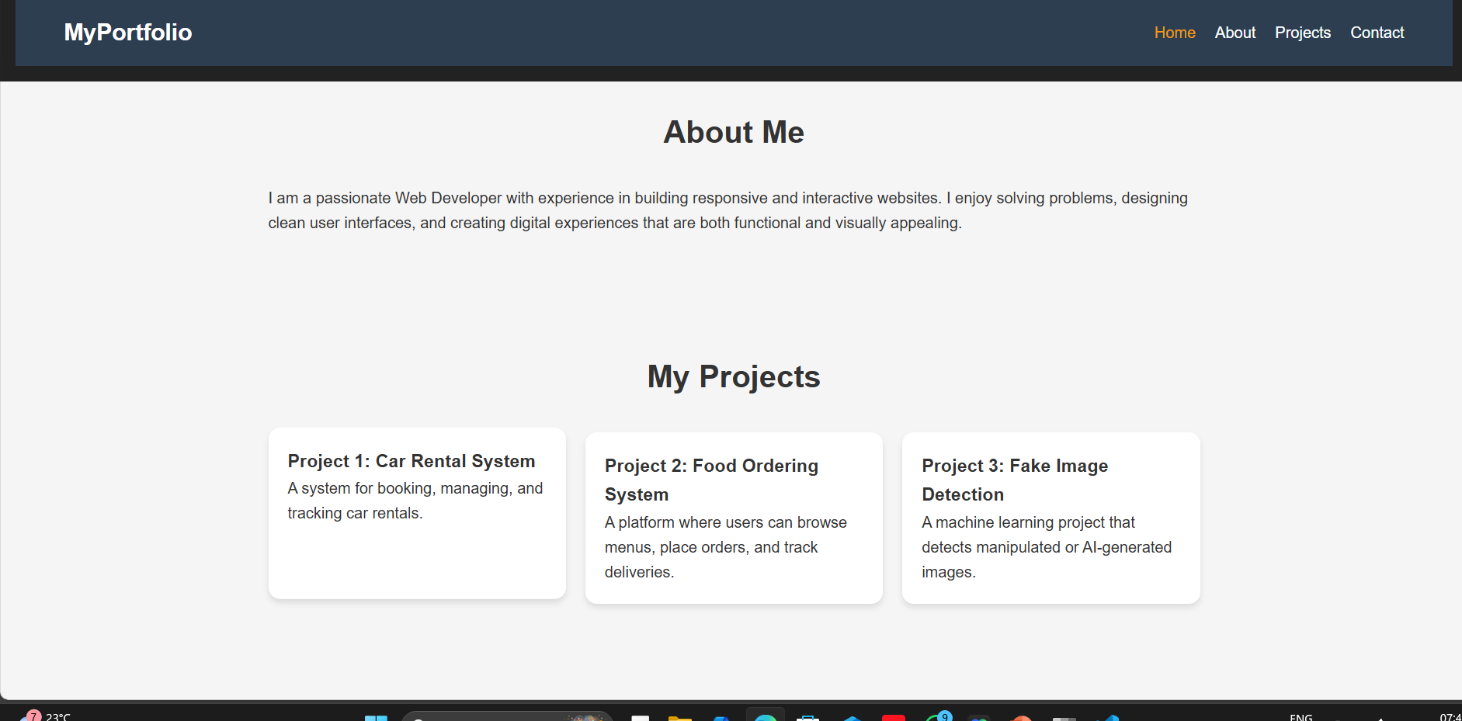

Slide 13
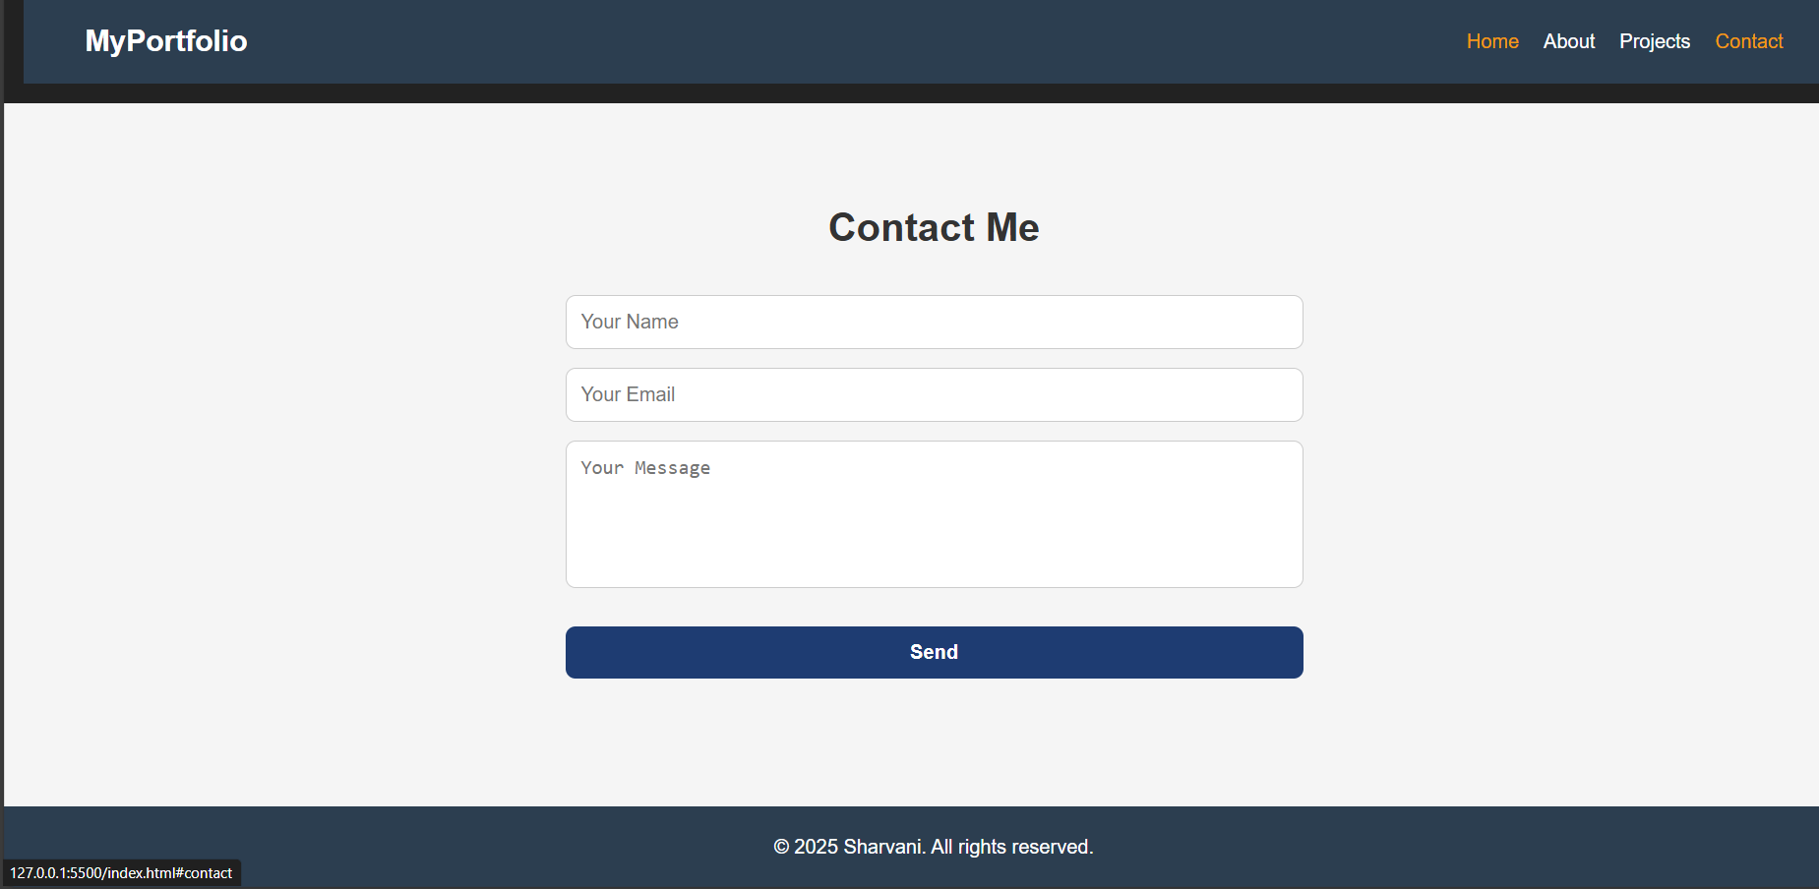
Git hub link :https://github.com/bejjanki-17/interactive-digital-portfolio

Slide 14
Conclusion
Built a responsive multi-page portfolio using HTML, CSS, and JavaScript.
Implemented navigation, project links, and mobile-friendly design for better user experience.
Deployed on GitHub Pages, making the portfolio accessible online and easy to update.

Slide 15
References
MDN Web Docs – HTML
MDN Web Docs – CSS
MDN – Responsive Design Basics
GitHub Pages Guide
FreeCodeCamp – How to Build a Portfolio Website

Slide 16
THANK YOU

