Slide 1

PRISM PULSE
Know exactly how your business is doing, every single day
Intelligence & Analytics for owners who run the business, not just watch it.
Notes:
Open with the promise: clarity every day, without needing an accounting background.

Slide 2



Most owners find out too late
Scattered spreadsheets
End-of-month surprises
Unpaid bills & dues
Sales in one file, expenses in another, nothing ties together.
You learn about a margin leak weeks after it started.
Who owes you, and whom you owe, lives in someone's head.

Slide 3
Three steps, a couple of minutes a day
1
2
3
Log it
We crunch it
You decide
Enter today's sales, purchases and expenses: one by one, in bulk, or imported from a spreadsheet.
Margins, trends, ledgers and comparisons are produced automatically.
See what's driving growth and what's quietly draining profit, before it becomes a problem.

Slide 4








Made for any business with daily Sales / Revenue
Hospitals
Restaurants
E-commerce
Services
Wholesale
Manufacturing
Retail
...and more

Slide 5

Fast daily entry & imports
Capture the day in seconds. No accounting background needed, just enter what happened.
Quick add: sales, expenses and purchases from the dashboard.
Bulk entry: a whole day's rows in one grid.
Spreadsheet import: upload sales, review, then commit.
Daily report: a clean snapshot of any day, as PDF.

Slide 6

Ledgers for every relationship
Running-balance ledgers keep every customer, vendor, bank account and partner always current.
Customer ledgers: what each customer bought and paid.
Vendor ledgers: balance owed to every supplier.
Bank accounts: balances and transfers between accounts.
Partner ledgers: capital and withdrawals by partner.

Slide 7

Receivables, payables & cash
Know what's owed to you, what you owe and what cash you actually have, live.
Receivables: record payments against customer dues.
Payables: track vendor bills and settle them.
Aging report: dues bucketed by days overdue.
Cash position: cash in hand and upcoming obligations.

Slide 8

Sales & purchase intelligence
Auto-generated insights show what's gaining momentum and what's losing it.
Revenue intelligence: which channel, product or department drives income.
Cost intelligence: every cost category compared month to month.
Patterns: best-selling days and payment-mode mix.
Early warnings: catch creeping expenses sooner.

Slide 9

Reports you want any time for :
Monthly summaries, category statements and full reports for any period you choose.
Monthly & yearly summaries: revenue, bills, average bill.
Category statements: drill into any category.
Financial statements: P&L, Balance Sheet, Cash Flow.
Export anywhere: PDF, Excel and CSV.

Slide 10
See it in action: six months at a glance
₹31.8L
September revenue
68.4%
net margin
183
bills in the month
Demo data: a multi-department hospital using the app for daily revenue and costs.

Slide 11
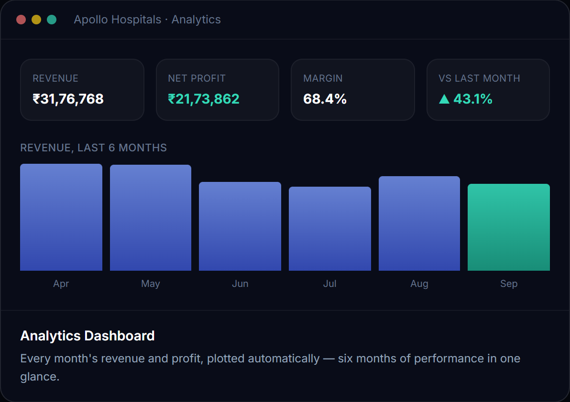
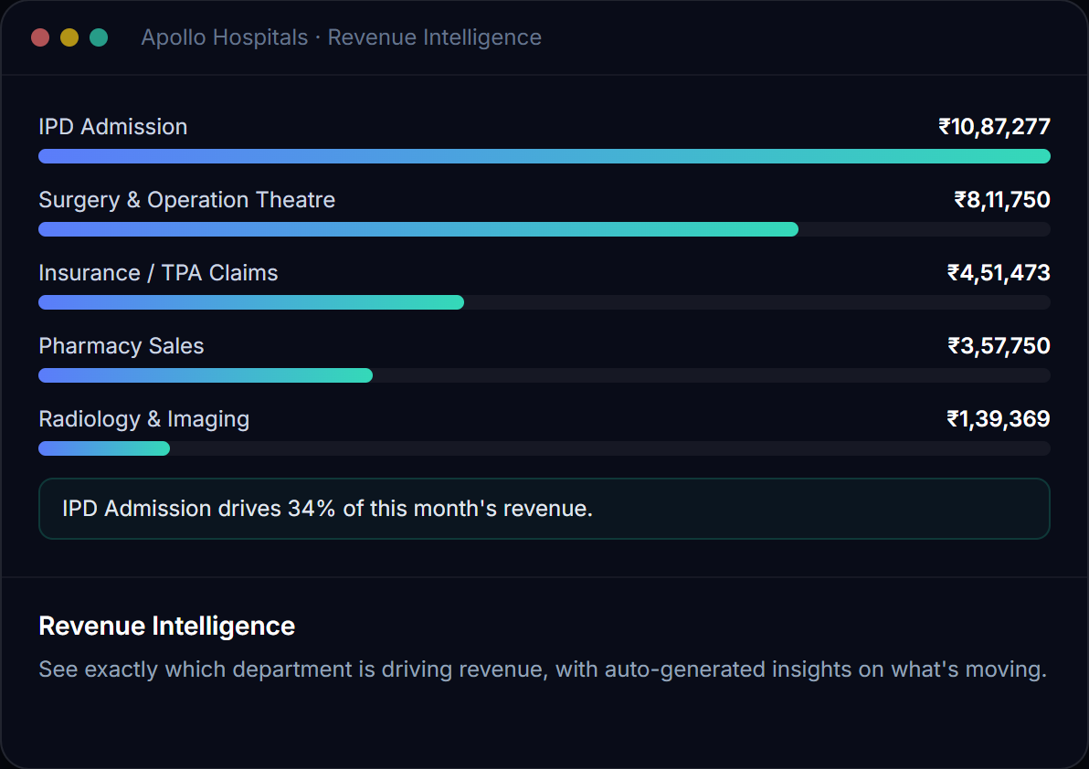
Your dashboard and revenue drivers
Real numbers from a live account: a multi-department hospital using Prism Pulse every day.

Slide 12
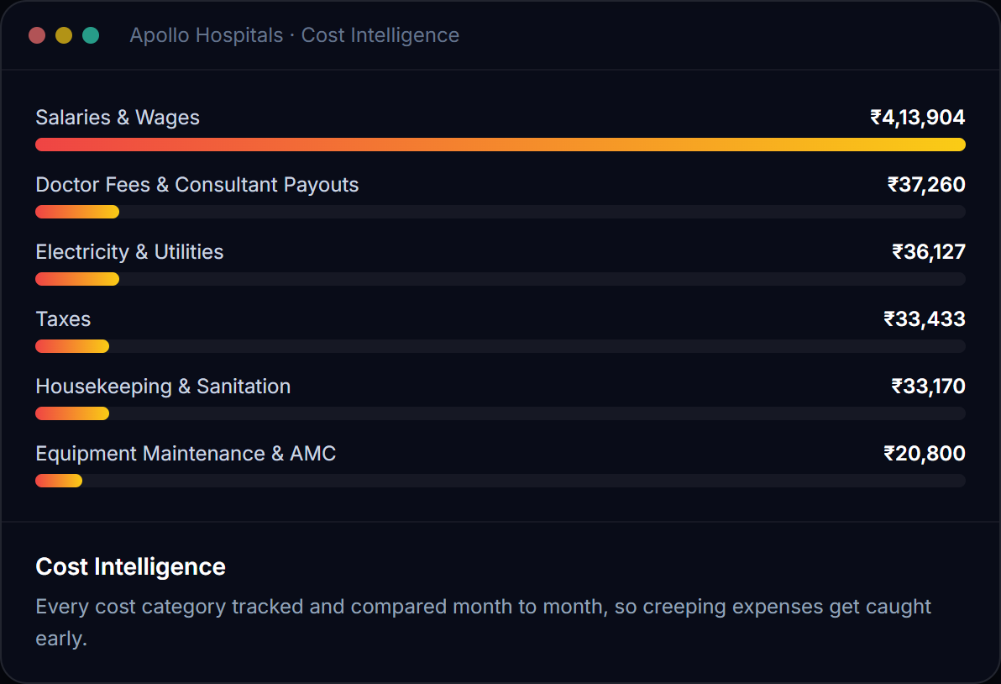
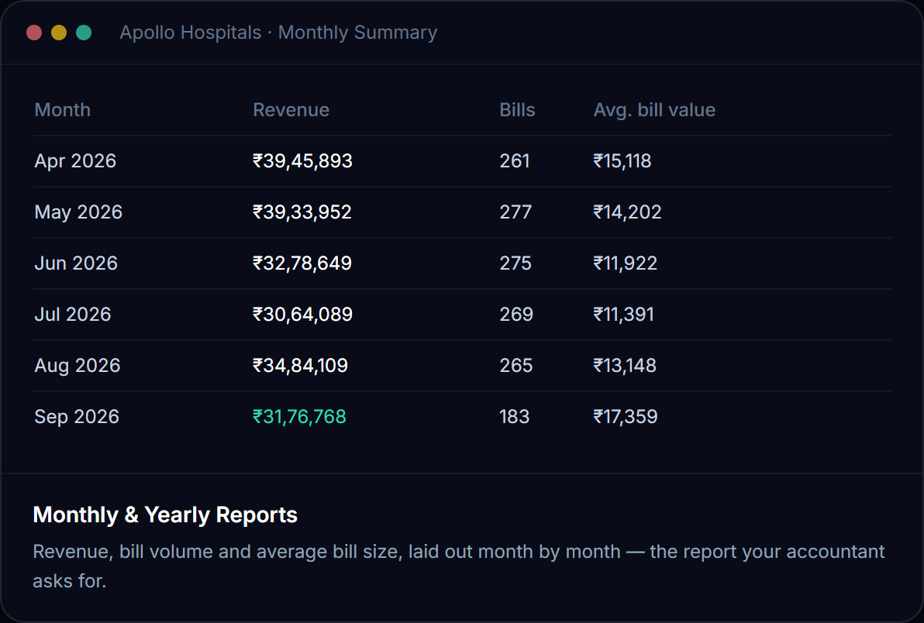
Where the money goes, month by month
Real numbers from a live account: a multi-department hospital using Prism Pulse every day.

Slide 13
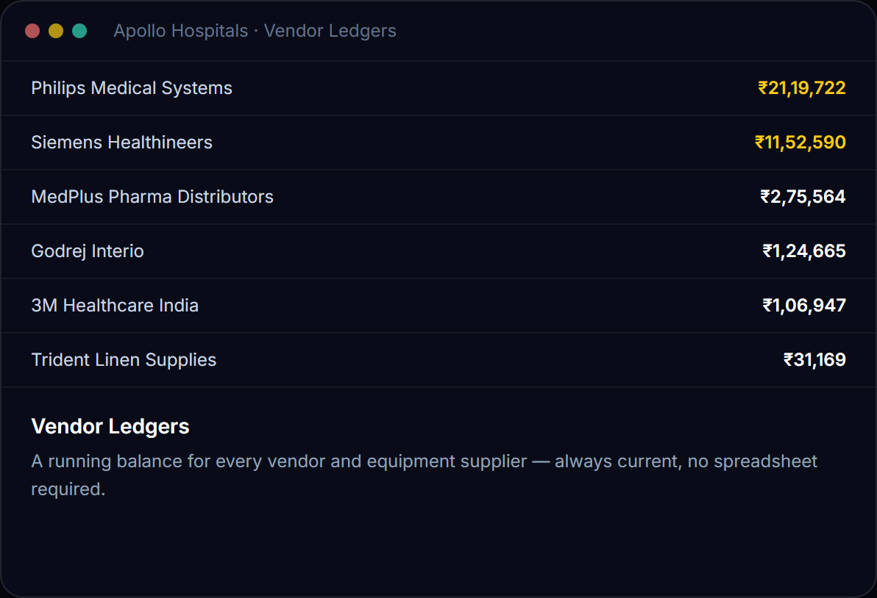
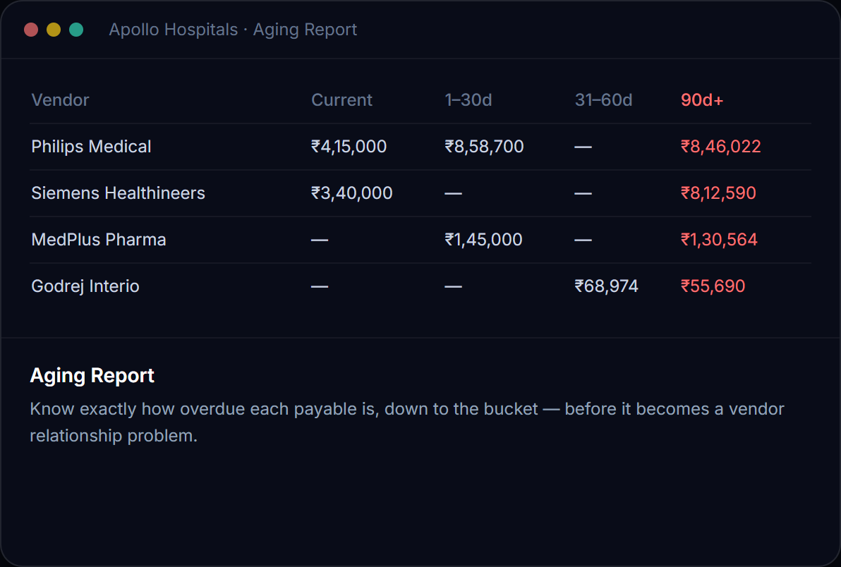
Vendor balances and what's overdue
Real numbers from a live account: a multi-department hospital using Prism Pulse every day.

Slide 14


Your data, your choice
Your own Google Drive
Prism Pulse managed database
Data lives in a Google Sheet in your Drive
You own the file: open or export any time
We never keep a copy of your financial data
We touch only the one Sheet we create
No Google account needed
Secure and managed for you
Dedicated, isolated data store
Switch later with a storage change request

Slide 15




Private by design, simple for a team
Isolated workspace
Team access
Every organization gets its own data store, never shared or mixed.
Owner plus manager logins, sized to your plan.
Secure sign-in
Always portable
Protected accounts and encrypted connections.
Export your reports and data whenever you need them.

Slide 16




Simple plans, transparent billing
Start free
Pick your plan
Pay your way
Clear invoices
Try it with your own data. No credit card required.
Plans by storage choice and team size, monthly or yearly.
Card, UPI and netbanking via Razorpay, with optional autopay.
Invoices, payment history and coupons on one billing page.

Slide 17

See what your numbers have been trying to tell you
Create your organization, free. Your own data, set up in minutes.
Start free today

Slide 18



Let's talk
Questions before you sign up? Reach out directly.
EMAIL
prismpulse.intelligence@gmail.com
Free to start. No credit card required.
PHONE
97 00 36 48 00

