Slide 1
Redfin Housing Market Analysis Project
Project Introduction and Overview

Slide 2
Project Overview
Exploring Housing Market Dynamics with Redfin Data
Goal: To explain how housing characteristics affect price, rather than to predict exact sale prices
  Understand which factors (size, location, year built) most influence housing prices
  Compare market characteristics between selected cities
  Communicate findings clearly through data visualization and regression interpretation
Core Questions
  Which factors (size, location, year built) drive price the most?
  How do prices differ across counties? Select 2~3 cities? Why?
  Can we build a model that accurately predicts housing prices?

Slide 3
Methodology & Tools
Step 1. Data Import & Cleaning – Pandas, NumPy
Step 2. Exploratory Data Analysis (EDA) – Visualization with Matplotlib
Step 3. Modeling – Linear Regression (Scikit-learn)
Step 4. Communication – Final report & presentation (Jupyter/Colab + PPT)

Slide 4
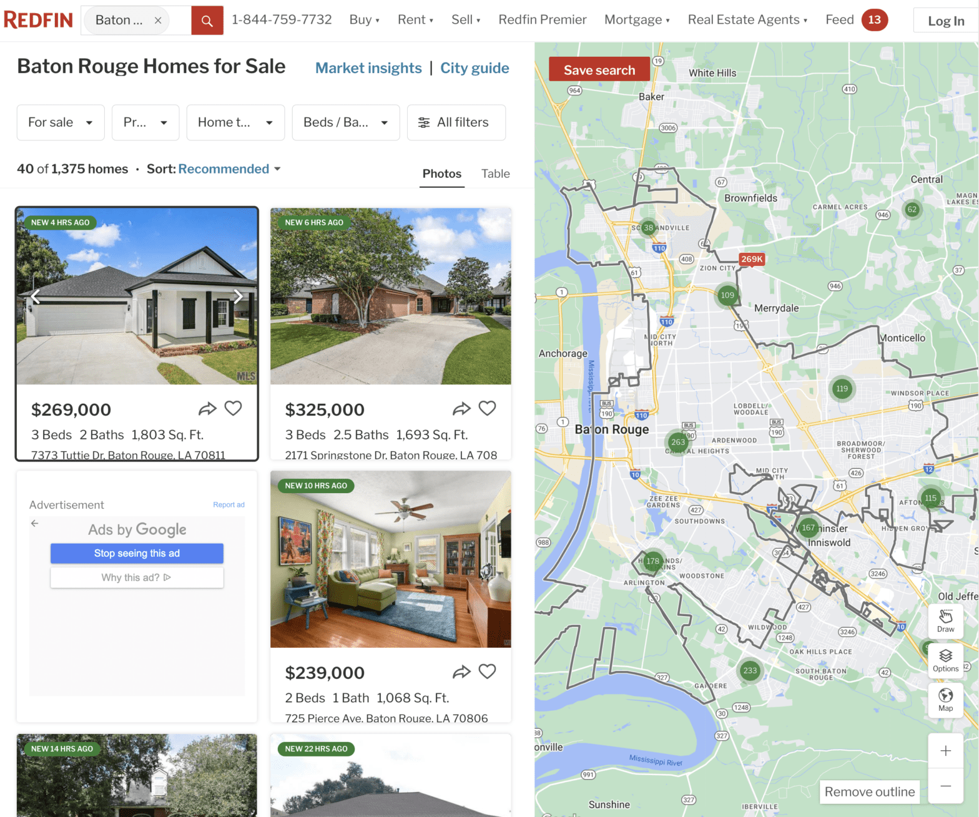
Data Source
Source: Redfin (https://www.redfin.com)
Redfin provides real estate listings including:
  Price, Beds, Baths, Square Feet
  Days on Market, Year Built
  City and State
Each row = one property listing
Each column = an attribute of that property.

Slide 5
How to Obtain the Data
Choose a city or region (e.g., Seattle, Austin, Boston)
Go to Redfin search page → Scroll down → Click 'Download Data'
Save the CSV file and load it into Python using pandas.read_csv()
Each team should select a different city for diversity.

Slide 6
Example Variables
These variables will form the basis of your exploratory and regression analysis.
  PRICE : Listing price ($)
  BEDS : Number of bedrooms
  BATHS : Number of bathrooms
  SQUARE FEET : Property area
  DAYS ON MARKET : Market duration
  YEAR BUILT : Construction year
  CITY : Location
  etc..

Slide 7
Expected Outcomes
Data-driven insights into housing markets
Regression model predicting housing prices
Team collaboration in full data science workflow
Practical skills: cleaning real-world data, visualization, modeling, storytelling

Slide 8
Deliverables
Jupyter Notebook (.ipynb):
  Load your Redfin CSV data
  Create basic visualizations (price histograms, scatter plots)
  Write a short paragraph summarizing potential research questions.
  Linear Regression & Interpretation.
PPT slides and report

Slide 9
Evaluation Criteria
Category | Total Points | C | B | A
Project – Final Report | 10 pts | • Insufficient data presented • Report written with little effort • (6) | • Adequate data and proper format • Reasonably well-organized • (8) | • Clear structure and logical flow • Provides meaningful insights from analysis • (10)
Project – Presentation | 10 pts | • Slides are lengthy and unfocused • Reads directly from slides • (6) | • Well-prepared slides • Delivery needs more rehearsal • (8) | • Answers questions appropriately • Presents clearly and coherently • (10)
Peer Review | 5 pts | 3 | 4 | 5
Expert Evaluation – Presentation | 15 pts | • Slides are lengthy and unfocused • Reads directly from slides • (9) | • Well-prepared slides • Delivery needs more rehearsal • (12) | • Answers questions appropriately • Presents clearly and coherently • (15)

Slide 10
Key Guidelines
Focus on explanation, not prediction
Each team selects a different city
Explore how size, age, and location influence price
Use EDA to tell a clear data story
Prepare cleaned data for regression analysis.

