Slide 1
RESPONSIBLE ML AUDIT
HMDA 2024 Mortgage Approval Model
Predicting loan approval from the 2024 HMDA Loan Application Register
Group 6 | DNSC 6330 Responsible Machine Learning | GWU | May 2026
Presented to the Internal Review Board
Measure
Diagnose
Document

Slide 2
OVERVIEW
Audit Framework: Five Questions
Q1
Optimization Objective
Q2
Known Failure Modes
Q3
Subgroup Error Measurement
Q4
Residual Risks After Mitigation
Q5
Is Deployment Defensible?
2 / 18
Notes:
Jenny

Slide 3
DATA
HMDA 2024 — Dataset at a Glance
17M+
3.96M
74.4%
50 States
Total Applications
After Filtering
Approval Rate
Geographic Scope
Label Construction
Race Breakdown
action_taken = 1
→ Label 1 (Approved)
action_taken = 2
→ Label 1 (Approved)
action_taken = 3
→ Label 0 (Denied)
4, 5, 6, 7, 8
→ Excluded
3 / 18
Notes:
Jenny

Slide 4
Q1 OPTIMIZATION OBJECTIVE
What Is the Model Optimizing For?
Primary Metric: AUC-ROC
Who Bears the Cost?
AUC measures discrimination across all thresholds
Applicants
Denied access to credit if FPR is high for minority groups
More robust than accuracy under 74/26 class imbalance
Lenders
Threshold = 0.80 to reduce false approvals while monitoring subgroup FNRs
Regulatory risk if model violates ECOA or Fair Housing Act
Business rationale: lenders need a model that separates likely approvals from denials better than accuracy alone
Regulators
⚠ Known Tradeoff
Systemic fair-lending violations if AIR < 0.80 not flagged
Optimizing overall AUC can hide poor subgroup performance. GBT scores 0.838 overall but only 0.815 for Black applicants — a gap that carries real-world consequences.
Community
Redlining if geographic proxies encode race implicitly
4 / 18
Notes:
Jenny

Slide 5
Q1 OPTIMIZATION OBJECTIVE
⚠ Protected Attributes
Featured used in Modeling
Race, Sex, Applicant Age, State Code
Feature | Definition
Income | The gross annual income, in thousands of dollars, relied on in making the credit decision, or if a credit decision was not made, the gross annual income relied on in processing the application
Property Value | The value of the property securing the covered loan or, in the case of an application, proposed to secure the covered loan, relied on in making the credit decision
Debt-to-income Ratio | The ratio, as a percentage, of the applicant’s or borrower’s total monthly debt to the total monthly income relied on in making the credit decision
ffiec_msa_md_median_family_income | FFIEC Median family income in dollars for the MSA/MD in which the tract is located
Loan Purpose | The purpose of covered loan or application
Reverse Mortgage | Whether the covered loan or application is for a reverse mortgage
Submission_of_application | Whether the applicant or borrower submitted the application directly to the financial institution
Business_or_commercial_purpose | Whether the covered loan or application is primarily for a business or commercial purpose
Occupany_type | Occupancy type for the dwelling
Construction_method | Construction method for the dwelling
6 / 18
Notes:
Franbon

Slide 6
Q2 FAILURE MODES
Where the Model Is Expected to Fail
Failure Type | Trigger Condition | Affected Group | Severity
Subgroup underperformance | Fewer minority training examples; higher variance | American Indian, Native Hawaiian | HIGH
Input gaming (evasion) | Applicant manipulates income or DTI to cross threshold | Sophisticated applicants | MEDIUM
Label-flip data poisoning | Insider flips approval labels in training data | Black applicants targeted in lab sweep | MEDIUM
Age disparity | Applicants >74 are below the threshold of 0.8 relative to applicants aged 45-54 | Elderly applicants (>74) | LOW–MED
6 / 18
Notes:
Franbon

Slide 7
Q2 EXPLAINABILITY
SHAP & LIME: What Drives Predictions?
LIME — GBT Top Features
Key Governance Findings
Black Applicant (P = 0.801)
Same top features, different weights
loan_purpose_1 ≤ 0
−0.168
Black and White applicants share the same top driver (loan purpose) but DTI and property value weights diverge, suggesting different decision logic by group.
0.06 < debt_to_income_ratio <= 0.61
+0.110
-0.01 < income <= 0.01
+0.035
DTI is the dominant risk signal
-0.04 < property_value <= 0.03
+0.019
The most denied applicants in both groups have DTI > 0.61, which LIME confirms contributes −0.37 to approval probability — the single largest feature impact.
White Applicant (P = 0.817)
loan_purpose_1 ≤ 0
−0.156
Proxy risk: tract_minority_population
0.06 < debt_to_income_ratio <= 0.61
+0.105
This geographic feature correlates strongly with race and appears in SHAP global importance. Including it as a model feature constitutes potential disparate treatment.
loan_purpose_4 <= 0
+0.040
-0.05 < property_value <= 0.03
+0.040
7 / 18
Notes:
Nick
When performing Lime and SHAP for the GBT model, we noticed that loan purpose, debt to income ratio, income, and property value are the main drivers of prediction. Globally, through SHAP, we see that that smaller predictors, like construction method and business/commercial purpose, are less significant predictors, but do act as supplemental information to inform the decision of application approval. We see that the DTI is also the strongest predictor on SHAP, having extremely strong importance to predicting approval and denials.
We see the LIME capture the middle approved applicants for both White (Non-Hispanic) and Black applicants. A few things to point out. One, the loan purpose being less than 0 has more of a negative weight on the black applicant than the white applicant by 0.01. However, it is notable that DTI has a larger positive weight for the Black applicant than the White applicant, which aligns with the fact that applicants with a lower DTI should be more inclined to be approved for a loan.
We also wanted to point out the significance of proxy risk that can be revealed by these tests. Tract_minority_population (Percentage of minority population to total population for tract, rounded to two decimal places), for instance, can indicate whether minority dense populations are an influence in predicting a loan. We also noticed that proxies such as tract_to_msa_income_percentage, derived_msa_md are proxy variables that should be excluded from the model.

Slide 8
Q2 COUNTERFACTUAL ANALYSIS
DiCE: What Would Flip a Denial?
DiCE generates counterfactuals: the minimum input changes needed to flip a model's decision. We ran DiCE on the GBT model varying income, DTI, property value, and MSA median family income.
Black Applicant — Approved (P=0.937)
N/A — Already Approved
Model approved at high confidence. No counterfactual needed — DTI in favorable range (0.06–0.61), purchase loan.
Black Applicant — Denied (P=0.035)
Reduce DTI or increase income
Denial driven by DTI > 0.61 (−0.37 LIME weight) and low income. Counterfactual: reduce DTI to 40.4% or increase income by ~55k.
White Applicant — Approved (P=0.937)
N/A — Already Approved
High confidence approval. Same feature profile structure as Black approved applicant — DTI and loan purpose are the key drivers.
White Applicant — Denied (P=0.033)
Reduce DTI or increase income
Same denial drivers as Black denied applicant. DTI > 0.61 and income below threshold. Counterfactuals require similar magnitude of change.
12 / 18
Notes:
Nick
We conducted DiCE to develop counterfactuals that would reveal how the applicant could change their variables and individualistic features. We did this indexed on the Black vs. White applicants, examining a protected group against a reference group. Each examination of each race is one for the most-approved applicant, and one of the least-approved applicant. The results show that in order for both the balck and white applicant to go from denied to approved, similar reduction in the DTI and increases income are needed. This aligns with our importance of the features, and also reveals that protected groups are not required to make more difficult changes to be approved

Slide 9
Q2 ML SECURITY
Adversarial Attack Surface
MEDIUM
Evasion (Input Gaming)
Evasion (Input Gaming)
Adversary: Applicant | Method: Manipulate income or DTI to cross 0.80 threshold
Finding: GBT: epsilon=0.1 shifts mean approval prob by -0.0054. LR more sensitive to gradient-based perturbation.
HIGH
Label-Flip Poisoning
Label-Flip Poisoning
Adversary: Insider / Data Handler | Method: Flip approved labels for Black applicants in training data
Finding: GBT: 5% poison rate produces delta AUC of only +0.0004 while fairness metrics shift materially — invisible to AUC monitoring
LOW
Membership Inference
Membership Inference
Adversary: API User | Method: Query model to determine if specific applicant was in training data
Finding: GBT MI AUC = 0.500, LR MI AUC = 0.500, no detectable privacy leakage. Near-zero gen gaps prevent exploitation.
Highest operational risk: label-flip poisoning by an insider — invisible to AUC and PSI monitoring. Requires subgroup-level FPR monitoring to detect.
14 / 18
Notes:
Bek

Slide 10
MODEL
Three Models Compared — GBT Selected
Baseline
SELECTED
Challenger
Logistic Regression
Gradient Boosting
Random Forest
Test AUC
0.781
Test AUC
0.838
Test AUC
0.843
Brier Score
0.145
Brier Score
0.122
Brier Score
0.121
AIR (approval)
0.923
AIR (approval)
0.945
AIR (approval)
0.938
Gen Gap
0.000
Gen Gap
0.001
Gen Gap
0.001
FPR Black
0.254
FPR Black
0.206
FPR Black
0.236
FPR White
0.239
FPR White
0.184
FPR White
0.254
Interpretable but lowest AUC; highest Black FPR.
GBT selected: highest AUC (0.838), lowest Brier (0.122), and lowest Black FPR (0.206), but residual subgroup gaps remain.
Strong Brier and gen gap, but higher Black FPR than GBT
9 / 18
GBT selected: strong AUC and Brier, lowest Black FPR, but subgroup gaps remain.
Notes:
Bek

Slide 11
Q3 SUBGROUP ERRORS — RACE
Disparate Impact Audit: Race (GBT Model)
Group | N (Test) | Approval Rate | AIR vs White | FPR | FNR | AUC
White (Non-Hispanic) | 488,758 | 53.8% | Reference | 0.184 | 0.359 | 0.833
Black / African American | 105,564 | 50.8% | 0.945 | 0.206 | 0.320 | 0.833
Hispanic or Latino | 121,967 | 58.8% | 1.093 | 0.220 | 0.257 | 0.847
Asian | 63,939 | 70.3% | 1.308 | 0.258 | 0.174 | 0.864
Am. Indian / AK Native | 9,432 | 47.9% | 0.891 | 0.158 | 0.340 | 0.849
AIR = group protected group approval rate ÷ reference group approval rate .
Note: Four-fifths rule:
AIR < 0.80 is flagged
Black AIR = 0.945, above the 0.80 threshold. However, Black FPR is higher than White FPR by 2.2pp and statistically significant.
Age >74 AIR = 0.898, above 0.80 but still lower than the 45–54 reference group. The main concern is the >74 female subgroup, where AIR falls below 0.80 . GBT age intersectional worst group: >74 Female at AIR 0.623. Requires ECOA review.
10 / 18
Notes:
Jenny

Slide 12
Q3 SUBGROUP ERRORS — SEX & AGE
Disparate Impact Audit: Sex and Age
By Sex (GBT Model)
By Age Group (GBT Model — ref: 45-54)
Female AIR = 0.938 (above 0.80 threshold). SMD = −7.03. Statistically significant but not practically flagged under current guidelines.
Applicants aged >74 have AIR = 0.64 and SMD = −36.0 (practically significant). ECOA protects against age discrimination — this warrants investigation.
Intersectional Analysis (Race × Sex)
Intersectional audit confirmed disparities invisible in single-attribute analysis. Combined race and sex subgroups reveal concentrated harm for specific applicant profiles that aggregate metrics would mask.
9 / 18
Notes:
Nick
Our preferred gradient boosting model was audited to measure disparate impact. While looking at Sex, we found that there is no evidence of disparate impact, except that the SMD is -10.11 between males and females. While it is statistically significant, it is not practically flagged under current guidelines. Yet, we see some evidence of disparate impact when conducting an intersectional analysis between race and sex. Native Hawaiian and Females are just above the 0.8 threshold, which could warrant frequent monitoring when the environment changes to ensure it does not go below the threshold. We also see that in an intersectional analysis between age and sex, older applicants, whether male or female, face disparate impact. This is a caution and a known failure mode of our model.

Slide 13
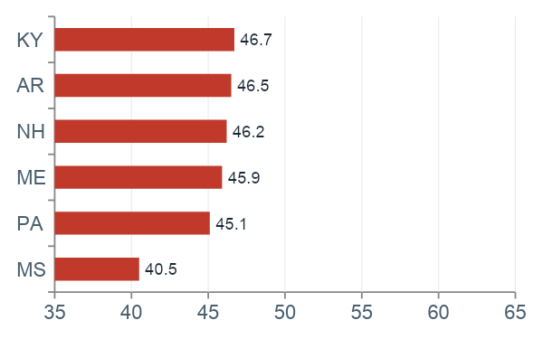
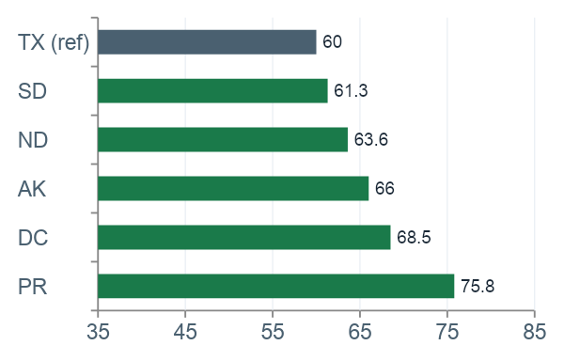
Q3 GEOGRAPHIC DISPARITY
State-Level Approval Rate Disparities
Approval rates from RF model. Reference group: Texas (TX) at 60.0%. All values are Percent Favorable from solas-ai AIR by State output.
Lowest Approval Rate States
Highest Approval Rate States
13 / 18
35-point spread: MS (40.5%) to PR (75.8%). TX reference at 60.0%. Mississippi is the lowest-performing state. Geographic disparity warrants deeper fair-lending review.

Slide 14
Q3 MODEL PERFORMANCE BY RACE
All Three Models: FPR by Race
GBT has the lowest FPR for Black/AA applicants (0.206) across all three models. RF has the lowest for Am. Indian (0.208). LR is highest across most groups.
13 / 18
Notes:
This chart compares false positive rates by race across GBT, Logistic Regression, and Random Forest. Higher FPR means the model is incorrectly denying applicants who were actually approved. GBT produces the lowest FPR for Black and African American applicants at 0.206, which was one of the main reasons we selected it. Logistic Regression generally performs worse across most groups, while Random Forest performs best for American Indian applicants at 0.127. The main takeaway is that no model performs best across every subgroup, which is why slice-level evaluation matters instead of relying only on aggregate AUC

Slide 15
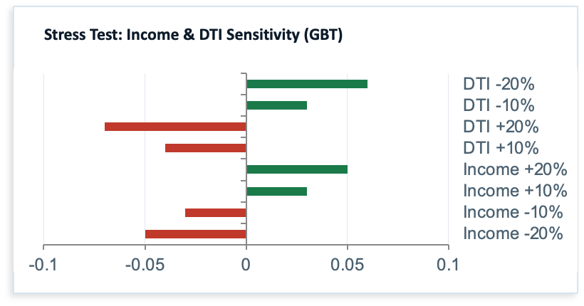
Q4 ROBUSTNESS & DRIFT
Model Stability Under Stress and Drift
0.0006
-0.0003
0.0008
Stable
GBT Gen Gap
(Train-Test AUC)
LR Gen Gap
RF Gen Gap
(pending)
PSI — Key Features
Drift Assessment
GBT and LR gen gaps near zero — no overfitting detected
All input features show PSI = 0.0 (Stable) — no covariate shift
DTI most sensitive: avg prediction range 0.73 vs income 0.03
Interest rate environment is primary post-2024 concept drift risk
GBT Brier = 0.122, LR Brier = 0.145 — GBT better calibrated
14 / 18
Notes:
Bek

Slide 16
Q4 RESIDUAL RISKS
What Remains After Mitigation?
Risk | Mitigation Attempted | Outcome | Accepted Residual
Racial FPR disparity (GBT Black FPR = 0.206 vs White 0.184) | Model selection (GBT outperforms LR/RF on Black FPR); threshold tuning | GBT lowest Black FPR of three models. Gap reduced but not eliminated | Small residual gap accepted. Monitor post-deployment monthly
Age disparity >74 (AIR below 0.80 threshold) | Flagged in audit. No model change — ECOA compliance under review | Practically significant. Intersectional worst group AIR = 0.490 | Cannot accept — requires legal review before deployment
Concept drift post-2024 | PSI and KS monitoring plan; retraining triggers defined | No current drift detected. All PSI = 0.0 (Stable). Forward-looking risk | Accepted with quarterly recalibration schedule
Label-flip poisoning vulnerability | Subgroup FPR monitoring added; data provenance controls recommended | Attack confirmed invisible to AUC (delta = 0.0004 at 5% poison rate) | Residual insider threat — data access controls required
15 / 18
Notes:
Bek

Slide 17
Q4/Q5 MONITORING PLAN
Post-Deployment Monitoring Framework
Area | Metric | Alert Trigger | Frequency
Fairness | AIR by race and sex | AIR < 0.80 or > 1.25 | Monthly
Fairness | FPR disparity by race | FPR gap > 5pp | Monthly
Performance | Test AUC and log loss | AUC drops > 2pp from baseline | Monthly
Calibration | Brier score by subgroup | Subgroup Brier > 0.20 | Quarterly
Drift | PSI on income, DTI, property value | PSI > 0.25 on any feature | Monthly
Security | Subgroup FPR post-retrain | Any > 10% shift from prior | Each retrain
Escalation policy: any fairness alert triggers a 30-day remediation review. Unresolved AIR violations pause deployment. GitHub repo maintained as the audit record.
16 / 18
Notes:
Nick

Slide 18
Q5 DEPLOYMENT DEFENSIBILITY
Is Deployment Defensible?
Recommendation: CONDITIONAL DEPLOYMENT — GBT Model with Active Monitoring
Defensible — Yes
Conditions Required Before Full Deployment
Optimization objective documented with business rationale
Legal review of >74 AIR below 0.80 under ECOA
Failure mode table with trigger conditions and severity
Legal review of borderline AIR 0.8 ratios for Female Native Hawaiians
AIR, SMD, FPR disparity computed across race, sex, age, state
Data access controls to prevent insider label-flip poisoning
Intersectional analysis completed
Robustness and drift testing conducted
RF challenger results documented, but GBT retained due to lower Black FPR
Monitoring plan with defined alert thresholds
Threshold 0.80 validated against lender's risk appetite
Reproducible GitHub codebase as audit record
17 / 18
Pause deployment if: AIR falls below 0.80 | Age disparity legal review unresolved | Any poisoning attack detected post-launch
Notes:
So, is deployment defensible? Our answer is yes, conditionally. The GBT model met the major audit requirements: optimization objective, failure-mode analysis, subgroup disparity testing, intersectional analysis, and robustness testing. We also documented the workflow in GitHub as a reproducible audit record.
That said, there are still conditions we would not ignore. The disparity for applicants over age 74 needs legal review under ECOA, the tract minority population feature requires a business necessity justification, and stronger data access controls are needed to reduce insider poisoning risk. If those conditions are addressed, we believe the model can be deployed responsibly with ongoing monitoring. If not, deployment should be paused.

Slide 19
Thank You
Group 6 | DNSC 6330 Responsible Machine Learning | GWU | May 2026
GitHub Repository: https://github.com/bek-92/hmda-responsible-ml-audit
Q1 Optimization Objective
Q2 Known Failure Modes
Q3 Subgroup Error Measurement
Q4 Residual Risks
Q5 Is Deployment Defensible?
A good audit is not a perfect model. It is a justified model with documented risks.

Slide 20
Appendix
Disparate Impact Audit: Sex (GBT Model)
Group | Reference Group | Group Category | Observations | Percent Missing | Total | Favorable | Percent Favorable | Percent Difference Favorable | AIR | P-Values | Practically Significant | Shortfall
is_Female | is_Male | sex | 792493 | 0.0 | 319170 | 170150 | 0.533101 | 0.034952 | 0.93847 | 6.015546e-207 | No | NaN
is_Male |  | sex | 792493 | 0.0 | 473323 | 268873 | 0.568054 | NaN | NaN | NaN |  | NaN
1 18

Slide 21
Appendix
Disparate Impact Audit: Age (GBT Model)
Group | Reference Group | Group Category | Observations | Percent Missing | Total | Favorable | Percent Favorable | Percent Difference Favorable | AIR | P-Values | Practically Significant | Shortfall
is_25-34 | is_45-54 | age | 792493 | 0.0 | 160916 | 115592 | 0.718338 | -0.209808 | 1.412579 | 0.000000e+00 | No | NaN
is_35-44 | is_45-54 | age | 792493 | 0.0 | 191809 | 114297 | 0.595890 | -0.087361 | 1.171791 | 0.000000e+00 | No | NaN
is_55-64 | is_45-54 | age | 792493 | 0.0 | 132772 | 59394 | 0.447338 | 0.061191 | 0.879671 | 1.626504e-245 | No | NaN
is_65-74 | is_45-54 | age | 792493 | 0.0 | 73170 | 28070 | 0.383627 | 0.124902 | 0.754386 | 0.000000e+00 | Yes | 9139.073106
is_<25 | is_45-54 | age | 792493 | 0.0 | 33130 | 24977 | 0.753909 | -0.245380 | 1.482528 | 0.000000e+00 | No | NaN
is_>74 | is_45-54 | age | 792493 | 0.0 | 29986 | 9882 | 0.329554 | 0.178975 | 0.648053 | 0.000000e+00 | Yes | 5366.753125
is_45-54 |  | age | 792493 | 0.0 | 170710 | 86811 | 0.508529 | NaN | NaN | NaN |  | NaN
1 18

Slide 22
Appendix
Disparate Impact Audit: Race and Sex (GBT Model)
Group | Reference Group | Group Category | Observations | Percent Missing | Total | Favorable | Percent Favorable | Percent Difference Favorable | AIR | P-Values | Practically Significant | Shortfall
is_Native Hawaiian or Other Pacific Islander / Female | is_White (Non-Hispanic) / Male | subgroup | 792493 | 0.0 | 1034 | 458 | 0.442940 | 0.108365 | 0.803439 | 3.352622e-12 | No | NaN
is_Native Hawaiian or Other Pacific Islander / Male | is_White (Non-Hispanic) / Male | subgroup | 792493 | 0.0 | 1799 | 831 | 0.461923 | 0.089382 | 0.837873 | 3.596517e-14 | No | NaN
is_American Indian or Alaska Native / Female | is_White (Non-Hispanic) / Male | subgroup | 792493 | 0.0 | 3598 | 1682 | 0.467482 | 0.083823 | 0.847955 | 1.128493e-23 | No | NaN
is_American Indian or Alaska Native / Male | is_White (Non-Hispanic) / Male | subgroup | 792493 | 0.0 | 5834 | 2839 | 0.486630 | 0.064675 | 0.882688 | 9.207491e-23 | No | NaN
is_Black or African American / Female | is_White (Non-Hispanic) / Male | subgroup | 792493 | 0.0 | 56156 | 28205 | 0.502262 | 0.049043 | 0.911041 | 1.572744e-101 | No | NaN
The intersectional group (n>=30) with the worst GBT Model AIR is is_Native Hawaiian or Other Pacific Islander / Female at 0.803.
1 18

Slide 23
Appendix
Disparate Impact Audit: Age and Sex (GBT Model)
Group | Reference Group | Group Category | Observations | Percent Missing | Total | Favorable | Percent Favorable | Percent Difference Favorable | AIR | P-Values | Practically Significant | Shortfall
is_>74_Female | is_45-54_Male | subgroup | 792493 | 0.0 | 16178 | 5180 | 0.320188 | 0.193709 | 0.623058 | 0.000000e+00 | Yes | 3133.828175
is_>74_Male | is_45-54_Male | subgroup | 792493 | 0.0 | 13808 | 4702 | 0.340527 | 0.173370 | 0.662637 | 0.000000e+00 | Yes | 2393.891918
is_65-74_Female | is_45-54_Male | subgroup | 792493 | 0.0 | 36291 | 13922 | 0.383621 | 0.130276 | 0.746494 | 0.000000e+00 | Yes | 4727.841656
is_65-74_Male | is_45-54_Male | subgroup | 792493 | 0.0 | 36879 | 14148 | 0.383633 | 0.130264 | 0.746517 | 0.000000e+00 | Yes | 4804.013183
1 18

Slide 24
Appendix
Disparate Impact Audit: Generalization Gap (GBT Model)
 | dataset | accuracy | auc | log_loss
0 | Train | 0.7087 | 0.8383 | 0.3942
1 | Test | 0.7080 | 0.8377 | 0.3950
2 | Train - Test Gap | 0.0006 | 0.0006 | 0.0007
1 18

Slide 25
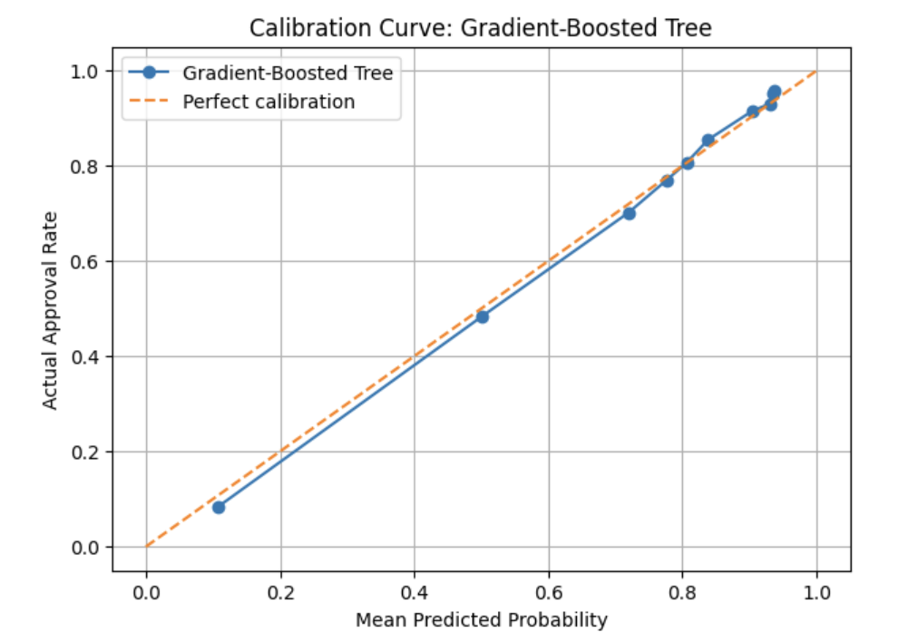
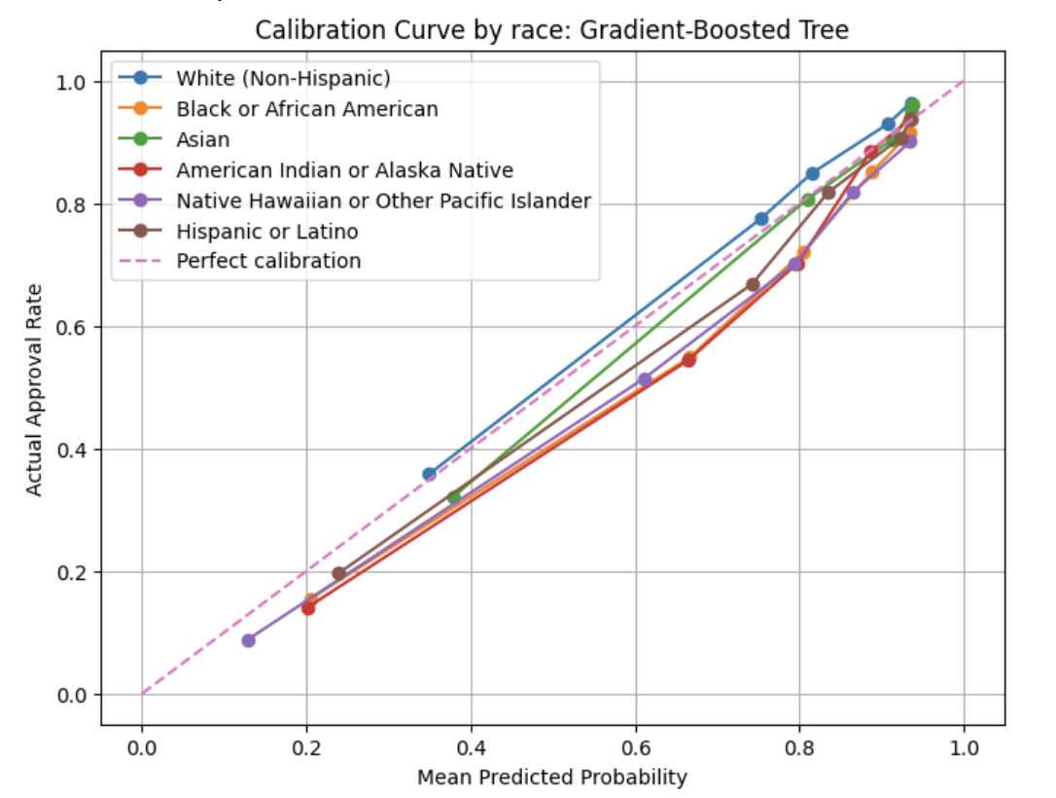
Appendix
Calibration (GBT Model)
1 18

Slide 26
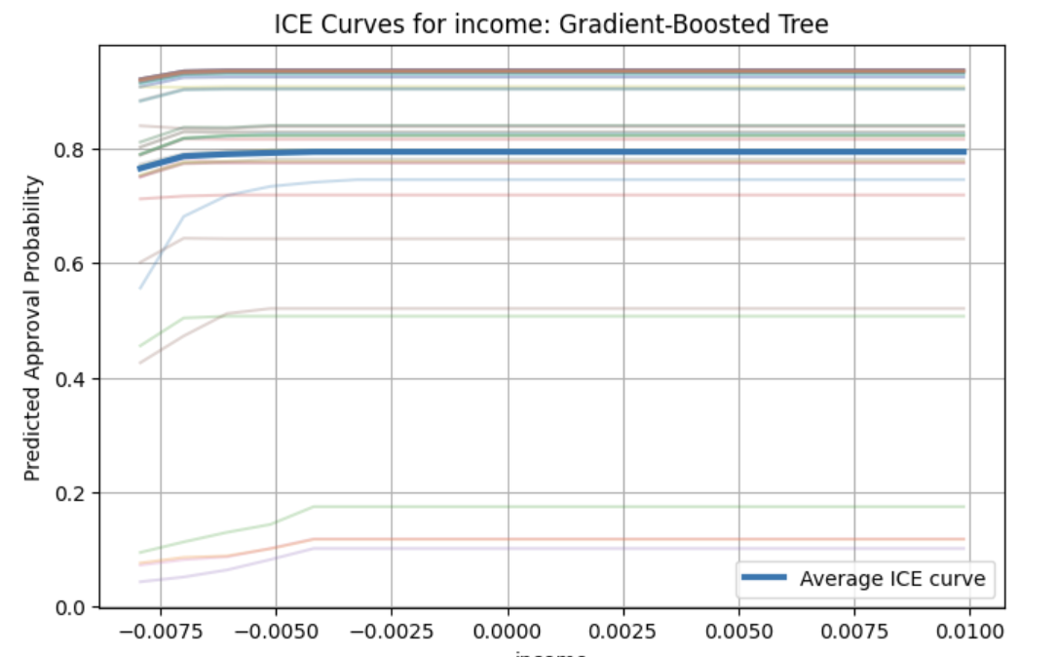
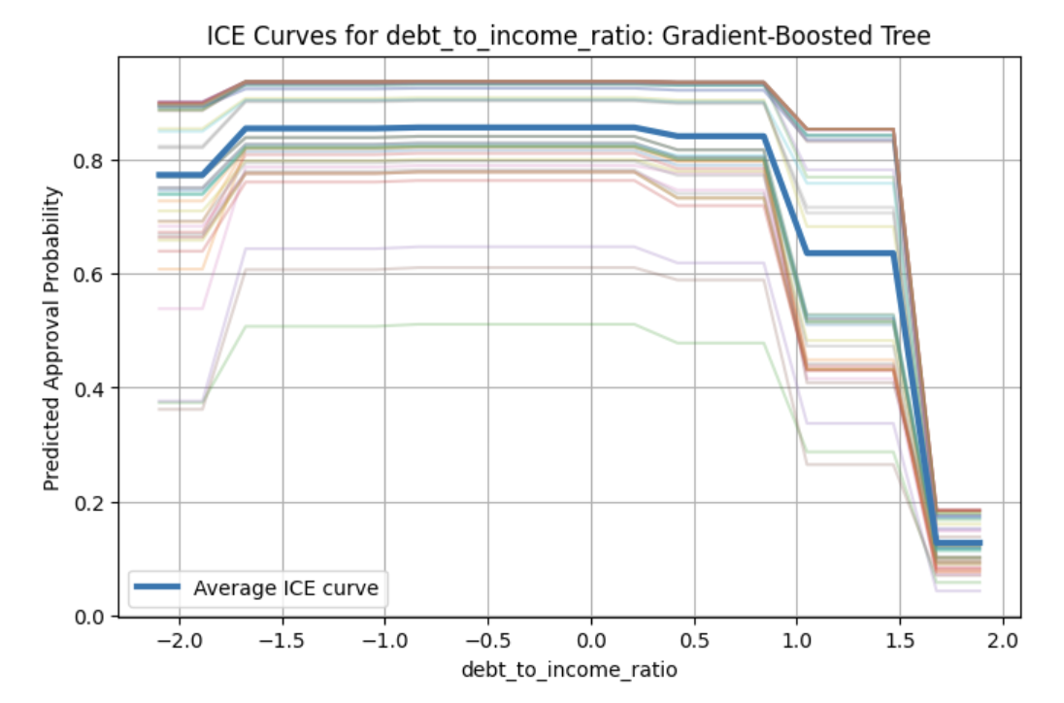
Appendix
ICE Curves (GBT Model)
1 18

Slide 27
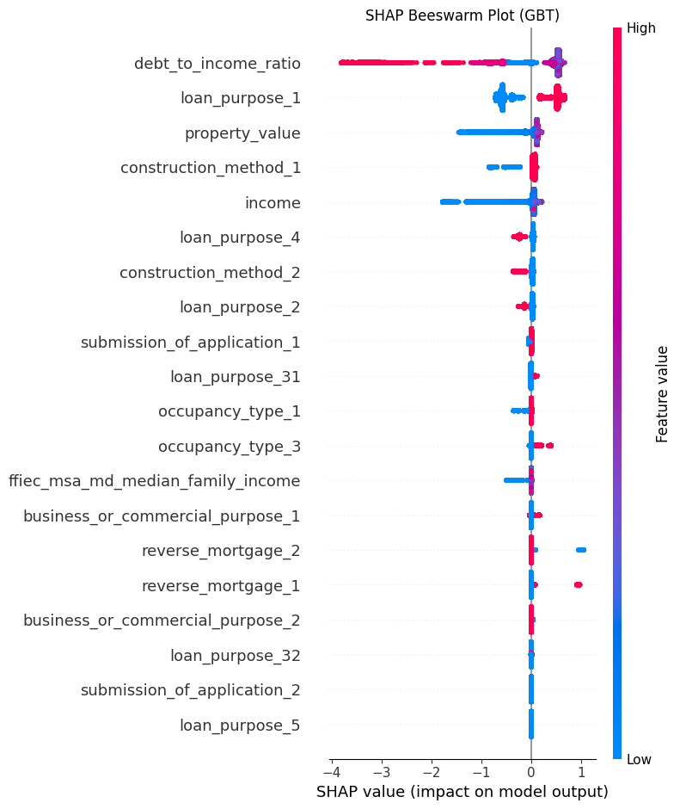
Appendix
SHAP plot (GBT Model)
1 18

