Slide 1
Atomic model
Tengo Khizanishvili

Slide 2

Plan
My atom model
About lithium
My atom scale compared to real atom
Process of building atom model

Slide 3

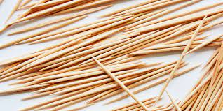
What was used to make this model
Material are simple, I used Styrofoam 7 big ones and 3 small ones I connected electron, neutrons and protons with toothpicks I panted the atom with permanent markers

Slide 4
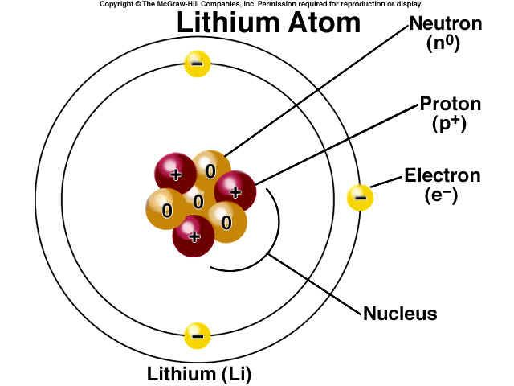
about my atomic model
Lithium (Li) is made of 3 protons, 3 electrons, 4 neutrons and nucleus

Slide 5
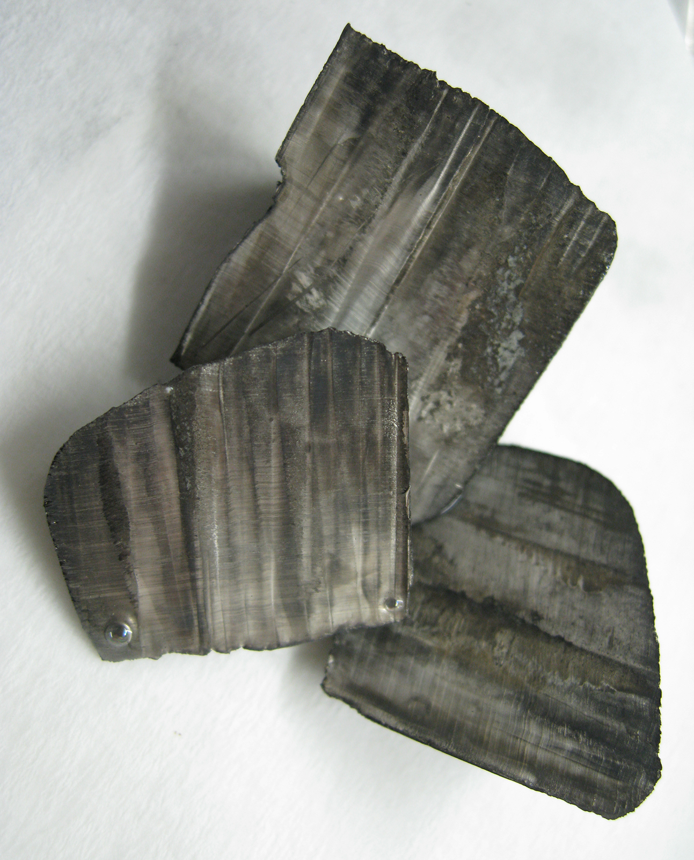
Lithium
Atom can have up to 5 layers of shell. shell is the thing that atoms orbit around . Lithium has 2 Shells 2 electrons on first shell and last electron on last Shell.
atomic mass - 6.941 U
density 0.534gram/cm^3
←Lithium
Symbol U=1/12

Slide 6
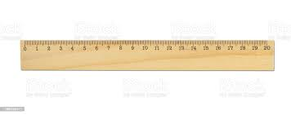
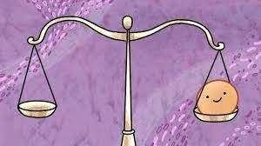
Sizes
Neutron size is about 0.8×10⁻¹⁵ m - my proton 464,000,000,000,000 times bigger than real proton
Proton size is about 0.84–0.87fm - neutron 464,000,000,000,000 times bigger than real neutron
Electrons - electron has no size
Protons and electrons real distance - 5.3E-7 cm my distance-2cm my size if we shrink the model is 5.3E-12 cm
Mistake is that real distance is 5.3x10^-7cm and my distance is 5.3x10^-12cm. So, there is difference of 10^-5

Slide 7
Inaccuracies
Inaccuracies are that real distance between atom and proton/neutron is 5.3x10^-7cm and my distance is 5.3x10^-12cm. So, there is difference of 10^-5 also mass does not match the real weight ratio. I think its impossible to make perfect atom model that does not have inaccuracies.
( I could not weight my model perfectly because I don’t have small scale)

Slide 8
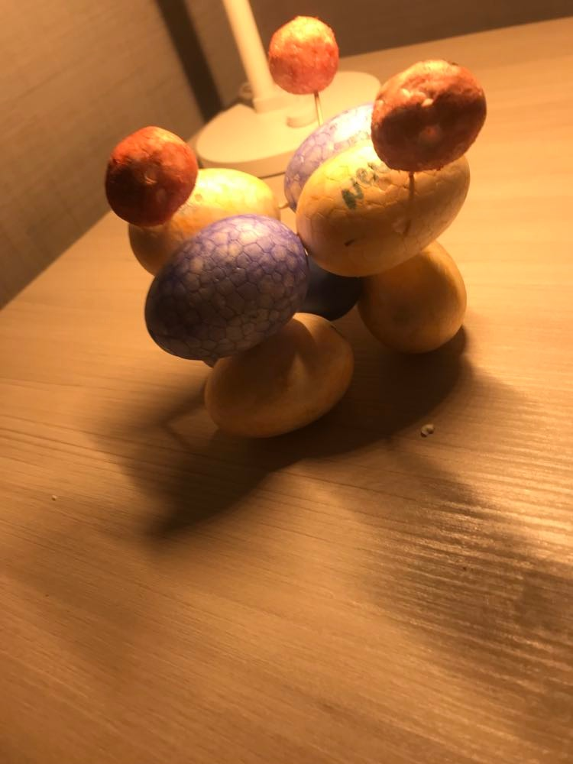
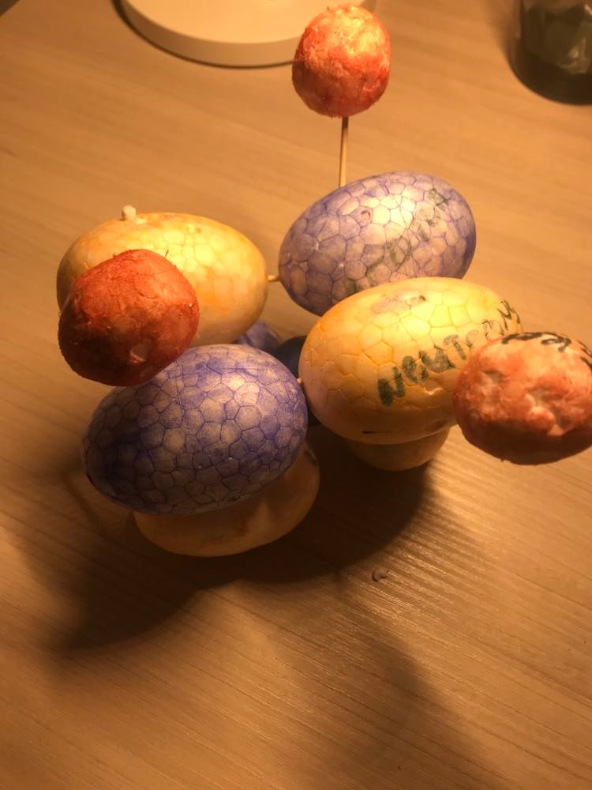
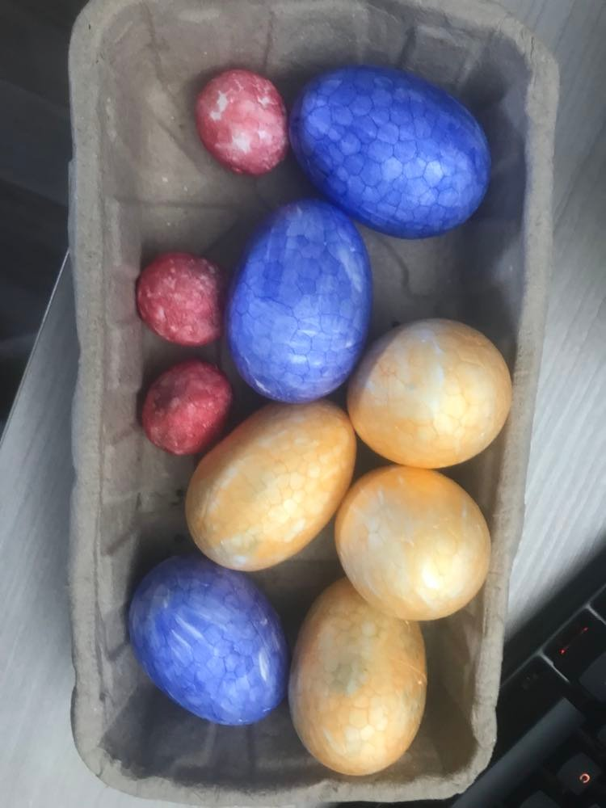
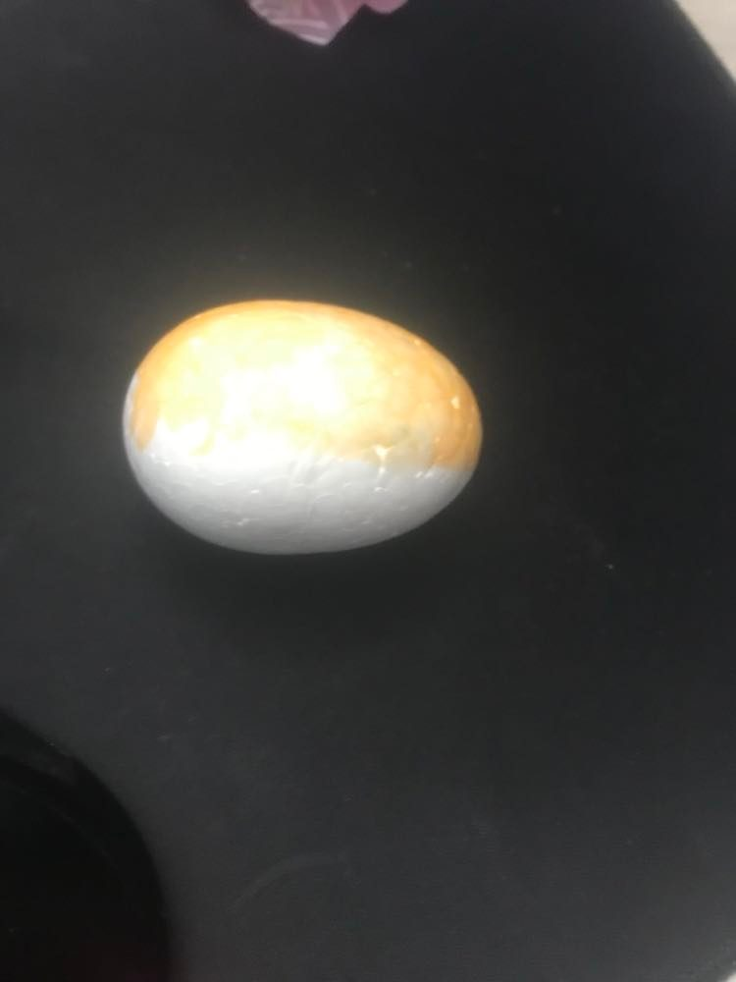
Process of making my model and final product

Slide 9

Thank you for your attention

