Slide 1
Atomic Model
Giorgi Devdariani

Slide 2
Plan
Atom I chose
Research
Calculation
My atomic model
Inaccuracies

Slide 3
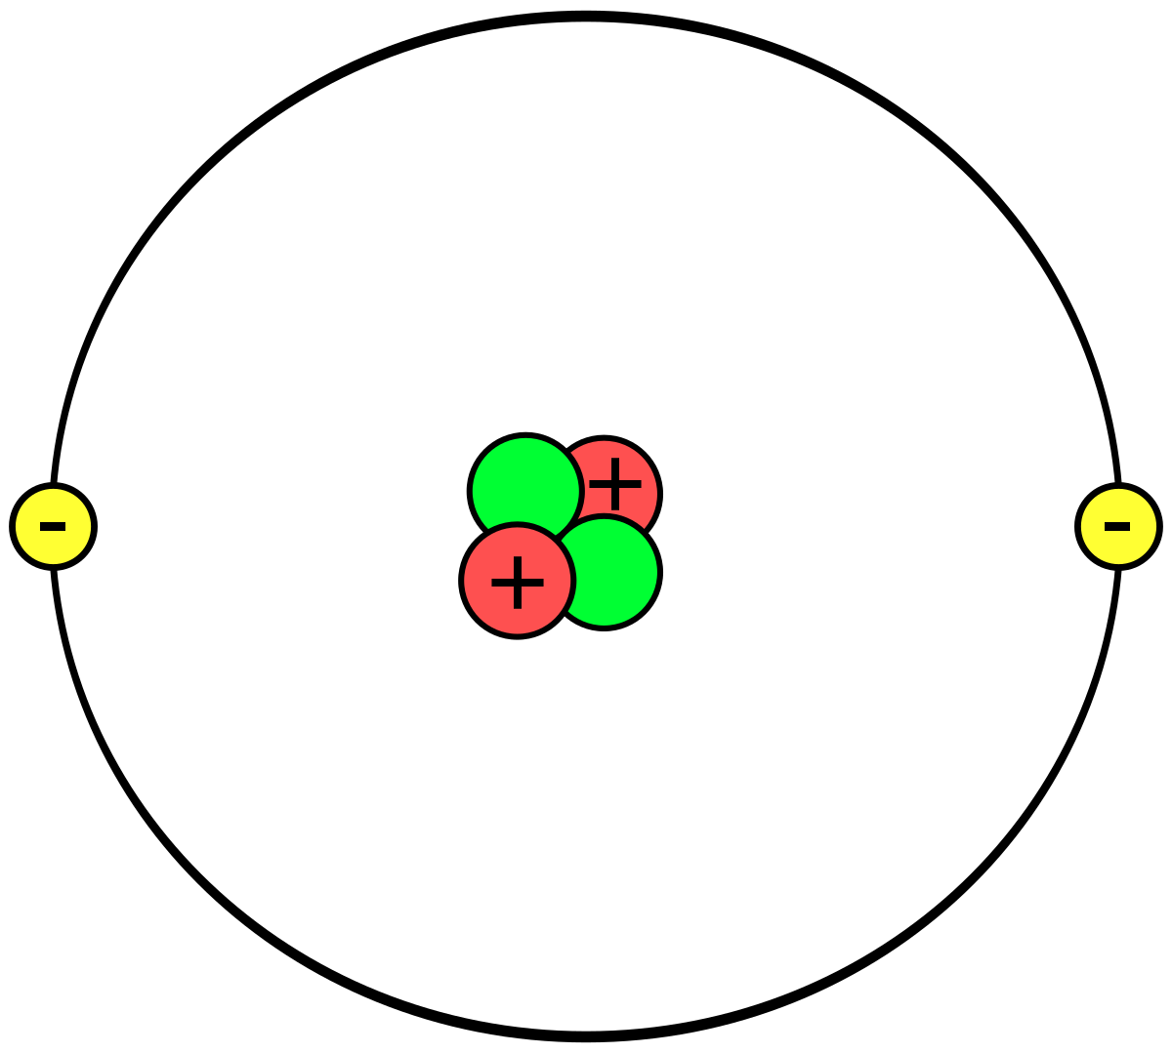
Atom I chose
I chose Helium, because It only had 2 electrons, 2 protons and 2 neutrons. To be more specific I chose Helium-4, which is the most stable isotope.

Slide 4

Research
Radius of a Proton/Neutron - 8.77 * 10^-16 m
Radius of an Electron - 10^-18
Distance between a first orbital and a nucleus - 5.29 * 10^-11 m

Slide 5
Calculations
The number that I multiplied sizes by - 5 * 10^15
Electron’s radius in the model - 5 * 10^-3 m
Proton’s/Neutron’s radius in the model - 4.385 m
The distance between electron and the nucleus - 264500 m

Slide 6
My atomic model
I used: colored clay, aluminium foil, chopsticks.
Electron is the blue colored ball. Red - protons. Yellow - neutrons.

Slide 7
Inaccuracies
Electron’s size in the model - 0.005 m radius
Proton’s size in the model - 0.03 m radius
Distance between the electron’s and the nucleus - 0.18 m
Protons and Neutrons are only 3.42075257 * 10^13 bigger
The distance is only enlarged by 3.4026465 * 10^9 times.

Slide 8
Thanks For Your Attention!

