Slide 1
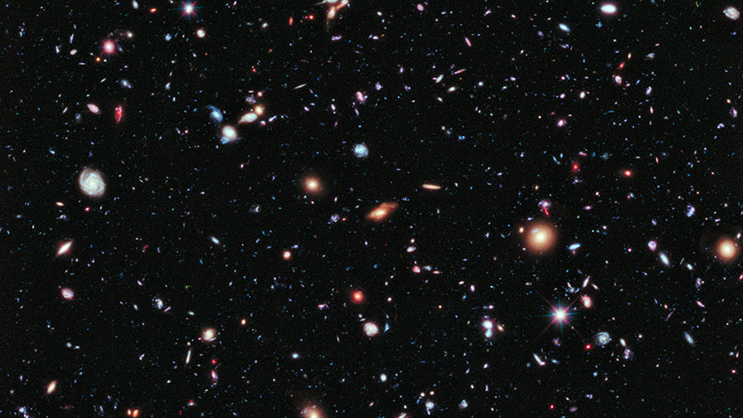
Solar System
Mariam Kilauridze

Slide 2
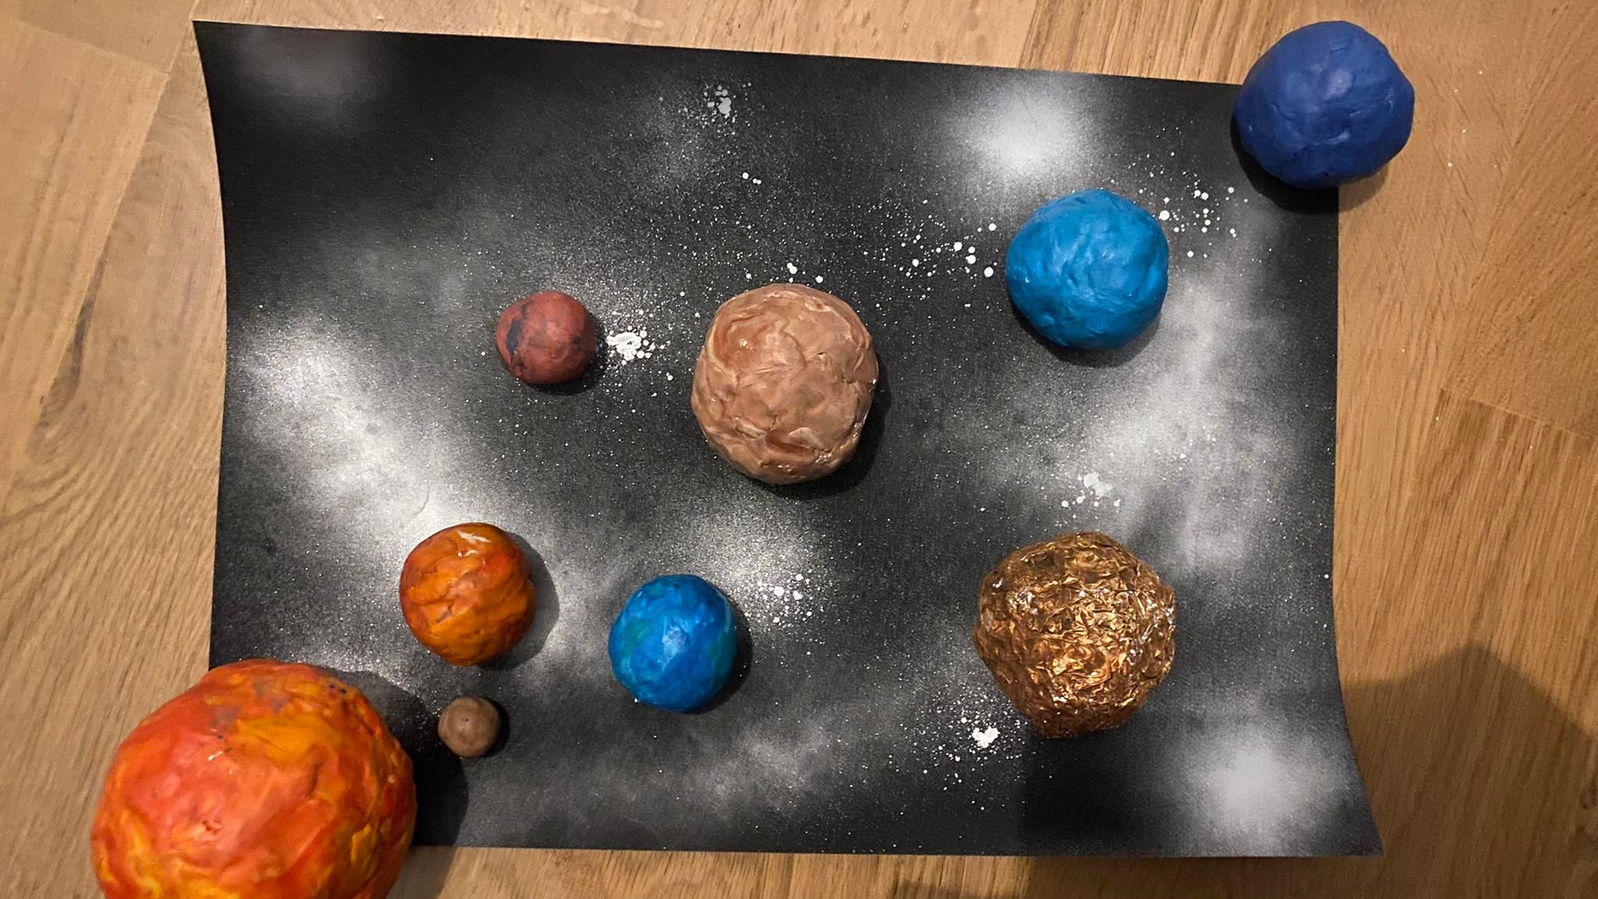

Slide 3
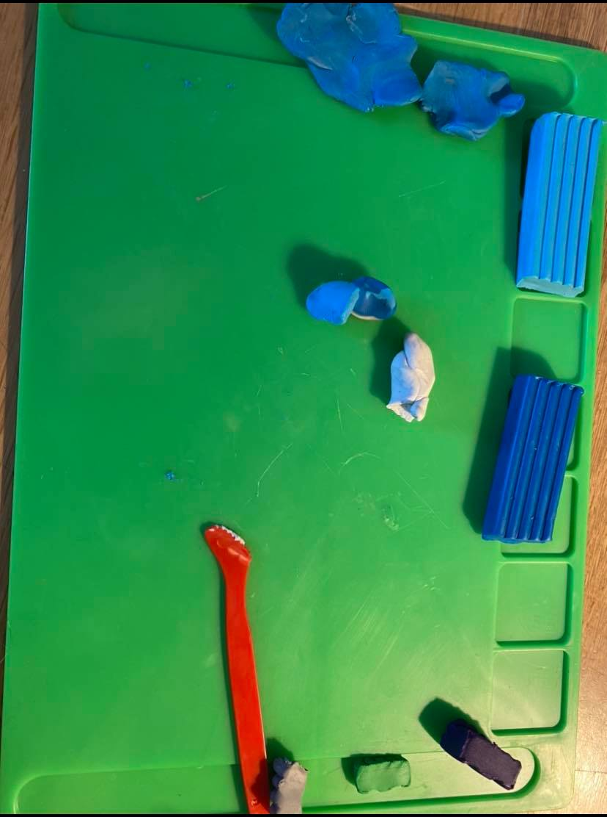
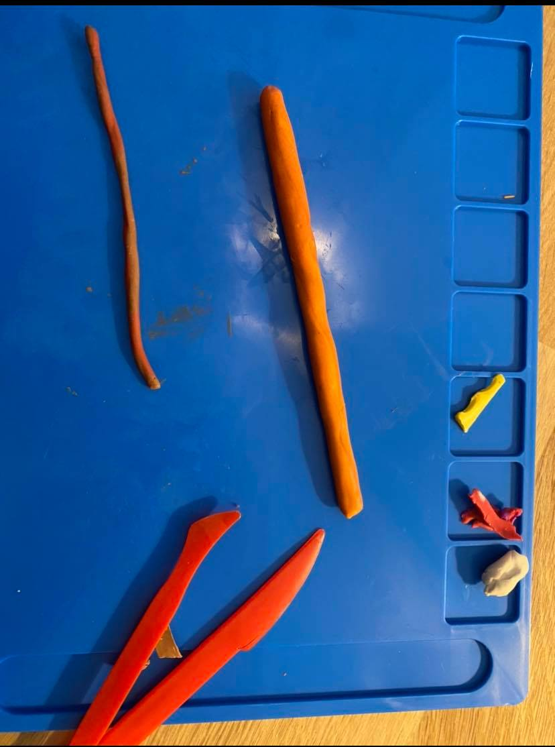
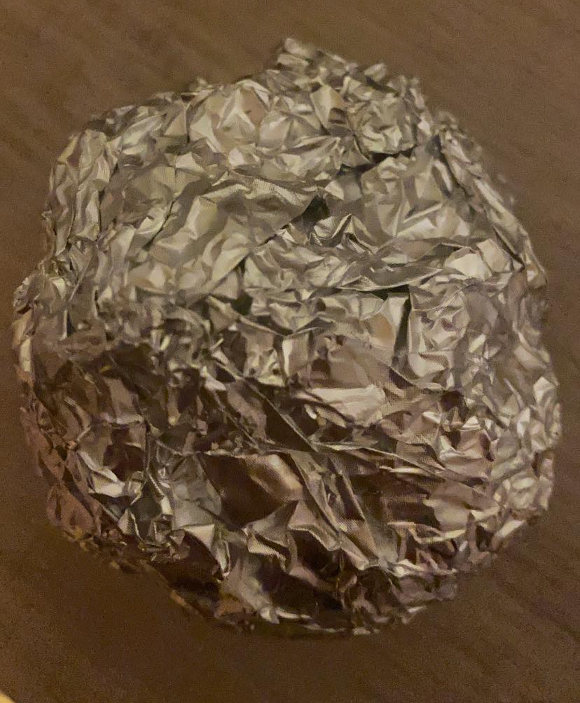
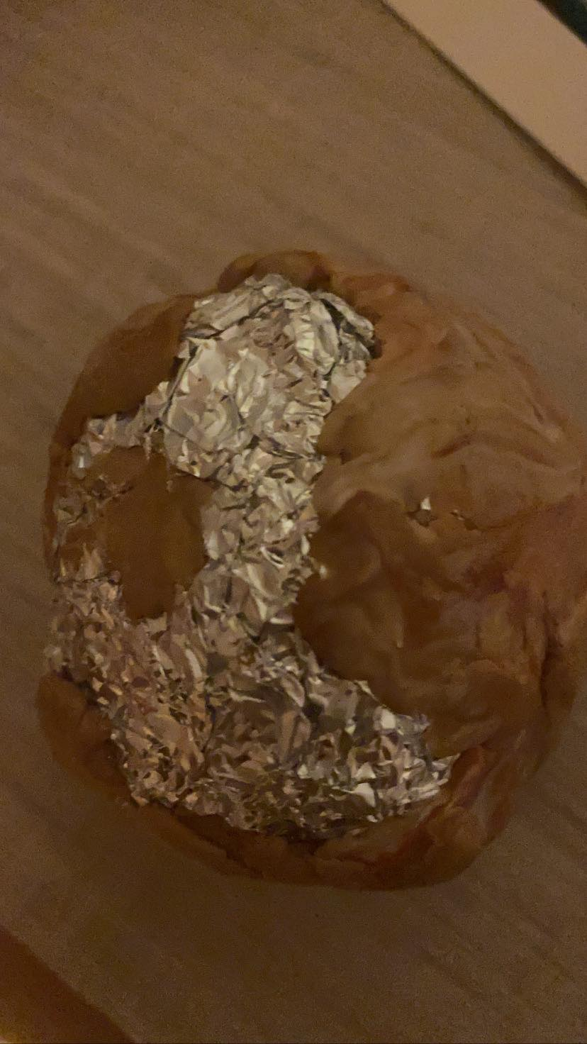
Process
First, I flattened out, modeling clay for every planet. Then I took tin foil bunched it up in my hand and made spherical shapes. I used a chart where it showed how big the planets were in reference to earth. Then I took the modeling clay which I had ready for every planet and spread it around the tin foil balls. I took a poster and spray painted black and silver. I took some pictures in the process. Here they are.

Slide 4
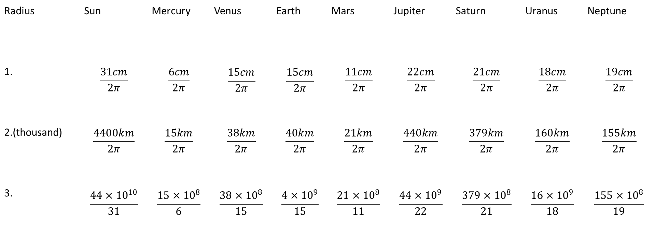
1.My solar system model sizes 2.Solar systems size in real life 3.How much bigger is our solar system compared my model
Radius | Sun | Mercury | Venus | Earth | Mars | Jupiter | Saturn | Uranus | Neptune
1. | $$\frac{31cm}{2π}$$ | $$\frac{6cm}{2π}$$ | $$\frac{15cm}{2π}$$ | $$\frac{15cm}{2π}$$ | $$\frac{11cm}{2π}$$ | $$\frac{22cm}{2π}$$ | $$\frac{21cm}{2π}$$ | $$\frac{18cm}{2π}$$ | $$\frac{19cm}{2π}$$
2.(thousand) | $$\frac{4400km}{2π}$$ | $$\frac{15km}{2π}$$ | $$\frac{38km}{2π}$$ | $$\frac{40km}{2π}$$ | $$\frac{21km}{2π}$$ | $$\frac{440km}{2π}$$ | $$\frac{379km}{2π}$$ | $$\frac{160km}{2π}$$ | $$\frac{155km}{2π}$$
3. | $$\frac{44×{10}^{10}}{31}$$ | $$\frac{15×{10}^{8}}{6}$$ | $$\frac{38×{10}^{8}}{15}$$ | $$\frac{4×{10}^{9}}{15}$$ | $$\frac{21×{10}^{8}}{11}$$ | $$\frac{44×{10}^{9}}{22}$$ | $$\frac{379×{10}^{8}}{21}$$ | $$\frac{16×{10}^{9}}{18}$$ | $$\frac{155×{10}^{8}}{19}$$

Slide 5
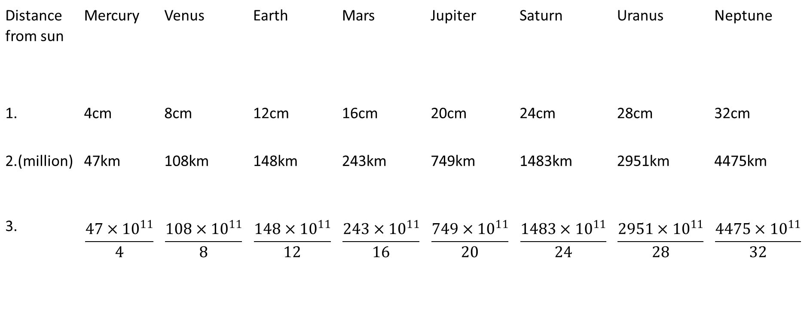
1.Distance from sun in my model 2.The real distance 3.How much smaller the distances are in my model, than in real life.
Distance from sun | Mercury | Venus | Earth | Mars | Jupiter | Saturn | Uranus | Neptune
1. | 4cm | 8cm | 12cm | 16cm | 20cm | 24cm | 28cm | 32cm
2.(million) | 47km | 108km | 148km | 243km | 749km | 1483km | 2951km | 4475km
3. | $$\frac{47×{10}^{11}}{4}$$ | $$\frac{108×{10}^{11}}{8}$$ | $$\frac{148×{10}^{11}}{12}$$ | $$\frac{243×{10}^{11}}{16}$$ | $$\frac{749×{10}^{11}}{20}$$ | $$\frac{1483×{10}^{11}}{24}$$ | $$\frac{2951×{10}^{11}}{28}$$ | $$\frac{4475×{10}^{11}}{32}$$

Slide 6
How big would every planet/star would be if we did the model in earths scale (Circumference=15cm)
 | Sun | Mercury | Venus | Earth | Mars | Jupiter | Saturn | Uranus | Neptune
1. | 31cm | 6cm | 15cm | 15cm | 11cm | 22cm | 21cm | 18cm | 19cm
2. | 1650cm | 5.7cm | 14.25cm | 15cm | 7.95cm | 168cm | 141.7cm | 60cm | 58.2cm
1. My model
2. my models measurements if this was an accurate model

