Slide 1
Robotics
Made by: Balint Bekesi

Slide 2
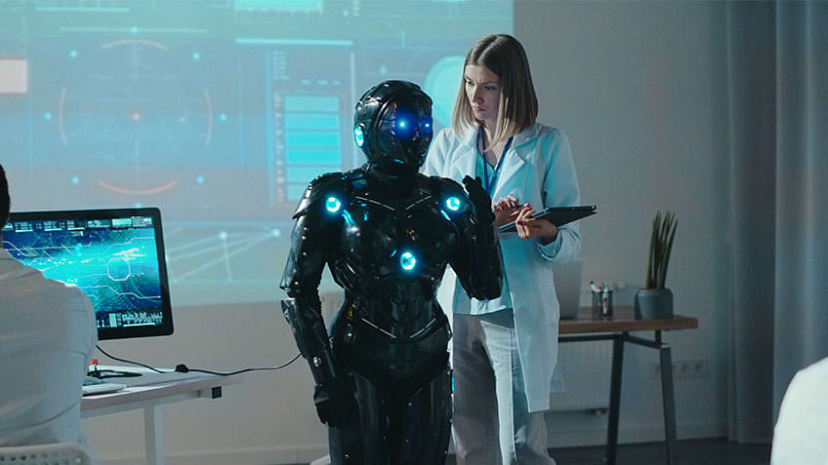
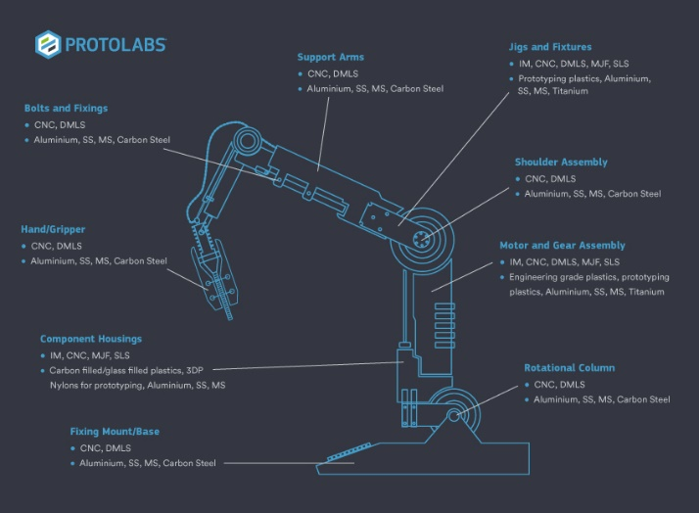
1.
What it is
Robotics involves designing and operating programmable machines called robots to perform tasks automatically.
In 2024, robotics is essential across industries, providing solutions through automation and AI.
Benefits of robotics include increased efficiency, productivity, and workplace safety.
Additionally, robotics helps businesses optimize resources and stay competitive.

Slide 3
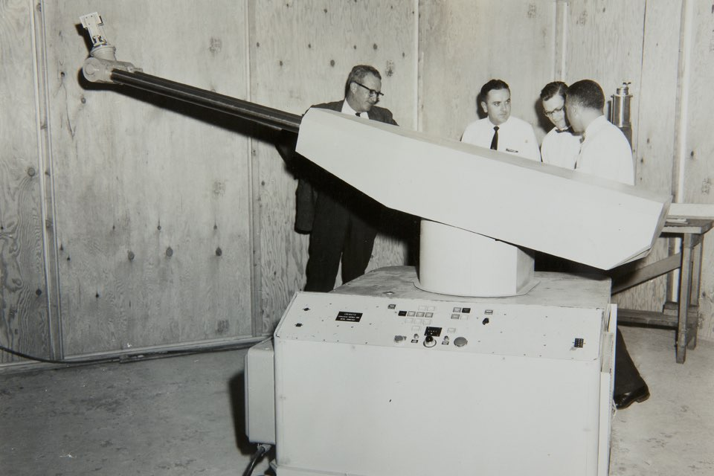
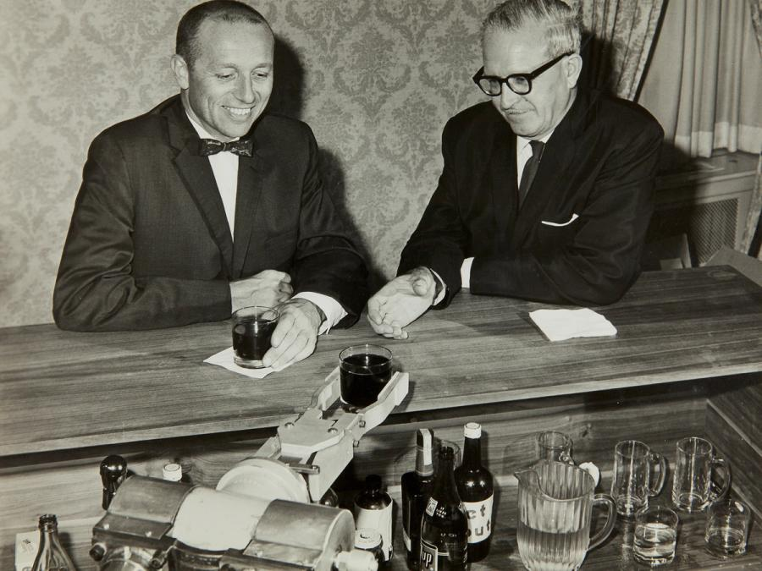
2.
How it started
Robotics started in the early 20th century for automation.
"Unimate," the first modern robot, transformed assembly lines in the 1960s.
Early robotics aimed to enhance industrial efficiency.
Robotics expanded into medicine, space, and entertainment.
Advancements in AI, sensors, and materials shape robotics' evolution.
Birth of a kawasaki industrial robot in the us (1954)
Unimation cofounders with their robot bartender (1958)

Slide 4
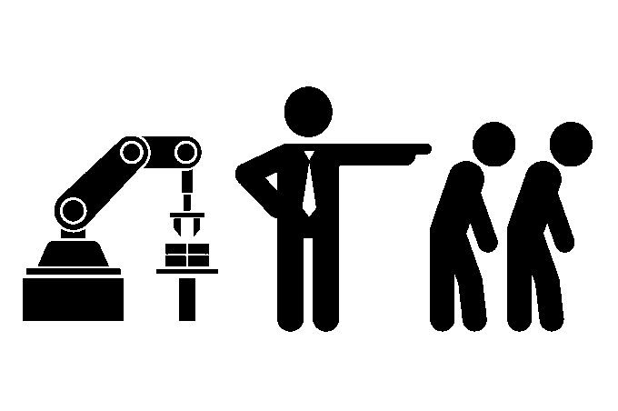
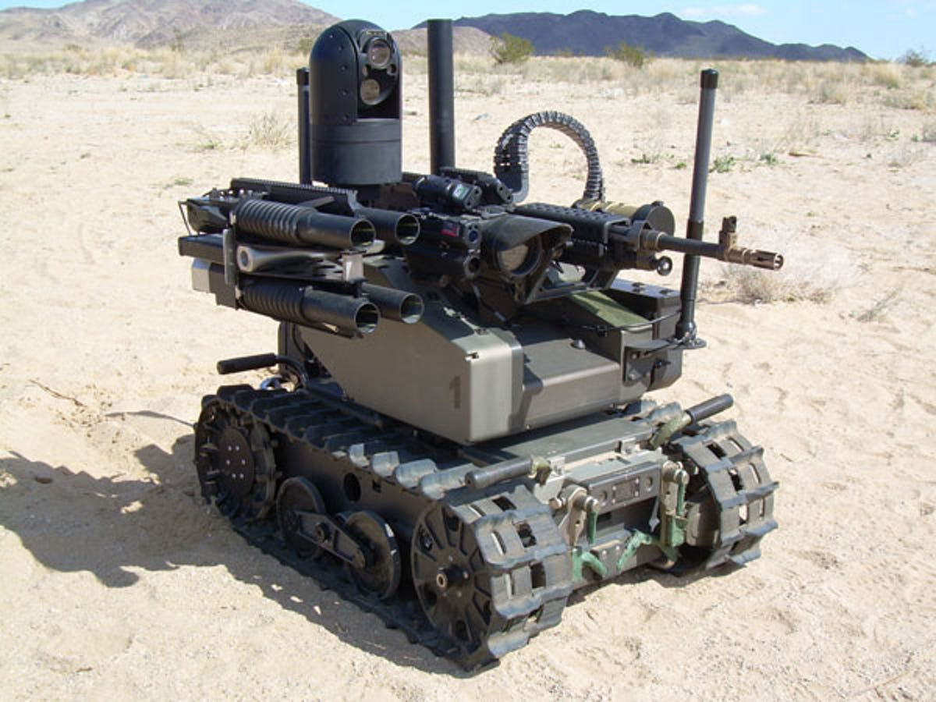
3.
The disadvantages
Robotics may lead to people losing jobs as machines take over tasks.
Robots can be expensive to start using, especially for small businesses.
There's a risk of accidents when robots work alongside people.
In the future, we might face tough questions about using robots in war or spying.
We could rely too much on robots, which might cause problems if they break or get hacked.

Slide 5
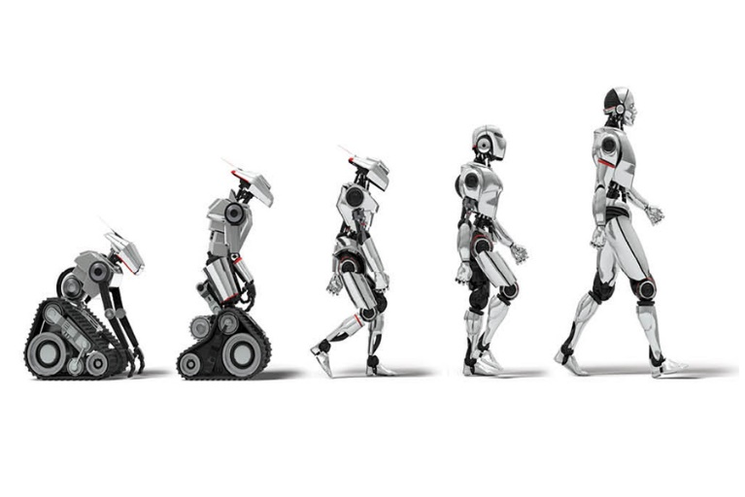
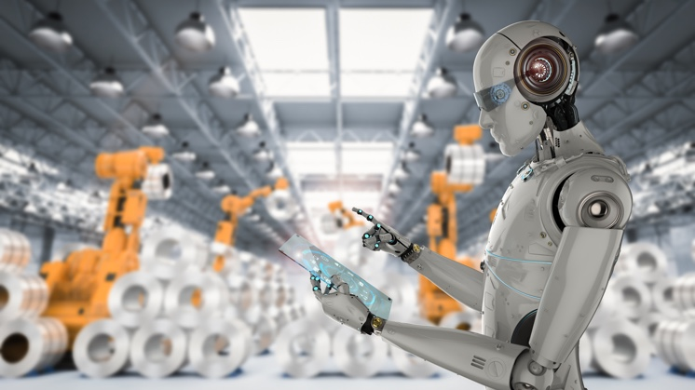
4.
The future of robots
Robotics will advance, with robots becoming more common in our lives.
They'll change how we work and live, taking over repetitive or dangerous tasks.
This might lead to job changes and the need for new skills.
Overall, robotics promises to improve efficiency and safety, but raises questions about ethics and societal impact.

Slide 6
5.
Words
Automation
Artificial Intelligence
Mechanization
Robotics
Sensors
Cybernetics
Autonomous
Machine Learning
Drones
Humanoid
Automatizálás
Mesterséges intelligencia
Mechanizáció
Robotika
Érzékelők
Kibernetika
Autonóm
Gépi tanulás
Drónok
Humanoid

Slide 7
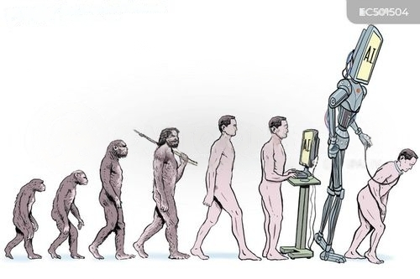
Thank you for your attention!

