Slide 1
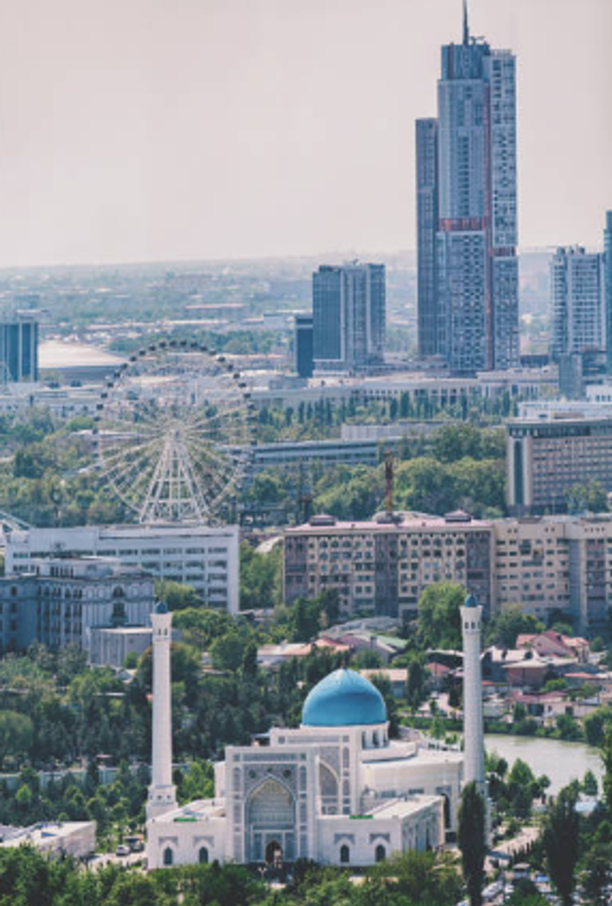

Tashkent Apartment Price Prediction
AI & MACHINE LEARNING PROJECT • TEAM (GROUP E40B)
Exploratory data analysis and Multiple Linear Regression modeling on Uybor.uz listings.
Start exploring ›
Oydinov Bexruz
202390243
Murtazoyev Xondamir
202390241
Sayfulloyev Muhammad
202390201
Abdumurodov Mashrab
202390257

Slide 2


Project Roadmap
CLICK A CARD TO JUMP TO A SECTION
01
Introduction
Team • Problem
02
Data & Features
Data • Cleaning • Features
03
Analysis & Model
EDA • Drivers • Weights
04
Results & Demo
Results • Demo • Q&A

Slide 3







Team Roles & Presentation Flow
TEAM STRUCTURE • SPEAKER 1: BEXRUZ OYDINOV
01
02
03
04
Bexruz Oydinov
Xondamir Murtazoyev
Muhammad Sayfulloyev
Mashrab Abdumurodov
Team Leader
CPO
Researcher
Prompt Eng
ID 202390243
ID 202390241
ID 202390201
ID 202390257
Problem & MLR Model
Pipeline & Features
EDA & Market Insights
Evaluation & Web App

Slide 4
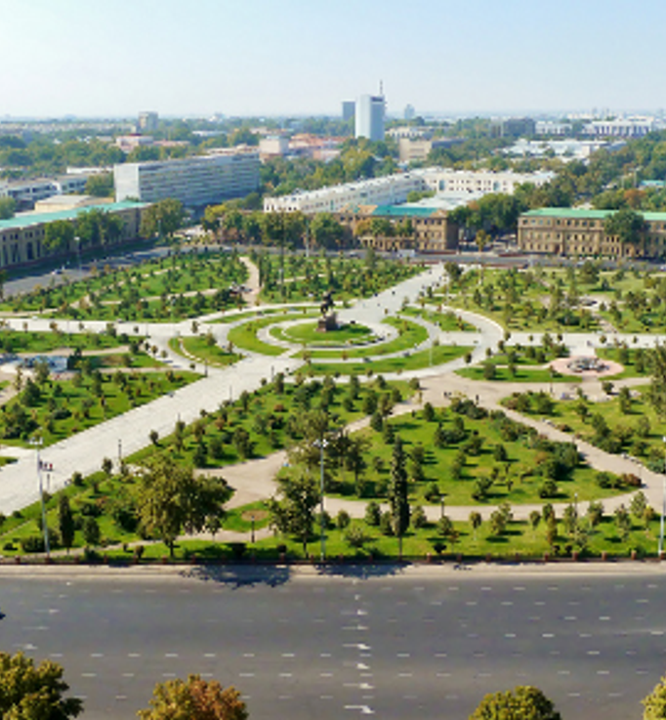




Market Problem & Research Objectives
PROJECT CONTEXT • SPEAKER 1: BEXRUZ OYDINOV
Subjective Pricing
Wide valuation gaps across Tashkent listings.
Core Objective
Predict fair USD value via regression.
Spatial Factor
Quantify price premiums across 12 districts.
Interpretability
Measure exact dollar impact per feature.

Slide 5


Uybor.uz Tashkent Real Estate Dataset
DATA SOURCE • SPEAKER 2: XONDAMIR MURTAZOYEV
7,421
9 RAW ATTRIBUTES
Area (m²)
Rooms
Scraped Apartment Listings Across 12 Tashkent Districts
Floor level
Price (USD)
GPS coordinates

Slide 6




Four-Stage Data Cleaning Pipeline
PREPROCESSING • SPEAKER 2: XONDAMIR MURTAZOYEV
01
02
03
04
Deduplication
Floor Logic Check
Outlier Trimming
Clean Dataset
Dropped 696 duplicate rows.
Enforced level below max_levels.
Filtered 1st to 99th percentiles.
6,360 verified housing records.

Slide 7



Engineered Features for Regression
DOMAIN FEATURES • SPEAKER 2: XONDAMIR MURTAZOYEV
Center Proximity
dist_from_center_km
Haversine distance to Amir Temur Square.
Floor Position Indicators
Binary flags for top and first floors.
Room Spaciousness
sqm_per_room
Total area divided by room count.
One-Hot District Encoding
11 binary columns avoiding multicollinearity.

Slide 8
Average Price per m² by District
EXPLORATORY DATA ANALYSIS • SPEAKER 3: MUHAMMAD SAYFULLOYEV
PREMIUM GAP
+64%
Mirobod ($965) vs Sergeli ($590) per square meter

Slide 9


Key Price Drivers & Spatial Trends
KEY DRIVERS • SPEAKER 3: MUHAMMAD SAYFULLOYEV
Living Area
Strongest linear driver of apartment price.
r = 0.81
Room Count
High positive correlation with total size.
r = 0.62
Center Distance
Prices drop sharply outside central ring.
r = −0.34
Top Floor Discount
Top floors trade lower in unrenovated buildings.
Discount

Slide 10
Multiple Linear Regression Learned Weights
MODEL COEFFICIENTS • SPEAKER 1: BEXRUZ OYDINOV
MODEL FEATURE | LEARNED COEFFICIENT | MARKET INTERPRETATION
Total Area (size) | +$868.50 / m² | Marginal dollar increase per square meter
District: Mirobod | +$11,850 | Executive central location premium
District: Yakkasaroy | +$9,200 | Central residential district premium
District: Mirzo Ulugbek | +$6,450 | High-demand eastern central premium
Distance to Center | −$1,620 / km | Price drop per km from Amir Temur Square
Top Floor Indicator | −$2,450 | Top floor discount vs middle levels

Slide 11
Model Evaluation on 20% Unseen Test Set
VALIDATION RESULTS • SPEAKER 4: MASHRAB ABDUMURODOV
$8,900
Mean Absolute Error
Average dollar deviation
Test R² Score
0.742
$12,450
Test RMSE
Root mean squared error
0.738
5-Fold CV R²
Consistent generalization
74.2% variance explained

Slide 12

Interactive Predictor Test Scenarios
LIVE DEPLOYMENT • SPEAKER 4: MASHRAB ABDUMURODOV
MIRZO ULUGBEK
YAKKASAROY
CHILONZOR
Predicted price
Predicted price
Predicted price
$65,185
$59,610
$40,540
3 rooms
75 m²
Floor 4/9
2 rooms
65 m²
Floor 3/5
2 rooms
55 m²
Floor 2/4

Slide 13
Thank You & Q&A
TEAM • GROUP E40B
Live demo of our Jupyter Notebook and Interactive Price Predictor available now.
Open the Live Price Predictor →
sites.google.com/view/real-estate-price-predictor/full-page-embed
Oydinov Bexruz • Murtazoyev Xondamir • Sayfulloyev Muhammad • Abdumurodov Mashrab

