Slide 1
DATA ANALYST CASE STUDY
Understanding the Child in Need
(CIN) Population
An exploratory analysis of vulnerability, repeat episodes, and age patterns
for a UK Local Authority Children's Services department
Prepared for Social Finance • Monday 27 July 2026
Notes:
Introduce yourself briefly. Frame the exercise: the LA gave us anonymised records for vulnerable children and wants evidence-based insight into the CIN population, especially what separates a single episode from a repeated pattern, and how that changes with age. Keep this to 20-30 seconds.

Slide 2
AGENDA
What this presentation covers
01
The population
Who are the children in this dataset, and how many experience a Child in Need episode?
02
One episode vs. three or more
How do children with a single CIN episode differ from those with repeated episodes?
03
The role of age
Do these differences show up the same way across early years, primary, secondary and post-16?
04
Data, limits & next steps
What would sharpen this analysis further — and what should we ask the LA?
2
Notes:
Quick roadmap so the panel knows the shape of the talk: population first, then the core comparison the LA asked for, then age, then what we'd want next. Move fast here - 15 seconds.

Slide 3
CONTEXT
Why this matters to the Local Authority
Children's Services already has an intuitive, frontline sense of how vulnerable children behave. This analysis is about turning that intuition into empirical, fact-based evidence — so the Local Authority can act earlier and more precisely to support this population.
WHAT IS A CIN EPISODE?
A 'Child in Need' (CIN) episode is a period during which Children's Services has formally determined a child is acutely vulnerable and requires action — short of statutory child protection.
THE TWO QUESTIONS WE FOCUS ON
1. What distinguishes a child with exactly 1 CIN episode from one with 3+ episodes?
2. How do those distinctions change with the child's age?
3
Notes:
Ground the audience in the domain language before the data: CIN sits below statutory Child Protection. Make clear the two questions the LA specifically asked us to answer - this is the spine of the whole deck.

Slide 4
THE DATA
One Local Authority, 74,247 children, 28 fields
74,247
28
30.3%
0
children in the dataset
fields per child
have ≥1 CIN episode
duplicate or missing records
A NOTE ON DATA QUALITY
• DWP, AdultOffender and NEET are 0 for every one of the 74,247 children — these fields appear unpopulated rather than genuinely absent, and are excluded from our conclusions.
• "Exclusion" (ever excluded) doesn't fully nest inside "Fixed-period exclusion" as expected — 2,520 children have a fixed-period exclusion flag but no exclusion flag. Worth clarifying the field definitions with the LA.
• The data is a point-in-time snapshot with no dates — we can describe association, not sequence or causality.
4
Notes:
Be upfront about data quality before showing results - it builds credibility. The three unpopulated fields and the exclusion-flag inconsistency are things you'd flag to a real client, not hide. This also previews the limitations slide near the end.

Slide 5
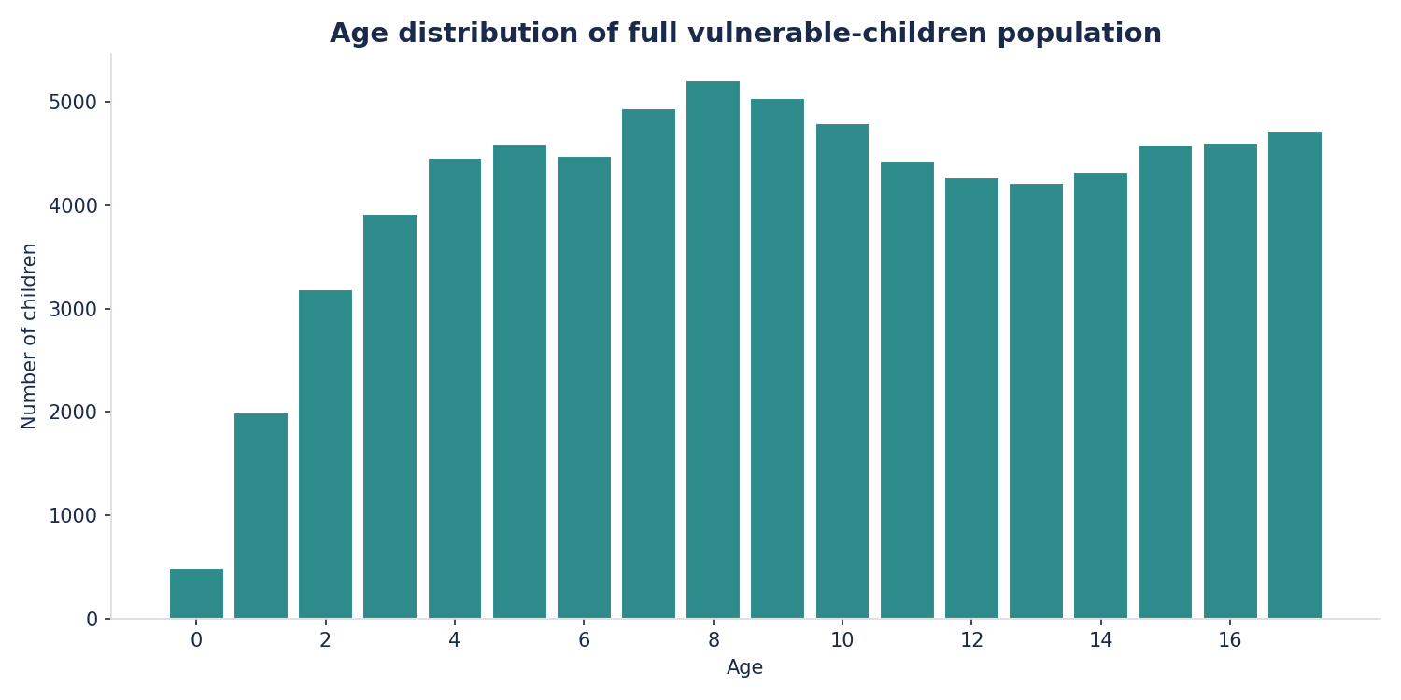
01 — THE POPULATION
A broad population, spanning every age from birth to 17
READING THE SHAPE
Numbers rise through early childhood, peak around age 13-14, then fall off sharply after 16 as young people age out of children's services.
This matters for our later age-based comparisons: the 16-17 group is naturally the smallest, so small differences there carry more statistical noise.
5
Notes:
Orient on the full population before narrowing to CIN. Note the smaller 16-17 bucket now so it's not a surprise later when age-band comparisons get noisier at that end.

Slide 6
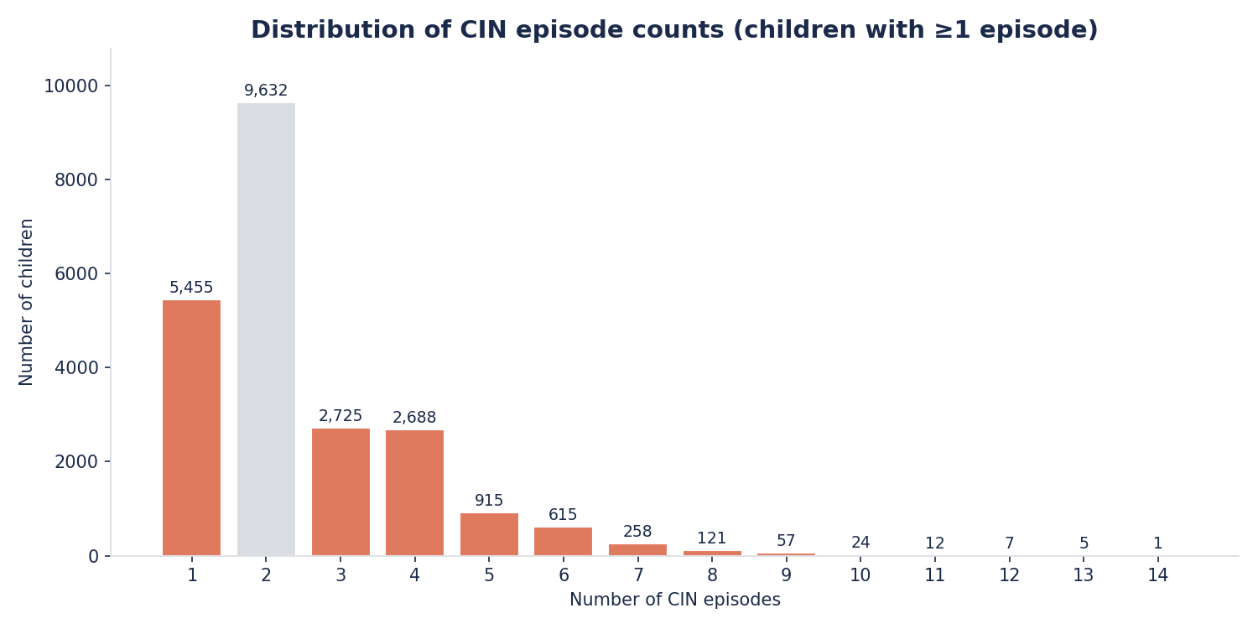
01 — THE POPULATION
Most CIN children have 1–2 episodes — a minority recur often
KEY NUMBERS
5,455
children with exactly 1 episode
7,428
children with 3+ episodes — our two comparison groups for the rest of this deck
6
Notes:
This is where we introduce the two groups the LA specifically asked about. Emphasise these are the two ends of a spectrum - most CIN children are in the middle (2-2 episodes) and aren't part of either comparison group.

Slide 7
02 — ONE EPISODE VS. THREE OR MORE
Two groups, one underlying question: single crisis, or a pattern?
GROUP A
GROUP B
Exactly 1 episode
3 or more episodes
n = 5,455
n = 7,428
A child who needed formal support once, and did not re-enter the CIN process again — potentially a single, resolved crisis.
A child who has repeatedly re-entered the CIN process — suggesting recurring or entrenched need rather than a one-off event.
7
Notes:
Frame this as a hypothesis, not a conclusion yet: is a single episode a one-off crisis that got resolved, or is 3+ episodes a different kind of case entirely? The next few slides are the evidence for that question.

Slide 8
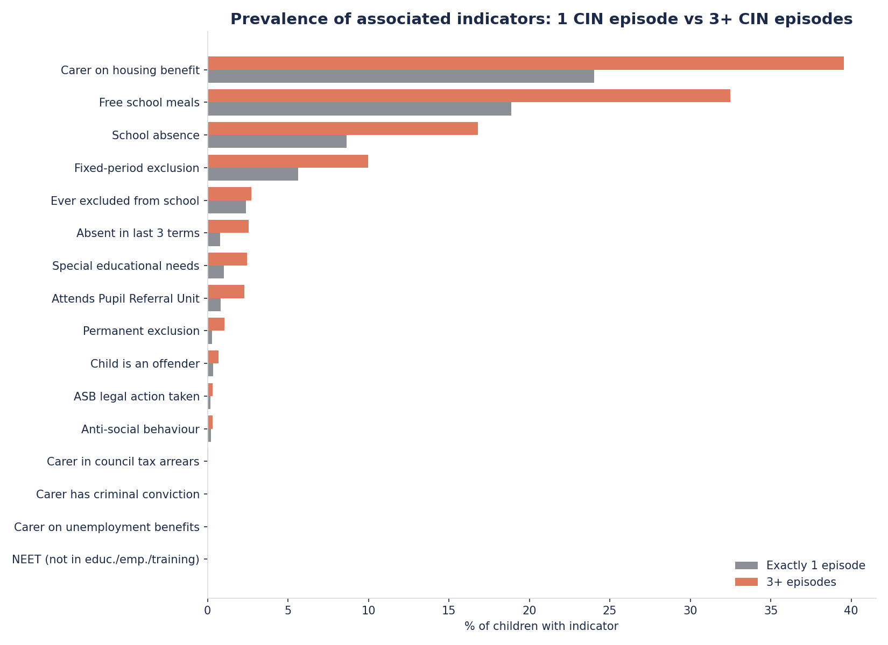
02 — ONE EPISODE VS. THREE OR MORE
Repeat-episode children show more associated indicators across the board
BIGGEST GAPS
+15.5pp
Housing benefit
+13.6pp
Free school meals
+8.2pp
School absence
All differences shown are statistically significant (Fisher's exact test, p<0.01) except the bottom five indicators on the chart.
8
Notes:
The headline slide. Walk top to bottom: housing benefit and FSM are proxies for household economic hardship; school absence is the first behavioural/attendance signal. Note the bottom five indicators are rare in this data and not statistically significant - be honest about that rather than over-claiming. If asked why Fisher's exact test rather than chi-square: some indicators are very rare (under 1% of children), and chi-square's approximation is unreliable with small counts - Fisher's exact test is accurate regardless of how rare the indicator is.

Slide 9
02 — ONE EPISODE VS. THREE OR MORE
The gaps behind the chart
Indicator | 1 episode | 3+ episodes | Gap | p-value
Carer on housing benefit | 24.0% | 39.6% | +15.5pp | <0.001
Free school meals | 18.9% | 32.5% | +13.6pp | <0.001
School absence | 8.7% | 16.8% | +8.1pp | <0.001
Fixed-period exclusion | 5.6% | 10.0% | +4.3pp | <0.001
Absent in last 3 terms | 0.8% | 2.5% | +1.8pp | <0.001
Attends Pupil Referral Unit | 0.8% | 2.3% | +1.5pp | <0.001
Special educational needs | 1.0% | 2.5% | +1.4pp | <0.001
Permanent exclusion | 0.3% | 1.0% | +0.7pp | <0.001
Child is an offender | 0.3% | 0.7% | +0.3pp | 0.009
Ever excluded from school | 2.4% | 2.7% | +0.3pp | 0.262 (n.s.)
n.s. = not statistically significant at the 5% level. Test: Fisher's exact test (chosen over chi-square because several indicators are rare, and chi-square's approximation is unreliable with small counts).
9
Notes:
Backup slide for anyone who wants the precise numbers and significance tests behind the chart - Fisher's exact test on each indicator. Don't dwell here if time is short; offer to come back to it in discussion. If asked: Fisher's exact test checks whether two group's proportions differ more than we'd expect by chance - same idea as chi-square, just more reliable when counts are small.

Slide 10
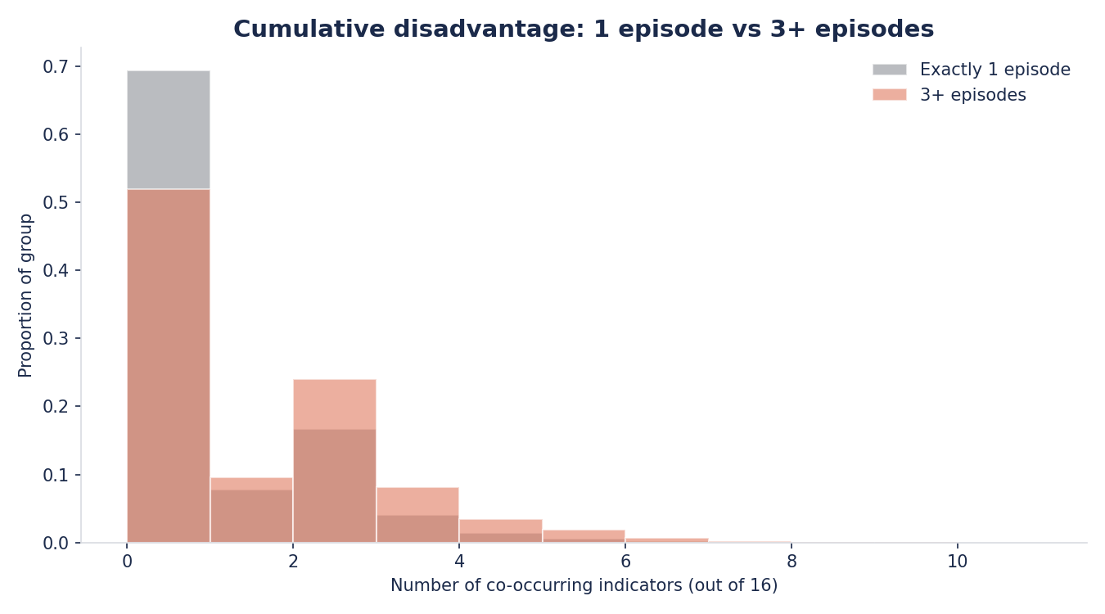
02 — ONE EPISODE VS. THREE OR MORE
Repeat episodes rarely arrive alone — indicators tend to stack
1.8×
more co-occurring indicators, on average, for children with 3+ CIN episodes (1.11) vs. exactly 1 (0.63). This is a descriptive count, not a validated risk score.
This supports thinking of repeat CIN involvement less as an isolated event and more as one marker within a wider cluster of household-level disadvantage.
10
Notes:
Shift from single-indicator comparisons to a cumulative view: it's not just that any one indicator is more common, it's that they co-occur more in the 3+ group. This is the household-level-disadvantage argument, which sets up the recommendations later.

Slide 11
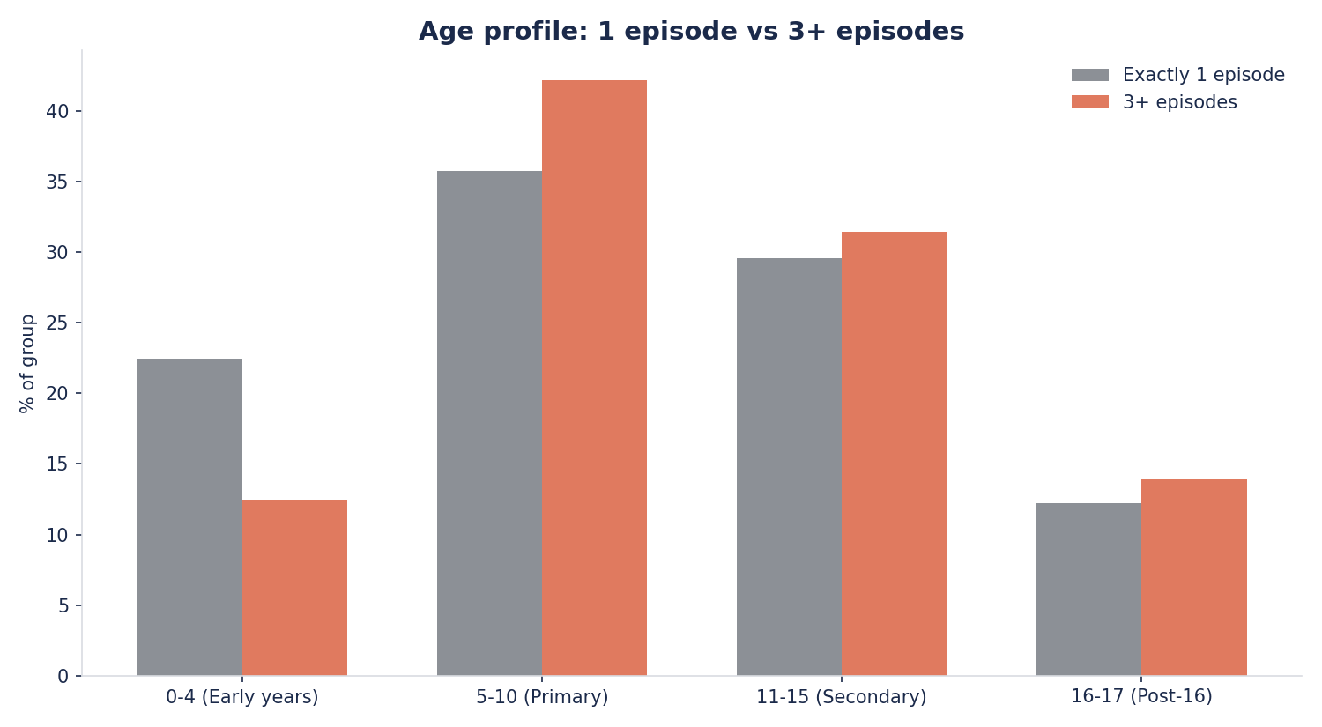
03 — THE ROLE OF AGE
Under-5s rarely recur; primary-age children make up the bulk of repeats
WHAT STANDS OUT
22.5% of the single-episode group is aged 0-4, vs. only 12.5% of the 3+ episode group.
Very young children's CIN involvement looks more likely to resolve after one episode. Recurrence is concentrated in primary-school age (42% of the 3+ group is aged 5-10) and continues into secondary school.
Mean age is 9.2 (1 episode) vs. 9.9 (3+ episodes) — a small but statistically significant gap (p<0.001).
11
Notes:
Transition into the age section - this is the LA's second explicit question. The 0-4 vs 5-10 contrast is the standout finding: young children's cases resolve more often, recurrence builds through primary and secondary.

Slide 12
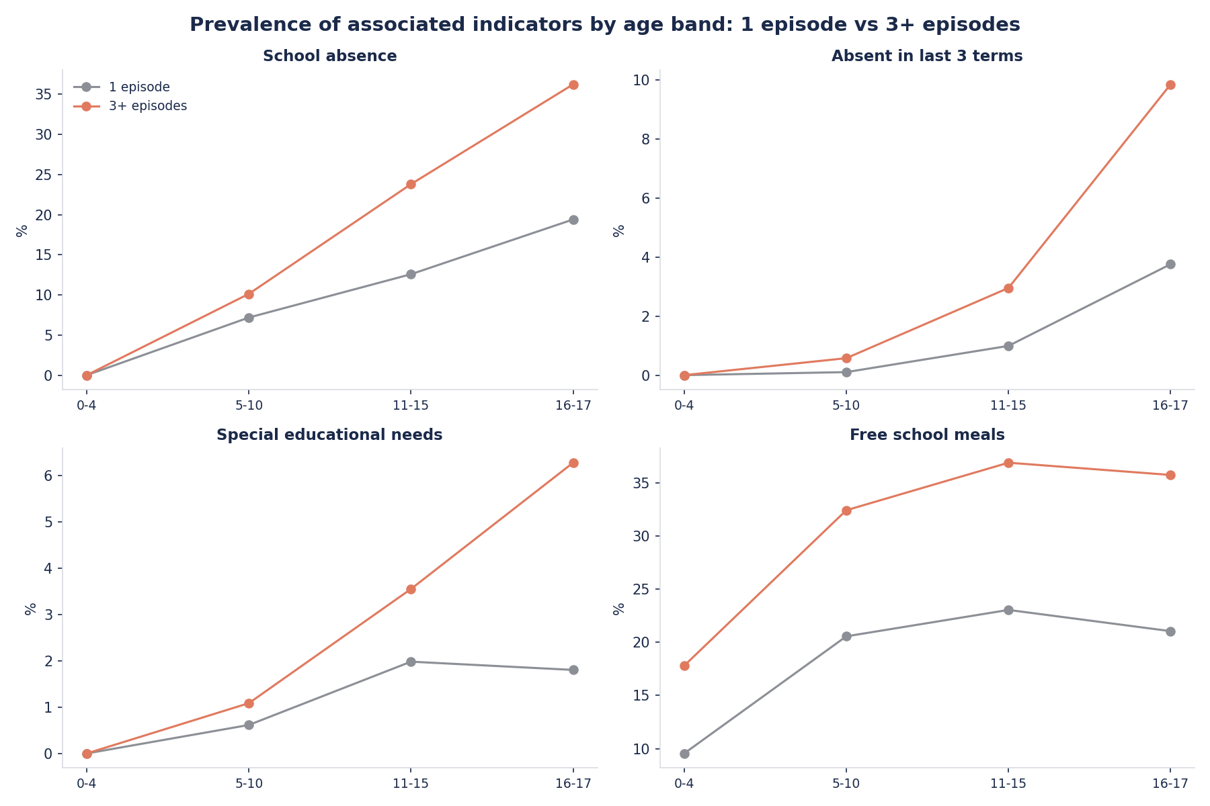
03 — THE ROLE OF AGE
The size of the gap itself changes with age
12
Notes:
The key point: it's not just that gaps exist, it's that they widen with age - especially absence and being absent in the last 3 terms, which nearly triple between 5-10 and 16-17. This is the strongest 'age matters' evidence in the deck and a good moment to slow down.

Slide 13
SUMMARY
Four things we'd want the Local Authority to take away
01
02
Repeat need clusters with disadvantage
Indicators rarely come alone
Housing benefit, free school meals and school absence are the strongest markers separating single-episode from repeat-episode children.
Children with 3+ episodes carry 1.8× as many co-occurring indicators — repeat CIN involvement is a signal of wider household pressure, not an isolated issue.
03
04
Age changes the story
Attendance gaps widen with age
Under-5s look more likely to resolve after one episode; recurrence is concentrated in primary and secondary years.
The absence-related gap between groups grows sharply through the teenage years — a plausible window for earlier intervention.
13
Notes:
Synthesis slide - if the panel only remembers four things, this is them. Say each one in a single sentence and move on; the detail was already covered.

Slide 14
CAVEATS
What this analysis can’t tell us — yet
No timing information
We can't tell whether indicators (e.g. absence) preceded or followed a CIN episode — so we can describe association, not cause and effect.
Unpopulated fields
DWP, AdultOffender and NEET carry no signal in this extract and were excluded rather than reported as “0% prevalence.”
No demographic or geographic detail
No gender, ethnicity, ward or deprivation data, which limits any equity or targeting analysis.
Single Local Authority
Findings reflect one LA's population, thresholds and recording practices — they may not generalise elsewhere.
14
Notes:
Important for credibility in a data science interview: show you know the difference between correlation and causation, and that you'd push back on data quality rather than presenting flawed fields as facts.

Slide 15
LOOKING BEYOND THIS EXERCISE
Other datasets we'd want, given no constraints
Case & referral history
Household context
Outcomes & wider services
MASH / contact & referral records, incl. reason for referral and step-up/step-down dates
Child Protection Plan history (starts, ends, categories)
Social worker / caseload continuity
Parental mental health, substance misuse & domestic abuse indicators (via multi-agency safeguarding data)
Housing type, moves, and area deprivation (IMD) by ward
Family structure & sibling CIN involvement
Health contacts (A&E, GP, health visitor)
School attainment & SEN provision detail, not just a flag
Geography, ethnicity & gender for equity analysis
15
Notes:
Answers question 3a from the brief directly. Pick 1-2 of these to elaborate on live rather than reading all nine - e.g. explain why timing/sequencing data (referral and step-down dates) would let us finally test cause vs. effect.

Slide 16
LOOKING BEYOND THIS EXERCISE
What we'd ask the Children Social Care Manager
1
When a case reopens, is that usually a new concern, or the same underlying issue resurfacing? Is that distinction currently recorded?
2
Is there a working definition of when an episode “ends” — and a target time before a case should be considered for step-down?
3
Do repeat episodes reflect families known to be higher-need from the outset, or does something change mid-way through casework?
4
What thresholds currently move a case from CIN into statutory Child Protection — and how many of our 3+ group have crossed that line?
5
Are there known capacity or caseload pressures around specific ages (e.g. transition to secondary school) that could shape the patterns we're seeing?
16
Notes:
Answers question 3b from the brief. These questions are chosen to test our main hypotheses against the manager's frontline knowledge - e.g. question 1 directly probes whether 'repeat episode' means a new problem or an old one resurfacing, which we couldn't tell from the data alone.

Slide 17
RECOMMENDATIONS
Three practical next steps for the Local Authority
Watch the housing benefit / FSM / attendance signal
1
These three factors show the widest gaps between single- and repeat-episode children — a natural starting point for an early-warning indicator.
Focus early support on primary-age children
2
Recurrence is heaviest in the 5-10 age band; the 0-4 group's episodes look more likely to resolve without repeat involvement.
Clarify data recording before building on it further
3
Fix the exclusion-flag inconsistency and confirm why DWP/AdultOffender/NEET are unpopulated, so future analysis — including any predictive model — rests on reliable fields.
17
Notes:
End on actionable substance rather than just findings - this is what separates a data analysis from a set of recommendations a Local Authority can actually use.

Slide 18
Thank you
Looking forward to discussing this with the Social Finance team.
Code and full analysis output accompany this deck.
Notes:
Invite discussion and questions. Have the Python script open in case they want to see methodology detail (e.g. which statistical test was used, how age bands were chosen).

