Slide 1

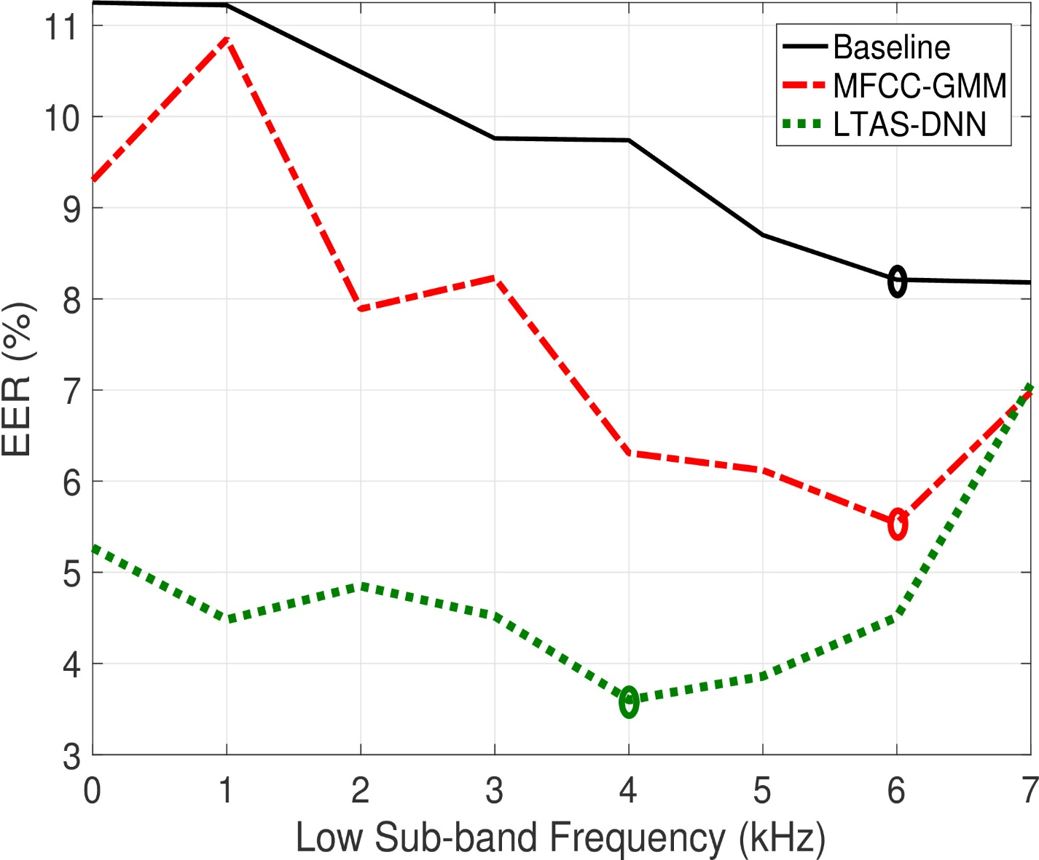
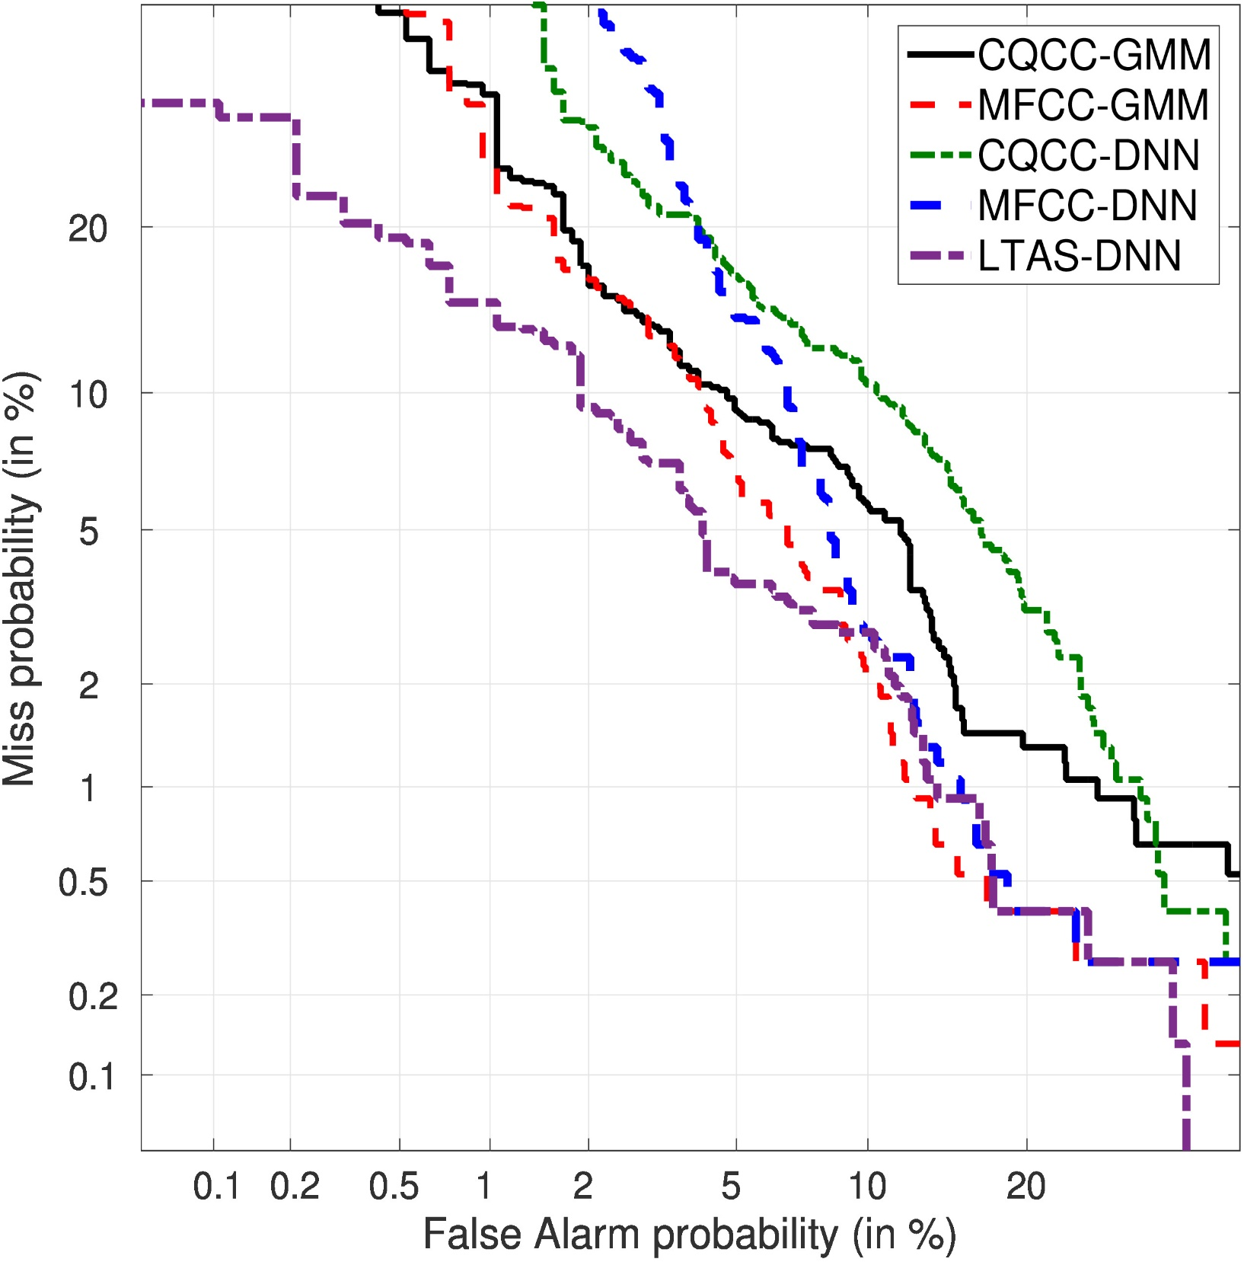
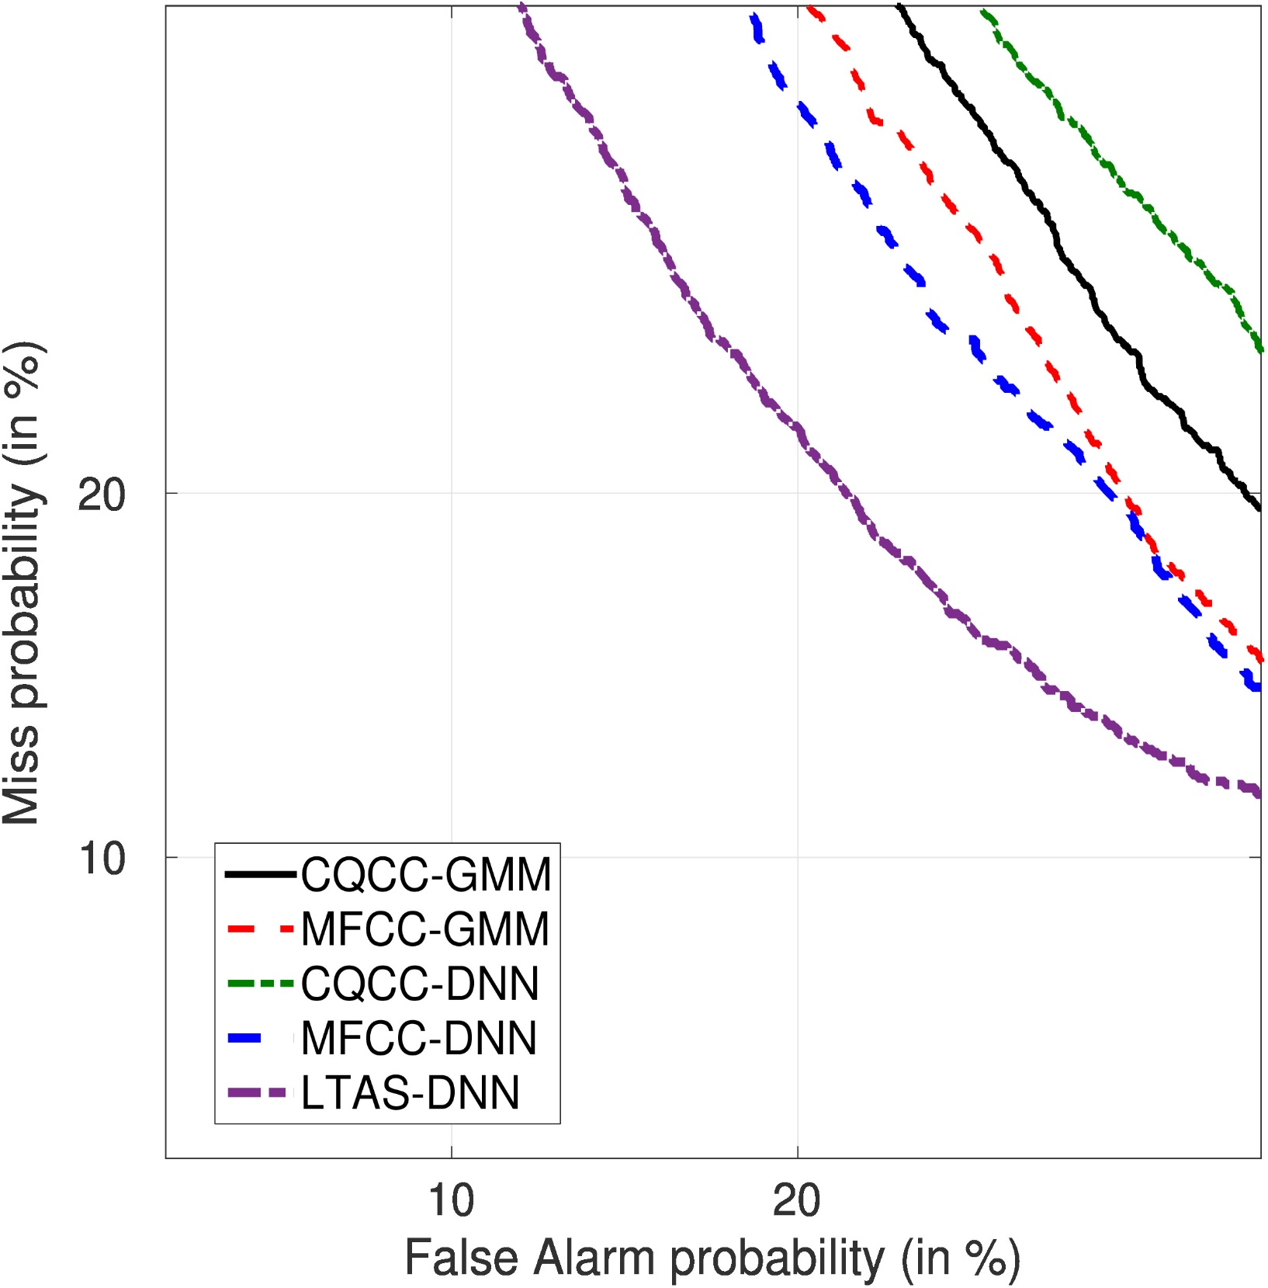
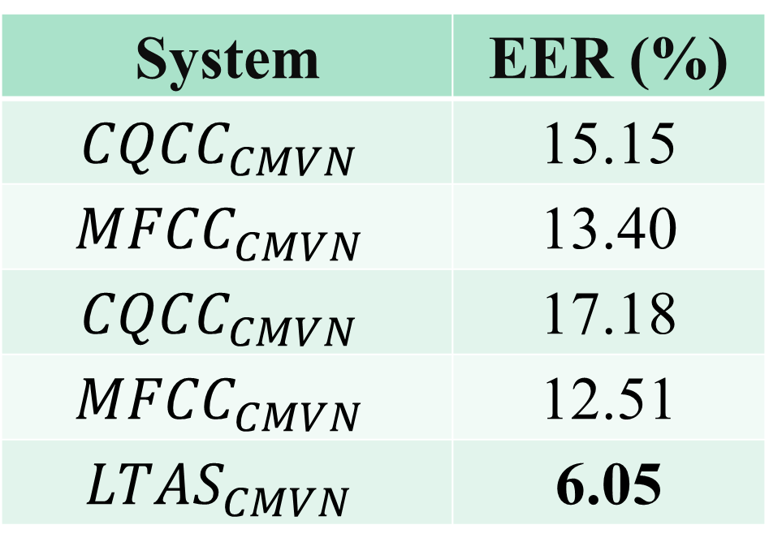



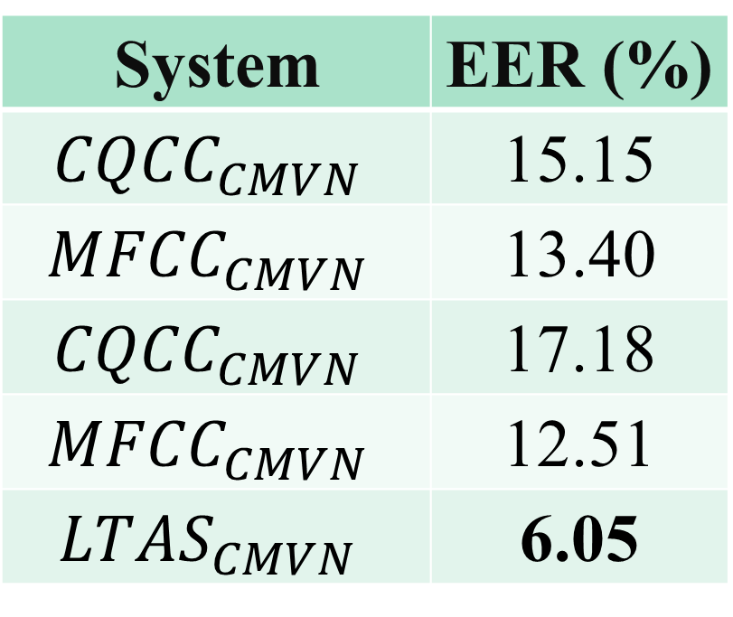
AN EXPERIMENTAL STUDY ON AUDIO REPLAY ATTACK DETECTION USING DEEP NEURAL NETWORKS
Bekir Bakar, Cemal Hanilçi
Bursa Technical University
Department of Electrical and Electronics Engineering
Bursa, Turkey
Replay Attack Detection
Results
Given a speech signal S, spoofing detection is a hypothesis test:
$H_{0}$ : S is genuine speech signal
$H_{1}$ : S is re-played/spoof speech signal
Using the feature vectors extracted from speech signal S, log-likelihood ratio (LLR) test can be applied to decide between two hypothesis:
$LLR(X)=\operatorname{logp}{(X|λ_{H_{0}}) }−\operatorname{logp}{(X|λ_{H_{1}}) }$
X $=\left\{x_{1},x_{2}, …x_{T}\right\}$ are the feature vectors.
$λ_{H_{0}} and λ_{H_{1}}$ are the acoustic models representing natural/genuine and re-played/spoof speech classes.
Development Set
Evaluation Set
Det Curves
System | EER (%)
CQCC-GMM | 8.18
MFCC-GMM | 5.54
CQCC-DNN | 10.05
MFCC-DNN | 6.44
LTAS-DNN | 4.10
System | EER (%)
$${CQCC}_{CMVN}$$ | 15.15
$${MFCC}_{CMVN}$$ | 13.40
$${CQCC}_{CMVN}$$ | 17.18
$${MFCC}_{CMVN}$$ | 12.51
$${LTAS}_{CMVN}$$ | 6.05
Short-term are inferior to long-term features independent of the classifier.
Features
Cepstral mean and variance normalization reduces performance
CQCC
18 dimensional ($c_{1}−c_{19}$) static constant Q cepstral coefficients [1] are computed using constant-Q transform.
Greater time resolution for the higher frequencies and greater frequency resolution for the lower frequencies.
MFCC
Mel-frequency cepstral coefficients are extracted from the pre-emphasized speech signal [2].
20 ms frames in 10 ms overlap, Hamming window.
27-channel mel-filterbank.
LTAS
The 514 dimensionel long-term average spectrum [3].
Represents an utterance in a long-term rather than short-term.
20 ms frames in 10 ms overlap.
512 point discrete Fourier transform
Concatenation of the mean and standard deviation statistics of logarithmic magnitude spectrum.
High-frequency components convey more discriminative information.
System | EER (%)
$${CQCC}_{CMVN}$$ | 15.15
$${MFCC}_{CMVN}$$ | 13.40
$${CQCC}_{CMVN}$$ | 17.18
$${MFCC}_{CMVN}$$ | 12.51
$${LTAS}_{CMVN}$$ | 6.05
DNN slightly improves the performans in comparison to GMM classifier for MFCC features.
GMM classifier is superior to DNN
back-end for CQCC features.
Classifiers
GMM
512 component Gaussian mixture model.
Expectation maximization (EM) algorithm.
Genuine and replay clases ($λ_{replay}$, $λ_{genine}$) replay attack detection score is computed as:
${LLR}_{GMM}(X)=\operatorname{logp}{(X|λ_{genuine}) }−\operatorname{logp}{(X|λ_{replay}) }$
DNN
Fully-connected feed-forward neural network.
Batch training, batch normalization and dropout.
The softmax function.
The posteriors obtained at the output layer (two units) of deep neural network is transformed into LLR score as:
${ LLR}_{GMM}(X)=\operatorname{logp}{(X|λ_{genuine}) }−\operatorname{logp}{(X|λ_{replay}) }$
References
[1] Massimiliano Todisco, Hector Delgado, and Nicholas Evans, “A new feature for automatic speaker verification anti-spoofing: Constant Q cepstral coefficients,” in Proc. Speaker Odyssey Workshop, 2016, pp. 249–252.
[2] S. Davis and P. Mermelstein, “Comparison of parametric representations for monosyllabic word recognition in continuously spoken sentences,” IEEE Transactions on Acoustics, Speech, and Signal Processing, pp. 357–366, Aug. 1980.
[3] H. Muckenhirn, M. Magimai-Doss, and S. Marcel, “Presentation attack detection using long-term spectral statistics for trustworthy speaker verification,” in Proc. BIOSIG, 2016, pp. 1–6.
[4] D. A. Reynolds, T. F. Quatieri and R. B. Dunn, ”Speaker verification using adapted Gaussian mixture models”, Digital Signal Processing, vol. 10, no. 1-3, pp. 19-41, 2000.
 | CQCC | MFCC | LTAS
Input Size Hidden Layers Unit Size Dropout | 18 3 256 0.2 | 57 3 256 0.2 | 514 5 1024 0.5
Optimized empirically.
These values are highly depend on data (features).

