Slide 1
Multi-column Deep Neural Networks for Image Classification*
Bekir Bakar
Bursa Technical University
b.bakar@outlook.com
*Ciregan, D., Meier, U., & Schmidhuber, J. (2012, June). Multi-column deep neural networks for image classification. In 2012 IEEE conference on computer vision and pattern recognition(pp. 3642-3649). IEEE.

Slide 2
Problem
Traditional methods of computer vision and machine learning cannot match human performance tasks such as the recognition of handwritten digits or traffic signs
Biologically plausible deep artificial neural network architectures can

Slide 3
Propose
Only winner neurons are trained. Several deep neural columns become experts on inputs preprocessed in different ways; their predictions are averaged
On the very competitive MNIST handwriting benchmark, our method is the first to achieve near-human performance

Slide 4
Architecture
Inspired by micro-columns of neurons in the cerebral cortex
Given some input pattern, the predictions of all columns are democratically averaged
Before training, the weights (synapses) of all columns are randomly initialized
Various columns can be trained on the same inputs, or on inputs preprocessed in different ways

Slide 5
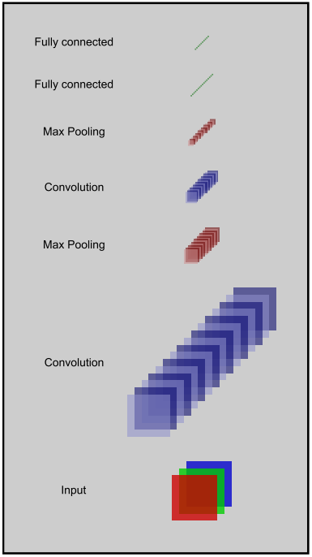
Architecture: DNN
2x48x48-100C5-MP2-100C5-MP2-100C4-MP2-300N-100N-6N represents a net with 2 input images of size 48x48
a convolutional layer with 100 maps and 5x5 filter
a max-pooling layer over non overlapping regions of size 2x2
a convolutional layer with 100 maps and 4x4 filters
a max-pooling layer over non overlapping regions of size 2x2
a fully connected layer with 300 hidden units
a fully connected layer with 100 hidden units and
a fully connected output layer with 6 neurons (one per class)

Slide 6
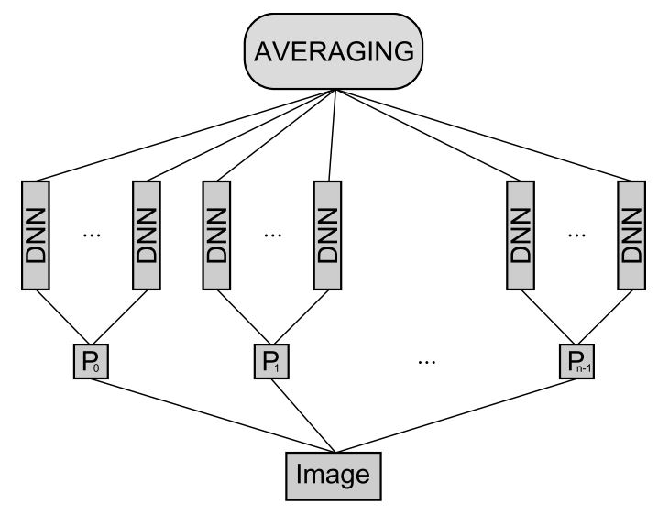
Architecture: Averaging

Slide 7
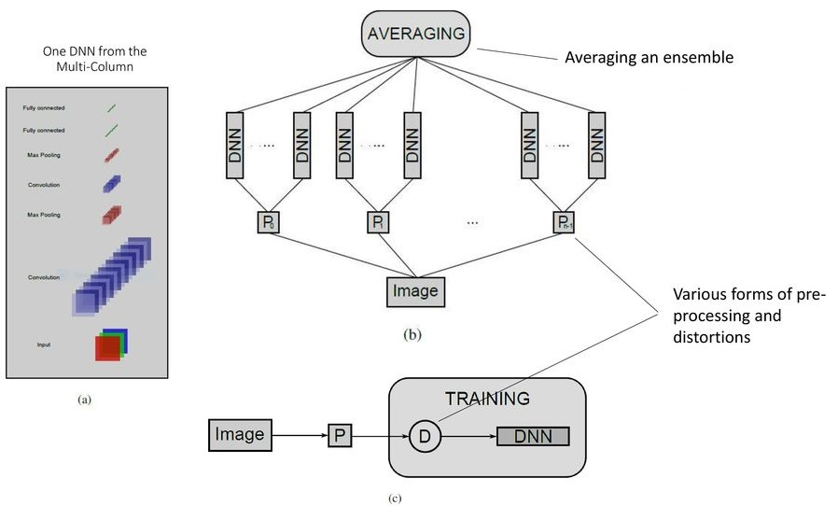
Architecture: MCDNN

Slide 8
Datasets
MNIST
NIST SD 19
Chinese characters
Traffic signs
CIFAR 10
NORB

Slide 9
MNIST
The MNIST database is a large database of handwritten digits that is commonly used for training various image processing systems
The original MNIST digits [20] are normalized such that the width or height of the bounding box equals 20 pixels.

Slide 10
Keynotes
Proposed method is fully supervised and does not use any additional unlabeled data source
On many other image classification datasets MCDNN improves the state-of-the-art by 30-80%
Single DNN already are sufficient to obtain new state-of-the-art results; combining them into MCDNNs yields further dramatic performance boosts

Slide 11
Results
Dataset | Best result of others [%] | MCDNN[%] | Relative improvement [%]
MNIST | 0.39 | 0.23 | 41
HWDB1.0 | 7.61 | 5.61 | 26
CIFAR10 | 18.50 | 11.21 | 39
Traffic Signs | 1.69 | 0.54 | 72
NORB | 5.00 | 2.70 | 46

