Slide 1
Object Detection and Localization for Document Profiling Systems
Yapay Zeka Dersi Sunumu
Bekir Bakar

Slide 2
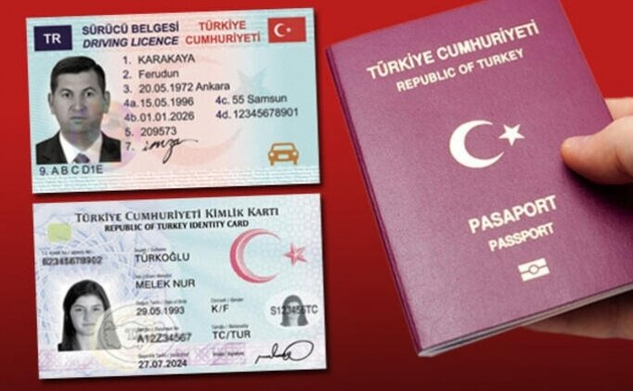
Sample Document

Slide 3
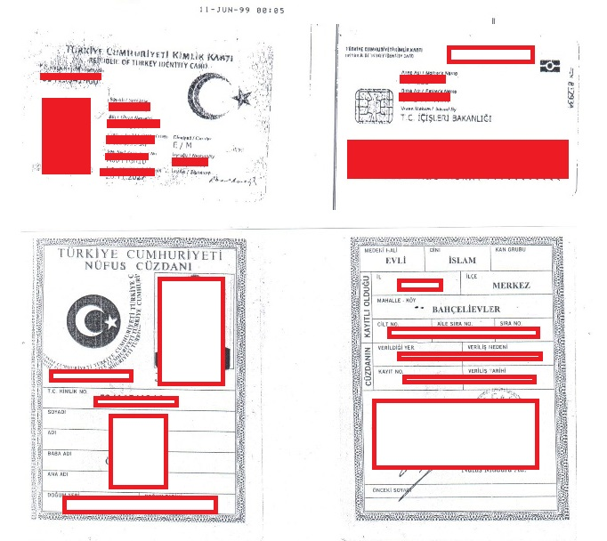
Sample Document

Slide 4
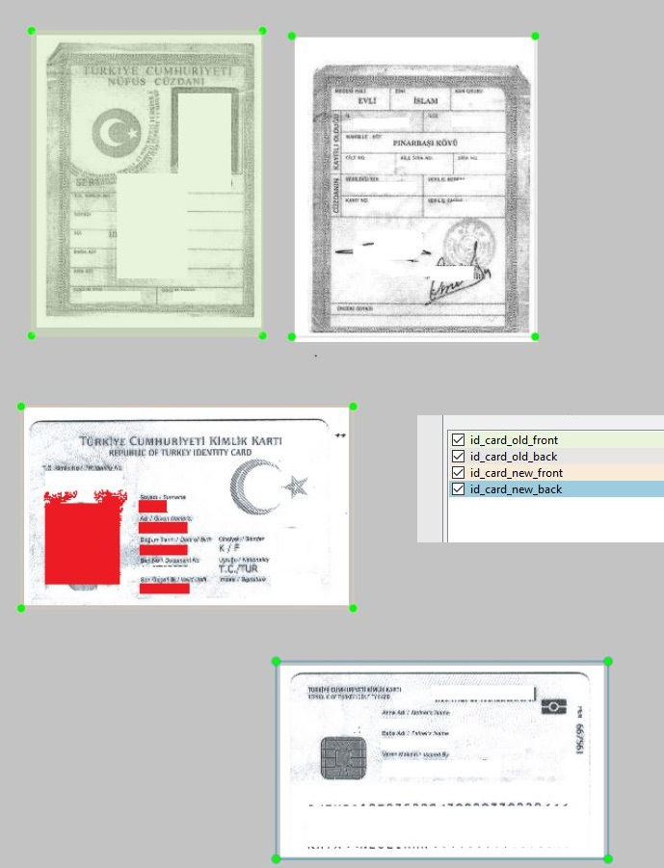
Image Annotation Sample Output
<object>
<name>id_card_old_front</name>
<bndbox>
<xmin>38</xmin>
<ymin>60</ymin>
<xmax>260</xmax>
<ymax>353</ymax>
</bndbox>
</object>
<object>
<name>id_card_new_front</name>
<bndbox>
<xmin>28</xmin>
<ymin>421</ymin>
<xmax>347</xmax>
<ymax>615</ymax>
</bndbox>
</object>

Slide 5
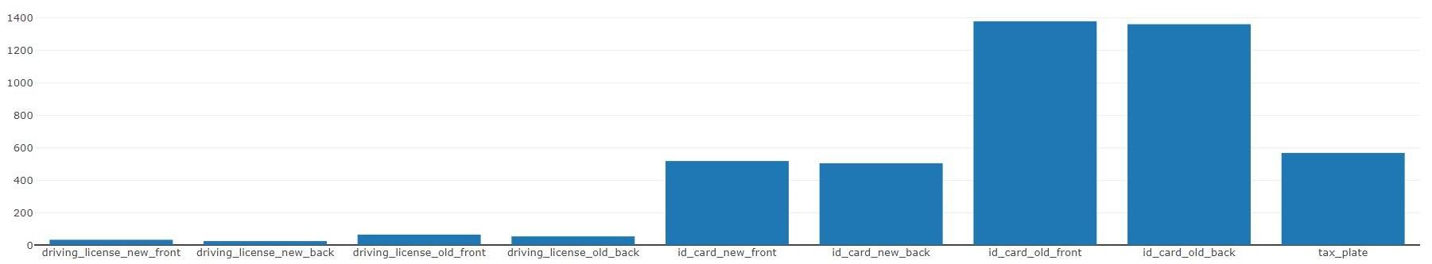
Image Dataset
sdfs
Deciding clases
Sparse dataset
Data augmentation
Front and back of documents
Which images stands together?

Slide 6
Dataset
Pre-processing
Noise Removal
Skew Correction
Perspective Correction
Fixed Size Images
Upscaling
Downscaling
Annotation

Slide 7
Object Detection
HOG Features
SPP-net
CNN based Detectors
SSD (regression based detector)
YOLO (regression based detector)

Slide 8
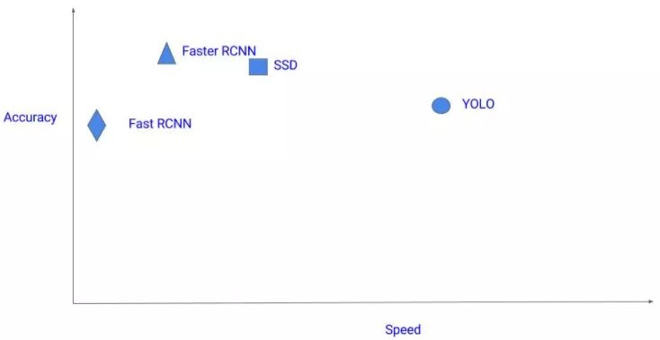
Compare Detectors
https://cv-tricks.com/object-detection/faster-r-cnn-yolo-ssd/

Slide 9
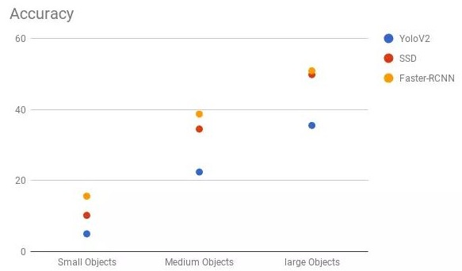
Compare Detectors
https://cv-tricks.com/object-detection/faster-r-cnn-yolo-ssd/
https://cv-tricks.com/object-detection/faster-r-cnn-yolo-ssd/

Slide 10
Single Shot Detector
Runs single network
Accuracy - speed trade-off
Liu, W., Anguelov, D., Erhan, D., Szegedy, C., Reed, S., Fu, C. Y., & Berg, A. C. (2016, October). Ssd: Single shot multibox detector. In European conference on computer vision (pp. 21-37). Springer, Cham.

Slide 11
Regional Convolutional Neural Network (CNN)
Mask R-CNN ¹
Faster R-CNN ²
Cascade R-CNN ³
According to literature: High accuray slow speed
Since regression based models succeed acceptable results, CNN based detector loss popularty
He, K., Gkioxari, G., Dollár, P., & Girshick, R. (2017). Mask r-cnn. In Proceedings of the IEEE international conference on computer vision (pp. 2961-2969).
Ren, S., He, K., Girshick, R., & Sun, J. (2015). Faster r-cnn: Towards real-time object detection with region proposal networks. arXiv preprint arXiv:1506.01497.
Cai, Z., & Vasconcelos, N. (2018). Cascade r-cnn: Delving into high quality object detection. In Proceedings of the IEEE conference on computer vision and pattern recognition (pp. 6154-6162).

Slide 12
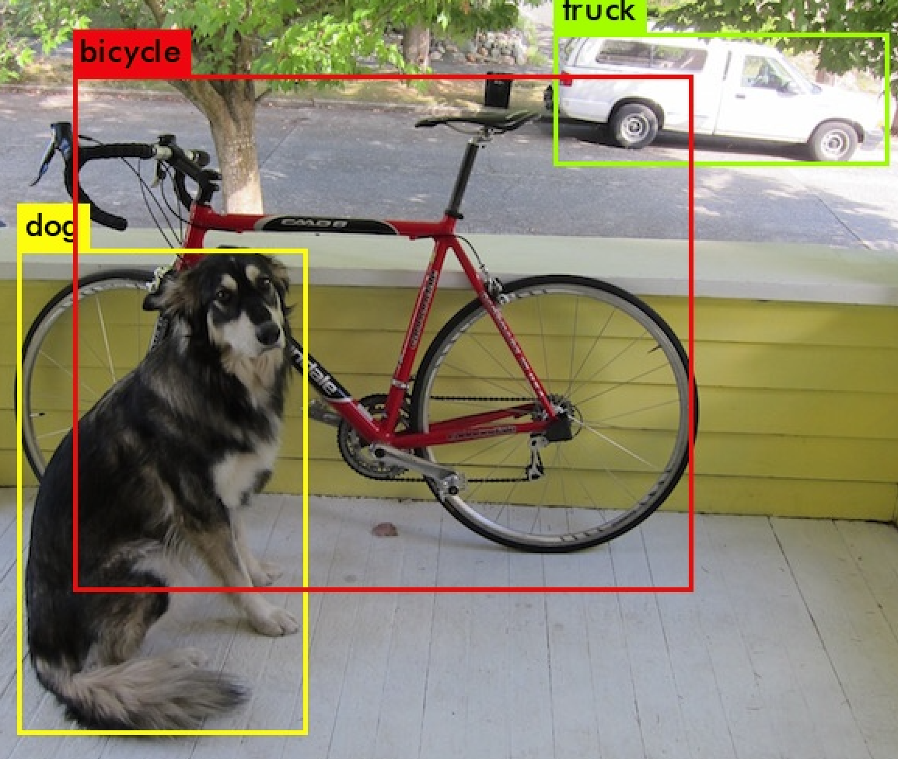
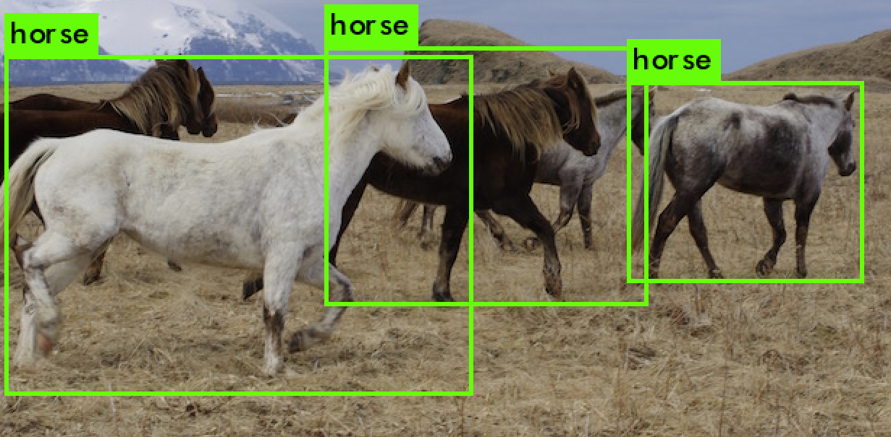
You Only Look Once (YOLO)
https://pjreddie.com/darknet/yolo/
https://youtu.be/MPU2HistivI
Redmon, J., Divvala, S., Girshick, R., & Farhadi, A. (2016). You only look once: Unified, real-time object detection. In Proceedings of the IEEE conference on computer vision and pattern recognition (pp. 779-788).

Slide 13
You Only Look Once (YOLO) - Overview
Prior detection systems repurpose classifiers or localizers to perform detection.
Apply the model to an image at multiple locations and scales.
High scoring regions of the image are considered detections.
A single neural network to the full image. This network divides the image into regions and predicts bounding boxes and probabilities for each region.
Bounding boxes are weighted by the predicted probabilities.
https://pjreddie.com/darknet/yolo/
https://youtu.be/MPU2HistivI
Redmon, J., Divvala, S., Girshick, R., & Farhadi, A. (2016). You only look once: Unified, real-time object detection. In Proceedings of the IEEE conference on computer vision and pattern recognition (pp. 779-788).

Slide 14
You Only Look Once (YOLO) - Versions
Version 1: Proposal Initial Version
Version 2 : YOLO9000 / YOLOv2
Inclusion of batch Normalization layers after each Conv Layer
It has 30 layers in comparison to YOLO v1 26 layers.
Anchor Boxes were introduced.
Version 3: YOLOv3
06 layers neural network
Detection on 3 scales for detecting objects of small to very large size
9 anchor boxes taken; 3 per scale. Hence more bounding boxes are predicted than YOLO9000 & YOLOv1
MultiClass problem turned in MultiLabel problem
Certain changes in the Error function.
Quite good with small objects
Ultranaltyics Implementations: https://github.com/ultralytics/yolov3
https://pjreddie.com/darknet/yolo/
https://youtu.be/MPU2HistivI
Redmon, J., Divvala, S., Girshick, R., & Farhadi, A. (2016). You only look once: Unified, real-time object detection. In Proceedings of the IEEE conference on computer vision and pattern recognition (pp. 779-788).

Slide 15
You Only Look Once (YOLO) - Implementation
Annotation over Dataset
Train
Evaluate
Report Results
https://pjreddie.com/darknet/yolo/
https://youtu.be/MPU2HistivI
Redmon, J., Divvala, S., Girshick, R., & Farhadi, A. (2016). You only look once: Unified, real-time object detection. In Proceedings of the IEEE conference on computer vision and pattern recognition (pp. 779-788).

Slide 16
Tools and Technologies
Python, C/C++
Darknet
PyTorch
Tensorflow
Keras
Vott Image Annotation - LabeImage

Slide 17
Conclusion - Throwbacks - Future Works
No OCR data from bounding boxes
Lack of data (hand crafted methods)
Rule based validator in case of wrong output
System speed
System accuray
Named Entity Recognition
Rule Based Models

Slide 18
Final
Info
Bekir Bakar
193331541008
Elektrik Elektronik Mühendisliği
Bursa Teknik Üniversitesi
Contact
b.bakar@outlook.com

