Slide 1
3D-grafikk Holger.Ludvigsen@Bekk.no

Slide 2
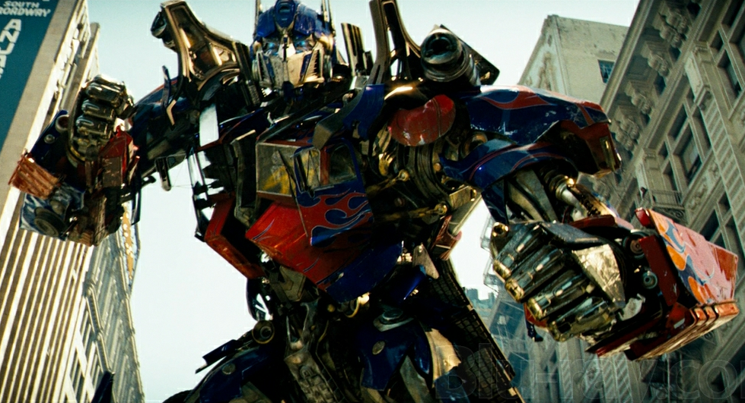


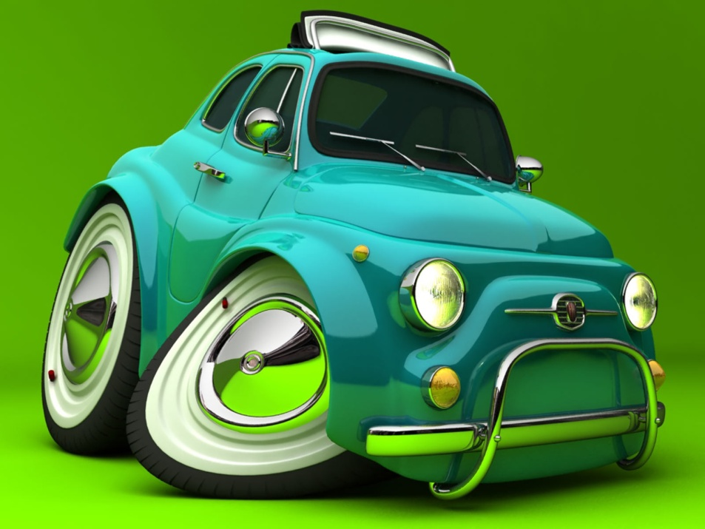

Slide 3
Fra modell til skjermbilde

Slide 4
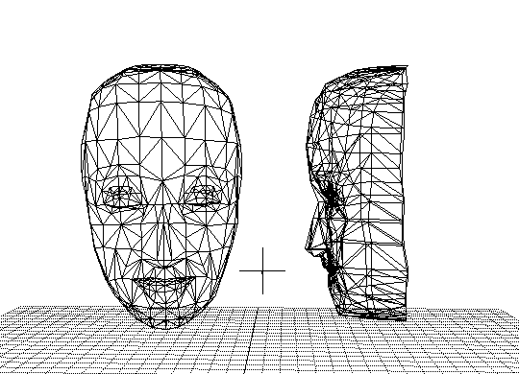
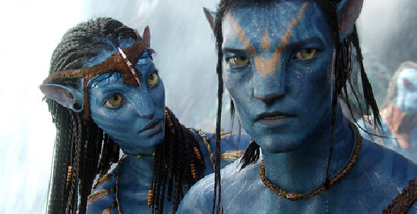
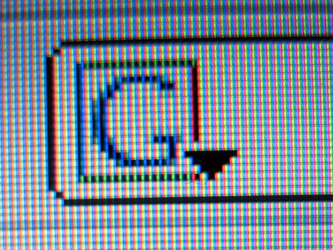
(9,0,11)
(34,178,89)
(20,24,390)
(10,2,6) (12,14,7)
(32,2,89)
(3,21,211)
(84,3,60)
(43,29,110)
(3,88,172)
(92,13,266)
(34,92,452)

Slide 5
Projisering

Slide 7
P
l
l₀
n
A

Slide 8
P
A
P’

Slide 10
Rasterisering

Slide 15
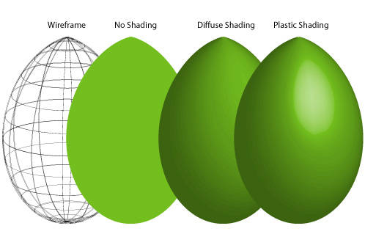

Slide 16
Shading

Slide 17
L
α
P1
N
P
P3
P2

Slide 18
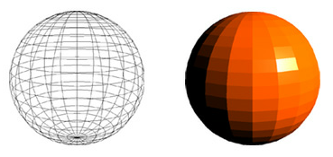

Slide 19
Gouraud

Slide 20
Gouraud

Slide 21
Gouraud

Slide 22
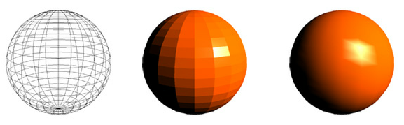

Slide 23
Phong

Slide 24
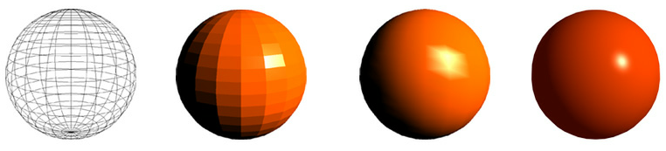

Slide 25
Fotorealisme

Slide 26
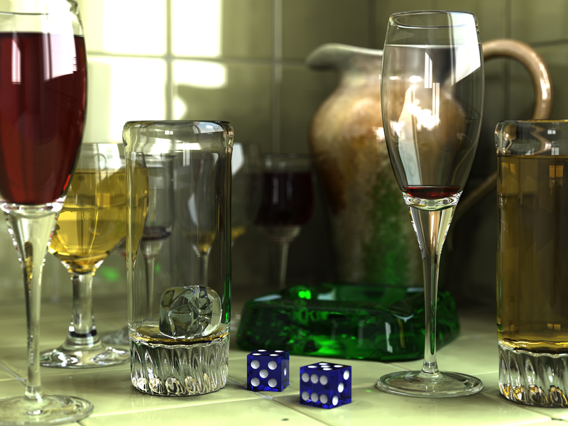

Slide 27
Ray tracing

Slide 30
Skygge

Slide 31
Refleksjon
N
a_{r}
a_{i}

Slide 32
Gjennomsiktighet
N_{i}
a_{i}
a_{r}
N_{r}
Snells lov
N_{i} ∙ sin a_{i} = N_{r} ∙ sin a_{r}

Slide 34
WebGL

Slide 35
foo.html
<html>
<head>
<script src=foo.js></script>
</head>
<body>
<canvas id="canv"></canvas>
</body>
</html>
foo.js
var canvas = document.getElementById("canv");
initGL(canvas);
initShaders();
initBuffers();
gl.clearColor(0.0, 0.0, 0.0, 1.0);
gl.enable(gl.DEPTH_TEST);
...

Slide 36
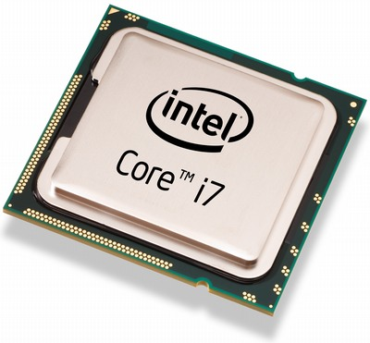
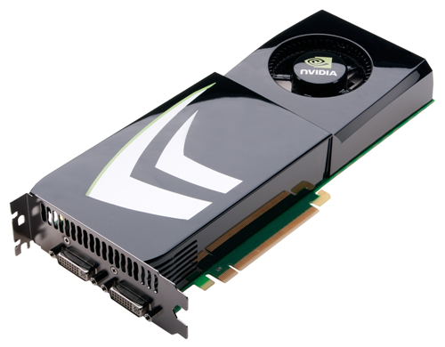
foo.html
<html>
<head>
<script src=foo.js></script>
</head>
<body>
<canvas id="canv"></canvas>
</body>
</html>
foo.js
var canvas = document.getElementById("canv");
initGL(canvas);
initShaders();
initBuffers();
gl.clearColor(0.0, 0.0, 0.0, 1.0);
gl.enable(gl.DEPTH_TEST);
...

Slide 37
DEMOS
Protein ribbons: http://web.chemdoodle.com/demos/pdb-ribbons
Github users globe: http://aasen.in/github_globe/
Planimator: http://seeplan.bengler.no/planimator
World wide maze: http://chrome.com/maze/
Bump map head: http://threejs.org/examples/webgl_materials_bumpmap.html
Webcam swiper: http://iambrandonn.github.io/WebcamSwiper/
Webcam displace: http://www.mrdoob.com/lab/javascript/webcam/displace/

Slide 38
gl.bufferData(gl.ARRAY_BUFFER, new Float32Array(vertices), gl.STATIC_DRAW);
cubeVertexPositionBuffer.itemSize = 3;
cubeVertexPositionBuffer.numItems = 24;
cubeVertexColorBuffer = gl.createBuffer();
gl.bindBuffer(gl.ARRAY_BUFFER, cubeVertexColorBuffer);
colors = [
[1.0, 0.0, 0.0, 1.0], // Front face
[1.0, 1.0, 0.0, 1.0], // Back face
[0.0, 1.0, 0.0, 1.0], // Top face
[1.0, 0.5, 0.5, 1.0], // Bottom face
[1.0, 0.0, 1.0, 1.0], // Right face
[0.0, 0.0, 1.0, 1.0] // Left face
];
var unpackedColors = [];
for (var i in colors) {
var color = colors[i];
for (var j=0; j < 4; j++) {
unpackedColors = unpackedColors.concat(color);
}
}
gl.bufferData(gl.ARRAY_BUFFER, new Float32Array(unpackedColors), gl.STATIC_DRAW);
cubeVertexColorBuffer.itemSize = 4;
cubeVertexColorBuffer.numItems = 24;
cubeVertexIndexBuffer = gl.createBuffer();
gl.bindBuffer(gl.ELEMENT_ARRAY_BUFFER, cubeVertexIndexBuffer);
var cubeVertexIndices = [
0, 1, 2, 0, 2, 3, // Front face
4, 5, 6, 4, 6, 7, // Back face
8, 9, 10, 8, 10, 11, // Top face
12, 13, 14, 12, 14, 15, // Bottom face
16, 17, 18, 16, 18, 19, // Right face
20, 21, 22, 20, 22, 23 // Left face
];
gl.bufferData(gl.ELEMENT_ARRAY_BUFFER, new Uint16Array(cubeVertexIndices), gl.STATIC_DRAW);
cubeVertexIndexBuffer.itemSize = 1;
cubeVertexIndexBuffer.numItems = 36;

Slide 39
gl.bufferData(gl.ARRAY_BUFFER, new Float32Array(vertices), gl.STATIC_DRAW);
cubeVertexPositionBuffer.itemSize = 3;
cubeVertexPositionBuffer.numItems = 24;
cubeVertexColorBuffer = gl.createBuffer();
gl.bindBuffer(gl.ARRAY_BUFFER, cubeVertexColorBuffer);
colors = [
[1.0, 0.0, 0.0, 1.0], // Front face
[1.0, 1.0, 0.0, 1.0], // Back face
[0.0, 1.0, 0.0, 1.0], // Top face
[1.0, 0.5, 0.5, 1.0], // Bottom face
[1.0, 0.0, 1.0, 1.0], // Right face
[0.0, 0.0, 1.0, 1.0] // Left face
];
var unpackedColors = [];
for (var i in colors) {
var color = colors[i];
for (var j=0; j < 4; j++) {
unpackedColors = unpackedColors.concat(color);
}
}
gl.bufferData(gl.ARRAY_BUFFER, new Float32Array(unpackedColors), gl.STATIC_DRAW);
cubeVertexColorBuffer.itemSize = 4;
cubeVertexColorBuffer.numItems = 24;
cubeVertexIndexBuffer = gl.createBuffer();
gl.bindBuffer(gl.ELEMENT_ARRAY_BUFFER, cubeVertexIndexBuffer);
var cubeVertexIndices = [
0, 1, 2, 0, 2, 3, // Front face
4, 5, 6, 4, 6, 7, // Back face
8, 9, 10, 8, 10, 11, // Top face
12, 13, 14, 12, 14, 15, // Bottom face
16, 17, 18, 16, 18, 19, // Right face
20, 21, 22, 20, 22, 23 // Left face
];
gl.bufferData(gl.ELEMENT_ARRAY_BUFFER, new Uint16Array(cubeVertexIndices), gl.STATIC_DRAW);
cubeVertexIndexBuffer.itemSize = 1;
cubeVertexIndexBuffer.numItems = 36;
three.js
var ratio = window.innerWidth / window.innerHeight;
camera = new THREE.Camera(70, ration, 1, 1000);
camera.position.z = 350;
scene = new THREE.Scene();
var geometry = new THREE.CubeGeometry(200, 200, 200)
var material = new THREE.MeshNormalMaterial()
cube = new THREE.Mesh(geometry, material);
scene.addObject(cube);
container = document.createElement('div');
document.body.appendChild(container);
renderer = new THREE.WebGLRenderer(); container.appendChild(renderer.domElement);

Slide 40
Enkelt three.js-eksempel

Slide 41
Spm?

Slide 42
Takk for meg!
Holger.Ludvigsen@Bekk.no

