Slide 1
MONGODB
NoSQL kursserie del 1
UiO
Frode Bjerke
04-03-2015

Slide 2
Om kursserien
Del 1
Del 2
Del 3
Introduksjon til MongoDB
Vi fokuserer på basisoperasjoner og funksjonalitet som gjør dette til et godt verktøy for rask utvikling!
Introduksjon til Neo4J
Neo4J går med tanke på funksjonalitet i motsatt retning av MongoDB. Det man får i retur er en database som kan gjøre ekstremt kraftige spørringer.
Vi har til nå sett på to ytterst forskjellige databaser. I tillegg har man de mer tradisjonelle relasjonelle SQL databasene og mange andre varisjoner av databaser. Så hvordan vet man hvilken man skal bruke når?
Denne kvelden vil være rettet mot å gi dere innsikt i det å velge riktig database til riktig oppgave.

Slide 3




Kursholdere I dag
Fredrik Valdmanis
Frithjof Nerdrum
Seniorkonsulent
UiO
Konsulent
INSA
Ken Grønnbeck
Frode Bjerke
Konsulent
NTNU
Konsulent
UiO

Slide 4

Introduction - Mongodb

Slide 5
What is mongodb?
MongoDB is a document-oriented non-relational database.
Notes:
Open source
NoSQL
Widely adopted lots of help to get

Slide 6
Document-oriented
JSON document
{
"_id" : 1358101,
"title" : "Viña Salceda Crianza 2007",
"containerSize" : "75 cl",
"price" : 169.9
}
Notes:
JSON
Key – value pairs
Values can be of types string, number, boolean, array or object
(Show in a editor)

Slide 7
Collections of documents
Products collection
Users collection
{ “title”: “Løiten Linie”, … }
{
"_id" : "doug_walker”,
"name" : ”Doug Walker",
“carts”: [{
products: [196501]
}]
}
{ “title”: “Absolut Vodka”, … }
{ “title”: “Silly Saison”, … }
{
"_id" : ”athena.beer”,
"name" : ”Athena Beer",
“carts”: [{
products: [1358101]
}]
}
{ “title”: “Mackmyra”, … }
Notes:
An array of documents is a collection.
A database consists of one or many collections.
Collections are vaguely the same as tables in SQL.

Slide 8
NON-relational
{
"_id" : ”athena.beer”,
"name" : ”Athena Beer",
“carts”: [{
products: [1358101]
}]
}
<- USER
The user Athena Beer refers to the product Viña Salceda in one of her carts. The database is however oblivious of that fact.
{
"_id" : 1358101,
"title" : "Viña Salceda Crianza 2007",
"containerSize" : "75 cl",
"price" : 169.9
}
PRODUCT ->
No constraints across documents
Notes:
No constraints across documents
Could lead to update anomalies if you reference items in other documents.

Slide 9
Origins - humongous
Scalability
Key-Value
(Memcached, …)
MongoDB
Relational databases
(Postgres, MySQL, …)
Functionality
Notes:
MongoDB gets its name from huMONGOus

Slide 10
Trade-offs
÷ Joins
÷ Transactions
No support for joining data between documents in database.
Joins can in many cases be avoided by embedding or denormalizing data.
Last resort is to join data in application code.
No support for transactions.
Atomical write operations on a per-document level.
Work around by embedding or application code.

Slide 11
Trade-Wins(?)
Schemaless
Bias toward access pattern
MongoDB does not enforce any schema.
Easier to get started.
Gives a lot of freedom and responsibility to the developer.
Design schema towards access pattern.
Embed data that belong together. Fetch all data you need in one simple query. No need for joins.
No difference between application model and database model means less code.
Notes:
Some of the things MongoDB give you that you might not be used to.
- Schemaless
- Design for access pattern

Slide 12
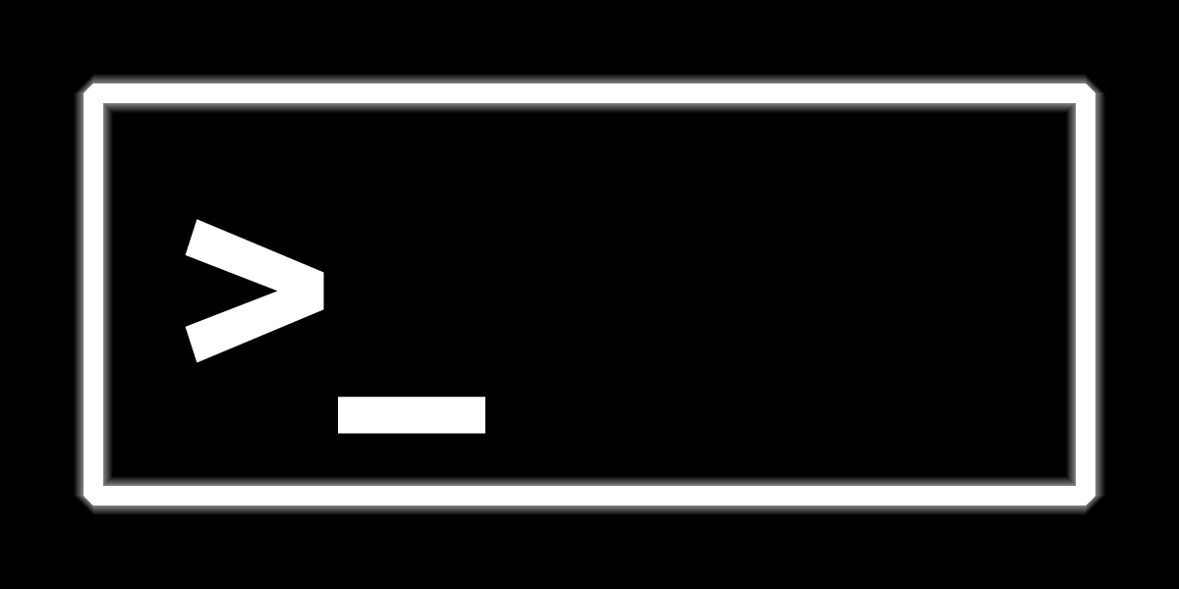
Queries and the shell

Slide 13
Query language
No specific query language.
Only methods in different programming language drivers.
Language drivers communicate via a wire-protocol to the database-server.

Slide 14
Mongodb shell
We are going to use the mongodb shell which is bundled with every install of MongoDB.
The MongoDB shell uses javascript.

Slide 15
Finds
Signature
Example
> db.collection.find({
<Criteria>
}, {
<Projection (optional)>
});
> db.products.find({
“title”: “Løiten Linie”
});
> db.products.find({
“title”: “Løiten Linie”,
“containerSize”: “70 cl”
}, {
“price”: 1,
“_id”: 0
});
> db.products.find().sort({
title: 1
}).limit(3);
Notes:
Show in the shell
Find løiten linie

Slide 16
inserts
Signature
Example
> db.users.insert(
<document or array of documents>
,
<optional options>
);
> db.users.insert({
_id: “richard.nixon”,
name: “Richard Nixon”,
birthdate: new Date(),
sex: “male”
});
Notes:
Show in the shell
Insert richard nixon

Slide 17
Updates
Signature
Example
> db.products.update({
<query>
}, {
<update>
}, {
<optional options>
});
> db.users.update({
_id: “richard.nixon”
}, {
“$set”: {name: “Richard M. Nixon”}
});
Notes:
Show in the shell
Update richard nixon
M. Is for Milhouse
Show overwrite

Slide 18
Logg på hver deres server
Velg dere en server og marker den med navn på: http://bit.ly/mongo-ip
2. Åpne en terminal:
> ssh mongokurs@<ipadresse>
Passord: mongoerkult
3. Finn oppgavesett på:
- Github.com/bekkopen/databasekurs/
Mongodb -> exercises
$ mongo
Connect to mongod on localhost:27017
> show dbs
List of databases
> use kursserie
Switch to the kursserie database
> show collections
products
system.indexes
users
> db.products.findOne();

Slide 19
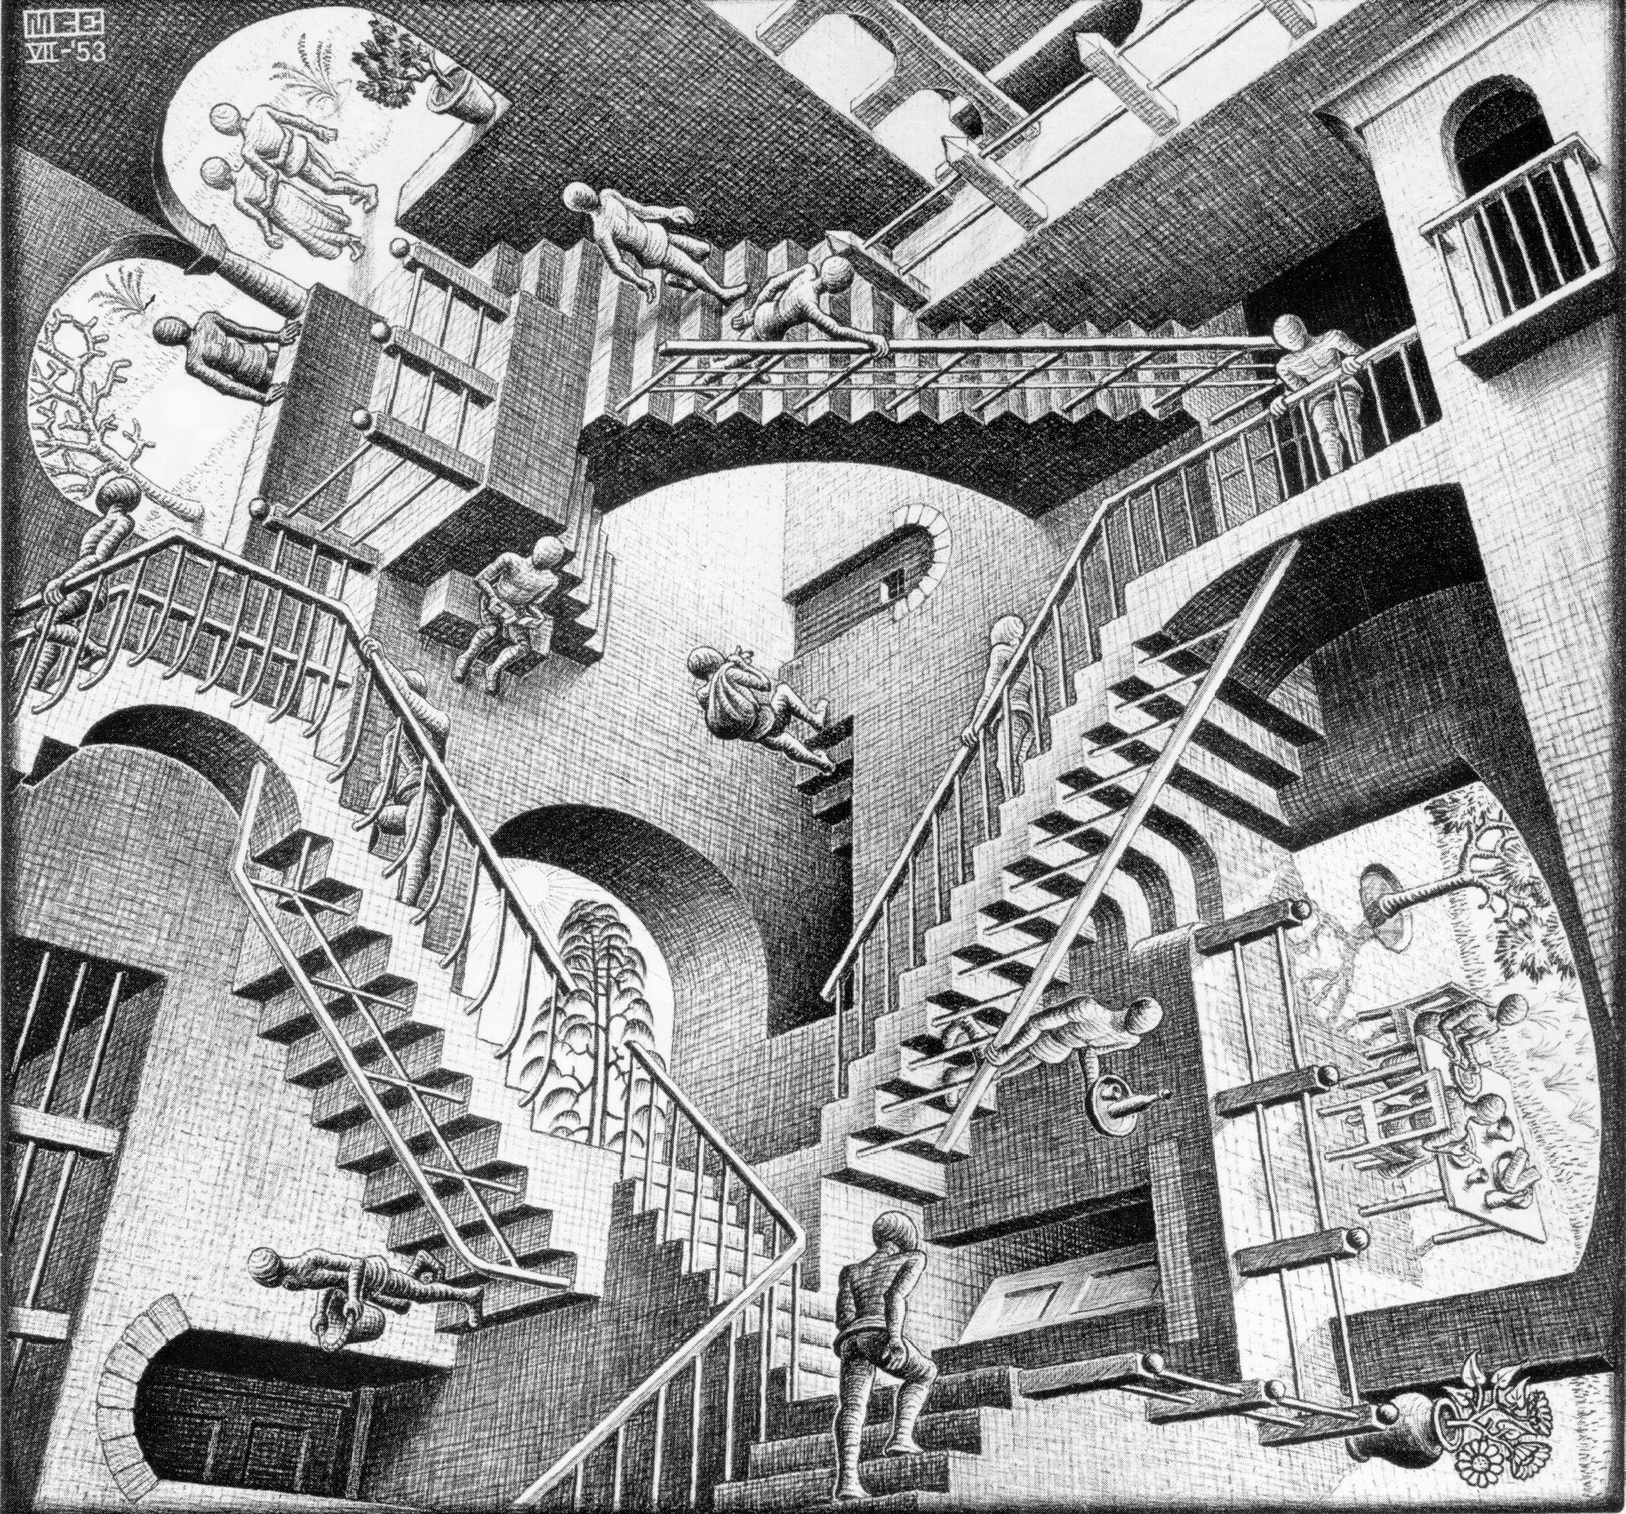
Structuring your data
Source: www.scottmcd.net/

Slide 20
One-to-one approach
By embedding
Good fit for most cases.
Man / wife type relations are more complex.
Person
_id: 42
Passport

Slide 21
One-to-many approach #1
Embedding
Works best for one-to-few cases.
Access pattern should be “get carts for a user”.
No update anomalies.
User
Cart

Slide 22
One-to-many approach #2
By embedding references
When too many carts for simple embedding to be viable.
Access pattern should be “get carts for a user”.
Adds complexity to application code.
Has update anomalies.
Anomaly when a cart is deleted. A user can now reference a non existing cart.
User
carts: [
9001,
9876
]
Cart
_id: 9001
Cart
_id: 9876

Slide 23
One-to-many approach #2
By reference
When one-to-truly-many.
Does not dictate access pattern, but adds complexity to application code.
Has update anomalies.
Anomaly when a user is deleted. Carts can now reference a non existing User.
User
_id: 42
Cart
userId: 42
Cart
userId: 42

Slide 24
One-to-many approach #4
By denormalizing
When one-to-many.
Access pattern should be “Get all carts and project cart content and customer”.
Has update anomalies.
No user document in this approach. Updating user information is tedious.
Larger disk footprint per cart.
Cart
userId: 42,
Username: “Happy Customer”
Cart
userId: 42,
Username: “Happy Customer”

Slide 25
Many-to-many approach
By embedding references in both documents
Complexity in application code.
Have update anomalies.
User
_id: 42
friends: [
56,
69
]
User
_id: 56
friends: [
42,
69
]

Slide 26
Structuring data in Mongodb
Keep data that you need together, together.
Related data should be kept in the same document.
Know your access pattern, design for it.
For most cases simply store the objects you have in your application.

Slide 27
LANGUAGE DRIVERS
Available and well supported in most languages.
Overview of supported drivers: http://docs.mongodb.org/ecosystem/drivers/
Separate free online courses for Java, Node.js, .NET and Python developers available at https://university.mongodb.com/
Most of the videos they use in the courses are here https://www.youtube.com/channel/UCO6fpQsiBhglTVGsjC1on7A/playlists

Slide 28
Resources
Course repository - https://github.com/bekkopen/databasekurs/tree/master/mongodb
MongoDB - http://www.mongodb.com/
Online docs - http://docs.mongodb.org/manual/
Free online courses - https://university.mongodb.com/
About version 3.0 coming in March - http://www.mongodb.com/blog/post/announcing-mongodb-30

