Slide 1
MONGODB
NoSQL databasekurs
BEKK Consulting as

Slide 2

Introduction - Mongodb
MongoDB is a document-oriented non-relational database.

Slide 3
Document-oriented
JSON document
{
"_id" : 1358101,
"title" : "Viña Salceda Crianza 2007",
"containerSize" : "75 cl",
"price" : 169.9
}
Notes:
JSON
Key – value pairs
Values can be of types string, number, boolean, array or object
(Show in a editor)

Slide 4
Collections of documents
Products collection
Users collection
{ “title”: “Løiten Linie”, … }
{
"_id" : "doug_walker”,
"name" : ”Doug Walker",
“carts”: [{
products: [196501]
}]
}
{ “title”: “Absolut Vodka”, … }
{ “title”: “Silly Saison”, … }
{
"_id" : ”athena.beer”,
"name" : ”Athena Beer",
“carts”: [{
products: [1358101]
}]
}
{ “title”: “Mackmyra”, … }
Notes:
An array of documents is a collection.
A database consists of one or many collections.
Collections are vaguely the same as tables in SQL.

Slide 5
NON-relational
{
"_id" : ”athena.beer”,
"name" : ”Athena Beer",
“carts”: [{
products: [1358101]
}]
}
<- USER
The user Athena Beer refers to the product Viña Salceda in one of her carts. The database is however oblivious of that fact.
{
"_id" : 1358101,
"title" : "Viña Salceda Crianza 2007",
"containerSize" : "75 cl",
"price" : 169.9
}
PRODUCT ->
No constraints across documents
Notes:
No constraints across documents
Could lead to update anomalies if you reference items in other documents.

Slide 6
IMPEDANCE MISMATCH relations in a relational database maps badly to a object oriented paradigm

Slide 7
Et enkelt domene
class Person{
int id;
String first_name;
String last_name;
String email;
String country;
List<Drugs> drugs;
List<CreditCard> cards;
}
class Drug{
int id;
String name;
String number;
String company;
}
class Card{
int id;
String type;
String number;
}
Notes:
Gitt et enkelt domene i kode og vi skal lagre dette i en normalisert database

Slide 8
Denormalisation
SELECT persons.*, drugs.*, credit_cards.*
FROM persons, drugs, credit_cards
WHERE persons.id = ? AND
persons.id = drugs.person_id AND
persons.id = credit_cards.person_id
SELECT *
FROM persons
WHERE id = ?
SELECT *
FROM drugs
WHERE person_id = ?
SELECT *
FROM credit_cards
WHERE person_id = ?
Notes:
Dere vet jo hvordan dette går. I første spørring vil vi få en denormalisert tabell, altså med duplikate verdier. Vi må så loope over dette og hente ut det vi trenger. Gitt flere tabell-joins får vi mer duplisert data og en eksponsensiell vekst I antall rader å loope over.
I løser dette ved å kjøre flere spørringer. Men flere slike joins tar også tid.
Med en relasjonsdatabase er det hele tiden slike avvininger å ta.
En dokumentdatabase lagrer alt ferdig denormalisert og slik mapping blir da triviellt. På bekostning av noe annet, selvsagt.

Slide 9
Origins - humongous
Scalability
Key-Value
(Memcached, …)
MongoDB
Relational databases
(Postgres, MySQL, …)
Functionality
Notes:
MongoDB gets its name from huMONGOus

Slide 10
Trade-offs
÷ Joins
÷ Transactions
No support for joining data between documents in database.
Joins can in many cases be avoided by embedding or denormalizing data.
Last resort is to join data in application code.
No support for transactions.
Atomical write operations on a per-document level.
Work around by embedding or application code.

Slide 11
Trade-Wins(?)
Schemaless
Bias toward access pattern
MongoDB does not enforce any schema.
Easier to get started.
Gives a lot of freedom and responsibility to the developer.
Design schema towards access pattern.
Embed data that belong together. Fetch all data you need in one simple query. No need for joins.
No difference between application model and database model means less code.
Notes:
Some of the things MongoDB give you that you might not be used to.
- Schemaless
- Design for access pattern

Slide 12
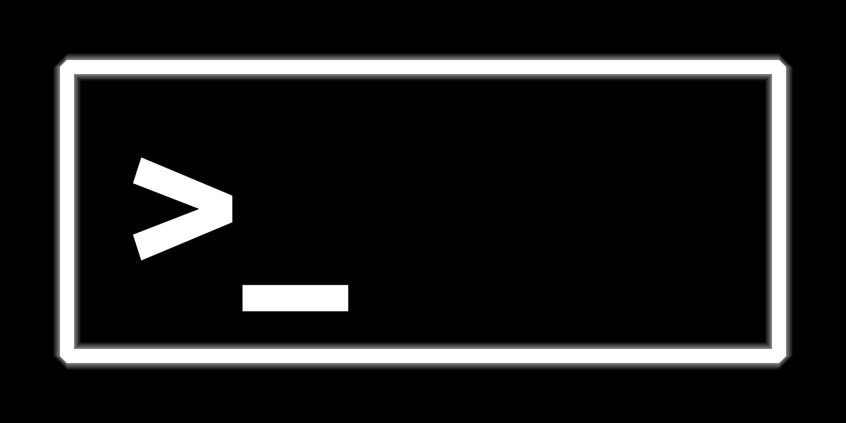
Queries and the shell

Slide 13
Query language
No specific query language.
Only methods in different programming language drivers.
Language drivers communicate via a wire-protocol to the database-server.

Slide 14
Mongodb shell
We are going to use the mongodb shell which is bundled with every install of MongoDB.
The MongoDB shell uses javascript.

Slide 15
Finds
Signature
Example
> db.collection.find({
<Criteria>
}, {
<Projection (optional)>
});
> db.products.find({
“title”: “Løiten Linie”
});
> db.products.find({
“title”: “Løiten Linie”,
“containerSize”: “70 cl”
}, {
“price”: 1,
“_id”: 0
});
> db.products.find().sort({
title: 1
}).limit(3);
Notes:
Show in the shell
Find løiten linie

Slide 16
inserts
Signature
Example
> db.users.insert(
<document or array of documents>
,
<optional options>
);
> db.users.insert({
_id: “richard.nixon”,
name: “Richard Nixon”,
birthdate: new Date(),
sex: “male”
});
Notes:
Show in the shell
Insert richard nixon

Slide 17
Updates
Signature
Example
> db.products.update({
<query>
}, {
<update>
}, {
<optional options>
});
> db.users.update({
_id: “richard.nixon”
}, {
“$set”: {name: “Richard M. Nixon”}
});
Notes:
Show in the shell
Update richard nixon
M. Is for Milhouse
Show overwrite

Slide 18
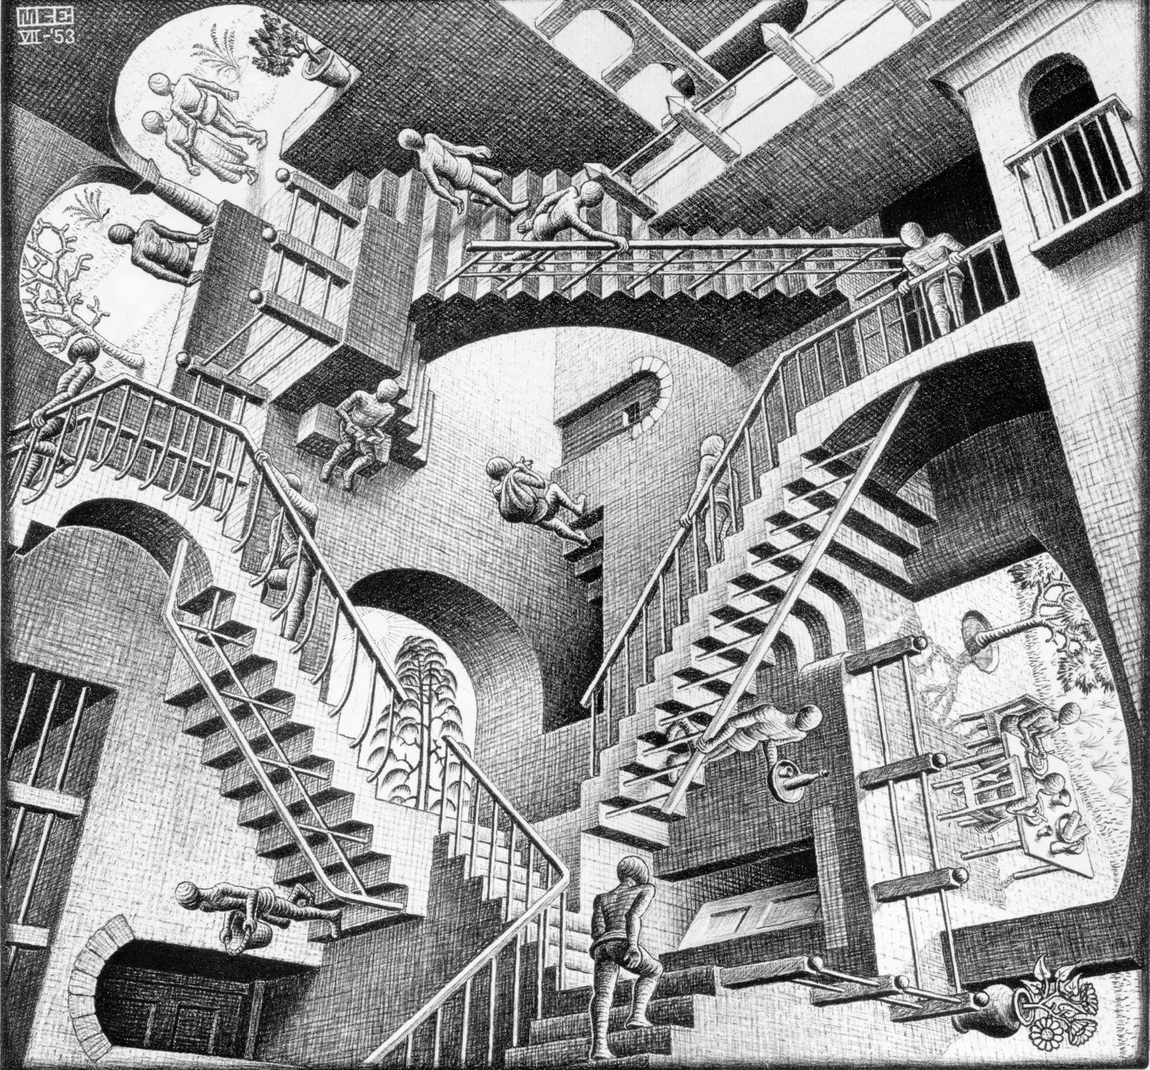
Structuring your data
Source: www.scottmcd.net/

Slide 19
One-to-one approach
By embedding
Good fit for most cases.
Man / wife type relations are more complex.
Person
_id: 42
Passport

Slide 20
One-to-many approach #1
Embedding
Works best for one-to-few cases.
Access pattern should be “get carts for a user”.
No update anomalies.
User
Cart

Slide 21
One-to-many approach #2
By embedding references
When too many carts for simple embedding to be viable.
Access pattern should be “get carts for a user”.
Adds complexity to application code.
Has update anomalies.
Anomaly when a cart is deleted. A user can now reference a non existing cart.
User
carts: [
9001,
9876
]
Cart
_id: 9001
Cart
_id: 9876

Slide 22
One-to-many approach #2
By reference
When one-to-truly-many.
Does not dictate access pattern, but adds complexity to application code.
Has update anomalies.
Anomaly when a user is deleted. Carts can now reference a non existing User.
User
_id: 42
Cart
userId: 42
Cart
userId: 42

Slide 23
One-to-many approach #4
By denormalizing
When one-to-many.
Access pattern should be “Get all carts and project cart content and customer”.
Has update anomalies.
No user document in this approach. Updating user information is tedious.
Larger disk footprint per cart.
Cart
userId: 42,
Username: “Happy Customer”
Cart
userId: 42,
Username: “Happy Customer”

Slide 24
Many-to-many approach
By embedding references in both documents
Complexity in application code.
Have update anomalies.
User
_id: 42
friends: [
56,
69
]
User
_id: 56
friends: [
42,
69
]

Slide 25
Structuring data in Mongodb
Keep data that you need together, together.
Related data should be kept in the same document.
Know your access pattern, design for it.
For most cases simply store the objects you have in your application.

Slide 26
LANGUAGE DRIVERS
Available and well supported in most languages.
Overview of supported drivers: http://docs.mongodb.org/ecosystem/drivers/
Separate free online courses for Java, Node.js, .NET and Python developers available at https://university.mongodb.com/
Most of the videos they use in the courses are here https://www.youtube.com/channel/UCO6fpQsiBhglTVGsjC1on7A/playlists

Slide 27
Resources
Course repository - https://github.com/bekkopen/databasekurs/tree/master/mongodb
MongoDB - http://www.mongodb.com/
Online docs - http://docs.mongodb.org/manual/
Free online courses - https://university.mongodb.com/
About version 3.0 coming in March - http://www.mongodb.com/blog/post/announcing-mongodb-30

