Slide 1
MONGODB
NoSQL kursserie del 1
NTNU
Frode Bjerke
11-02-2015

Slide 2
Om kursserien
Del 1
Del 2
Del 3
Introduksjon til MongoDB
Vi fokuserer på basisoperasjoner og funksjonalitet som gjør dette til et godt verktøy for rask utvikling!
Introduksjon til Neo4J
Neo4J går med tanke på funksjonalitet i motsatt retning av MongoDB. Det man får i retur er en database som kan gjøre ekstremt kraftige spørringer.
Vi har til nå sett på to ytterst forskjellige databaser. I tillegg har man de mer tradisjonelle relasjonelle SQL databasene og mange andre varisjoner av databaser. Så hvordan vet man hvilken man skal bruke når?
Denne kvelden vil være rettet mot å gi dere innsikt i det å velge riktig database til riktig oppgave.

Slide 3





Kursholdere I dag
Andreas Heim
Eivind Bergstøl
Fagleder NoSQL
Seniorkonsulent
Ken Grønnbeck
Frode Bjerke
Konsulent
Konsulent
Tri Nguyen
Konsulent

Slide 4

Introduction - Mongodb

Slide 5
What is mongodb?
MongoDB is a document-oriented non-relational database.
Notes:
Open source
NoSQL
Widely adopted lots of help to get

Slide 6
Document-oriented
JSON document
{
"_id" : 1358101,
"title" : "Viña Salceda Crianza 2007",
"containerSize" : "75 cl",
"price" : 169.9
}
Notes:
JSON
Key – value pairs
Values can be of types string, number, boolean, array or object
(Show in a editor)

Slide 7
Collections of documents
Products collection
Users collection
{ “title”: “Løiten Linie”, … }
{
"_id" : "doug_walker”,
"name" : ”Doug Walker",
“carts”: [{
products: [196501]
}]
}
{ “title”: “Absolut Vodka”, … }
{ “title”: “Silly Saison”, … }
{
"_id" : ”athena.beer”,
"name" : ”Athena Beer",
“carts”: [{
products: [1358101]
}]
}
{ “title”: “Mackmyra”, … }
Notes:
An array of documents is a collection.
A database consists of one or many collections.
Collections are vaguely the same as tables in SQL.

Slide 8
NON-relational
{
"_id" : ”athena.beer”,
"name" : ”Athena Beer",
“carts”: [{
products: [1358101]
}]
}
<- USER
The user Athena Beer refers to the product Viña Salceda in one of her carts. The database is however oblivious of that fact.
{
"_id" : 1358101,
"title" : "Viña Salceda Crianza 2007",
"containerSize" : "75 cl",
"price" : 169.9
}
PRODUCT ->
No constraints across documents
Notes:
No constraints across documents
Could lead to update anomalies if you reference items in other documents.

Slide 9
Origins - humongous
Scalability
Key-Value
(Memcached, …)
MongoDB
Relational databases
(Postgres, MySQL, …)
Functionality
Notes:
MongoDB gets its name from huMONGOus

Slide 10
Trade-offs
÷ Joins
÷ Transactions
No support for joining data between documents in database.
Joins can in many cases be avoided by embedding or denormalizing data.
Last resort is to join data in application code.
No support for transactions.
Atomical write operations on a per-document level.
Work around by embedding or application code.

Slide 11
Trade-Wins(?)
Schemaless
Bias toward access pattern
MongoDB does not enforce any schema.
Easier to get started.
Gives a lot of freedom and responsibility to the developer.
Design schema towards access pattern.
Embed data that belong together. Fetch all data you need in one simple query. No need for joins.
No difference between application model and database model means less code.
Notes:
Some of the things MongoDB give you that you might not be used to.
- Schemaless
- Design for access pattern

Slide 12
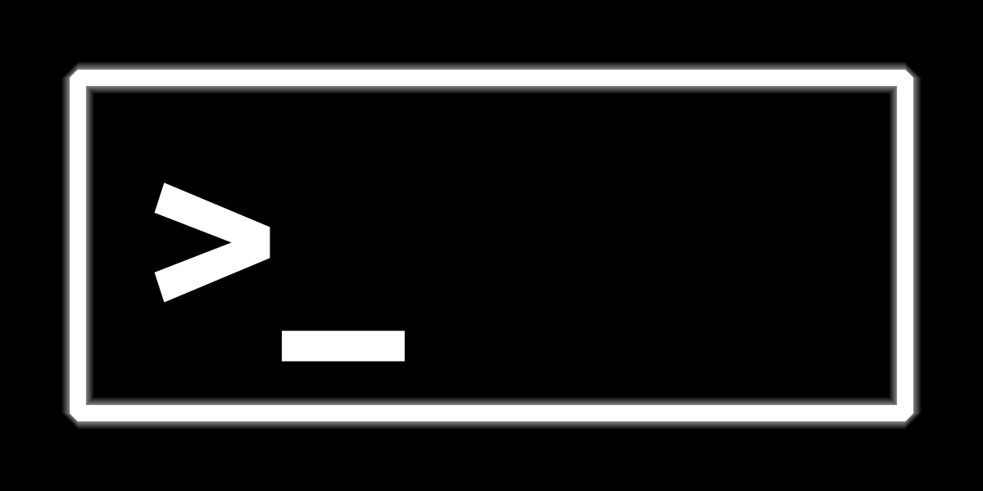
Queries and the shell

Slide 13
Query language
No specific query language.
Only methods in different programming language drivers.
Language drivers communicate via a wire-protocol to the database-server.

Slide 14
Mongodb shell
We are going to use the mongodb shell which is bundled with every install of MongoDB.
Uses javascript.
$ mongo
Connect to mongod on localhost:27017
> Show dbs
List of databases
> Use kursserie
Switch to the kursserie database
> Show collections
products
system.indexes
users
> db.products.findOne();

Slide 15
Finds
Signature
Example
> db.collection.find({
<Criteria>
}, {
<Projection (optional)>
});
> db.products.find({
“title”: “Løiten Linie”
});
> db.products.find({
“title”: “Løiten Linie”,
“containerSize”: “70 cl”
}, {
“price”: 1,
“_id”: 0
});
> db.products.find().sort({
title: 1
}).limit(3);
Notes:
Show in the shell
Find løiten linie

Slide 16
inserts
Signature
Example
> db.users.insert(
<document or array of documents>
,
<optional options>
);
> db.users.insert({
_id: “richard.nixon”,
name: “Richard Nixon”,
birthdate: new Date(),
sex: “male”
});
Notes:
Show in the shell
Insert richard nixon

Slide 17
Updates
Signature
Example
> db.products.update({
<query>
}, {
<update>
}, {
<optional options>
});
> db.users.update({
_id: “richard.nixon”
}, {
“$set”: {sex: “female”}
});
Notes:
Show in the shell
Update richard nixon
Show overwrite

Slide 18
Logg på hver deres server
Velg en server og skriv deres navn ved den: http://bit.ly/1z7E3Ou
Åpne en terminal:
> ssh mongokurs@<ipadresse>
Passord: mongoerkult
$ mongo
Connect to mongod on localhost:27017
> Show dbs
List of databases
> Use kursserie
Switch to the kursserie database
> Show collections
products
system.indexes
users
> db.products.findOne();

Slide 19
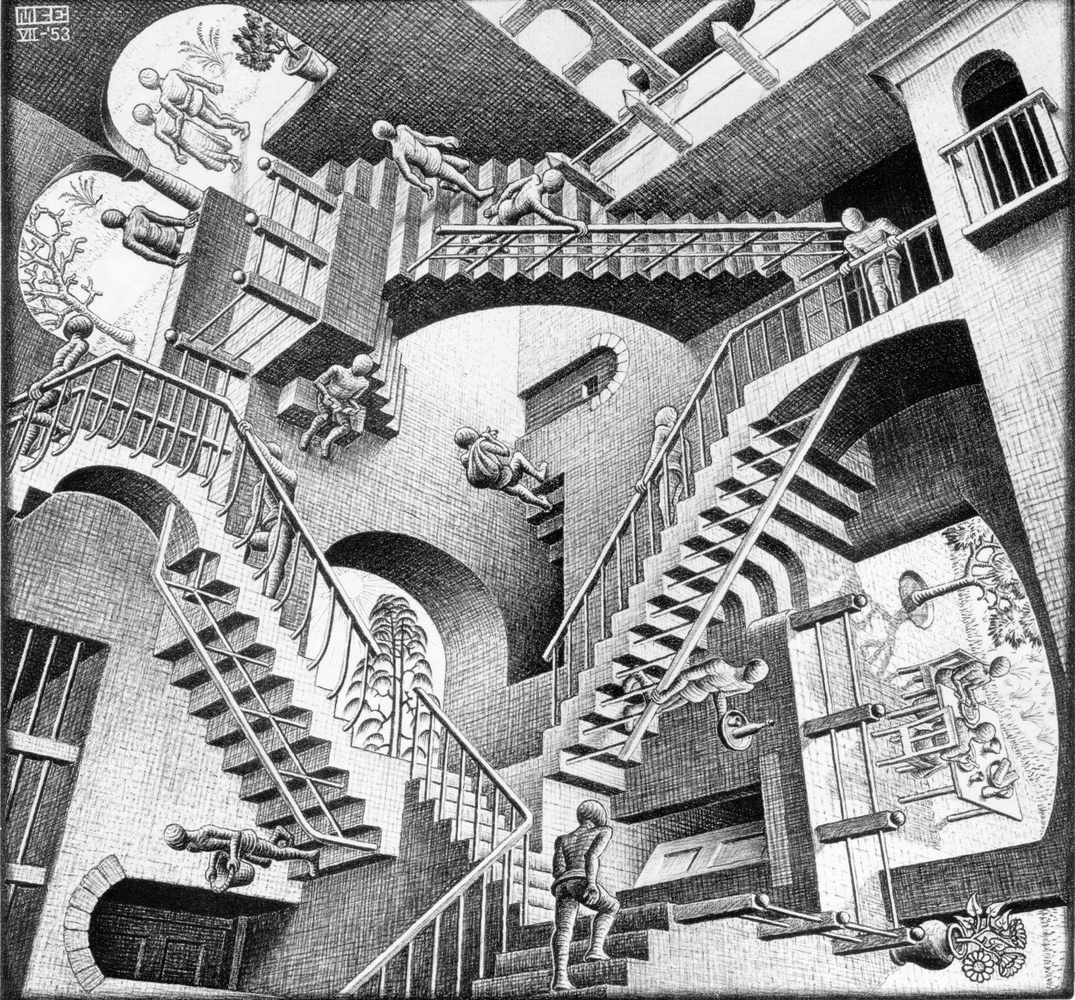
Structuring your data
Source: www.scottmcd.net/

Slide 20
Normalization
userid | name | scores
1 | John Doe | [9, 7, 2]
Denormalized
userid | name
1 | John Doe
Normalized
userid | score
1 | 9
userid | score
1 | 9
userid | score
1 | 9

Slide 21
Goals of normalization
Free database of update anomalies
Minimize redesign costs
Avoid bias towards one access pattern

Slide 22
Structuring data in Mongodb
Keep data that you need together, together.
Related data should be kept in the same document.
Know your access pattern, design for it.
For most cases simply store the objects you have in your application.

Slide 23
One-to-one
Case
Approach
Example
A person has a spouse.
(Let’s at least model it as a one to one relation).
Reference in either document
OR
Embed
CONSIDER
Size of each.
Do you need both at the same time.
Atomicity of data.
Reference:
{
_id: 1,
name: “John”,
spouse: 2
}
Embed:
{
_id: 2,
name: “Kari”,
spouse: {
id: 1,
name: “John”
}
}

Slide 24
One-to-Many
Case
Approach
Example
Comments on a blog post.
Embed comments
What if too many comments?
OR
A document per comment
When many comments expected.
CONSIDER
Know if you are going to have one-to-few or truly one-to-many.
MongoDB documents have a max size of ~16MB.
Embed comments:
{
_id: 1
title: “A blog post”,
comments: [
{
by: “troll”,
content: “..”
}
]
}
A document per comment:
{
blogpost: 1,
content: “..”,
by: “troll”
}

Slide 25
LANGUAGE DRIVERS
Available and well supported in most languages.
Overview of supported drivers: http://docs.mongodb.org/ecosystem/drivers/
Separate free online courses for Java, Node.js, .NET and Python developers available at https://university.mongodb.com/
Most of the videos they use in the courses are here https://www.youtube.com/channel/UCO6fpQsiBhglTVGsjC1on7A/playlists

Slide 26
Resources
Course repository - https://github.com/bekkopen/databasekurs/tree/master/mongodb
MongoDB - http://www.mongodb.com/
Online docs - http://docs.mongodb.org/manual/
Free online courses - https://university.mongodb.com/
About version 3.0 coming in March - http://www.mongodb.com/blog/post/announcing-mongodb-30

