Slide 1


Slide 2
SIRT-EXCELLENCE
Guided By: Presented By:
Prof.Vijendra sir Pankaj Panjwani
Prof.Jitendra sir Pankaj Pandey
Prof.Anjali madam Bharat Sharma

Slide 3
DEVELOPERS
PANKAJ PANJWANI
PANKAJ PANDEY
BHARAT SHARMA

Slide 4
ABSTRACT
  OBJECTIVE:
Airline Reservation System contains the details about flight schedules and its fare tariffs, passenger reservations and ticket records. An airline’s inventory contains all flights with their available seats. The inventory of an airline service is generally divided into three category of classes (e.g. First, Business or Economy class) and each category is having seats up to 26 bookings, along with prices and booking conditions. Inventory data is imported and maintained through a Schedule Distribution System over standardized interfaces. One of the core functions of the inventory management of airline reservations is the inventory control. Inventory control steers how many seats are available for the different booking classes, by opening and closing individual booking classes for sale. In combination with the fares and booking conditions stored in the Fare Quote System the price for each sold seat is determined.

Slide 5
MODULES
Registration module
Administrative module
Passenger module

Slide 6
1. Registration module
In registration module first we ask passenger to give his details.After registering with us the passenger can logon to his/her own account and can view all flight details such as Timings, Prices,Availability of seats and can book the ticket with unique ticket id.Once Passenger registered with us can book any number of tickets.

Slide 7
2. Administrative module
Administrative module is provided for the sake of administrators to manage the site and update the content at regular intervals, The major operations included in this module are:
Create and maintain airline schedule, fare and timings of the Flight.
View the passenger list.
View the available seats in the flights.
Cancel the tickets.
Updating the flight schedule and timings and fare.

Slide 8
3. Passenger module
This module is meant for passengers, where a user logging into his/her owns account will view this panel. The major operations included in this module were
View all airline schedules, timings, fare details and seats availability.
Book for the tickets.
View and cancelling of the ticket.
Send feedback

Slide 9
3. SCOPE & PURPOSE
3.1 PURPOSE:
Airline Reservation System contains the details about flight schedules and its fare tariffs, passenger reservations and ticket records.
The inventory of an airline service is generally divided into three category of classes (e.g. First, Business or Economy class) and each category is having seats up to 26 bookings, along with prices and booking conditions.

Slide 10
  SCOPE:
Inventory control steers how many seats are available for the different booking classes, by opening and closing individual booking classes for sale. In combination with the fares and booking conditions stored in the Fare Quote System the price for each sold seat is determined.

Slide 11
EXISTING SYSTEM
In few countries if a person wants to book a flight ticket, he use to follow one of these things:
Manually goes to the Airport and book his ticket.
Downloading the ticket form as paper document, filling it manually and submitting it at Airport.
Fill the Ticket form on system and get the print out as paper documents to submit it at Airport.
Booking the Ticket at some particular registered ticket counters in online.
Even above approaches make a ticket booking online, it was not completely done on online. Passenger may not have much freedom over this approach.
Hence the Passenger may or may not be satisfied with this approach as it includes manual intervention like travelling to Airport for booking his ticket.

Slide 12
PROPOSED SYSTEM:
The Proposed system ensures the complete freedom for users, where user at his own system can logon to this website and can book his ticket. Our proposed system allows only registered users to book the tickets, view timings and cancel their tickets.
In this Proposal the entire work is done on online and ticket with id is also provided for passengers as a print document. Here passengers can send their queries and suggestions through a feedback form.

Slide 13
SYSTEM DESIGN
Unified Modeling Language:
UML stands for Unified Modeling Language. It is a third generation method for specifying, visualizing and documenting the artifacts of an object oriented system under development. Object modeling is the process by which the logical objects in the real world (problem space) are represented (mapped) by the actual objects in the program (logical or a mini world). This visual representation of the objects, their relationships and their structures is for the ease of understanding. This is a step while developing any product after analysis.

Slide 14
The Unified Modeling Language encompasses a number of models.
Use case diagrams
Class diagrams
Sequence diagrams

Slide 15
Use Case Diagram:
Use case diagram consists of use cases and actors and shows the interaction between them. The key points are:
The main purpose is to show the interaction between the use cases and the actor.
To represent the system requirement from user’s perspective.
The use cases are the functions that are to be performed in the module.
An actor could be the end-user of the system or an external system.

Slide 16
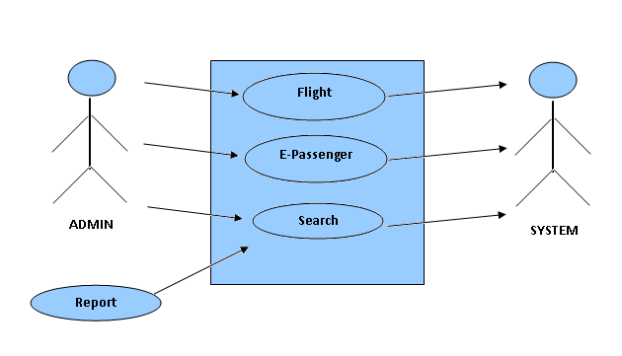

Slide 17
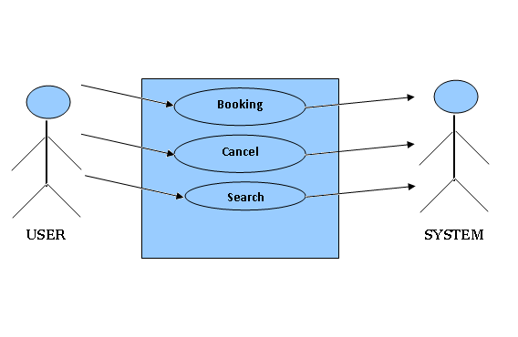

Slide 18
Sequence Diagram:
The purpose of sequence diagram is to show the flow of functionality through a use case. In other words, we call it a mapping process in terms of data transfers from the actor through the corresponding objects.

Slide 19


Slide 20
Login
Application
Database
Login
:Request
:Validate()
:executeQuery()
Response
Show Result
Failed:show()

Slide 21
Login
Application
Database
Login
:Request
:Validate()
:executeQuery()
Response
Show Result

Slide 22


Slide 23
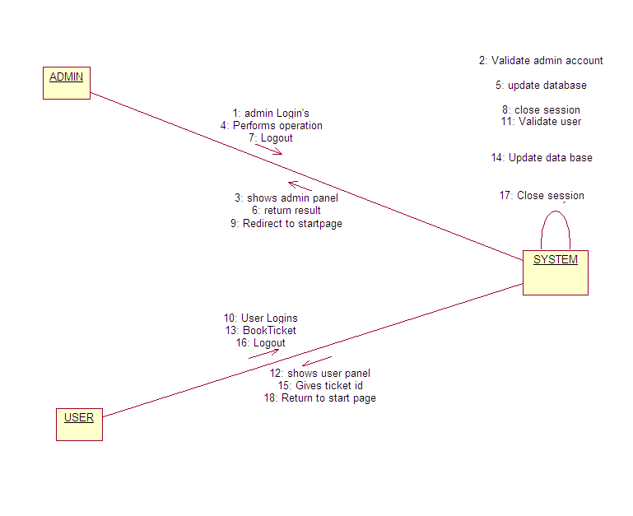

Slide 24


Slide 25
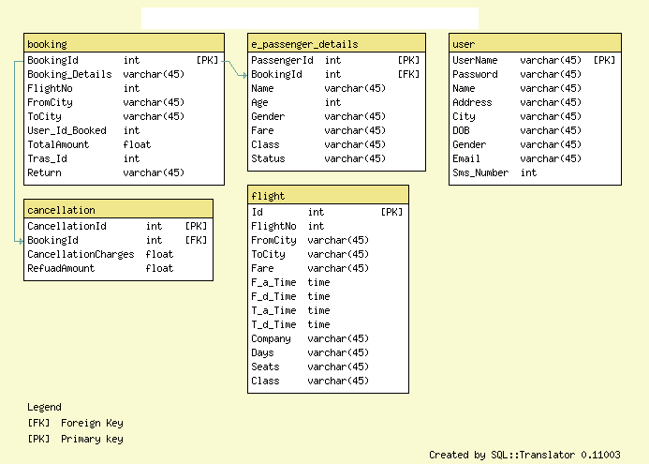

Slide 26
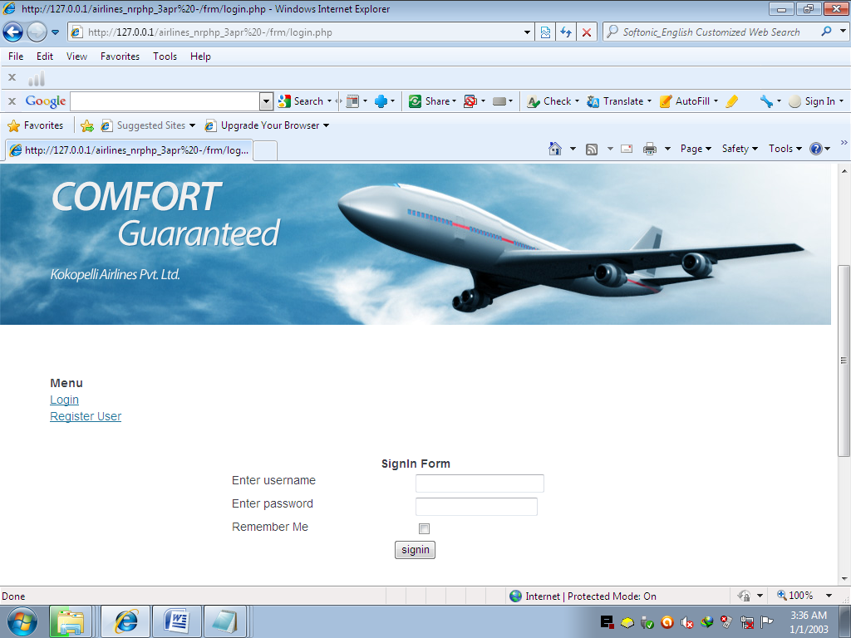
SCREEN SHOTS

Slide 27
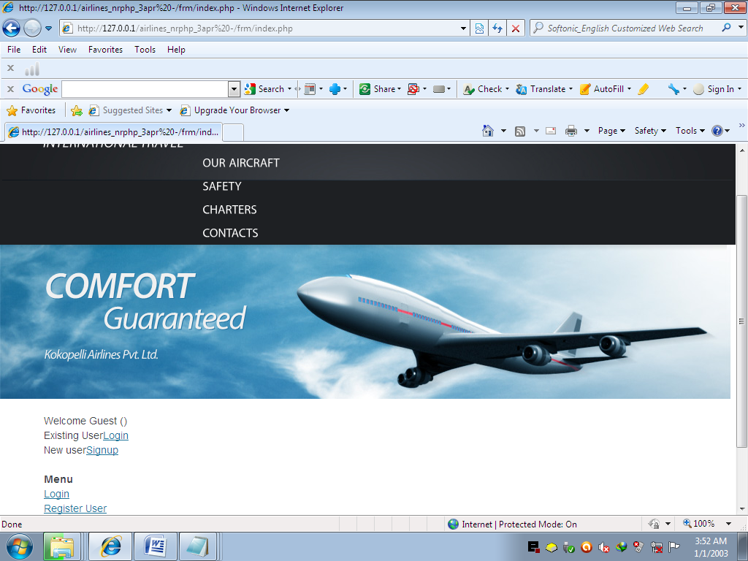

Slide 28
LOGIN FORM

Slide 29
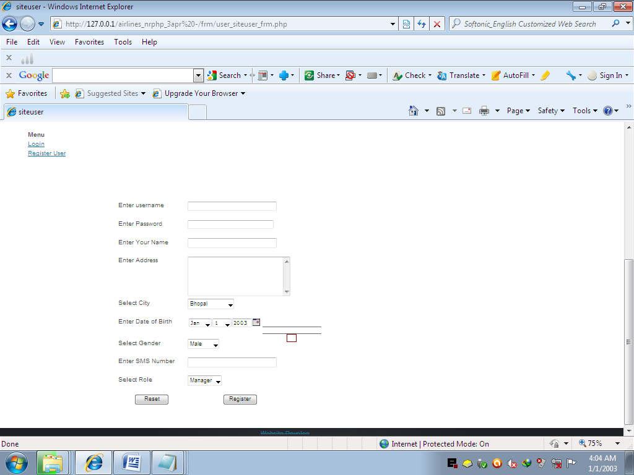
REGISTRATION FORM

Slide 30
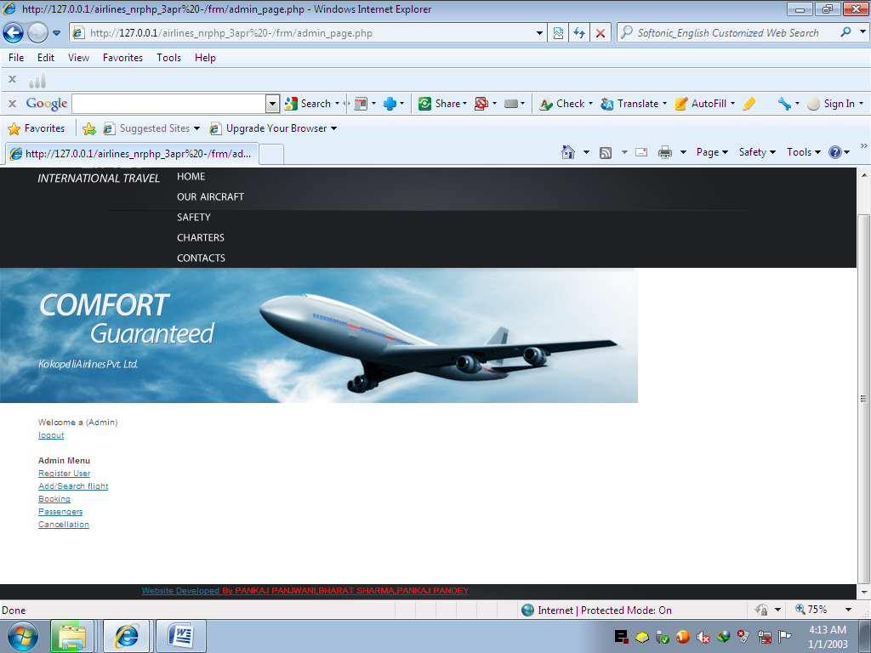
WELCOME USER PAGE

Slide 31
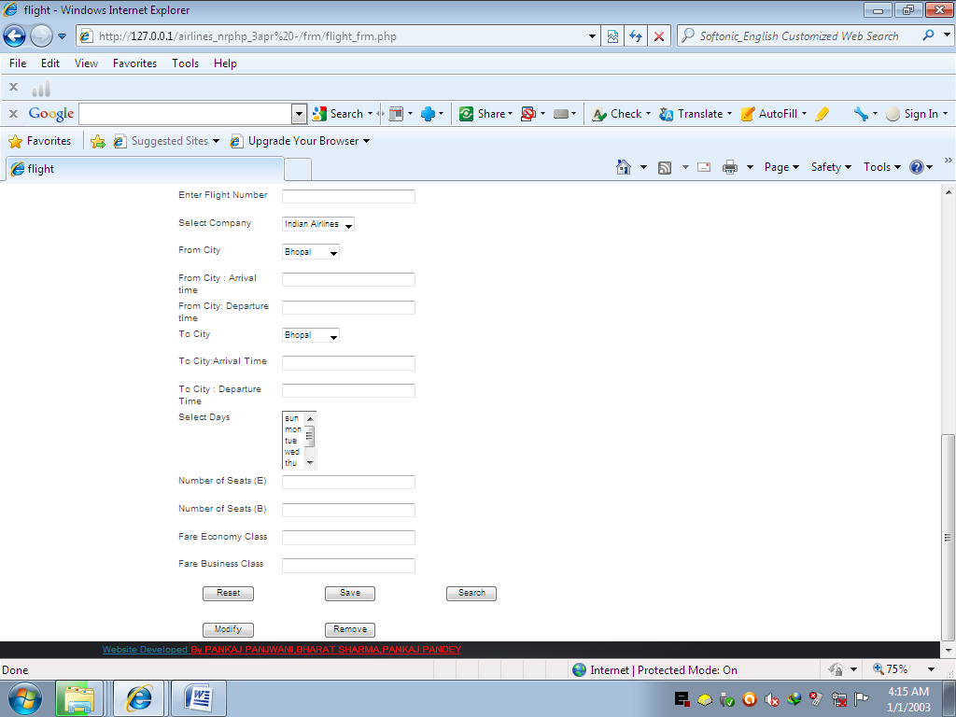
ADD/SEARCH FLIGHT

Slide 32
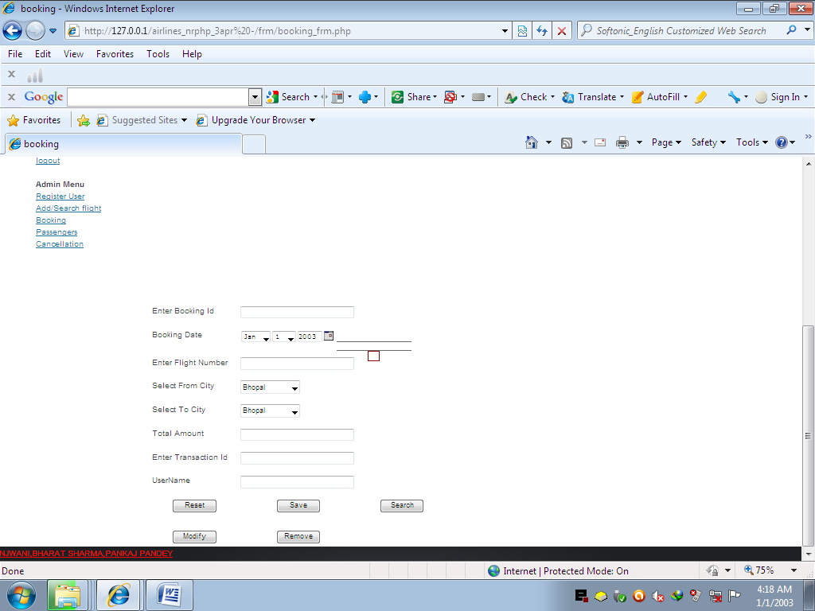
BOOKING PAGE

Slide 33
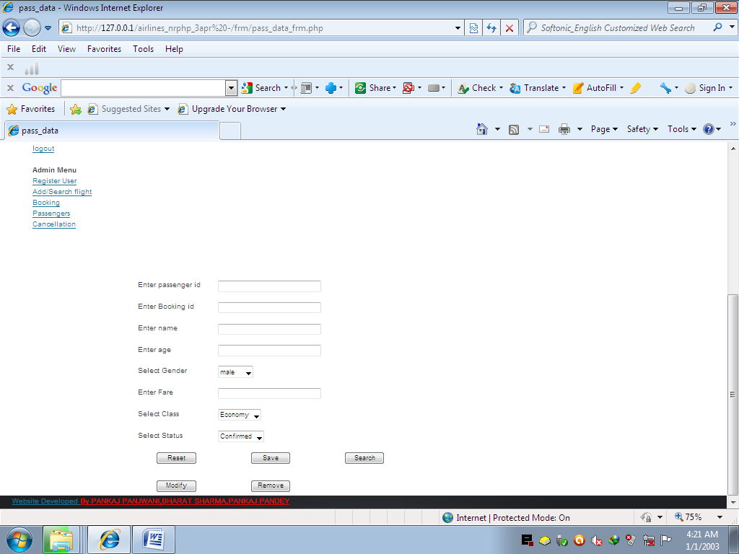
PASSENGER DETAIL

Slide 34
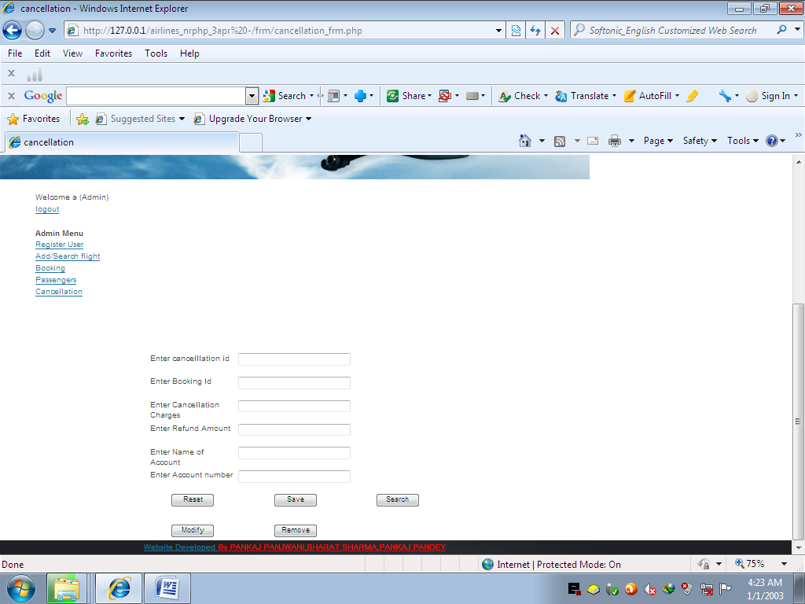
CANCELLATION FORM

Slide 35
CONCLUSION & FUTURE SCOPE
Getting accurate information about what visas or permits you need is an important part of preparing for a trip or stay abroad. To help you with this task we have provided information about embassies and consulates abroad, and we have also included companies that provide visa and passport services.
We offer documentation processing, application & filing services for those interested in applying for a visa.A strong research team ensures that cases are evaluated and processed as per the latest updated rules and regulations.

Slide 36
BIBLIOGRAPHY
FOR PHP INSTALLATION
www.php.net
FOR DEPLOYMENT AND PACKING ON SERVER
www.developer.com
www.15seconds.com
FOR MYSQL
www.mysql.com
FOR PHP,CSS,APACHE
www.php.net
www.cssed.sourceforge.net
www.apache.org

Slide 37
THANKYOU

