Slide 1
Functional Dependency

Slide 2
Functional Dependency
A “good” database schema should not lead to update anomalies.
• update anomalies,
• functional dependencies,
• Armstrong Axioms,
• closures.

Slide 3
Update Anomalies
Redundancy in a database means storing a piece of data more than once.
Redundancy is often useful for efficiency and semantic reasons, but creates the potential for consistency problems.
A poor redundancy control may cause update anomalies.
Consider the example relation below (adapted from “An Introduction to Database Systems” by Desai):

Slide 4
STUDENTS
Name | Course | Phone_no | Major | Prof | Grade
Jones | 353 | 237-4539 | Comp Sci | Smith | A
Ng | 329 | 427-7390 | Chemistry | Turner | B
Jones | 328 | 237-4539 | Comp Sci | Clark | B
Martin | 456 | 388-5183 | Physics | James | A
Dulles | 293 | 371-6259 | Decision Sci | Cook | C
Duke | 491 | 823-7293 | Mathematics | Lamb | B
Duke | 356 | 823-7293 | Mathematics | Bond | UN
Jones | 492 | 237- 4539 | Comp Sci | Cross | UN
Baxter | 379 | 839-0827 | English | Broes | C
Modification anomalies: e.g. Jones’s phone number appears 3 times. When a phone number is changed, it must be changed in all 3 places, or the data will be inconsistent.

Slide 5
Update Anomalies
Insertion anomalies:
• If Jones enrolls in another course, and a different phone number is entered, again the data will be inconsistent.
• Also, if the only way that the association between course and professor is stored in this relation, we can only enter the association when someone enrolls in the course.
Deletion anomalies: If the last student in a course is deleted, the association between professor and course is lost.

Slide 6

Functional dependencies
A function f from S₁ to S₂ has the property
A generalization of keys to avoid design flaws violating the above rule.
Let X and Y be sets of attributes in R.
X (functionally) determines Y , X → Y , iff t₁[X] = t₂[X] implies t₁[Y ] = t₂[Y ].
i.e., f (t(X)) = t [Y]
We also say X →Y is a functional dependency, and that Y is functionally dependent on X.
X is called the left side, Y the right side of the dependency.
$if x, y ∈S_{1} and x=y, then f$($x)=f(y$) .

Slide 7
Examples
• For every Name, there is a unique Phone_no and Major, assume Name is unique;
• For every Course, there is a unique Prof;
• For every Name and Course, there is a unique
Grade.

Slide 8
In this example:
{Name} →{Phone_no , Major}
{Course} → {Prof}
{Name , Course} → {Grade}
We can also show these in a diagram like this one:
Notice that other FD’s follow from these:
{Name} → {Major}
{Course , Grade} → {Prof , Grade}
Name | Course | Phone_no | Major | Prof | Grade
8

Slide 9
Functional dependencies
Let F be a set of FD’s.
Definition 1: X → Y is inferred from F (or that F infers X → Y ), written in
F |= X→ Y
if any relation instance satisfying F must also satisfy X → Y .
Impossible to list every relation to verify if X → Y is inferred from F.
A set ρ of derivation rules are required, such that:
a X → Y is inferred from F according to Definition 1 iff it can be
derived using ρ.

Slide 10
Armstrong’s axioms (1974)
Notation: If X and Y are sets of attributes, we write XY for their union.
e.g. X = {A, B}, Y = {B, C}, XY = {A, B, C}
F1 (Reflexivity) If X ⊇ Y then X →Y .
F2 (Augmentation) {X → Y } |= XZ → Y Z.
F3 (Transitivity) {X → Y , Y → Z} |= X → Z.
F4 (Additivity) {X→ Y , X → Z} |= X → Y Z.
F5 (Projectivity) {X → Y Z} |= X → Y .
F6 (Pseudotransitivity) {X → Y , Y Z → W} |= XZ → W.

Slide 11
Example: Given F = {A → B,A → C,BC → D}, derive A → D:
1. A → B (given)
2. A → C (given)
3. A → BC (by F4, from 1 and 2)
4. BC → D (given)
5. A → D (by F3, from 3 and 4)

Slide 12
F4 (Additivity) {X→ Y , X → Z} |= X → Y Z.
F5 (Projectivity) {X → Y Z} |= X → Y .
F6 (Pseudotransitivity) {X → Y , Y Z → W} |= XZ → W.
In fact, F4, F5, and F6 can be derived from F1-F3.
Example: Prove {X→ Y , X → Z} |= X → Y Z.
1) X→ Y is given.
2) XX → XY (by F2); that is, X → XY
3) X → Z is given.
4) X Y → Y Z (by F2)
5) X → Y Z (by F3, 2) and 4))

Slide 13
Armstrong’s axioms
We can prove that Armstrong’s axioms are sound and complete:
Sound: if F derives A →B by using Armstrong’s axioms, then F |= A → B by Definition 1.
Complete: if F |= M → N by Definition 1, then F derives M → N by using Armstrong’s axioms.

Slide 14
Algorithm to Check a FD
Given F, how do we check if X →Y is in F⁺?
F⁺ denotes the smallest set of FD’s that
• contains F, and
• is closed under Armstrong’s axioms.
F⁺ is the closure of F.

Slide 15
F = { A → B, B → C, A → C }
F⁺ = {AB -> A, AB -> B, AB -> C, AC -> A, AC -> B,
AC -> C, ABC -> A, ABC -> B, ABC -> C, AB -> AB,
AB -> BC, AB -> AC, …….}
F⁺ always has an exponential size regarding |F|.

Slide 16

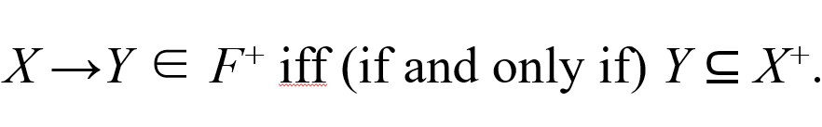
Too expensive to compute F⁺ to verify a membership.
Instead we can compute the closure X⁺ of X under F, X⁺ is the largest set of attributes functionally determined by X.
It can be proven (using additivity) that
S1:
S2:

Slide 17
Example:
F = { A → B, BC → D, A → C }, compute {A}⁺
1st scan of F:
X⁺ := {A}
X⁺ := {A, B}
X⁺ := {A, B, C}
2nd scan of F:
X⁺ := {A, B, C, D }
3rd scan of F: no change, therefore the algorithm terminates.
{A}⁺ := {A, B, C, D }

Slide 18
Algorithm to compute X⁺
X⁺ := X;
change := true;
while change do
begin
change := false;
for each FD W → Z in F do
begin
if (W ⊆ X⁺) and (Z X⁺) then do
begin
X⁺ := X⁺ ∪ Z;
change := true;
end
end
end

Slide 19
Algorithm to Compute a Candidate Key
Given a relational schema R and a set F of functional dependencies on R.
A key X of R must have the property that X⁺ = R.
Algorithm to compute a candidate key
Step 1: Assign X a superkey in F.
Step 2: Iteratively remove attributes from X while retaining the property X⁺ = R till no reduction on X.
The remaining X is a candidate key.

Slide 20
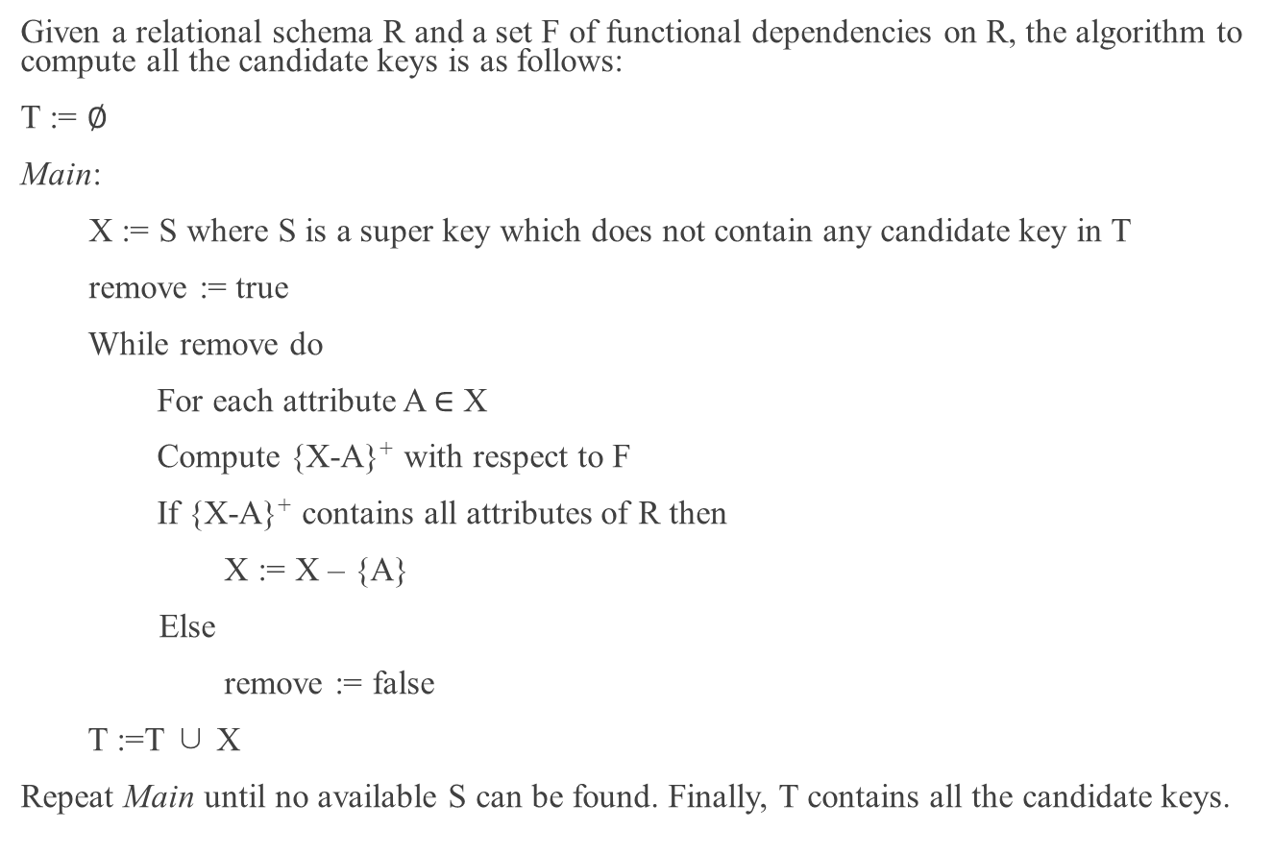
Algorithm to Compute All the Candidate Keys
Given a relational schema R and a set F of functional dependencies on R, the algorithm to compute all the candidate keys is as follows:
T := $∅$
Main:
X := S where S is a super key which does not contain any candidate key in T
remove := true
While remove do
For each attribute A $∈$ X
Compute {X-A}⁺ with respect to F
If {X-A}⁺ contains all attributes of R then
X := X – {A}
Else
remove := false
T :=T ∪ X
Repeat Main until no available S can be found. Finally, T contains all the candidate keys.

Slide 21
Example:
R = {A, B, C, D} and F = { A → B, BC → D, A → C }
X = {A, B, C} if the left hand side of F is a super key.
A cannot be removed because {BC}⁺ = {B, C, D} ≠ R
B can be removed because {AC}⁺ = {A, B, C, D} = R
X = { A, C}
C can be further removed because {A}⁺ = {A, B, C, D}
X = {A}

