Slide 1
Relational Database Design

Slide 2
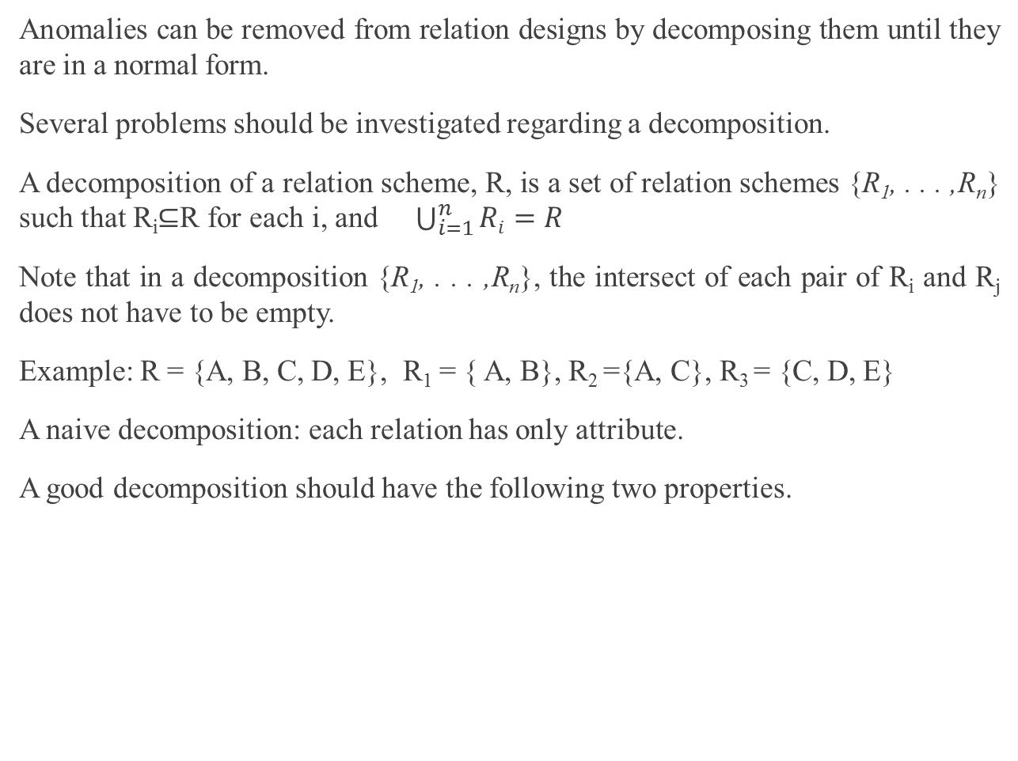
10 Relational Database Design
Anomalies can be removed from relation designs by decomposing them until they are in a normal form.
Several problems should be investigated regarding a decomposition.
A decomposition of a relation scheme, R, is a set of relation schemes {R₁, . . . ,R_{n}} such that R_{i}⊆R for each i, and $\bigcup_{i=1}^{n}{Ri}=R$
Note that in a decomposition {R₁, . . . ,R_{n}}, the intersect of each pair of R_{i} and R_{j} does not have to be empty.
Example: R = {A, B, C, D, E}, R₁ = { A, B}, R₂ ={A, C}, R₃ = {C, D, E}
A naive decomposition: each relation has only attribute.
A good decomposition should have the following two properties.

Slide 3
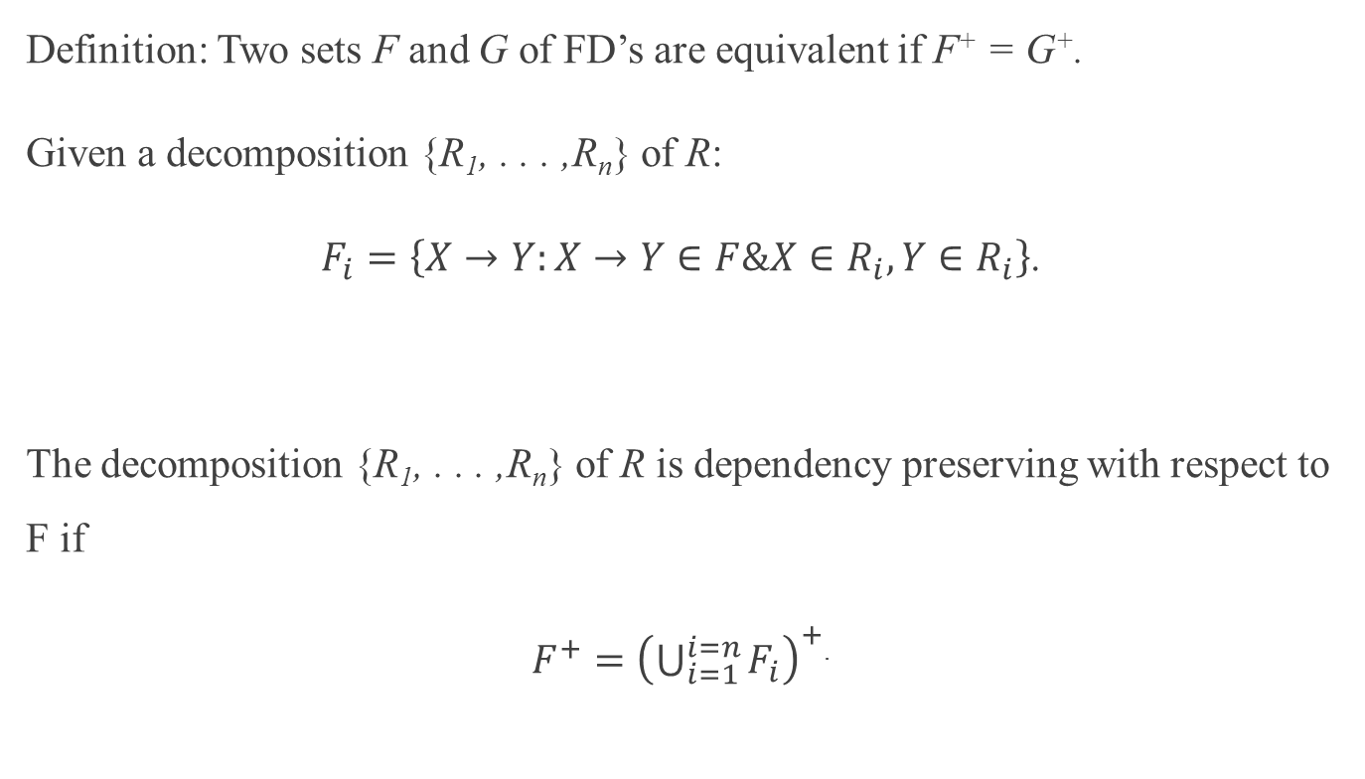
Dependency Preserving
Definition: Two sets F and G of FD’s are equivalent if F⁺ = G⁺.
Given a decomposition {R₁, . . . ,R_{n}} of R:
$F_{i}=\left\{X→Y:X→Y∈F\&X∈R_{i},Y∈R_{i}\right\}$.
The decomposition {R₁, . . . ,R_{n}} of R is dependency preserving with respect to F if
$F^{+}={\left(\bigcup_{i=1}^{i=n}{F_{i}}\right)}^{+}$.

Slide 4
Examples
F = { A → BC, D → EG, M → A }, R = (A, B, C, D, E, G, M, A)
1) Given R₁= ( A, B, C, M) and R₂ = (C, D, E, G),
F₁ = { A → BC, M → A}, F₂ = {D → EG}
F = F₁ U F₂. thus, dependency preserving
2) Suppose that F’ = F U {M → D}. R₁ and R₂ remain the same.
Thus, F₁ and F₂ remain the same.
We need to verify if M→D is inferred by F₁ U F₂.
Since M⁺ | _{F1 U F2} = {M, A, B, C}, M→D is not inferred by F₁ U F_{2.}
Thus, R₁ and R₂ are not dependency preserving regarding F’.
3) F’’ = {A → BC, D → EG, M → A , M→C, C→ D, M→ D}
F₁ = {A → BC, M→ A, M→ C}, F₂ = {D→ EG, C→ D}
It can be verified that M→ D is inferred by F₁ and F_{2.}
Thus, F’’⁺ = (F₁ U F₂)⁺
Hence, R₁ and R₂ are dependency preserving regarding F’’.

Slide 5
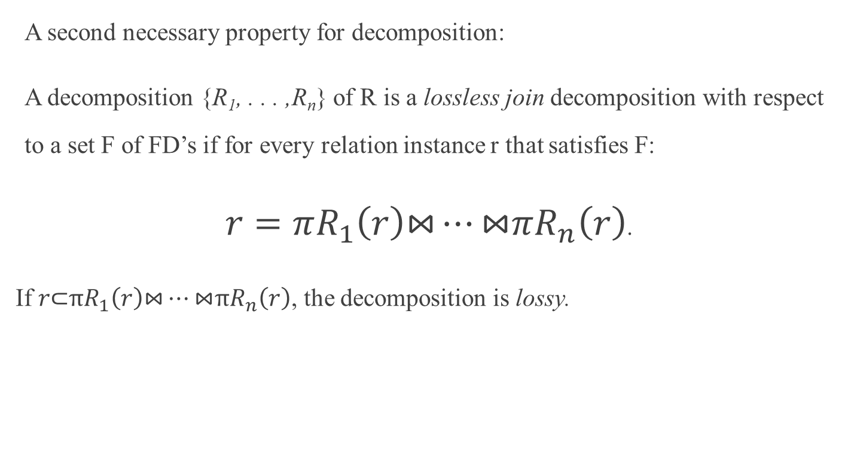
Lossless Join Decomposition
A second necessary property for decomposition:
A decomposition {R₁, . . . ,R_{n}} of R is a lossless join decomposition with respect to a set F of FD’s if for every relation instance r that satisfies F:
$r=πR_{1}\left(r\right)\text{⋈}…\text{⋈}πR_{n}\left(r\right)$.
If $r\text{⊂}πR_{1}\left(r\right)\text{⋈}…\text{⋈}πR_{n}\left(r\right)$, the decomposition is lossy.

Slide 6
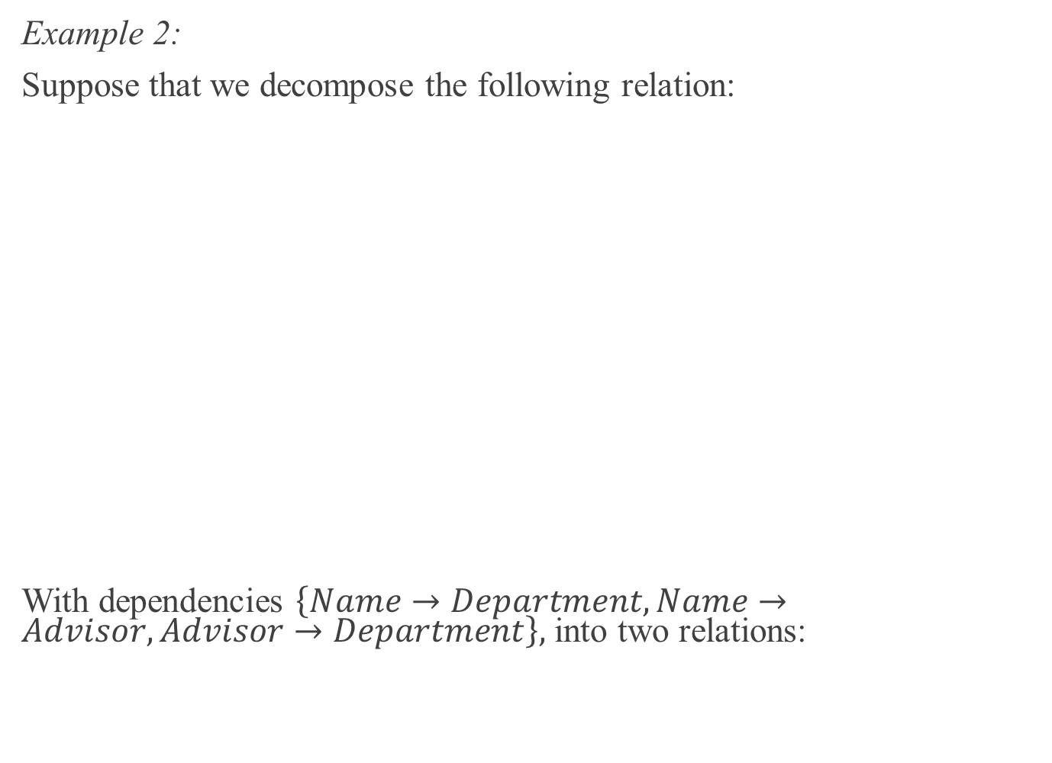
Lossless Join Decomposition(cont)
Example 2:
Suppose that we decompose the following relation:
With dependencies $\left\{Name→Department, Name→Advisor, Advisor→Department\right\},$ into two relations:
STUDENT_ADVISOR
Name | Department | Advisor
Jones | Comp Sci | Smith
Ng | Chemistry | Turner
Martin | Physics | Bosky
Dulles | Decision Sci | Hall
Duke | Mathematics | James
James | Comp Sci | Clark
Evan | Comp Sci | Smith
Baxter | English | Bronte

Slide 7
Lossless Join Decomposition(cont)
STUDENT_DEPARTMENT
Name | Department
Jones | Comp Sci
Ng | Chemistry
Martin | Physics
Duke | Mathematics
Dulles | Decision Sci
James | Comp Sci
Evan | Comp Sci
Baxter | English
DEPARTMENT_ADVISOR
Department | Advisor
Comp Sci | Smith
Chemistry | Turner
Physics | Bosky
Decision Sci | Hall
Mathematics | James
Comp Sci | Clark
English | Bronte
If we join these decomposed relations we get:

Slide 8
Lossless Join Decomposition(cont)
Name | Department | Advisor
Jones | Comp Sci | Smith
Jones | Comp Sci | Clark*
Ng | Chemistry | Turner
Martin | Physics | Bosky
Dulles | Decision Sci | Hall
Duke | Mathematics | James
James | Comp Sci | Smith*
James | Comp Sci | Clark
Evan | Comp Sci | Smith
Evan | Comp Sci | Clark*
Baxter | English | Bronte
This is not the same as the original relation (the tuples marked with * have been added). Thus the decomposition is lossy.
Useful theorem: The decomposition {R₁,R₂} of R is lossless iff the common attributes R₁∩R₂ form a superkey for either R₁ or R₂.

Slide 9
Lossless Join Decomposition(cont)
Example 3: Given R(A,B,C) and F = {A→ B}. The decomposition into R₁(A,B) and R₂(A,C) is lossless because A→ B is an FD over R₁, so the common attribute A is a key of R₁.

Slide 10
Testing for the lossless join property
Algorithm TEST_LJ
Step 1: Create a matrix S, each element s_{i,j}∈S corresponds the relation R_{i}
and the attribute A_{j}, such that:
s_{j,i} = a if A_{i}∈ R_{j}, otherwise s_{j,i} = b.
Step 2: Repeat the following process till S has no change or one row is
made up entirely of “a” symbols.
Step 2.1: For each X→ Y , choose the rows where the elements
corresponding to X take the value a.
Step 2.2: In those chosen rows (must be at least two rows), the elements
corresponding to Y also take the value a if one of the chosen
rows take the value a on Y .

Slide 11
Testing for the lossless join property(cont)
The decomposition is lossless if one row is entirely made up by “a” values.
The algorithm can be found as the Algorithm 15.2 in E/N book.
Note: The correctness of the algorithm is based on the assumption that no null values are allowed for the join attributes.
If and only if exists an order such that R_{i} ∩ M_{i-1} forms
a superkey of R _{i} or M_{i-1}, where M_{i-1} is the join on R₁, R₂, … R_{i-1}

Slide 12
Testing for the lossless join property(cont)
Example: R = (A,B,C,D), F = {A→B,A →C,C → D}.
Let R₁ = (A,B,C), R₂ = (C,D).
Initially, S is
A B C D
R₁ a a a b
R₂ b b a a
Note: rows 1 and 2 of S agree on {C}, which is the left hand side of C→D. Therefore, change the D value on rows 1 to a, matching the value from row 2.
Now row 1 is entirely a’s, so the decomposition is lossless.
(Check it.)

Slide 13
Testing for the lossless join property(cont)
Example 2: R = (A,B,C,D,E),
F = {AB →CD,A → E,C → D}. Let R₁ = (A,B,C),
R₂ = (B,C,D) and R₃ = (C,D,E).
Example 3: R = (A,B,C,D,E,G),
F = {A → B,C → DE,AB → G}. Let R₁ = (A,B),
R₂ = (C,D,E) and R₃ = (A,C,G).

Slide 14
Testing for the lossless join property(cont)
Example 4: R = (A,B,C,D,E,G),
F = {AB →G, C → DE, A → B}.
Let R₁ = (A,B), R₂ = (C, D, E) and R₃ = (A,C,G).
A B C D E G
R₁ a a b b b b
R₂ b b a a a b
R₃ a b a b b a
A B C D E G
R₁ a a b b b b
R₂ b b a a a b
R₃ a b a b b a
A B C D E G
R₁ a a b b b b
R₂ b b a a a b
R₃ a b a a a a
X
X
X
a
a
a

Slide 15
Lossless decomposition into BCNF
Algorithm TO_BCNF
D := {R₁,R₂, ...R_{n}}
While ∃ a R_{i} ∈ D and R_{i} is not in BCNF Do
{ find a X →Y in R_{i} that violates BCNF; replace R_{i} in D by (R_{i} − Y ) and (X ∪ Y ); }
F = {A→B,A→C, A→D, C→E, E→D, C→G},
R1 = (C, D, E, G), R2 = (A, B, C, D)
R11 = (C, E, G), R12 = (E, D) due E→D
R21 = (A, B, C), R22 = (C, D) because of C → D

Slide 16
Lossless decomposition into BCNF
Algorithm TO_BCNF
D := {R₁,R₂, ...R_{n}}
While ∃ a R_{i} ∈ D and R_{i} is not in BCNF Do
{ find a X →Y in R_{i} that violates BCNF; replace R_{i} in D by (R_{i} − Y ) and (X ∪ Y ); }
Since a X →Y violating BCNF is not always in F, the main difficulty is to verify if R_{i} is in BCNF; see the approach below:
1. For each subset X of R_{i}, computer X⁺.
2. X →(X⁺|_{Ri} − X) violates BCNF, if X⁺|_{Ri} − X ≠ ∅ and R_{i} − X⁺ ≠ ∅ .
Here, X⁺|_{Ri} − X = ∅ means that each F.D with X as the left hand side is trivial;
R_{i} − X⁺ = ∅ means X is a superkey of R_{i}

Slide 17
Lossless decomposition into BCNF(cont)
Example: (From Desai 6.31)
Find a BCNF decomposition of the relation scheme below:
SHIPPING(Ship , Capacity , Date , Cargo , Value)
F consists of:
Ship→ Capacity
{Ship , Date}→ Cargo
{Cargo , Capacity}→ Value

Slide 18
Lossless decomposition into BCNF(cont)
From Ship→ Capacity, we decompose SHIPPING into
R₁(Ship , Date , Cargo , Value)
Key: {Ship,Date}
A nontrivial FD in F⁺ violates BCNF:
{Ship , Cargo} → Value
and
R₂(Ship , Capacity)
Key: {Ship}
Only one nontrivial FD in F⁺: Ship → Capacity
Ship → Capacity
{Ship , Date}→ Cargo
{Cargo , Capacity}→ Value

Slide 19
Lossless decomposition into BCNF(cont)
R₁ is not in BCNF so we must decompose it further into
R₁₁ (Ship , Date , Cargo)
Key: {Ship,Date}
Only one nontrivial FD in F⁺ with single attribute on the right side: {Ship , Date} →Cargo
and
R₁₂ (Ship , Cargo , Value)
Key: {Ship,Cargo}
Only one nontrivial FD in F⁺ with single attribute on the right side: {Ship,Cargo} → Value
This is in BCNF and the decomposition is lossless but not dependency preserving (the FD {Capacity,Cargo} → Value) has been lost.
Ship → Capacity
{Ship , Date}→ Cargo
{Cargo , Capacity}→ Value

Slide 20
Lossless decomposition into BCNF(cont)
Or we could have chosen {Cargo , Capacity} →Value, which would give us:
R₁ (Ship , Capacity , Date , Cargo)
Key: {Ship,Date}
A nontrivial FD in F⁺ violates BCNF:
Ship → Capacity
and
R₂ (Cargo , Capacity , Value)
Key: {Cargo,Capacity}
Only one nontrivial FD in F⁺ with single attribute on the right side: {Cargo , Capacity} → Value
Ship → Capacity
{Ship , Date}→ Cargo
{Cargo , Capacity}→ Value

Slide 21
and then from Ship→ Capacity,
R₁₁ (Ship , Date , Cargo)
Key: {Ship,Date}
Only one nontrivial FD in F⁺ with single attribute
on the right side: {Ship , Date} → Cargo
And
R₁₂ (Ship , Capacity)
Key: {Ship}
Only one nontrivial FD in F⁺: Ship → Capacity
This is in BCNF and the decomposition is both lossless and dependency preserving.
However, there are relation schemes for which there is no lossless, dependency preserving decomposition into BCNF.
Ship → Capacity
{Ship , Date}→ Cargo
{Cargo , Capacity}→ Value
A
B
C

Slide 22
Lossless and dependency-preserving decomposition into 3NF
A lossless and dependency-preserving decomposition into 3NF is always possible.
More definitions regarding FD’s are needed.
A set F of FD’s is minimal if
1. Every FD X→ Y in F is simple: Y consists of a single attribute,
2. Every FD X→ A in F is left-reduced: there is no proper subset
Y ⊂ X such that X → A can be replaced with Y→A.
that is, there is no Y ⊂X such that
((F − {X → A}) ∪{Y → A})⁺ = F⁺
3. No FD in F can be removed; that is, there is no FD X→A in F
such that
(F − {X → A})⁺ = F⁺.
Iff F |= Y → A
Iff X→A is inferred
From F– { X→A}

Slide 23
Computing a minimum cover
F is a set of FD’s.
A minimal cover (or canonical cover) for F is a minimal set of FD’s F_{min} such that F⁺ = F⁺_{min}.
Algorithm Min_Cover
Input: a set F of functional dependencies.
Output: a minimum cover of F.
Step 1: Reduce right side. Apply Algorithm Reduce right to F.
Step 2: Reduce left side. Apply Algorithm Reduce left to the output of Step 2.
Step 3: Remove redundant FDs. Apply Algorithm Remove_redundency to the output of Step 2. The
output is a minimum cover.
Below we detail the three Steps.

Slide 24
Computing a minimum cover(cont)
Algorithm Reduce_right
INPUT: F.
OUTPUT: right side reduced F’.
For each FD X→ Y ∈ F where Y = {A₁,A₂, ...,A_{k}}, we use all X →{A_{i}} (for 1≤ i ≤ k) to replace X→ Y .
Algorithm Reduce_left
INPUT: right side reduced F.
OUTPUT: right and left side reduced F’.
For each X → {A} ∈ F where X = {A_{i} : 1 ≤ i ≤ k}, do the following. For i = 1 to k, replace X with X − {A_{i}} if A∈(X − {A_{i}})⁺.
Algorithm Reduce_redundancy
INPUT: right and left side reduced F.
OUTPUT: a minimum cover F’ of F.
For each FD X → {A} ∈ F, remove it from F if: A ∈ X⁺ with respect to F − {X →{A}}.

Slide 25
Example:
R = (A, B, C, D, E, G)
F = {A → BCD, B → CDE, AC → E}
Step 1: F’ = {A → B, A→C, A → D, B→ C, B→ D, B→ E, AC → E}
Step 2: AC → E
C⁺ = {C}; thus C → E is not inferred by F’.
Hence, AC → E cannot be replaced by A → E.
A⁺ = {A, B, C, D, E}; thus, A→ E is inferred by F’.
Hence, AC→ E can be replaced by A → E.
F’’ = {A→ B, A→C, A→ D, A→ E, B→ C, B→D, B→ E}
Step 3: A+|_{F’’ – {A → B}}= {A, C, D, E}; thus A→B is not inferred by F’’ –{A→B}.
That is, A→B is not redundant.
A+|_{F’’ – {A → C}}= {A, B, C, D, E}; thus, A→ C is redundant.
Thus, we can remove A→C from F’’ to obtain F’’’.
Iteratively, we can A→D and A→E but not the others.
Thus, F_{min}={A→B, B→C, B→D, B→E}.

Slide 26
3NF decomposition algorithm
Algorithm 3NF decomposition
1. Find a minimum cover F’ of F.
2. For each left side X that appears in F’, do:
create a relation schema X ∪ A₁ ∪ A₂... ∪ A_{m} where X →{A₁}, ... , X → {A_{m}} are all the
dependencies in F’ with X as left side.
3. if none of the relation schemas contains a key of R,
create one more relation schema that contains attributes that form a key for R.
See E/N Algorithm 15.4.

Slide 27
Example:
R = (A, B, C, D, E, G)
F_{min}={A→B, B→C, B→D, B→E}.
Candidate key: (A, G)
R₁ = (A, B), R₂ = (B, C, D, E)
R₃ = (A, G)

Slide 28
3NF decomposition algorithm(cont)
Example: (From Desai 6.31)
Beginning again with the SHIPPING relation. The functional dependencies already form a canonical cover.
• From Ship→Capacity, derive R₁(Ship,Capacity),
• From {Ship,Date} → Cargo, derive
R₂(Ship , Date , Cargo),
• From {Capacity,Cargo} → Value, derive
R₃(Capacity , Cargo , Value).
• There are no attributes not yet included and the original key {Ship,Date} is included in R₂.

Slide 29
3NF decomposition algorithm(cont)
Another Example: Apply the algorithm to the LOTS example given earlier.
A minimal cover is
{ Property_Id→Lot_No,
Property_Id → Area, {City,Lot_No} → Property_Id,
Area → Price, Area → City, City → Tax_Rate }.
This gives the decomposition:
R₁ (Property_Id , Lot_No , Area)
R₂ (City , Lot_No , Property_Id)
R₃ (Area , Price , City)
R₄ (City , Tax_Rate)
Exercise 1: Check that this is a lossless, dependency preserving decomposition into 3NF.
Exercise 2: Develop an algorithm for computing a key of a table R with respect to a given F of FDs.

Slide 30
Summary
Data redundancies are undesirable as they create the potential for update anomalies,
One way to remove such redundancies is to normalise a design, guided by FD’s.
BCNF removes all redundancies due to FD’s, but a dependency preserving decomposition cannot always be found,
A dependency preserving, lossless decomposition into 3NF can always be found, but some redundancies may remain,
Even where a dependency preserving, lossless decomposition that removes all redundancies can be found, it may not be possible, for efficiency reasons, to remove all redundancies.

