Slide 1
Transactions, Recovery and Concurrency (II)
Concurrency Control

Slide 2
Concurrency Control Methods
Locking Mechanism
The idea of locking some data item X is to:
give a transaction exclusive use of the data item X,
do not restrict the access of other data items.
This prevents one transaction from changing a data item currently being used in another transaction.
We will discuss a simple locking scheme which locks individual items, using read and write locks

Slide 3
Locking Rules
In this schema, every transaction T must obey the following rules.
1) If T has only one operation (read/write) manipulating an item X:
obtain a read lock on X before reading it,
obtain a write lock on X before writing it,
unlock X when done with it.
2) If T has several operations manipulating X:
obtain one proper lock only on X:
a read lock if all operations on X are reads;
a write lock if one of these operations on X is a write.
unlock X after the last operation on X in T has been executed.

Slide 4
Locking Rules (cont.)
In this scheme,
Several read locks can be issued on the same data item at the same time.
A read lock and a write lock cannot be issued on the same data item at the same time, neither two write locks.
This still does not guarantee serializability.

Slide 5
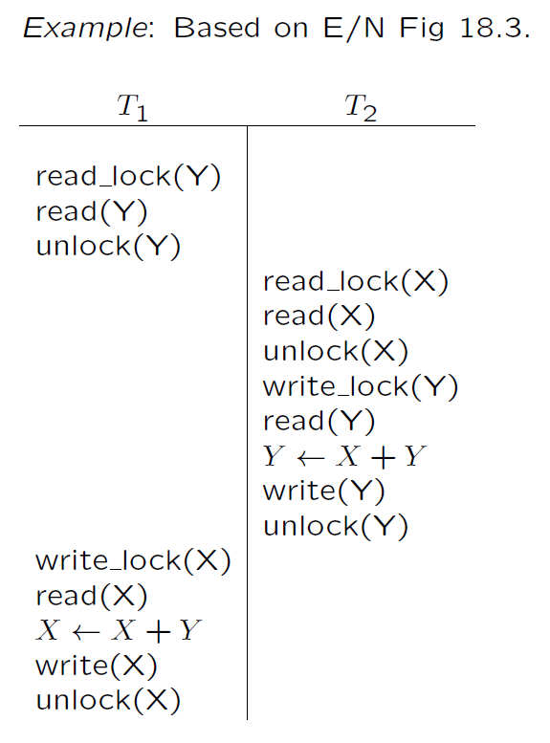
T1
T2

Slide 6
Two Phase Locking (2PL)
To guarantee serializability, transactions must also obey the two-phase locking protocol:
Growing Phase: all locks for a transaction must be obtained before any locks are released, and
Shrinking Phase: gradually release all locks (once a lock is released no new locks may be requested).

Slide 7
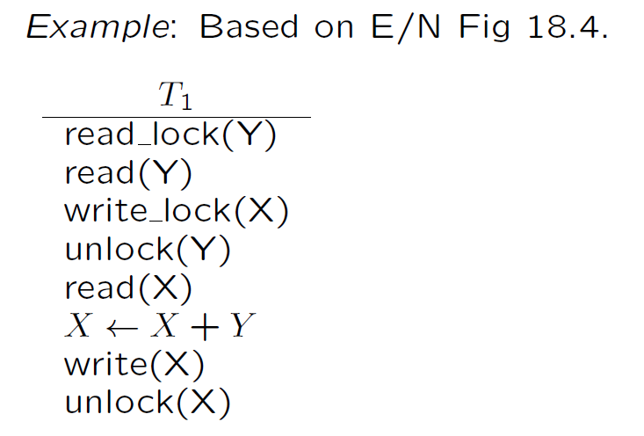
Two Phase Locking (2PL) (Cont.)
Locking thus provides a solution to the problem of correctness of schedules.
Two phase locking ensures conflict serializability

Slide 8
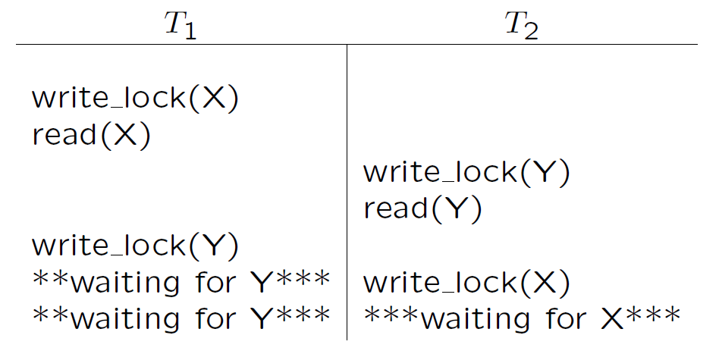
Deadlock
A problem that arises with locking is deadlock.
Deadlock occurs when two transactions are each waiting for a lock on an item held by the other.

Slide 9
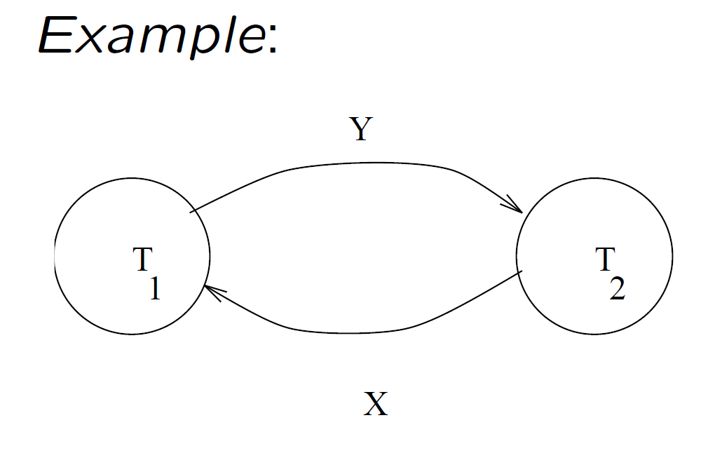
Deadlock Check
Create the wait-for graph for currently active transactions:
create a vertex for each transaction; and
an arc from T_{i} to T_{j} if T_{i} is waiting for an item locked by T_{j}.
If the graph has a cycle, then a deadlock has occurred.

Slide 10
Several methods to deal with deadlocks
deadlock detection
periodically check for deadlocks, abort and rollback some transactions (restart them later). This is a good choice if transactions are very short or very independent.

Slide 11
Several methods to deal with deadlocks (Cont.)
deadlock prevention - Assign priorities based on timestamps. Assume Ti wants a lock that Tj holds. Two policies are possible:
Wait-Die: If Ti has higher priority, Ti waits for Tj; otherwise Ti aborts
Wound-wait: If Ti has higher priority, Tj aborts; otherwise Ti waits
If a transaction re-starts, make sure it has its original timestamp

Slide 12
Timestamp ordering
The idea here is:
to assign each transaction a timestamp (e.g. start time of transaction), and
to ensure that the schedule used is equivalent to executing the transactions in timestamp order

Slide 13
Each data item, X, is assigned
a read timestamp, read TS(X) - the latest timestamp of a transaction that read X, and
a write timestamp, write TS(X) - the latest timestamp of a transaction that write X.

Slide 14
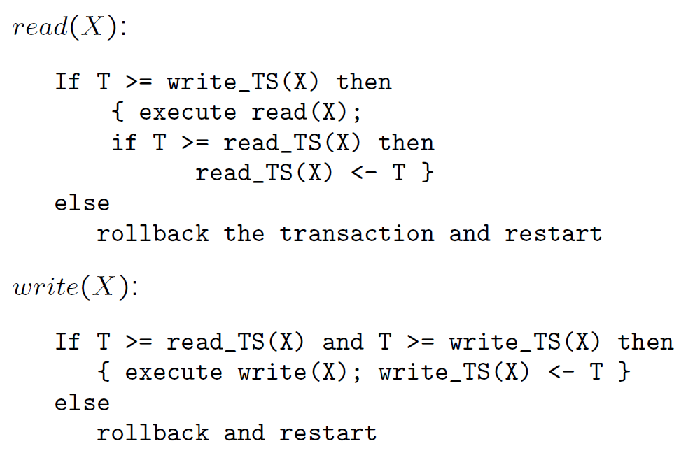
These are used in read and write operations as follows. Suppose the transaction timestamp is T.

Slide 15
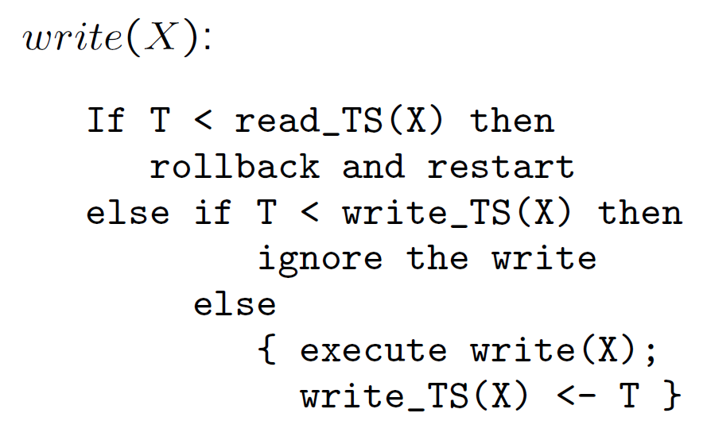
Thomas' write rule:

Slide 16
T₁ T₂ T₃
read (x)
read (y)
write (y)
read (z)
read (z)
write (z)
Write (z)
r_TS (x) = 0
w_TS(x) = 0
r_TS (y) = 0
w_TS(y) = 0
r_TS (z) = 0
w_TS(z) = 0
→ 1
→ 2
→ 2
→ 1
→ 3
→ 3

Slide 17
Some problems:
Cyclic restart: There is no deadlock, but a kind of livelock can occur - some transactions may be constantly aborted and restarted.
Cascading rollback: When a transaction is rolled back, so are any transactions which read a value written by it, and any transactions which read a value written by them . . . etc. This can be avoided by not allowing transactions to read values written by uncommitted transactions (make them wait).

Slide 18
Multiple-Granularity Locks
Hard to decide what granularity to lock (tuples vs. pages vs. tables).
Shouldn’t have to decide!
Data “containers” are nested:
Database
Tables
contains
Pages
Tuples

Slide 19
Solution: New Lock Modes, Protocol
Allow Xacts to lock at each level, but with a special protocol using new “intention” locks:
Before locking an item, Xact must set “intention locks” on all its ancestors.
For unlock, go from specific to general (i.e., bottom-up).
SIX mode: Like S & IX at the same time.
--
IS
IX
S
X
--
√
√
√
√
√
IS
√
√
√
√
IX
√
√
√
S
√
√
√
X
√

Slide 20
Multiple Granularity Lock Protocol
Each Xact starts from the root of the hierarchy.
To get S or X lock on a node, must hold IS or IX on parent node.
What if Xact holds SIX on parent? S on parent?
To get X or IX or SIX on a node, must hold IX or SIX on parent node.
Must release locks in bottom-up order.
Protocol is correct in that it is equivalent to directly setting
locks at the leaf levels of the hierarchy.

Slide 21
Examples
T1 scans R, and updates a few tuples:
T1 gets an SIX lock on R, then repeatedly gets an S lock on tuples of R, and occasionally upgrades to X on the tuples.
T2 uses an index to read only part of R:
T2 gets an IS lock on R, and repeatedly gets an S lock on tuples of R.
T3 reads all of R:
T3 gets an S lock on R.
OR, T3 could behave like T2; can use lock escalation to decide which.
--
IS
IX
S
X
--
√
√
√
√
√
IS
√
√
√
√
IX
√
√
√
S
√
√
√
X
√

Slide 22
Dynamic Databases
Sailors (sid: integer, sname: string, rating: integer, age: real)
Reserves (sid: integer, bid: integer, day: dates, rname: string)
If we relax the assumption that the DB is a fixed collection of objects, even Strict 2PL will not assure serializability:
T1 locks all pages containing sailor records with rating = 1, and finds oldest sailor (say, age = 71).
Next, T2 inserts a new sailor; rating = 1, age = 96.
T2 also deletes oldest sailor with rating = 2 (and, say, age = 80), and commits.
T1 now locks all pages containing sailor records with rating = 2, and finds oldest (say, age = 63).
No consistent DB state; however T1 “correctly” gets through!

Slide 23
The Problem
T1 implicitly assumes that it has locked the set of all sailor records with rating = 1.
Assumption only holds if no sailor records are added while T1 is executing!
Need some mechanism to enforce this assumption. (Index locking and predicate locking.)
Example shows that conflict serializability guarantees serializability only if the set of objects is fixed!

Slide 24
Index Locking
Data
Index
r=1
If there is a dense index on the rating field using Alternative (2), T1 should lock the index page containing the data entries with rating = 1.
If there are no records with rating = 1, T1 must lock the index page where such a data entry would be, if it existed!
If there is no suitable index, T1 must lock all pages, and lock the file/table to prevent new pages from being added, to ensure that no new records with rating = 1 are added.

Slide 25
Predicate Locking
Grant lock on all records that satisfy some logical predicate, e.g. age > 2*salary.
Index locking is a special case of predicate locking for which an index supports efficient implementation of the predicate lock.
What is the predicate in the sailor example?
In general, predicate locking has a lot of locking overhead.

Slide 26
Locking in B+ Trees
How can we efficiently lock a particular leaf node?
Btw, don’t confuse this with multiple granularity locking!
One solution: Ignore the tree structure, just lock pages while traversing the tree, following 2PL.
This has terrible performance!
Root node (and many higher level nodes) become bottlenecks because every tree access begins at the root.

Slide 27
Two Useful Observations
Higher levels of the tree only direct searches for leaf pages.
For inserts, a node on a path from root to modified leaf must be locked (in X mode, of course), only if a split can propagate up to it from the modified leaf. (Similar point holds w.r.t. deletes.)
We can exploit these observations to design efficient locking protocols that guarantee serializability even though they violate 2PL.

Slide 28
A Simple Tree Locking Algorithm
Search: Start at root and go down; repeatedly, S lock child then unlock parent.
Insert/Delete: Start at root and go down, obtaining X locks as needed. Once child is locked, check if it is safe:
If child is safe, release all locks on ancestors.
Safe node: Node such that changes will not propagate up beyond this node.
Inserts: Node is not full.
Deletes: Node is not half-empty.

Slide 29
ROOT
Do:
1) Search 38*
2) Delete 38*
3) Insert 45*
4) Insert 25*
20
A
35
B
23
F
38
44
C
G
H
I
D
E
20*
22*
23*
24*
35*
36*
38*
41*
44*

Slide 30
A Better Tree Locking Algorithm (See Bayer-Schkolnick paper)
Search: As before.
Insert/Delete:
Set locks as if for search, get to leaf, and set X lock on leaf.
If leaf is not safe, release all locks, and restart Xact using previous Insert/Delete protocol.
Gambles that only leaf node will be modified; if not, S locks set on the first pass to leaf are wasteful. In practice, better than previous alg.

Slide 31
Example
ROOT
A
Do:
1) Delete 38*
2) Insert 25*
4) Insert 45*
5) Insert 45*,
then 46*
20
35
B
23
F
38
44
C
G
H
I
D
E
20*
22*
23*
24*
35*
36*
38*
41*
44*

Slide 32
Even Better Algorithm
Search: As before.
Insert/Delete:
Use original Insert/Delete protocol, but set IX locks instead of X locks at all nodes.
Once leaf is locked, convert all IX locks to X locks top-down: i.e., starting from node nearest to root. (Top-down reduces chances of deadlock.)
(Contrast use of IX locks here with their use in
multiple-granularity locking.)

Slide 33
Hybrid Algorithm
The likelihood that we really need an X lock decreases as we move up the tree.
Hybrid approach:
Set S locks
Set SIX locks
Set X locks

Slide 34
Multiversioning
Similar to the timestamp ordering approach; but is allowed to access “old” versions of a table.
A history of the values and timestamps (versions) of each item is kept.
When the value of an item is needed, the system chooses a proper version of the item that maintains serializability.
This results in fewer aborted transactions at the cost of greater complexity to maintain more versions of each item.

Slide 35
We will look at a scheme, several versions X₁,…,X_{k} of each data item are kept. For each X_{i} we also keep
read TS(X_{i}) - as for timestamp ordering.
write TS(X_{i}) - as for timestamp ordering.

Slide 36
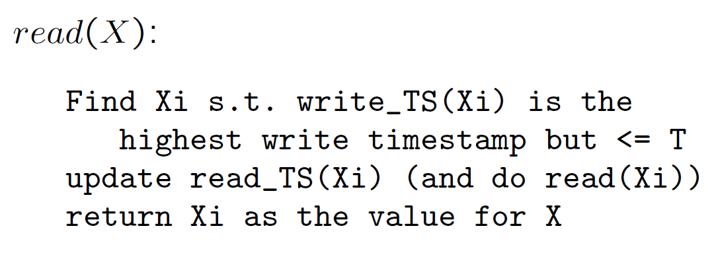
Read and write are done as follows for a transaction P with timestamp T.

Slide 37
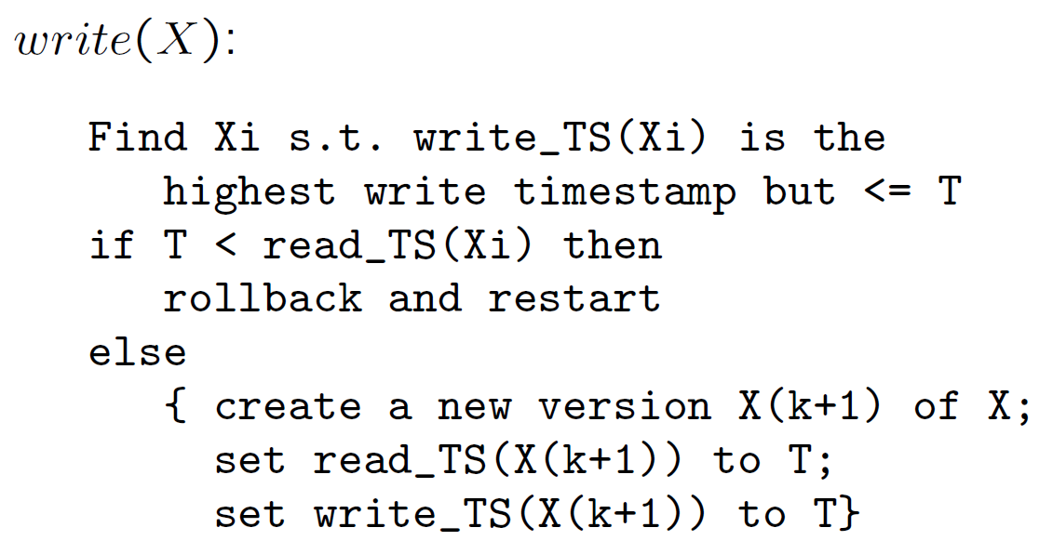
Note: Cascading rollback and cyclic restart problems can still occur, but should be reduced.
However, there is an increased overhead in maintaining multiple versions of items.

Slide 38
Optimistic scheduling
In two-phase locking, timestamp ordering, and multiversioning concurrency control techniques, a certain degree of checking is done before a database operation can be executed.
The idea here is to push on and hope for the best!
No checking is done while the transaction is executing.

Slide 39
The protocol has three phases.
read phase - A transaction can read data items from the database into local variables. However, updates are applied only to local copies of the data items kept in the transaction workspace.
validation phase - checks are made to ensure that serializability is not violated,
write phase -if validation succeeds, updates are applied and the transaction is committed. Otherwise, the updates are discarded and the transaction is restarted.

Slide 40
A scheme uses timestamps and keeps each transaction's
read-set - the set of items read by the transaction,
write-set - the set of items written by the transaction.
During validation, we check that the transaction does not interfere with any transaction that is committed or currently validating.

Slide 41
Each transaction T is assigned 3 timestamps:
Start(T), Validation(T), Finish(T).
To pass the validation test for T, one of the following must be true:
1. Finish(S) < Start(T); or
2. for S s.t. Start(T) < Finish(S), then
write set of S is disjoint from the read set of T, and
Finish(S) < Validation(T).

Slide 42
Optimistic control is a good option if there is not much interaction between transactions.
Note: Our earlier treatment of recovery methods largely ignored concurrency issues.

Slide 43
2PL vs. TSO vs. MV vs. OP
A Comparison among two-phase locking (2PL), timestamp ordering (TSO), multiversioning (MV), optimistic (OP) concurrency control techniques.
MV should provide the greatest concurrency degree (in average). However, we need to maintain multiversions for each data item.
2PL can offer the second greatest concurrency degree (in average); but will result in deadlocks. To resolve the deadlocks, either
need additional computation to detect deadlocks and to resolve the deadlocks, or
reduce the concurrency degree to prevent deadlocks by adding other restrictions.

Slide 44
2PL vs. TSO vs. MV vs. OP (cont.)
If most transactions are very short, we can use 2PL + deadlock detection and resolution.
TSO has a less concurrency degree than that of 2PL if a proper deadlock resolution is found. However, TSO does not cause deadlocks. Other problems, such as cyclic restart and cascading rollback, will appear in TSO.
If there are not much interaction between transactions, OP is a very good choice. Otherwise, OP is a bad choice.

